Slide 1
Supporting UK Manufacturing and skills in a post Covid-19 world
Embedding design thinking in the curriculum
14.10 to 14.20 Wednesday 24th February 2021

Slide 2
“Education to me appears to be broken -
When we went to school, teachers taught us how to memorise answers. In today’s society, answers are readily available; we need to be teaching students how to ask better questions”
Dilbagh Gill
CEO and Team Principal Mahindra Racing – One of the 10 founding partners for the Grand Prix E-Championship
Notes:
Taken from his interview on the 'High Performance podcast' January 2021

Slide 3
Exeter College Speech – Lifetime Skills Guarantee 29th September 2020
“Our economy has been shaken by COVID, and in the hand-to-mouth scrabbling's of the pandemic the shortcomings of our labour market – and our educational system – have been painfully apparent.”
“It’s absurd to talk about skills in this limited way. Everything is ultimately a skill – a way of doing something faster, better, more efficiently, more accurately, more confidently, whether it is carving, or painting, or brick laying, or writing, or drawing, or mathematics, Greek philosophy; every single study can be improved not just by practice but by teaching.”
Notes:
An acknowledgement of the issue and there are some good things within this White paper; but there is also a major flaw in the governments implementation

Slide 4
The UK’s design heritage is an opportunity UK has a long and proud heritage in engineering, design and manufacturing. In many sectors we have led the world – and still do. Our reputation for design remains high.UK manufacturing is currently the world’s ninth largest manufacturing nation in the world, engineering generating 21.4% of the UK’s GVA and the creative industries rate of job growth exceeding the national average. But across a number of sectors the skills gap is widening, and we are currently facing challenges. Businesses are facing an uphill battle to find their workforce of the future – bright, creative and innovative young people both inspired to work in design and technological fields and skilled in these areas. School leaders, finding design and technology (D&T) both time and resource expensive are cutting back in these areas in favour of subjects deemed more conducive to the acquisition of favourable Ofsted outcomes under the current accountability system. The result is that students with an interest in D&T are side-lined and industry’s workforce of tomorrow ever diminishes. There is an estimate shortfall of between 37,000 and 59,000 annually for core engineering roles requiring level 3+ skills Nesta’s report ‘The creative economy and the future of employment’ indicates that there are 2.6 million jobs in the UK’s creative economy, growing at around three times the rate of the workforce as a whole.
Notes:
An acknowledgement of the issue and there are some good things within this White paper; but there is also a major flaw in the governments implementation

Slide 5
So what is so unique about design and technology?
Design and Technology enables children and young people to actively contribute to the creativity, culture, wealth and well-being of themselves, their community and their nation. It teaches them how to assess and take risks and so become more resourceful, innovative, enterprising and capable.
Perhaps most importantly, when taught well, it addresses the ‘why?’ as well as the ‘what?’

Slide 6
Knowledge
Skills
Personal Attributes
Character sets – Confidence – Self-belief – A sense of purpose – inquisitive – Problem solver – resilient (Grit) Etc.
Notes:
Guy Claxton What's the point of School Rediscovering the heart of education - One book that I constantly went back to as a headteacher to recalibrate

Slide 7
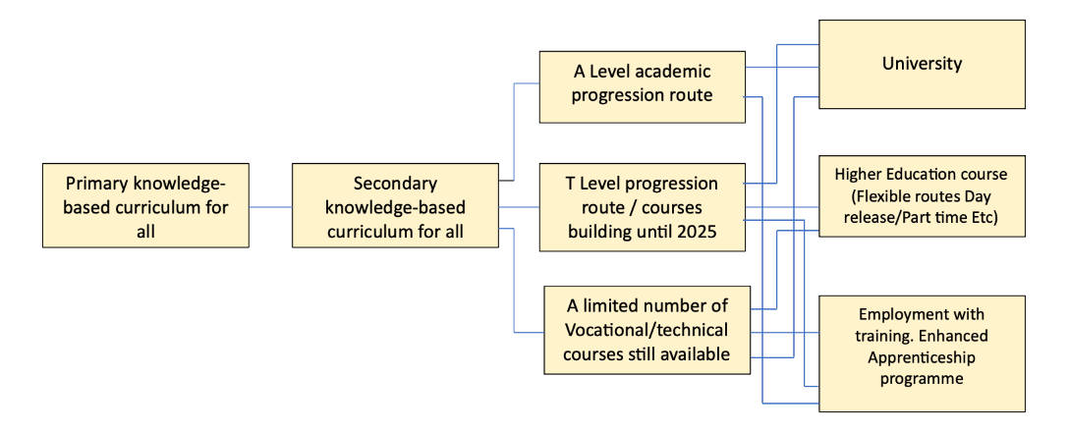
The problem as I see it…
Aged 5 -16
16-18
18+
Notes:
Splitting the school population 50:50 aged 16 with one half moving on a journey to university and the other taking a FE Skills course is oversimplifying and missing the key point that a technical education can be for all abilities

Slide 8
Blueprint 1000 what is it and why is it necessary?
To really connect with students, our subject needs context for learning set within the world
outside of education, a world that they can easily connect to and which relates to their experience.
In our experience the world of education wants to work with business but often does not know how to best approach this and is only willing to give this limited time and resource. Some schools have cracked this – many have not.
Equally, business increasingly wants to connect with education. This may be for a range of reasons – talent supply chain, CSR, a desire to ‘give back’, be a good neighbour, showcase their curriculum product Etc. They don’t simply want to write a cheque and want more than a seat at a yearly careers event.
Blueprint 1000® is our mechanism to join business/industry with education with enhanced curriculum and personal outcomes the clear objective.
www.blueprint1000.org.uk
Bulletproof International Branding and Design
James Dyson Foundation
SEMMCO Engineering
Foster and Partners Architects
Fulcro
Construction Industry Solutions Ltd (COINS)
The Reece Group
Northwood School
Your Game Plan
Motion Real Estate Media Ltd
Silverstone Innovation Cluster
Bricsys

Slide 9
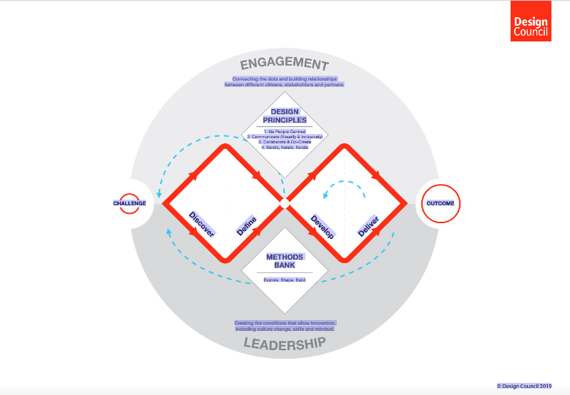
In summary
The COVID-19 pandemic has forced us all to stop and re-evaluate. The worst decision we could now take is to try to rush back to where we were before.
Knowledge acquisition is essential, but on its own is limited.
We need to reshape our education system to encourage our young people to “ask better questions.”

