Slide 1
Session 3b

Slide 2
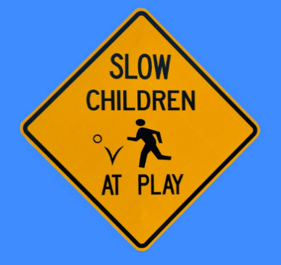
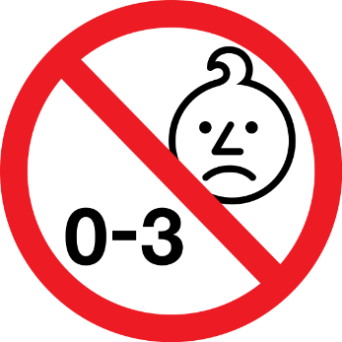
Equipment/preparation needed for the lesson
Examples of products with safety marks on them.
Notes:
Images: Public Domain: Pixabay.com

Slide 3
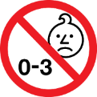
11.3
11.3
11.3
Safety and Quality Assurance
What is a standard?
What is quality assurance?
The Consumer Safety Act:
The Trade Descriptions Act:
Examples of standards:
*
*
*
*
The Sale of Goods Act:
Fire Safety regulations:
Standards that your product may need to follow:
*
*
*
*
Safety marks that your product may need:
*
*
*
*
Quality assurance criteria for your product:
*
*
*
*
Laws that your product may need to follow:
*
*
*
*

Slide 4
Session 3b
Inspiring innovation
Learning objectives:
To consider why standards are important in everyday products.
To explore the different tests/marks that you can apply for to show quality in varying products.
To understand the different laws that protect consumers.
To apply this knowledge to your innovative product idea.
Keywords:
BSI
CE
Quality assurance
Standards
Safety
Notes:
4

Slide 5
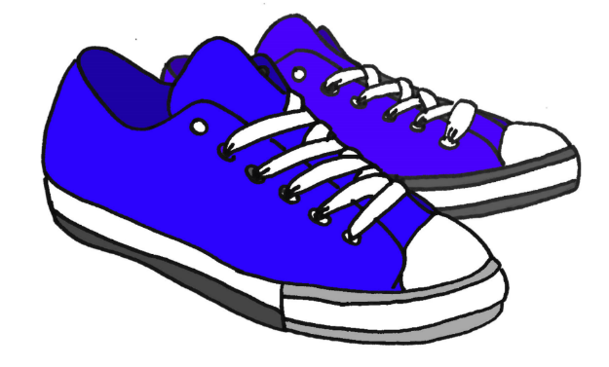
What size trainers do you wear?
Would you be disappointed if you ordered your favourite brand of trainers off the internet in your size, but they didn’t fit?
SHOP A - Size 5
SHOP B - Size 5
SHOP C - Size 5

Slide 6
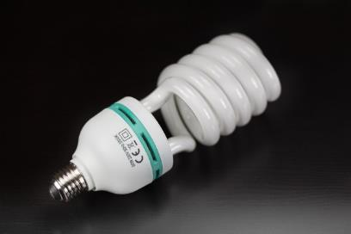
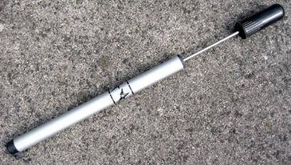
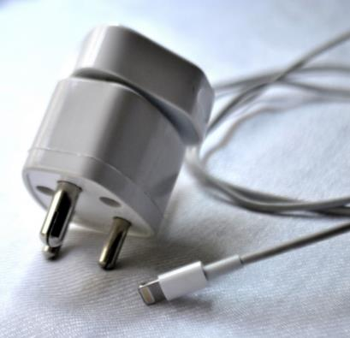
Imagine if light bulbs from different shops did not fit the lamps in your home, or that USB devices did not fit all USB ports on computers...
Imagine if a bike pump you purchased in one shop did not fit your bike tyre from another shop...
Imagine if the wheels on trains didn't fit the train tracks from one town to another, or that phone chargers did not fit wall sockets...
Standards make life easier by making products work better and ensuring quality amongst products. Without standards for manufacturers to follow, all our products would behave and function slightly differently, making them hard to operate, fix or programme.
Notes:
See: http://www.bsieducation.org/Education/11-14/default.shtml for further information.
Images:
Light bulb - https://pixabay.com/en/energiesparlampe-bulbs-sparlampe-1167347/
Bike pump - https://commons.wikimedia.org/wiki/File:Bicycle_pump_Luftpumpe.jpg
Phone charger - http://pdpics.com/photo/3731-phone-charger-cord/

Slide 7
What standard fittings might your product need?
Think about what your product might need to interact with e.g. train tracks for train wheels.
Sockets
Cables
Fastenings
Sizes
Bulbs

Slide 8
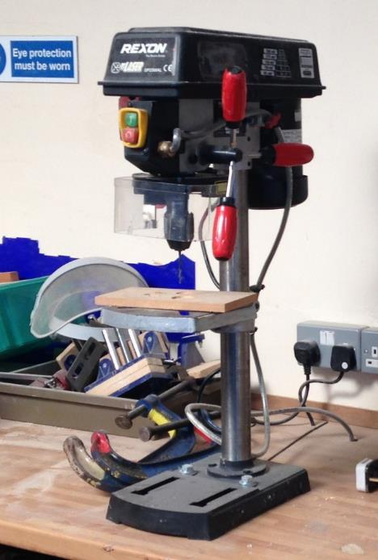
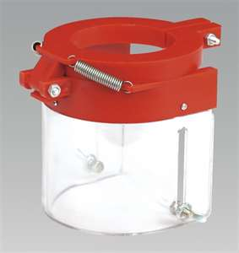
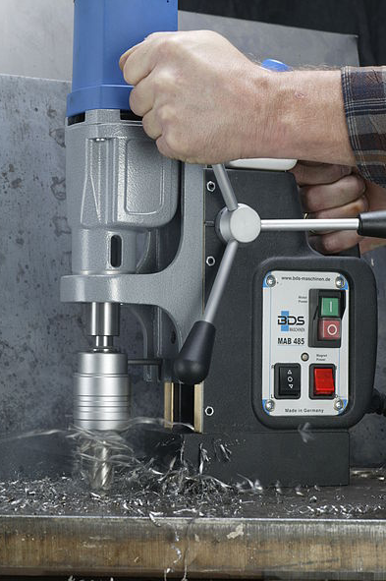
Standards also try to protect people and keep them safe…
Pillar drills put a guard around where the drill bit goes – why?
Notes:
Images:
Drill – Jenny Dhami; https://en.wikipedia.org/wiki/File:Magnetic_Drilling_Machine_from_BDS.jpg

Slide 9
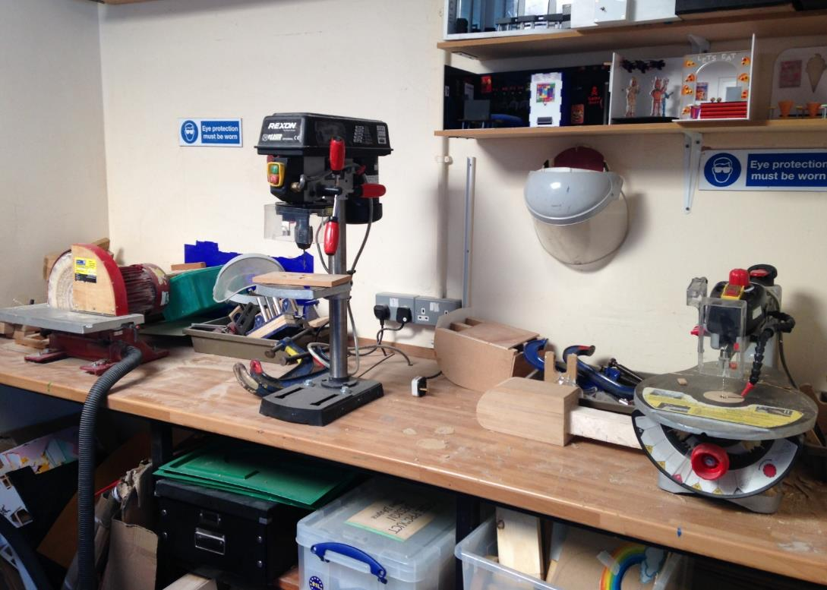
What standards can you see in this workshop picture?
Notes:
Images – Jenny Dhami

Slide 10
What standards can you see in this workshop picture?
Safety signage
Guards on pillar drill
Goggles easy to access
½ circular sander protected by guard
Guards on scroll saw
Extraction

Slide 11
BSI = British Standards Institute
The British Standards Institution (BSI) is a large organisation that brings together experts from across the designing and manufacturing industries to help create the standards by which products are measured.
e.g.
The use of lead free and non-toxic paint on children’s toys
The avoidance of finger traps
Guards on electrical toys

Slide 12
Many products display a Kitemark
This shows that a product meets the BSI safety and quality standards and has been tested to prove this.
Many products display a CE mark
This shows that a product meets the EEC safety and quality standards and has been tested to prove this.
Products will be removed from shops in Europe if they do not meet these minimum standards.
Notes:
Images:
BSI Kitemark - http://upload.wikimedia.org/wikipedia/en/thumb/0/0f/BSI_Kitemark.svg/464px-BSI_Kitemark.svg.png
CE - http://www.bbc.co.uk/schools/gcsebitesize/design/images/sc_ce_symbol.gif

Slide 13
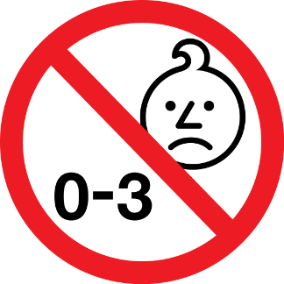
The Lion Mark
The Lion Mark was created in 1988 to show that the manufacturer/retailer has agreed to the ‘British Toy and Hobby Associations’ code of practice, in relation to the way the toy performs.
It is a mark showing tests have been made for safety, that it is not a counterfeit and that it will be advertised truthfully.
Not suitable for children aged 0-3
Why might this be needed?
Notes:
Images:
0-3 symbol - https://upload.wikimedia.org/wikipedia/commons/thumb/f/f2/Age_warning_symbol.svg/564px-Age_warning_symbol.svg.png
Lion Mark - http://www.btha.co.uk/wp-content/uploads/2012/10/lionmark.jpg

Slide 14
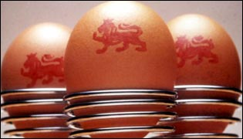
Food safety
The Food Standards Agency protects the public's health and consumer interests in relation to food.
See more information on www.food.gov.uk/
e.g. Lion stamp on eggs
Shows where they have come from and a ‘best before’ date due to the rise in salmonella and the need for hygiene controls.
Notes:
Images:
Food standards agency - http://upload.wikimedia.org/wikipedia/en/thumb/c/cb/Food_Standards_Agency.svg/1280px-Food_Standards_Agency.svg.png
Eggs - http://newsimg.bbc.co.uk/media/images/38820000/jpg/_38820051_lion_eggs_315.jpg

Slide 15
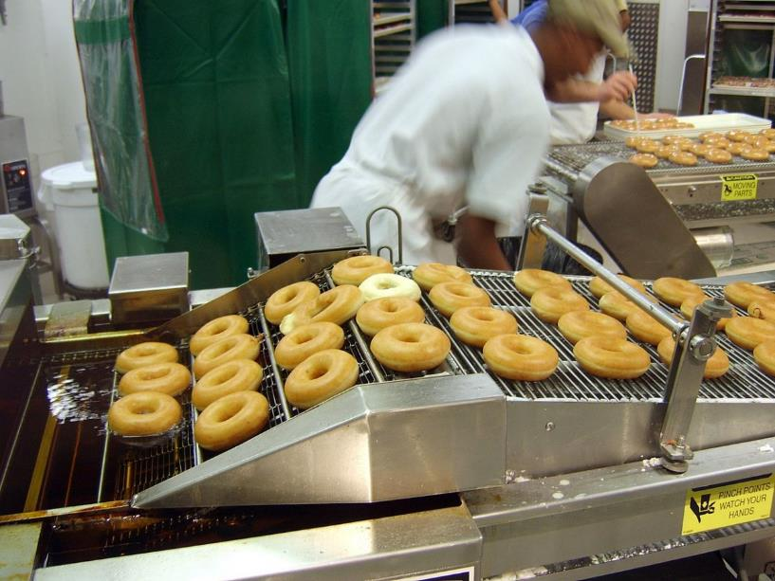
Quality assurance
Safety symbols provide quality assurance to the customer.
But what is quality assurance?
Quality assurance ensures that each and every product produced by a manufacturer meets stringent tests to ensure that they are the same.
For example with donuts – that they have the same consistency, are cooked to the same temperature for the correct length of time, taste the same, have the same amount of icing on each one.
Manufactures ensure this by testing every xth product in a production line against an agreed set of criteria.
What criteria would you use to test your product against?
Notes:
Image:
Doughnuts - https://upload.wikimedia.org/wikipedia/commons/thumb/5/50/Krispy_Kreme_Doughnuts.jpg/1280px-Krispy_Kreme_Doughnuts.jpg

Slide 16
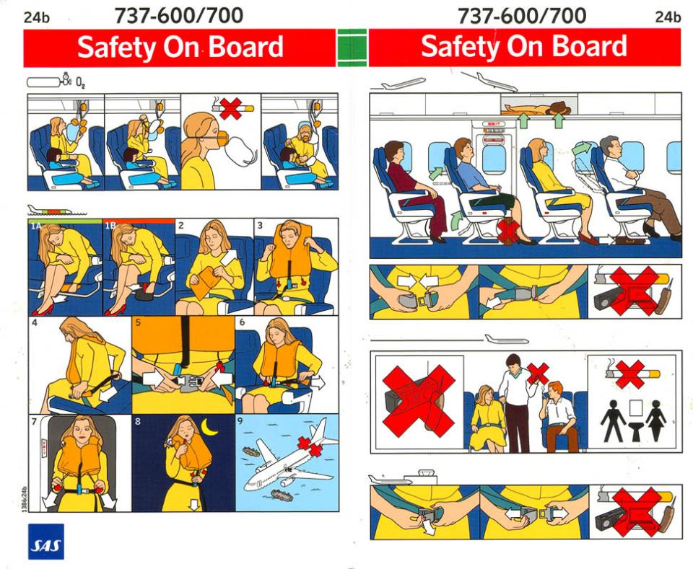
Why would you find these on a plane?
Who are the stakeholders that they are trying to protect?
What safety instructions would your product need?
Notes:
Airplane instructions - https://i.stack.imgur.com/O7mFt.jpg

Slide 17
What laws are there to protect the consumer?
The Consumer Safety Act
Protects consumers with regard to clothing, toys and electrical goods. Using this Act, the government can ban dangerous goods.
The Trades Description Act
Ensures that the claims that manufacturers make about their product are true. E.g. if a product claims to allow you to see into space but it doesn’t, then the manufacturer can be sued.
The Sales of Goods Act
Ensures that products last a reasonable amount of time and work in the way that they should.
Fire Safety Regulations
Protects the public against poor quality furniture that could set alight and give out dangerous fumes.
What laws would your product need to adhere to?

Slide 18
What would your product need to do to ensure it keeps its stakeholders safe?
Labelling
Instructions
BSI tests
Age limits
Stamps/marks
Safety fastenings

