Slide 1
Session 3a

Slide 2
Equipment/preparation needed for the lesson
Sticky notes/scraps of paper
Drawing equipment
Check that sound is working on your teacher’s computer
Notes:
Images: Pixabay

Slide 3
11.3
11.3
11.3
Marketing strategy
Your product =
Who is your product aimed at? Who are all the stakeholders?
1)
2)
3)
4)
Where will your product be sold? (which shop/site?) =
USP (unique selling points) about your product:
1)
2)
3)
4)
Your brand (existing or made up) =
Why?
*
*
*
Colours associated with your brand?
Suitable catch phrases:
*
*
*
Suitable celebrities to endorse:
*
*
*
Suitable films/programs/series to place your product within:
*
*
*
Ideas for a logo for your product:
Successful current adverts:
Ideas for successful advertisement of your product:

Slide 4
Session 3a
Inspiring innovation
Learning objectives:
To consider the commercial viability of your product as a group
To explore and develop which brand you could sell your product under or create your own brand
To think about the impact of
Product placement
Celebrity endorsement
Catch phrases
Keywords:
Product placement
Celebrity endorsement
Catch phrases
Branding
Logos
Marketing
Notes:
4

Slide 5
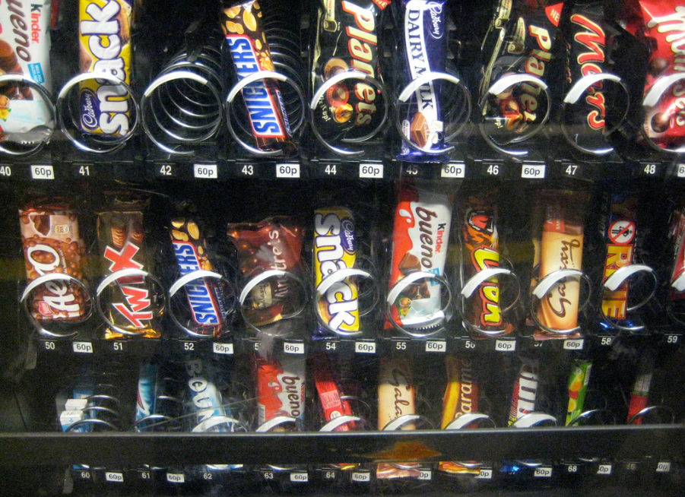
From the picture, which brands can you identify? Write these on your sticky note…
How did you identify them?
Colours
Type font
Shape
Notes:
Image: Creative Commons: Phil Whitehouse

Slide 6
What brand am I?
1.
3.
2.
5.
4.
7.
6.
Notes:
Images:
Coca Cola - https://upload.wikimedia.org/wikipedia/commons/thumb/c/ce/Coca-Cola_logo.svg/2000px-Coca-Cola_logo.svg.png
Sony - https://upload.wikimedia.org/wikipedia/commons/thumb/c/ca/Sony_logo.svg/2000px-Sony_logo.svg.png
Starbucks - https://pixabay.com/p-1069758/?no_redirect
Google - https://upload.wikimedia.org/wikipedia/commons/5/51/Google.png
Mcdonalds - https://upload.wikimedia.org/wikipedia/commons/thumb/a/a9/Mcdonalds-90s-logo.svg/1014px-Mcdonalds-90s-logo.svg.png
Ebay - https://upload.wikimedia.org/wikipedia/commons/thumb/1/11/EBay_former_logo.svg/1543px-EBay_former_logo.svg.png
H&M - https://upload.wikimedia.org/wikipedia/commons/thumb/5/53/H%26M-Logo.svg/1280px-H%26M-Logo.svg.png

Slide 7
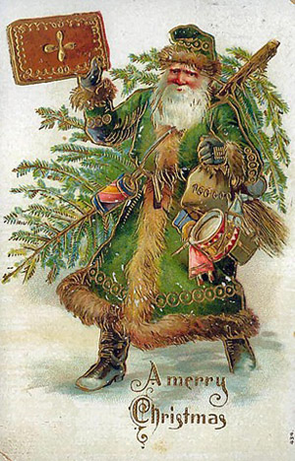
Father Christmas was originally GREEN!
Why do we think of him now as RED?
Notes:
Due to the branding of Coca Cola portraying Father Christmas in the Coca Cola Red – the perception of Father Christmas is now that he is RED.
Images:
Coca cola - https://upload.wikimedia.org/wikipedia/commons/thumb/c/ce/Coca-Cola_logo.svg/2000px-Coca-Cola_logo.svg.png
Father Christmas - http://3.bp.blogspot.com/_s5iNjHF-jmk/SUG1y7yYWJI/AAAAAAAAAX0/VS0ndd0Z9c8/s200/Father+Christmas.jpg

Slide 8
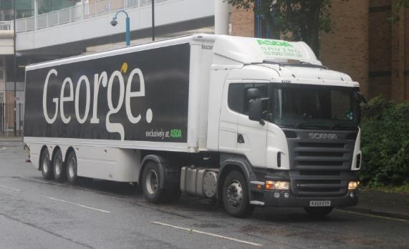
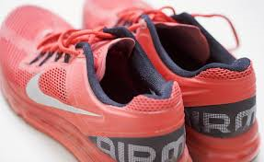
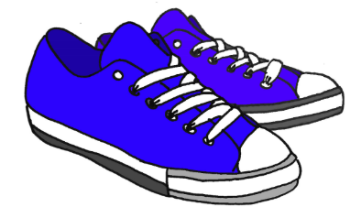
What words do you associate with the following brands?
How much would you pay for trainers from Nike in comparison to trainers from Asda?
1.
2.
3.
4.
5.
1.
2.
3.
4.
5.
Why are people prepared to pay more for certain brands?
Notes:
Discussion on brand reputation, perceived quality etc.
Images:
Nike - https://upload.wikimedia.org/wikipedia/commons/thumb/a/a6/Logo_NIKE.svg/640px-Logo_NIKE.svg.png
Asda - https://c1.staticflickr.com/8/7114/7487482204_d3e7a5354f_b.jpg
Trainers – plain - http://www.publicdomainpictures.net/pictures/40000/velka/blue-trainers.jpg

Slide 9
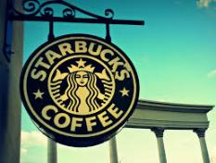
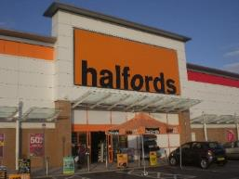
Your product…
Imagine that the product you created last lesson was to be mass produced and sold in high street stores
Who is your product aimed at?
What are the unique selling features of your product (USP)?
What brand would you choose to sell your product from? (You can choose any brand)
Is there a suitable brand or would you need to recreate your own?
Think about what colours would be suitable?
What would you not like to associate with your product?
Notes:
Images, as previously, and:
Mothercare - http://maternidadcomopuedas.com/wp-content/uploads/2016/07/mothercare-logo.jpg
Halfords - http://upload.wikimedia.org/wikipedia/commons/e/e6/Halfords_Ocean_Park.JPG

Slide 10
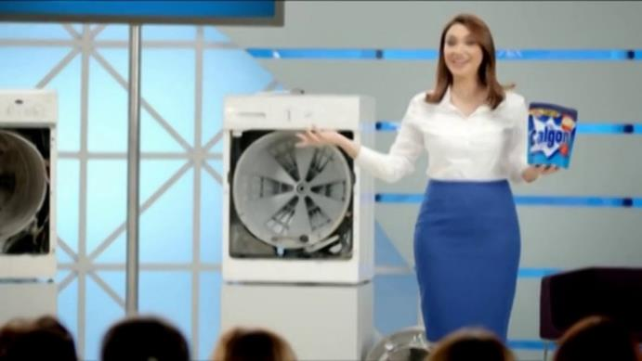
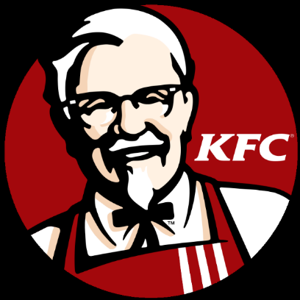
Guess the catch phrase…
Maybe she’s born with it, maybe it’s Maybelline.
Finger lickin’ good!
Washing machines live longer with Calgon
What could be the catch phrase for your product?
Just do it
Notes:
Images:
Maybelline - https://upload.wikimedia.org/wikipedia/commons/7/7c/Maybelline_logo_png.png
Calgon - http://i.vimeocdn.com/video/433299795_1280x720.jpg
KFC - http://upload.wikimedia.org/wikipedia/en/thumb/b/bf/KFC_logo.svg/768px-KFC_logo.svg.png

Slide 11
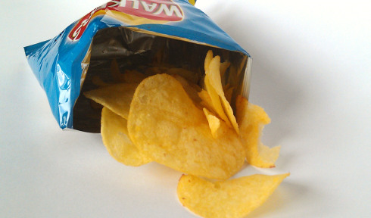
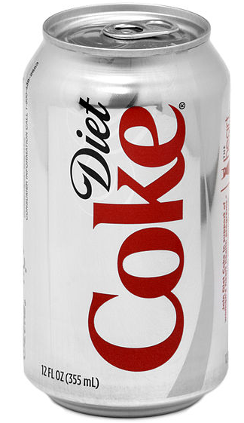
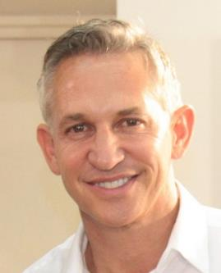
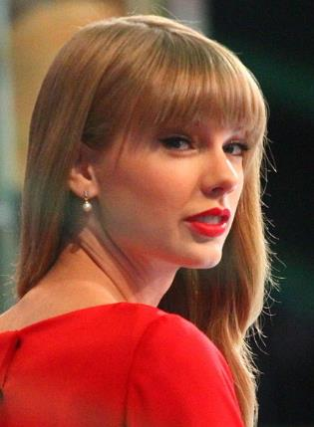
What celebrity would you associate with these products/brands?
Reveal the celebrities…
Which celebrity could endorse your product?
Notes:
Images:
Crisps - https://upload.wikimedia.org/wikipedia/en/7/74/Packet_of_Walkers_Salt_%26_Vinegar_crisps.jpg
Gary Lineker - https://c1.staticflickr.com/4/3770/10343539824_594ff574f7_b.jpg
Taylor Swift – https://commons.wikimedia.org/wiki/File:Taylor_Swift_GMA_2012.jpg
Diet Coke can – Public Domain
Pencil - https://pixabay.com/static/uploads/photo/2015/08/29/14/49/pencil-913101_960_720.png

Slide 12
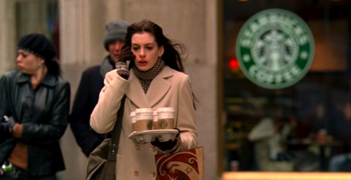
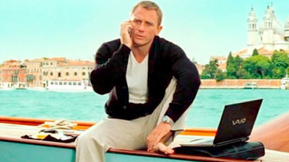
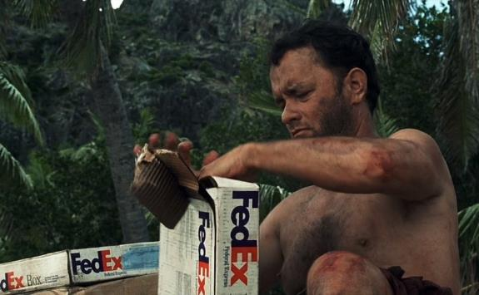
Guess what film each picture is from…
Devil Wears Prada
James Bond - Skyfall
Castaway
Notes:
Images:
James Bond - http://www.joescaramanga.co.uk/blog/wp-content/uploads/2012/10/casino-royale-laptop.jpg
Lotus James Bond - https://nomequieroquedar.files.wordpress.com/2012/07/james_bond_lotus-600x391.jpg?w=300
Castaway - http://static5.businessinsider.com
Devil wears Prada - http://2.bp.blogspot.com/-mmbg-s8fYdI/US4XR4FxEOI/AAAAAAAAAEs/DUJ38-7MaUc/s1600/Starbucks.png

Slide 13
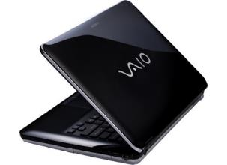
How can you relate branding to each of these films?
James Bond - Skyfall
Devil Wears Prada
Castaway
Notes:
Images:
Fedex - http://pre08.deviantart.net/1872/th/pre/f/2016/156/4/0/fedex_logo_vector_by_windows7starterfan-da55dfr.png
Vaio laptop - http://woikr.com/wp/wp-content/uploads/2009/05/vaio-cs-24-black.jpg

Slide 14
Product Placement
This is called Product placement – where a product is purposely placed in a film/program/series so that its target audience sees the product being used by people or in environments that they may look up to.
James Bond - Skyfall
Which film would you place your product in to reach the right audience?
Notes:
Image:
Vaio laptop - http://woikr.com/wp/wp-content/uploads/2009/05/vaio-cs-24-black.jpg

Slide 15
In your groups…
From today’s session – make some difficult design decisions about the way your product will be branded and marketed
Brainstorm/draw ideas for a logo for your product and develop this into a design decision.
Decide on a catchy slogan for your product.
Decide which celebrity you would have to endorse your product.
Decide which film/series you would place your product in to promote it.
Stretch yourselves – think about how your TV advert might appear, draw out a storyboard to show this.

Slide 16
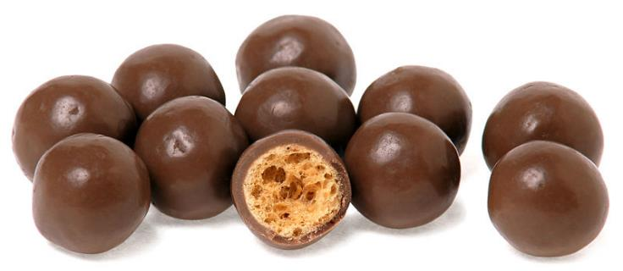
www.youtube.com/watch?v=UcraY0ZkyTI
Excellent adverts…
What would work for your product?
Notes:
Image: Public Domain

