Slide 1
Session 2

Slide 2
Equipment/preparation needed for the lesson
Sticky notes/scraps of paper
Sugar paper
A3 plain paper
Drawing equipment
Pencil crayons
Check that sound is working on your computer and if your whiteboard is interactive that it is calibrated
Notes:
Images - Pixabay

Slide 3
Session 2
Inspiring innovation
Learning objectives:
To creatively develop your innovative design ideas through design iterations.
To think outside of the box.
To constantly refer to your stakeholder requirements.
To create a winning idea in small groups ready to market next lesson.
Keywords:
Creatively
Design iterations
Stakeholders
Smart/modern
materials
Annotate
Notes:
3

Slide 4
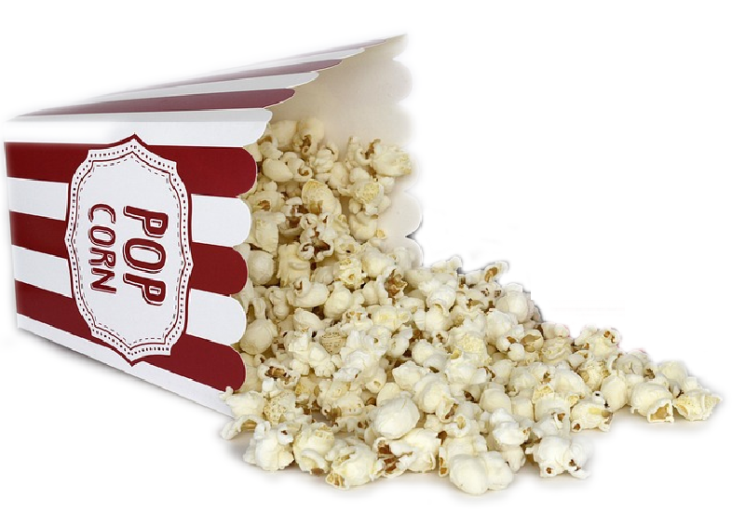
“Being a smart material is like opening a bag of popcorn.”
Would you agree?
Write your answer on your sticky note – you can agree or disagree but you must give a reason for your decision…
Notes:
Image: Public Domain

Slide 5
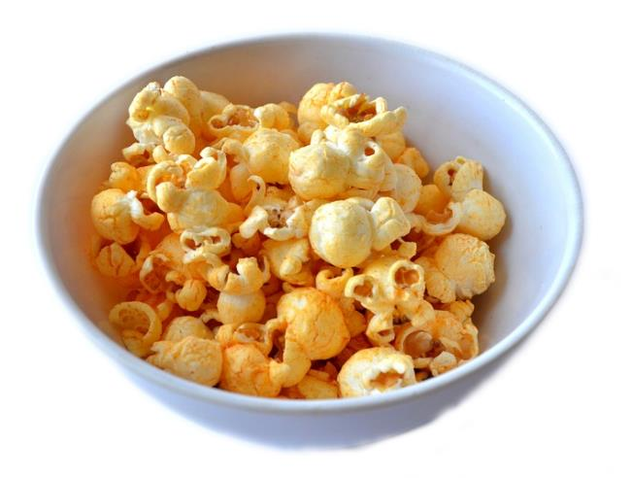
“Being a smart material is like opening a bag of popcorn.”
What did you think of?
Did you think of these?
The outcome is always a nice surprise.
The input is different to the output (like with the kernels).
The texture can change (like the kernels to the popcorn).
You need the right conditions to change the properties.
A smart material is not like popcorn, because popcorn can’t return to the kernels.
Notes:
Image: Public Domain

Slide 6
“if you always do what you always did then you’ll always get what you always got…”
Henry Ford
Today you are going to build up a page of unusual design iterations in this design task, try to keep this quote at the forefront of your thoughts.

Slide 7
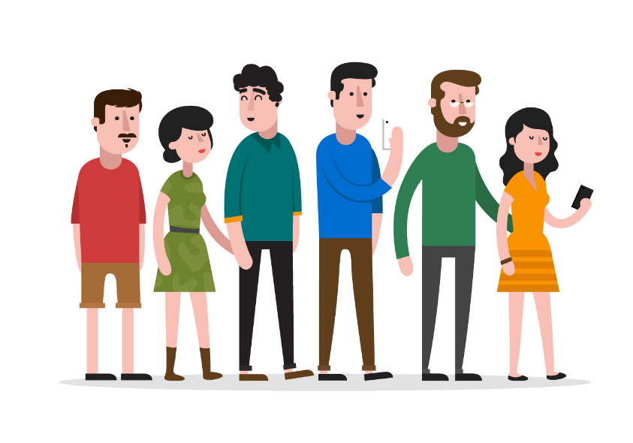
As you design try to also remember
Is it a ‘winning’ idea?
Is it innovative?
Does it meet your
stakeholder requirements?
Would they want to buy your product?
Notes:
Image:
Stakeholders - https://static.vecteezy.com/system/resources/previews/000/099/226/original/people-in-a-row-vector.jpg

Slide 8
Write down any word you can think of that begins with the letter:
‘S’

Slide 9
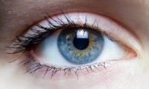
Click on a word to decide on the direction of your design iteration:
Techie
Beauty is in the eye of the beholder
Add
Listen
Function
Airplane
Action
Random letter ‘S’
Finished
Notes:
Images:
Eye - https://upload.wikimedia.org/wikipedia/commons/6/64/Iris_-_left_eye_of_a_girl.jpg

Slide 10
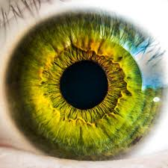
Techie…
“if you always do what you always did then you’ll always get what you always got…”
Use a different technology with your design:
Face recognition technology
Finger print recognition
Retina scanning
Back
Notes:
Images:
Finger print - https://cdn.pixabay.com/photo/2014/09/22/16/36/fingerprint-456483_960_720.jpg
Eye - https://encrypted-tbn0.gstatic.com/images?q=tbn:ANd9GcTANXWVGPWwAyQjiEN2v9ZQB3xmg7y5w93dA6uNzYRDY3s1EZNtTg
Face recognition - https://c1.staticflickr.com/9/8319/8044570589_f374e7207b_b.jpg

Slide 11
“if you always do what you always did then you’ll always get what you always got…”
Beauty is in the eye of the beholder
Choose any of these conditions and change/do a new design…
Shape
Shrink
Expand
Use only wiggly lines
Use only straight lines
Use only curves
Make your design feminine
Make your design masculine
Back
Notes:
Image:
Eye - https://upload.wikimedia.org/wikipedia/commons/6/64/Iris_-_left_eye_of_a_girl.jpg

Slide 12
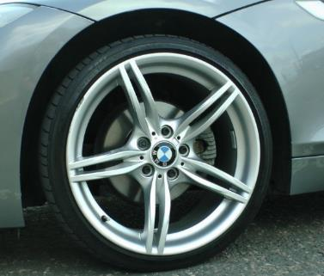
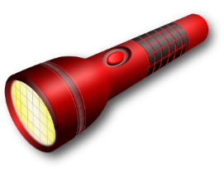
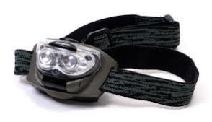
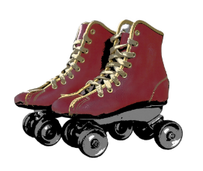
Add…
“if you always do what you always did then you’ll always get what you always got…”
Add something on…
Wheels
Hat
Foot
Roller skate
Beach ball
Torch
Something else
Back
Notes:
Images:
Feet - https://cdn.pixabay.com/photo/2015/07/03/17/41/feet-830503_960_720.jpg
Wheel - http://www.publicdomainpictures.net/pictures/130000/velka/bmw-car-wheel.jpg
Yellow hat - https://cdn.pixabay.com/photo/2014/03/24/17/06/safety-helmet-295057_960_720.png
Red hat - https://cdn.pixabay.com/photo/2014/04/03/00/35/hat-308779_960_720.png
Roller skate - https://cdn.pixabay.com/photo/2015/09/22/19/53/retro-952363_960_720.png
Beach ball - https://cdn.pixabay.com/photo/2014/04/03/11/36/beachball-311978_960_720.png
Torch https://cdn.pixabay.com/photo/2013/07/13/12/33/light-159858_960_720.png
Head torch https://upload.wikimedia.org/wikipedia/commons/b/bd/LED-headlamp.jpg
Graduation hat - https://upload.wikimedia.org/wikipedia/commons/thumb/c/c9/Graduation_hat.svg/2000px-Graduation_hat.svg.png
Christmas hat - https://cdn.pixabay.com/photo/2015/12/11/05/00/santa-hat-1087651_960_720.png

Slide 13
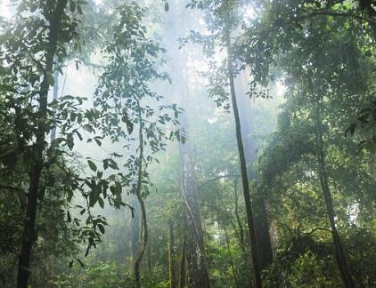
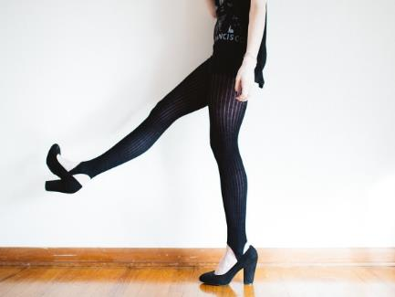
Listen…
“if you always do what you always did then you’ll always get what you always got…”
Click the icons below to listen to the sound clip and be inspired to iterate your design…
Water
Rainforest
Irish tapping
Back
Notes:
Images:
Listen symbol - https://upload.wikimedia.org/wikipedia/commons/thumb/c/c9/Icon_sound_loudspeaker.svg/1094px-Icon_sound_loudspeaker.svg.png
Water - https://pixabay.com/en/florida-stream-creek-river-flow-67898/
Sounds:
Public Domain: http://soundbible.com http://www.grsites.com

Slide 14
Function
“if you always do what you always did then you’ll always get what you always got…”
Change the main use of the product
Add a secondary function
Make it fly
Adapt for opposite type of customer
Make the product operate using only renewable energy sources
Back
Notes:
Image:
http://www.fragmaq.com.br/wp-content/uploads/2013/06/1-conceito-do-ecodesenvolvimento.jpg

Slide 15
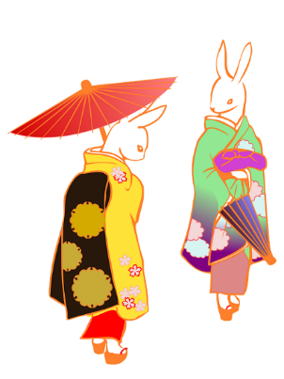
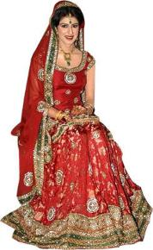
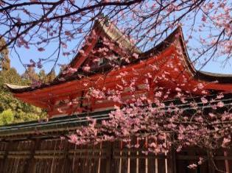
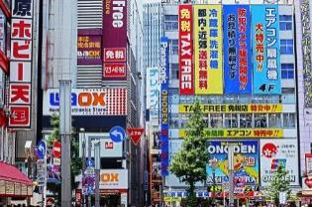
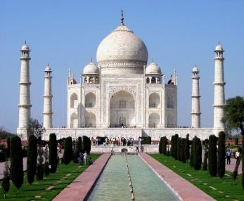
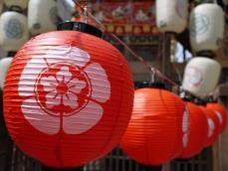
Japan
Mexico
India
“if you always do what you always did then you’ll always get what you always got…”
Theme your design around a different country….
Back
Notes:
Images: Japan –
https://upload.wikimedia.org/wikipedia/commons/thumb/0/06/War_flag_of_the_Imperial_Japanese_Army.svg/1280px-War_flag_of_the_Imperial_Japanese_Army.svg.png
https://cdn.pixabay.com/photo/2016/05/30/12/47/japan-1424672_960_720.jpg
https://cdn.pixabay.com/photo/2015/06/11/09/48/cherry-805688_960_720.jpg
https://cdn.pixabay.com/photo/2017/02/07/14/54/umbrella-2046160_960_720.png
https://cdn.pixabay.com/photo/2015/04/19/09/48/japan-729593_960_720.jpg
https://cdn.pixabay.com/photo/2012/04/11/16/46/geisha-girl-28855_960_720.png
https://upload.wikimedia.org/wikipedia/commons/thumb/e/e6/Chenzihmyon_typefaces.svg/1280px-Chenzihmyon_typefaces.svg.png
Mexican
https://cdn.pixabay.com/photo/2013/07/12/17/19/mexico-152016_960_720.png
https://cdn.pixabay.com/photo/2013/07/13/10/53/mexico-157993_960_720.png
https://cdn.pixabay.com/photo/2016/03/29/19/35/mexico-1289099_960_720.jpg
https://cdn.pixabay.com/photo/2016/04/16/11/45/mexico-flag-1332910_960_720.png
https://cdn.pixabay.com/photo/2017/01/12/18/00/sombrero-1975267_960_720.png
https://cdn.pixabay.com/photo/2013/07/13/10/53/cactus-157994_960_720.png
India –
https://upload.wikimedia.org/wikipedia/commons/c/c8/Taj_Mahal_in_March_2004.jpg
https://cdn.pixabay.com/photo/2015/03/26/10/45/henna-691901_960_720.jpg
https://cdn.pixabay.com/photo/2015/09/29/18/05/elephant-964295_960_720.png
https://upload.wikimedia.org/wikipedia/commons/b/bc/Flag_of_India.png
https://c1.staticflickr.com/1/574/21055379079_9cfb52253e.jpg

Slide 16
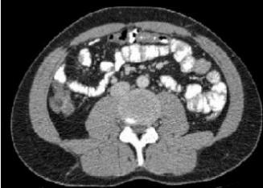
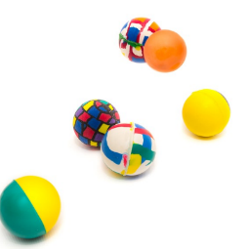
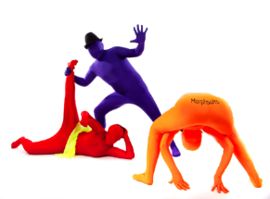
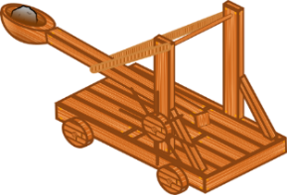
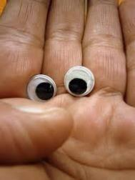
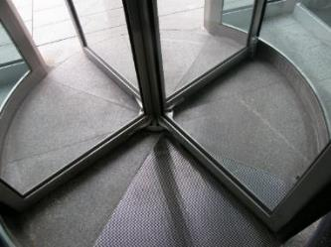
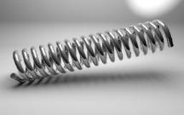
Action
“if you always do what you always did then you’ll always get what you always got…”
Create some kind of movement in your design
Reverse
Capture
Twist
Multiply
Catapult
Revolve
Scan
Back
Notes:
https://cdn.pixabay.com/photo/2013/07/13/14/08/microphone-162210_960_720.png
https://encrypted-tbn0.gstatic.com/images?q=tbn:ANd9GcTpK6bCV62GwgPFITMJFiDvJGKHzNASgRK8dQIuClpDtABTFTNC
https://cdn.pixabay.com/photo/2015/10/23/20/45/live-1003646_960_720.jpg
https://cdn.pixabay.com/photo/2013/07/12/14/34/catapult-148509_960_720.png
https://cdn.pixabay.com/photo/2017/03/30/13/46/bouncing-2188491_960_720.jpg
https://cdn.pixabay.com/photo/2017/01/08/12/36/spiral-1962819_960_720.jpg
https://upload.wikimedia.org/wikipedia/commons/d/da/Morphsuit_photoshoot_3_post_overlap.jpg
https://cdn.pixabay.com/photo/2016/10/26/17/30/effect-1772022_960_720.jpg
https://upload.wikimedia.org/wikipedia/en/4/49/CT_Scan_Bowel.JPG
https://upload.wikimedia.org/wikipedia/commons/b/bb/Revolving_door-base.jpg
https://cdn.pixabay.com/photo/2017/01/01/19/02/kaleidoscope-1945279_960_720.jpg

Slide 17
“if you always do what you always did then you’ll always get what you always got…”
Random letter ‘S’
Try to include one of the classes ‘S’ words into your design
Back

Slide 18
Share: pair with someone who has the same product as you…
In groups of 2-3, share your ideas with one another.
Which would be ‘winning’ ideas to take forward?
Which ideas are innovative and you have never seen sold in the shops before?
Which ideas would meet the requirements of your stakeholders?
Could a few of your ideas be combined?
As a group decide on one idea to take forward or combine your ideas to make a winning idea. Draw this out clearly and annotate on your piece of sugar paper.

