Slide 1
Inspiring innovation
Intellectual property in product design
Notes:
The majority of images used in this presentation are from Public Domain and Creative Commons sources including Pixabay.com and Wikipedia; permissions have been sought and acknowledged where images are from other sources.

Slide 2
Contents
Session 1 Smart and modern materials
Session 2 Developing your design
Session 3a Commercial viability
Session 3b Why standards are important
Session 4 Different forms of intellectual property
Patents
Trade marks
Copyright
Registered designs
Extra activities

Slide 3
Links to the national curriculum KS4 and KS5 GCSE design and technology specifications
Key Stage 3
Creative and practical activities
Iterative design
Range of domestic and local contexts
Understand user needs
Solve their own design problems
Design of innovative, functional and appealing products
Variety of design approaches
New and emerging technologies
Views of intended users
Properties of materials (smart materials)
Key Stage 4 GCSE
Focus on needs, wants and values of individuals and groups, leading students to address problems and/or opportunities
Developments in modern and smart materials, composite materials and technical textiles
Explore and develop ideas, testing, critically analysing and evaluating their work in order to inform and refine their design decisions thus achieving improved outcomes
Use different design strategies such as collaboration, user-centred design and systems thinking, to generate initial ideas and avoid design fixation
Key Stage 5 AS/A-level Product Design
The regulatory and legislative framework for health and safety and the impact on designing and making
The implications of intellectual property, registered designs, registered trade marks, copyright, design rights and patents
The role of marketing, enterprise, innovation and collaboration in the development of products
User-centred design: the investigation and analysis of a problem within a context, and the needs, wants and values of users, to define a design opportunity or problem leading to the production of a design brief and specification to direct, inform and evaluate their design practice
How to critically analyse and evaluate their own ideas and decisions whilst using iterative design and make processes
How to evaluate their prototypes/products taking into account the views of potential users, customers or clients
The application of relevant standards to their design tasks including those published by the British Standards Institute (BSI)
The application of smart and modern materials

Slide 4
Session 1

Slide 5
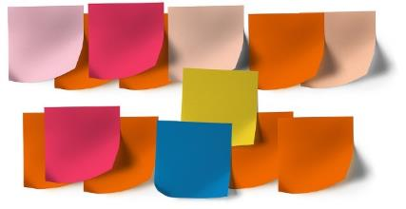
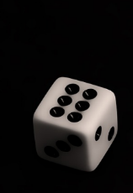
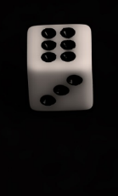
Equipment/preparation needed for the lesson
Sticky notes/scraps of paper
Dice
Drawing equipment
Print, laminate and cut up the SMART/MODERN materials cards and the product cards
Check that sound is working on your computer and if your whiteboard is interactive that it is calibrated
Notes:
Dice – Public Domain.

Slide 6
11.3
11.3
11.3
11.3
11.3
Smart/modern materials
Smart material =
11.3
Thermochromic =
Photochromic =
Fluorescent =
Reflective =
Shape memory =
Piezoelectric materials =
e.g.
e.g.
e.g.
e.g.
e.g.
Micro encapsulation =
Electroluminescent =
Conductive thread =
Biodegradable packaging =
Polymorph =
Self healing materials =
e.g.
e.g.
e.g.
e.g.
e.g.
e.g.
Notes:
Print this for students to complete

Slide 7
Design ideas
You are in the year 2200 – use your smart/modern materials to redesign a product:
Material 1 =
Material 2 =
Product =
Potential stakeholders and their requirements:
*
*
*
*
*
*

Slide 8
Session 1
Inspiring innovation
Learning objectives:
To explore the limitless ideas for smart and modern materials in design and technology
To creatively design using smart and modern materials whilst considering stakeholders’ requirements
Keywords:
Smart materials
Modern materials
Properties
Stakeholders
Notes:
8

Slide 9
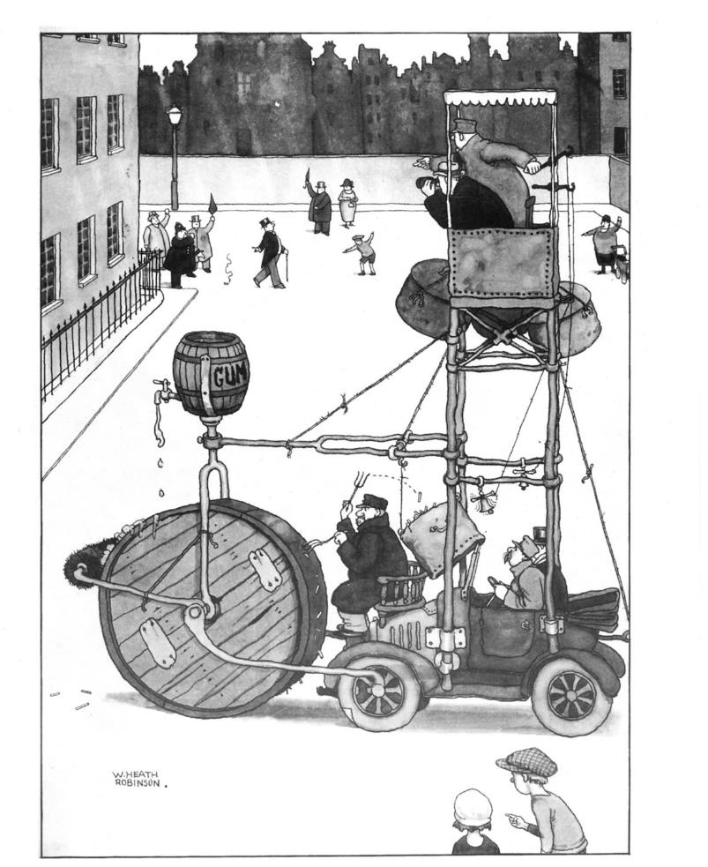
Create three sentences using these phrases:
What can you see?
What is it making you think?
What is it making you wonder?
e.g.
I can see two men at the top of a vehicle.
I think they are watching out.
I am wondering how they got up there?
Notes:
Image: https://upload.wikimedia.org/wikipedia/commons/1/10/William_Heath_Robinson_Inventions_-_Page_057.png

Slide 10
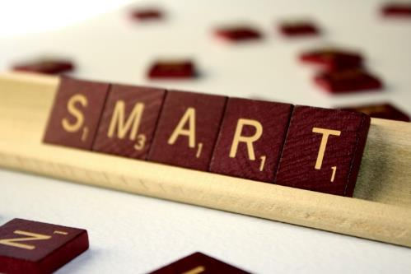
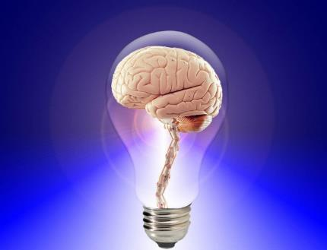
What is a smart material?
Smart materials appear to ‘think’ by sensing the conditions in their environment and responding.
Can you think of a product that uses a smart material?
Notes:
Images:
Book – https://www.psychologytoday.com/blog/evolution-the-self/201705/are-you-smart-or-smart-enough
Smart letters – http://www.photos-public-domain.com/2011/09/19/smart/
Lightbulb brain - http://brianadragon.com/2013/08/27/smart-think/

Slide 11
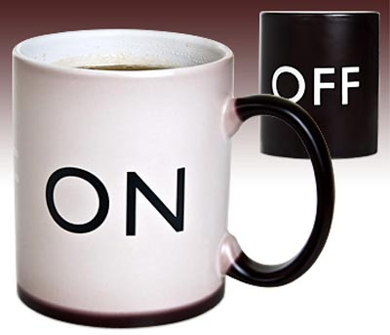
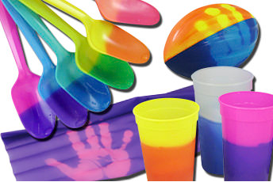
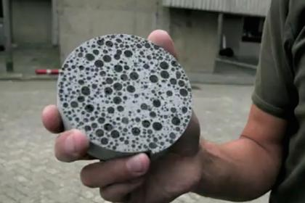
What smart materials can you think of?
Notes:
Images: Public Domain
Spoons and cups: LCR Hallcrest Ltd: https://www.hallcrest.com/
Concrete disc – https://www.flickr.com/photos/uclnews/8518049675

Slide 12
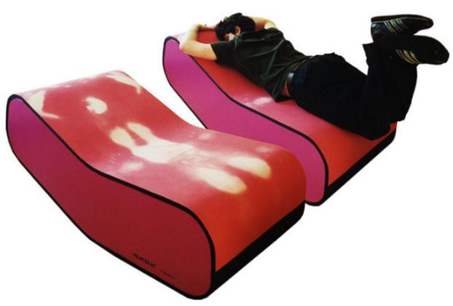
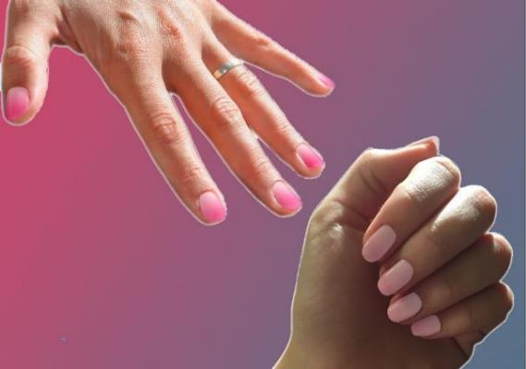
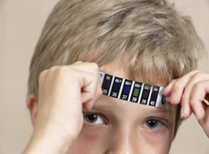
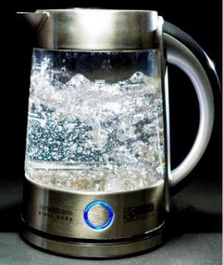
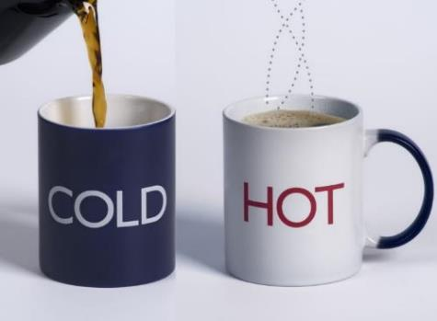
Thermochromic = Change colour due to heat.
To cold
Plastic spoons change colour when in hot water – used to test the heat of baby food.
Bath plugs that show when the bath water is too hot.
Mugs and kettles that change colour with hot water.
Bandages coloured with thermochromic dyes change colour if a wound becomes inflamed.
Used in the food industry to indicate freshness.
From warm hands
SMART MATERIAL
Notes:
Images:
Mugs - https://upload.wikimedia.org/wikipedia/commons/2/2f/Hot_Cold_mug.jpg
Kettle - https://pixabay.com/en/kettle-glass-water-blow-geraert-357178/
Thermometer - http://www.bbc.co.uk/schools/gcsebitesize/design/electronics/materialsrev5.shtml
Spoons and cups - LCR Hallcrest Ltd: https://www.hallcrest.com/
Heat Seat: J.MAYER.H http://www.jmayerh.de/47-0-Heat-Seat.html

Slide 13
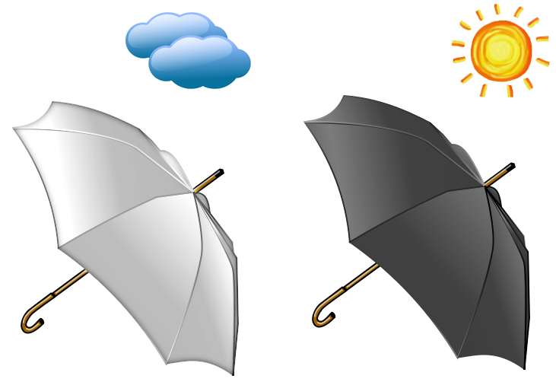
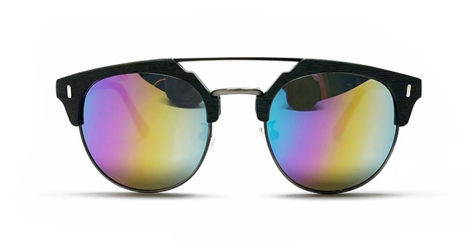
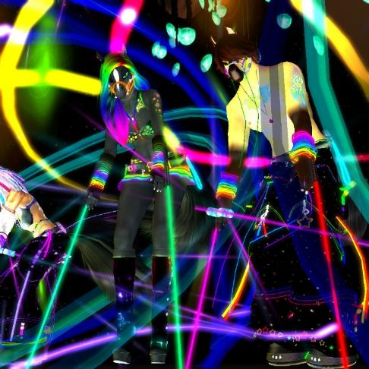
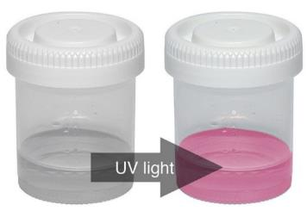
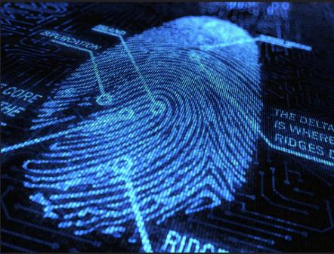
Photochromic
= Change colour when they go outside in sunlight.
Security markers on products.
Sunglasses that darken in the sun.
Rave-wear – using UV light.
SMART MATERIAL
Notes:
Images:
Fingerprint - https://www.flickr.com/photos/93243105@N03/8477734222
UV Light – http://www.mindsetsonline.co.uk
Glasses - https://pixabay.com/en/sunglasses-shades-eyewear-2255620/
Rave –
https://c1.staticflickr.com/8/7761/18295806945_e0ea7c00df_b.jpg

Slide 14
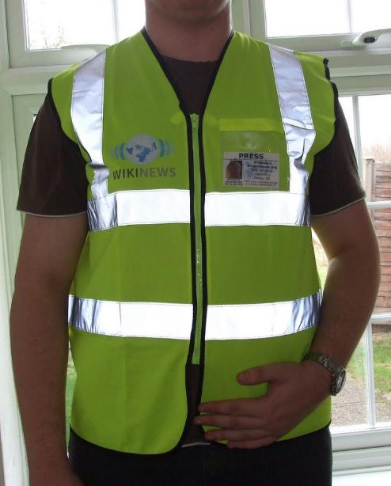
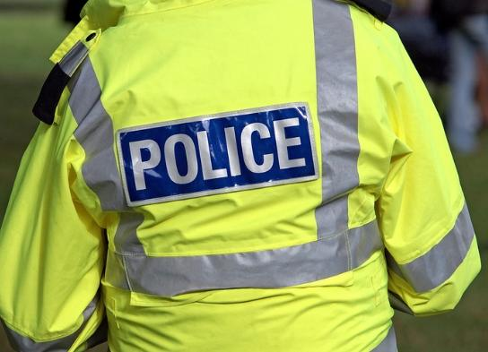
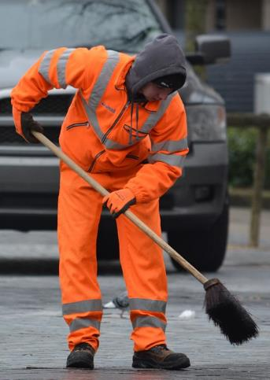
Fluorescent fabrics = Look bright from the way the colours absorb and emit light.
Reflective fabrics = Minute glass beads are embedded into fabrics, yarns and dyes which reflect light.
People working in traffic management on roads, rail and at airports.
Building construction people.
Life saving equipment – buoyancy vests in lifeboats.
Leisure wear which needs high visibility – sailing/hiking.
MODERN MATERIAL
Notes:
Images:
High vis jacket - https://c1.staticflickr.com/3/2162/2280001440_24a3c51a4f_b.jpg
COASTGUARD - http://coastguard.dodlive.mil/files/2011/05/110504-G-TM873-042-CGC-Bertholf-small-boat-launch-Version-2.jpg
Police – Public Domain
Street cleaner - http://maxpixel.freegreatpicture.com/Scavenger-Brush-People-Cleaning-Wagner-Orange-253932

Slide 15
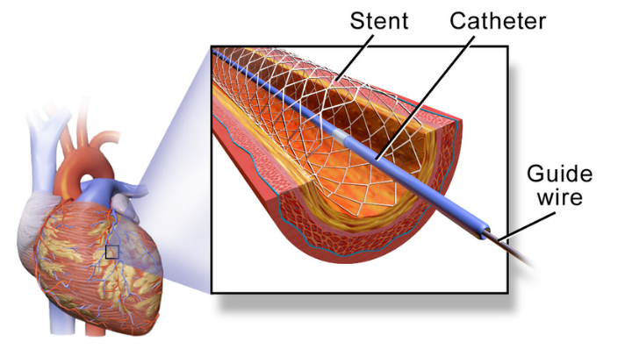
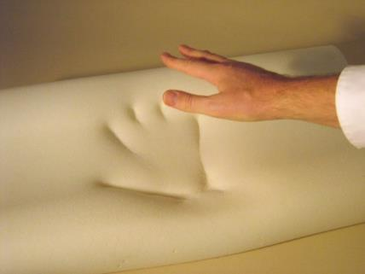
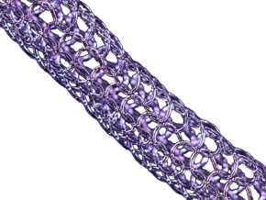
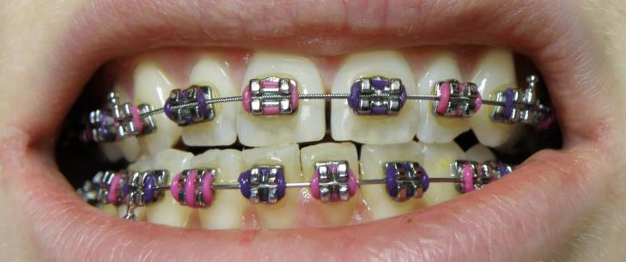
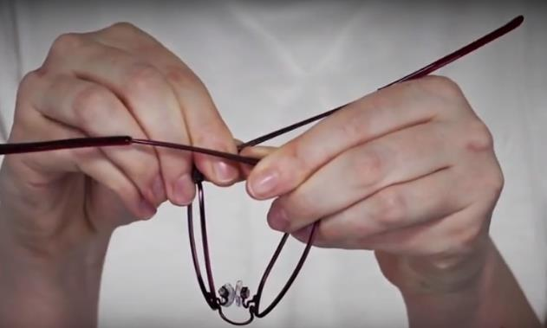
Shape memory = After deformation the material remembers original shape and returns when heated.
Stents are tubes threaded into arteries that expand with a rise in body temperature to allow increased blood flow.
Glasses that return to their original shape after bending.
Braces made from Nitinol gently exert pressure to push teeth back together.
heat
SMART MATERIAL
Notes:
Images:
Stent in coronary artery – Blausen.com staff (2014). "Medical gallery of Blausen Medical 2014". WikiJournal of Medicine 1 (2). DOI:10.15347/wjm/2014.010. ISSN 2002-4436
Bedding - https://upload.wikimedia.org/wikipedia/commons/thumb/4/48/MemoryFoam-fast.jpg/1024px-MemoryFoam-fast.jpg
BRACES - https://upload.wikimedia.org/wikipedia/commons/e/e1/Orthobraces_-_dental_braces_lower_upper_jaw.jpg
Flexible Specs - https://www.specsavers.co.uk/kids-flexi

Slide 16
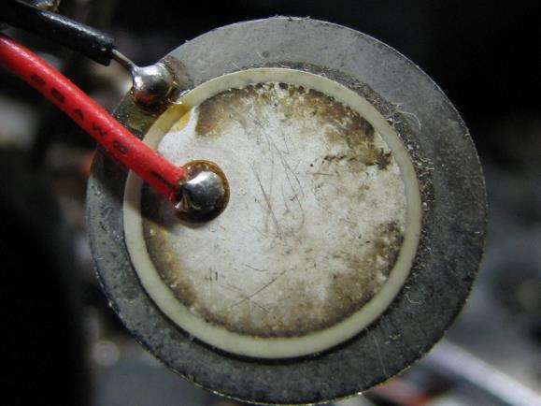
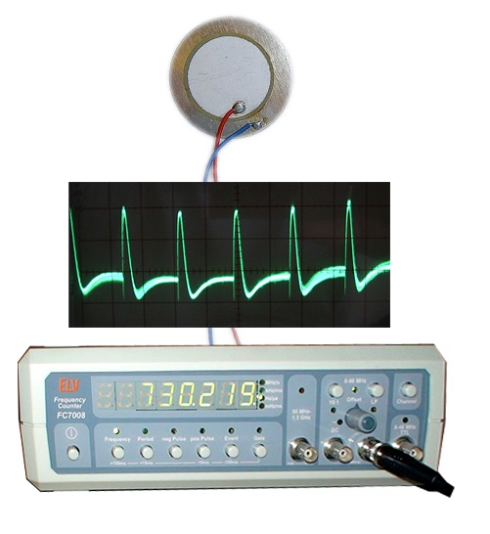
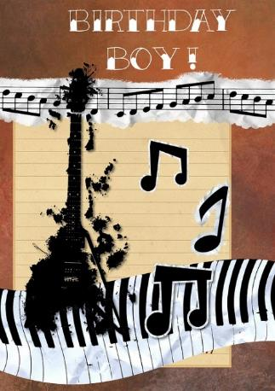
Piezoelectric = Applying a mechanical stress to these materials generates an electric current.
Piezoelectric crystal
Piezoelectric microphones transform changes in pressure caused by sound waves into an electrical signal.
Burglar alarms.
Talking or musical birthday cards.
Oscillator
Frequency counter
SMART MATERIAL
Notes:
Images:
Birthday card - https://cdn.pixabay.com/photo/2016/03/24/10/36/happy-1276482_960_720.jpg
Buzzer - https://upload.wikimedia.org/wikipedia/commons/d/d3/2007-07-24_Piezoelectric_buzzer.jpg
Oscillator signal - https://commons.wikimedia.org/wiki/File:AF_oscillator_signal.JPG
Frequency counter - https://kk.wikipedia.org/wiki/%D0%A1%D1%83%D1%80%D0%B5%D1%82:Frequency_counter.jpg
Microphone - https://commons.wikimedia.org/wiki/File:Piezo.jpg

Slide 17
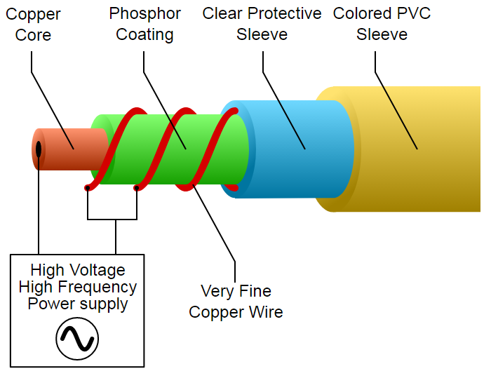
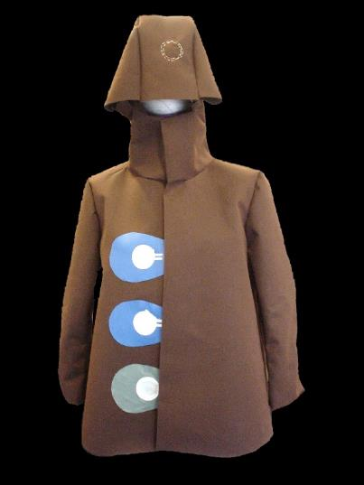
Electroluminescent = Give out a light when .
Puddlejumper
is a luminescent raincoat that glows in the rain.
It uses hand-silkscreened electroluminescent lamps on the front of the jacket which are wired to interior electronics and conductive water sensors on the back and sleeves. When water hits one of the sensors, the equivalent lamp lights up, creating a flickering pattern of illumination that mirrors the rhythm of rainfall.
For more information – see http://www.interactivearchitecture.org/smart-materials-1-definition.html
Safety signs and clothing used at night.
Laptop displays.
LCD TV displays.
SMART MATERIAL
Notes:
Cable - By LogiNevermore (Own work) [CC BY-SA 3.0 (http://creativecommons.org/licenses/by-sa/3.0 ) or GFDL (http://www.gnu.org/copyleft/fdl.html )], via Wikimedia Commons
Puddlejumper: http://acg.media.mit.edu/people/elise/glow/index.html
Alternative if needed:
[Coat image simulated based on ‘Yellow coat by Balenciaga’, Creative Commons: Irekia]

Slide 18
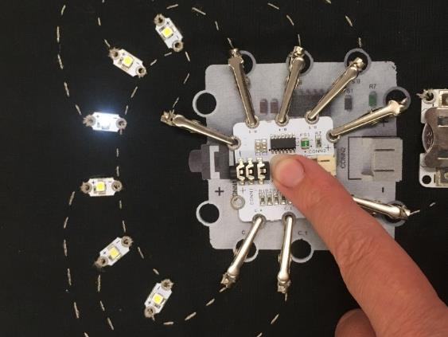
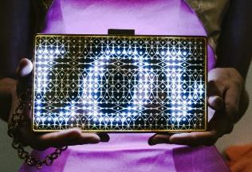
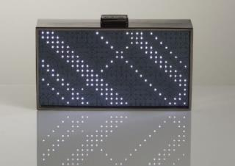
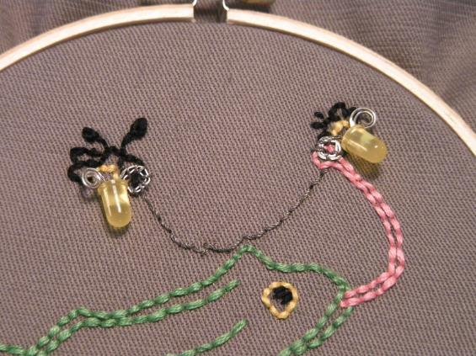
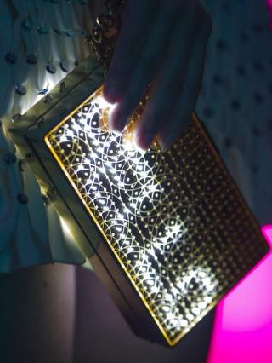
Conductive thread = Allow a circuit to be sewn by joining up components that are sewn in.
Unusual clothing.
Accessories.
Christmas decorations.
Katy Perry’s custom made dress made with over 3,000 full colour micro LED lights, at the infamous Met Costume Institute Gala in New York.
MODERN MATERIAL
Notes:
Images:
Bags and dress – CuteCircuit: http://cutecircuit.com
LEDs: https://www.flickr.com/photos/bekathwia/2532005574

Slide 19
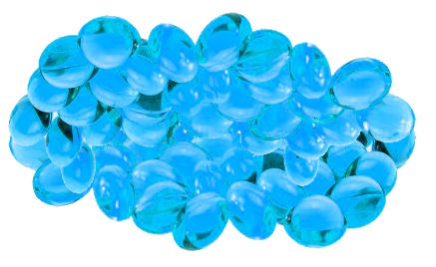
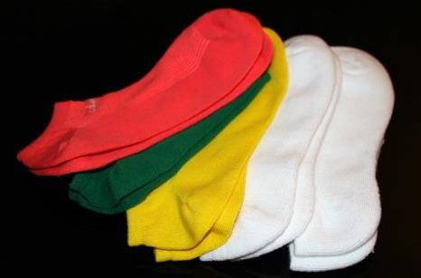
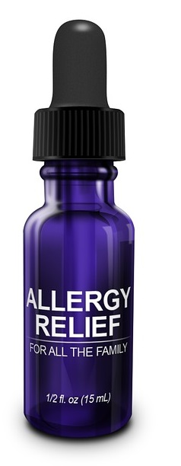
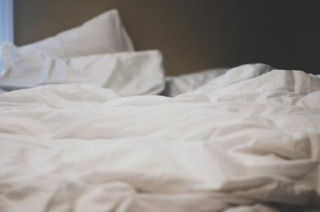
Micro – encapsulation
= Tiny bubbles of liquid or solids are encapsulated into the fabric. With wear, the contents are released.
Medical fabrics can be encapsulated antiseptics or with substances essential to the body.
Allergy control fabrics can be used to prevent dust mites in bedding for people with breathing problems.
Sanitised fabrics with anti microbial properties for socks, sportswear, towels and carpets.
MODERN MATERIAL
Notes:
Images:
Socks - https://upload.wikimedia.org/wikipedia/commons/4/4f/Socken_farbig.jpeg
Sportswear - https://c1.staticflickr.com/6/5562/14916291660_27e27e3b4a_b.jpg

Slide 20
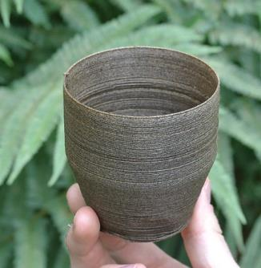
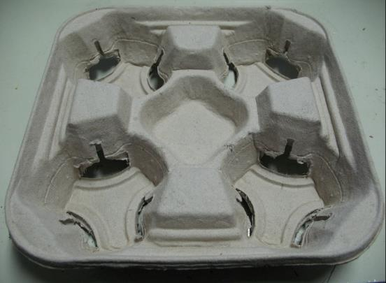
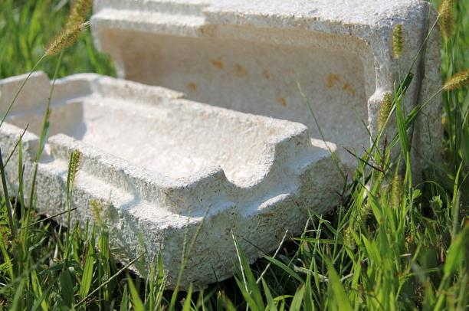
Biodegradable packaging = Waste potato starch, wood-fiber pulp or mycelium is used as the raw material. Can then be composted or used as pig/worm food.
Biodegradable plates, trays, bowls and cups.
Range of packaging, industrial and medical products.
MODERN MATERIAL
Notes:
Images:
Biodegradable packaging - https://www.flickr.com/photos/75778657@N06/6806712061
https://earthpac.co.nz/

Slide 21
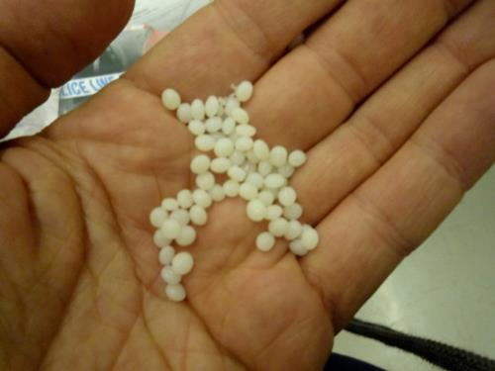
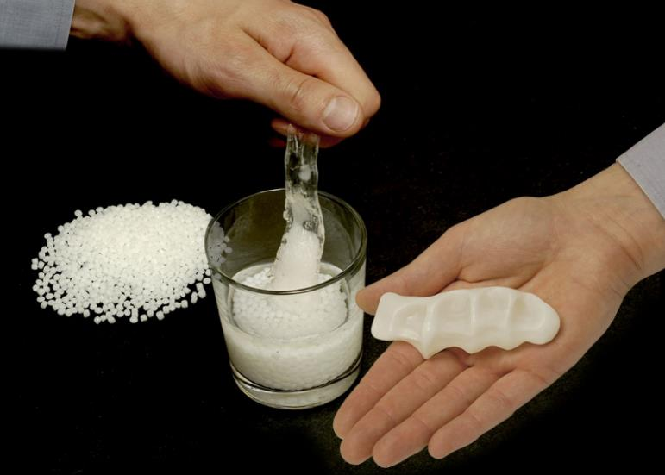
Polymorph = Polymer that melts in hot water or by a hairdryer and can be moulded by hand into any shape.
Handles.
Orthopaedic aids.
Prototyping.
SMART MATERIAL
Notes:
Images:
Hand - https://c1.staticflickr.com/6/5086/5357722309_b8c7d3cf9e_b.jpg
Polymorph & student - http://www.mindsetsonline.co.uk

Slide 22
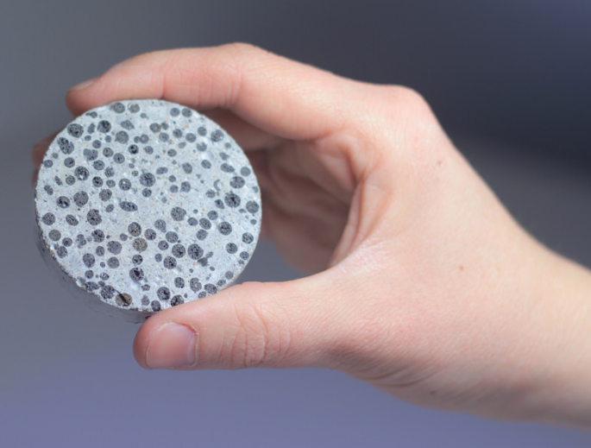
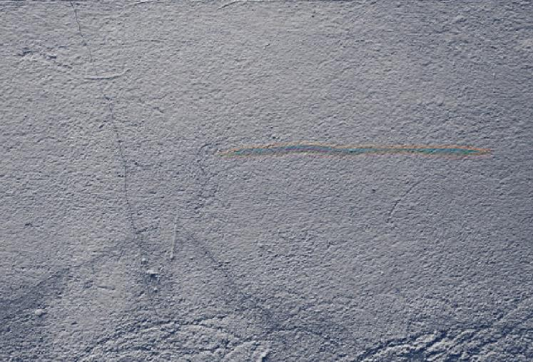
Self healing materials = Have the ability to detect and repair damage that they have undergone.
Bio-concrete uses bacteria that reacts with water to heal itself by producing limestone to fill any micro cracks that appear.
SMART MATERIAL
Notes:
Concrete disc – https://www.flickr.com/photos/uclnews/8518049675

Slide 23
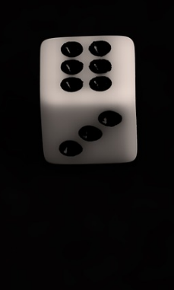
Roll the dice to get two numbers:
Shape memory polymers
Thermochromic materials
Biodegradable packaging
Electroluminescent materials
Conductive thread
Photochromic materials
Note down which two you have selected.
Notes:
Dice – Public Domain.

Slide 24
Scenario
You are in the year 2200 – Roll your dice again to decide on a product.
Using your two smart materials think about how you could redesign one of the following to be an innovative product:
A high chair
A pair of shoes
A skateboard
A watch
An Amazon locker
A car scraper
Notes:
Dice – Public Domain.

Slide 25
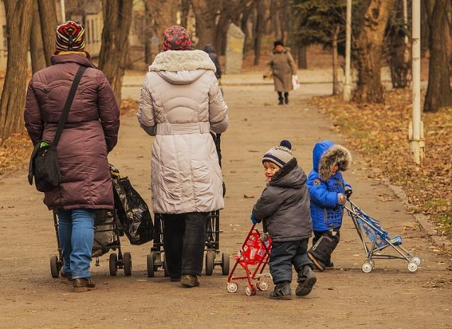
Stakeholders…
Stakeholders = a person, group or organisation with an interest in the product or system.
e.g. a child’s toy
Child = the user
Parent/guardian/grandparent/friend = buyer/repairer.
Who could/would be your stakeholders for your product?
What would their requirements be for your product?
Notes:
Image: Public Domain.

Slide 26
Take the cards that match your smart/modern material and the card that matches your product and be creative.

Slide 27
Photochromic
= change colour when outside in sunlight
Thermochromic = change colour due to heat
Shape memory = after deformation the material remembers original shape and returns when heated
Plastic spoons change colour when in hot water – used to test the heat of baby food.
Bath plugs that show when the bath water is too hot.
Mugs and kettles that change colour with hot water.
Bandages coloured with thermochromic dyes change colour if a wound becomes inflamed.
Used in the food industry to indicate freshness.
Security markers on products.
Sunglasses that darken in the sun.
Rave-wear – using UV light.
Stents are tubes threaded into arteries that expand with a rise in body temperature to allow increased blood flow.
Glasses that return to their original shape after bending.
Outlast – a fabric designed by NASA that absorbs, stores and releases heat for optimal temperatures. Now used in mattresses.
Braces made from Nitinol gently exert pressure to push the teeth back together.
Electroluminescent = give out a light when electric current is applied to them
Conductive thread = allow a circuit to be sewn by joining up components that are sewn in
Biodegradable packaging = waste potato starch is used as the raw material. Can be composted or used as pig/worm food
Safety signs and clothing used at night.
Laptop displays.
LCD TV displays.
Katy Perry’s custom made LED with fibre optics dress at the infamous Met Costume Institute Gala in New York.
Unusual clothing.
Christmas decorations.
Biodegradable plates, trays, bowls and cups.
Range of packaging, industrial and medical products.
Notes:
Print and cut out these cards to help with design decisions.

Slide 28
A pair of shoes
A high chair
A skateboard
A watch
An Amazon locker
A car scraper
Notes:
Print and cut out these cards to help with design decisions.
Images:
Amazon locker - https://upload.wikimedia.org/wikipedia/commons/thumb/7/75/Amazon_Locker_at_Baltoro%2C_345_West_42nd_st%2C_Manhattan_NYC.jpg/1280px-Amazon_Locker_at_Baltoro%2C_345_West_42nd_st%2C_Manhattan_NYC.jpg
https://upload.wikimedia.org/wikipedia/commons/d/dc/Amazon_Locker_Faust_door_open_2.jpg
Highchair - http://www.publicdomainpictures.net/pictures/160000/nahled/child-in-highchair-clipart.jpg
Watch - https://upload.wikimedia.org/wikipedia/commons/3/35/Gold_Chaika_Pocket_Watch_made_in_the_USSR.jpg
https://upload.wikimedia.org/wikipedia/commons/c/cc/Arcadia_watch_c_1950.png
https://c1.staticflickr.com/9/8831/17870204354_b50a4557d9_b.jpg
Skateboard - http://www.publicdomainpictures.net/pictures/70000/velka/skateboard.jpg
https://upload.wikimedia.org/wikipedia/commons/thumb/2/25/Skateboard_on_side.JPG/1280px-Skateboard_on_side.JPG
https://cdn.pixabay.com/photo/2016/02/02/15/43/skateboard-1175519_960_720.jpg
https://cdn.pixabay.com/photo/2015/12/13/20/53/skateboard-1091710_960_720.jpg
Car scraper –
https://upload.wikimedia.org/wikipedia/commons/9/9e/Ice_scraper_on_a_car_window.JPG
http://img.thrfun.com/img/007/385/scraping_icy_windshield_s.jpg
https://c1.staticflickr.com/7/6151/6256627661_6566688ff5_b.jpg
Shoes - https://static.pexels.com/photos/66856/women-s-shoes-red-pin-fashion-66856.jpeg
https://cdn.pixabay.com/photo/2015/09/13/16/48/shoes-938433_960_720.jpg
https://cdn.pixabay.com/photo/2015/02/09/13/41/shoe-629644_960_720.jpg
http://maxpixel.freegreatpicture.com/static/photo/1x/Pet-Dog-Animal-Red-Shoes-Wildlife-Photography-1607219.jpg
https://cdn.pixabay.com/photo/2016/11/03/23/36/baby-shoes-1796583_960_720.jpg

Slide 29
If you could add smart/modern materials to this scene – what would you add and why?
Notes:
Plenary.
https://upload.wikimedia.org/wikipedia/commons/1/10/William_Heath_Robinson_Inventions_-_Page_057.png

