Slide 1
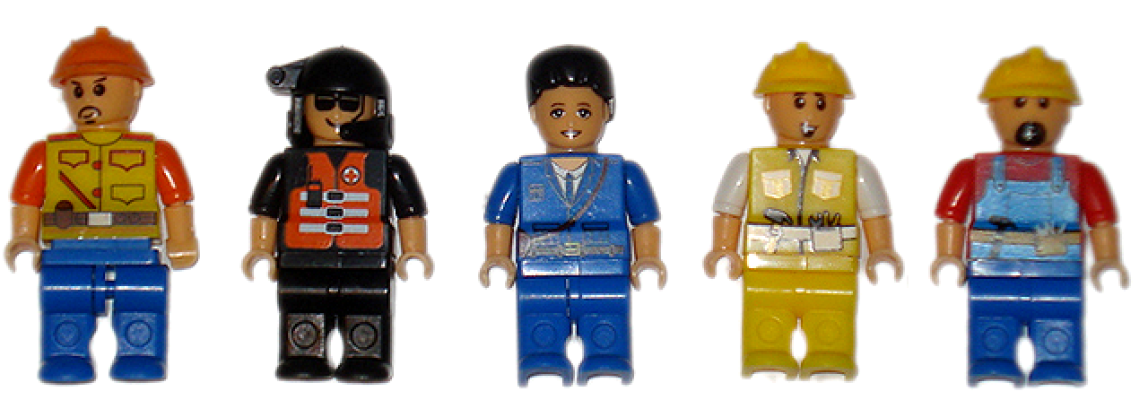
Building services
Challenges

Slide 2
Building services
What are building services?

Slide 3
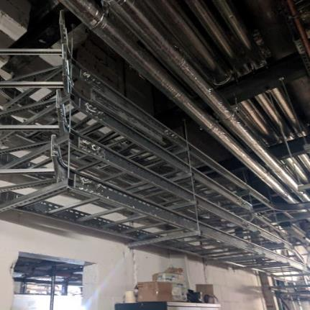
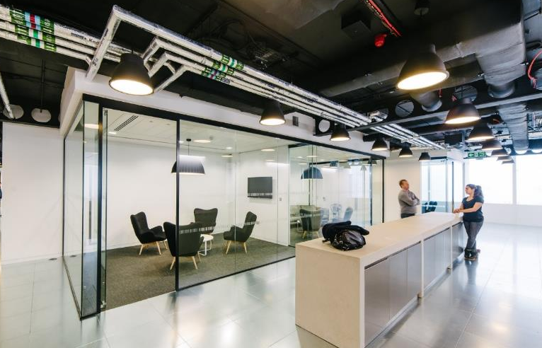
What are building services?
Building services turn buildings into places that meet the needs of their users. Places in which we live and work have to be safe and have the appropriate heating, lighting, levels of humidity and access to services such as water, drainage, electricity and online access.
Many services may be invisible in a finished building, but without them we would not be able to go about our daily lives safely and work efficiently.
Imagine your home or school with no heating, lighting, ventilation or power.

Slide 4
Building services
Challenge 1: Playing field shelter

Slide 5
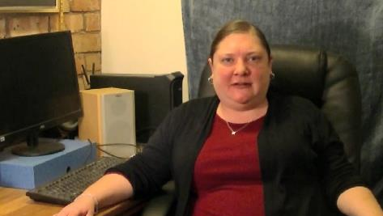
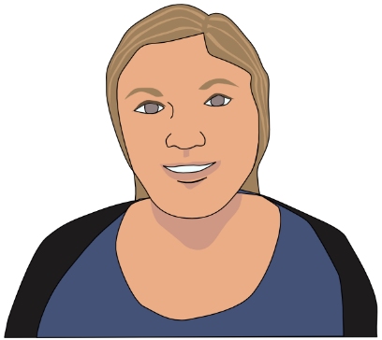
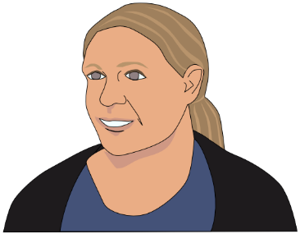
Hello, I’m Poppy and I specialise in solar and wind powered systems in building design. How can you use electrical systems to improve this shelter?
Think about…
A Who might be using the shelter?
B What sort of things will these people need?
C What low-cost facilities might it include?
D How might they be powered?
Renewable energy designer
In my role I often work alongside specialists in electrical and renewable energy, as well as other building services and structural engineers.
I use Computer Aided Design (CAD) to draw up designs that have been proposed to see if they are viable and affordable. Most of my work is office based but I do go on site visits to see how the proposed design will be installed and also to see the final solution in place.
In this project you can design a solution to make the shelter more useful and a better place to hang out.
An empty shelter is like any building without services: it only becomes really useful and welcoming when fitted with facilities that serve the needs of its users.
Playing field shelter challenge
A playing field shelter keeps out the rain but what else can it do for those using it?
How might any electrical solutions be powered?
Research the needs of people using the shelter – what do they use if for and what do they think would make it better?
Think of some solutions to make it a better place to be
Think about including electrical systems
How might these be powered?
Develop a design to show how if might work and the components you will need
You might make a circuit to test it out
Tip:
Programming the circuit so that it only operates when someone is in the shelter can help save energy. What switches might you need to make this work?

Slide 6
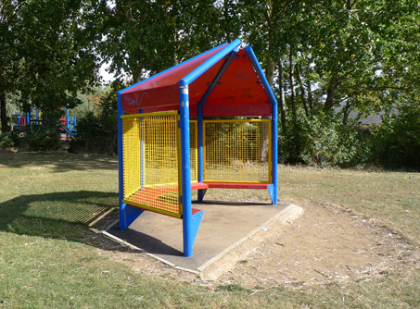
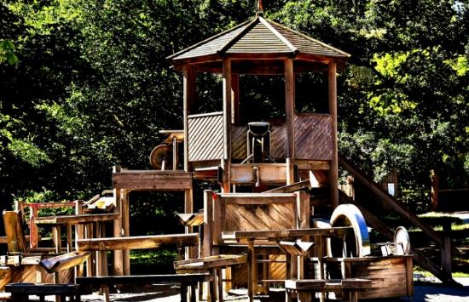
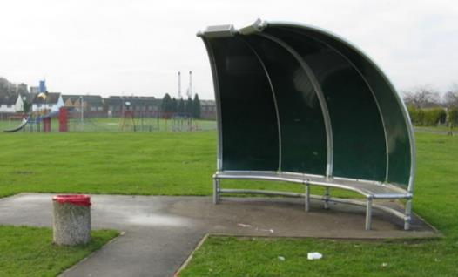
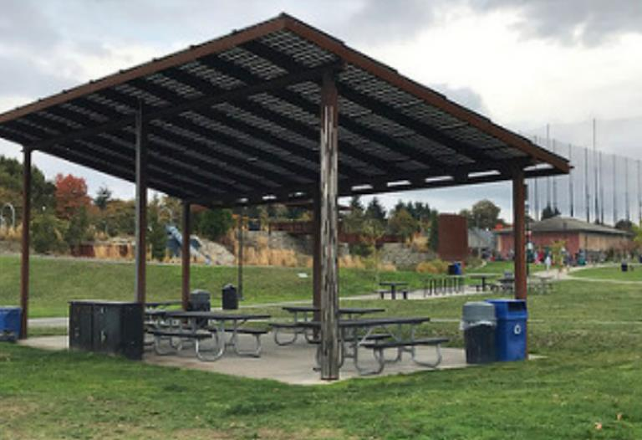
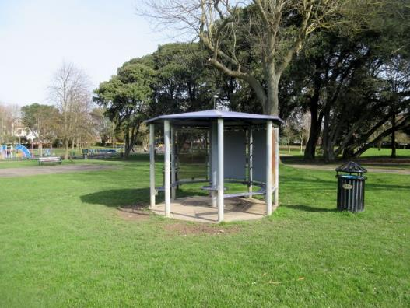
Playing field shelter
Inspirations
Tip:
When constructing a shelter you can improve the strength of the structure by ribbing, laminating and folding and triangulation.
Photo © Peter Holmes
Notes:
Images: Public Domain; Creative commons: Whatlep; Peter Holmes; Cameraman; Seattle Parks

Slide 7
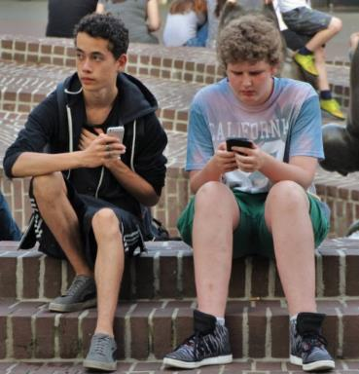
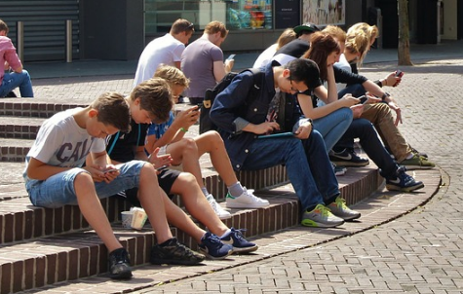
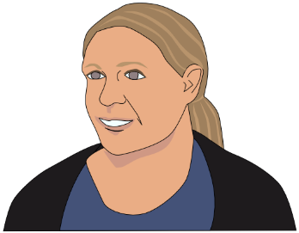
Playing field shelter
Inspirations
Tip:
To improve the design of the shelter you might think of how the seating is arranged and perhaps effective ways of keeping out the wind and rain, and adding facilities such as lighting, heating and phone chargers.
Notes:
Images: Public Domain; Creative commons: Adam Jones;

Slide 8
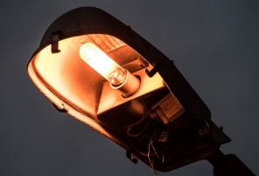
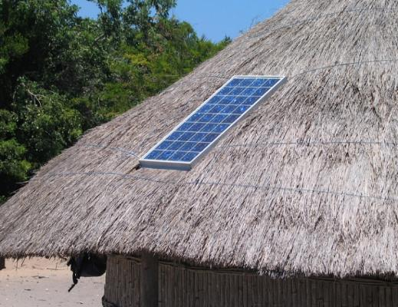
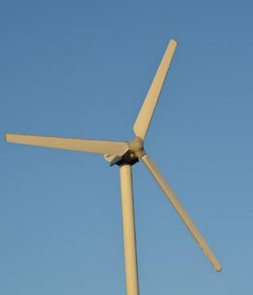
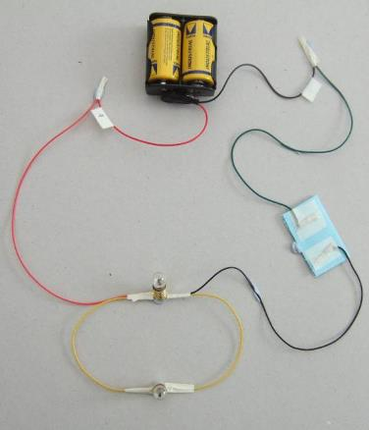
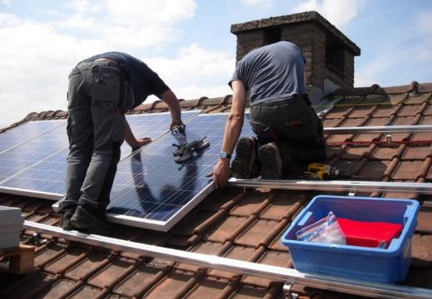
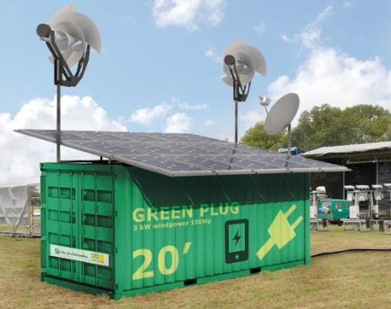
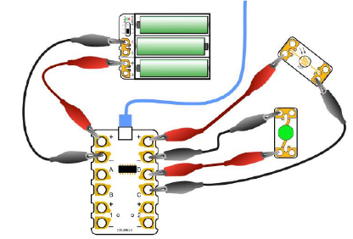
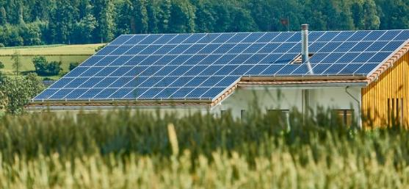
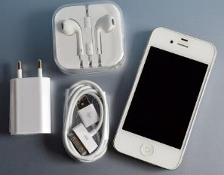
Playing field shelter
Inspirations
Tip:
Using a Passive Infrared (PIR) sensor and a light sensor in a circuit can help you control and limit any wasted electricity.
Notes:
Images: Public Domain; D&T Association

Slide 9
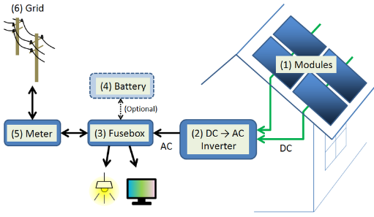
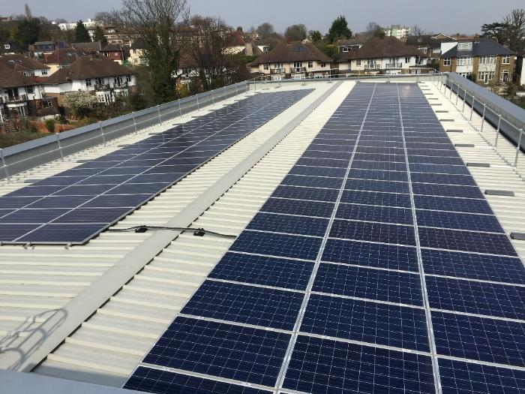
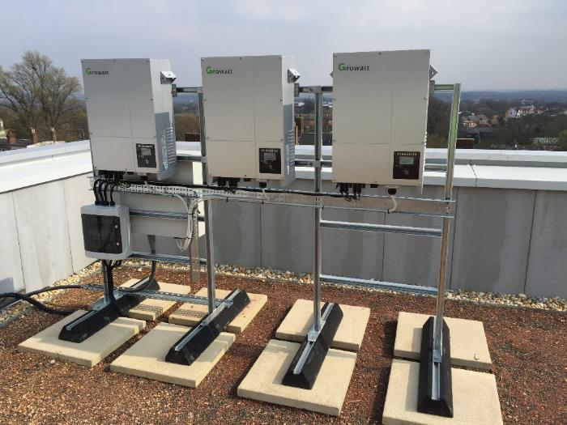
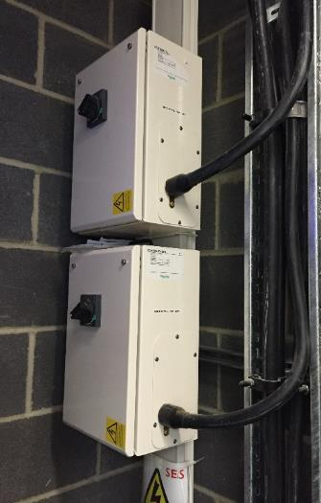
Playing field shelter
PV systems
Many modern buildings install photovoltaic (PV) systems to generate electrical power using solar rays. A PV system can be large or small and includes solar panels to collect and convert sunlight into electricity, and an inverter which changes the electric current from direct (DC) to alternating current (AC). There will also be mounts for the panels, cabling, battery storage and other accessories.
Notes:
Images: Bryden Wood Ltd; creative commons: S-kei
Link: https://en.wikipedia.org/wiki/Photovoltaic_system

Slide 10
Building services
Challenge 2: Library access challenge

Slide 11
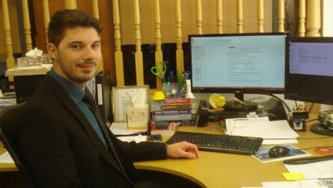
Hi, I’m Louis and I
manage projects where building services can provide solutions to people’s problems. What building services solutions you can come up with to help with this project?
Think about…
A Who might be using the library?
B What access issues will there be?
C What can you think of to overcome the issues?
D How will you test these out?
Project engineer
As a project engineer I work with architects, contractors and specialist engineers to make projects work for all its users.
I work from an office but often visit construction sites to meet with the engineers and builders to make sure everything is going according to plan.
Building services can improve users’ experiences of buildings by installing different services that make a building feel good to be in.
In this project you need to think about who is likely to be disadvantaged by limited signage, narrow doorways, low lighting and access to different levels in the building.
Issues around access are subject to regulations and local authority architects will be involved in deciding how and where these might be put into place.
Library access challenge
A library needs to improve its access to ensure everyone can use the facilities.
Which building services will need to be considered?
Research library users’ needs
Put yourself in the place of someone with mobility or visual impairment issues
Think of some solutions to improve access for people who have a disability
Find solutions that can be built into a library
Design some possible outcomes that you could model
Hint:
Solutions do not need to be expensive: changing the lighting or painting clear lines and messages on surfaces are ways to help partially sighted people find their way.

Slide 12
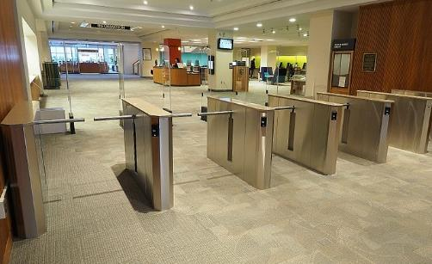
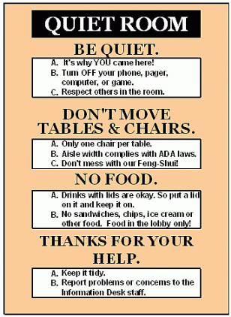
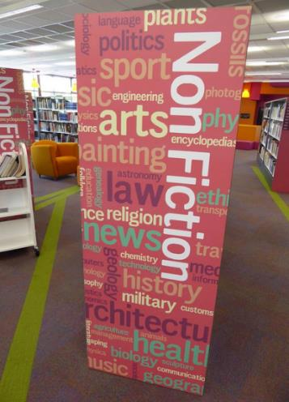
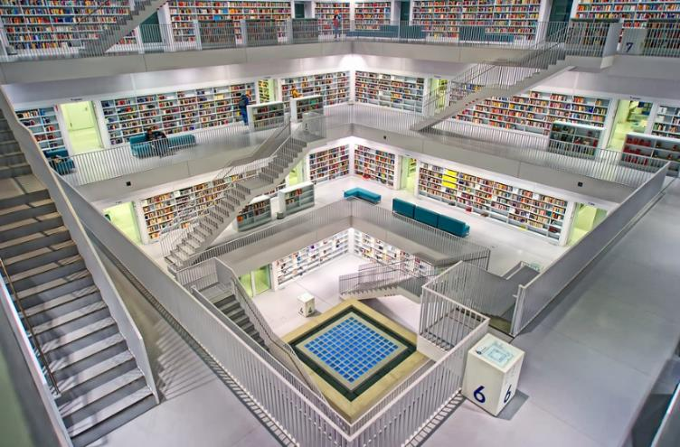
Library access
Inspirations
Tips:
Think about…
Accessing different levels.
The width of doorways and passages.
Helping partially sighted or blind people get around.
What about people who cannot hear well?
Notes:
Images: Public domain; Creative Commons: cjmoss1; Fabtron; Enokson; State Library of NSW

Slide 13
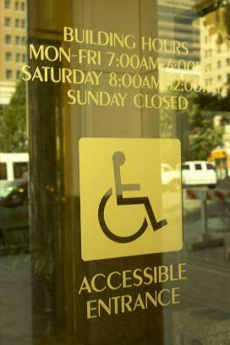
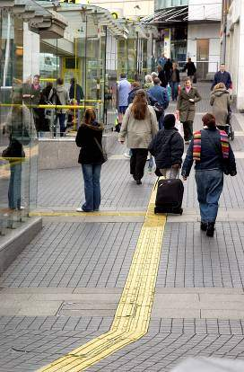
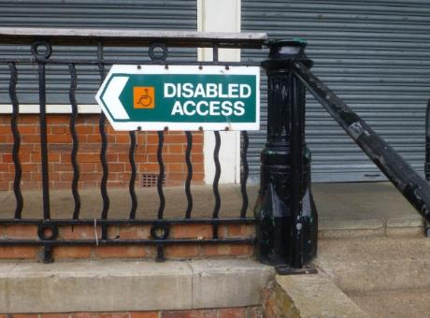
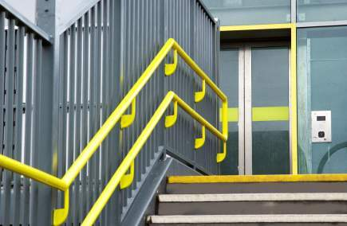
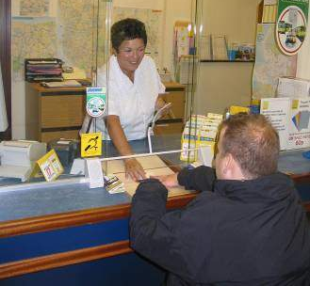
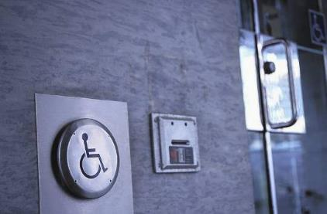
Library access
Inspirations
Remember:
For some people strong colours and clear audible messages are important. Temperature and humidity may also be important considerations.
Notes:
Images: Public domain; D&T Association; DPTAC; U.S. Air Force

Slide 14
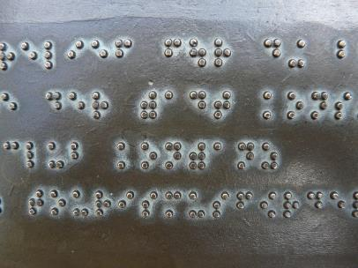
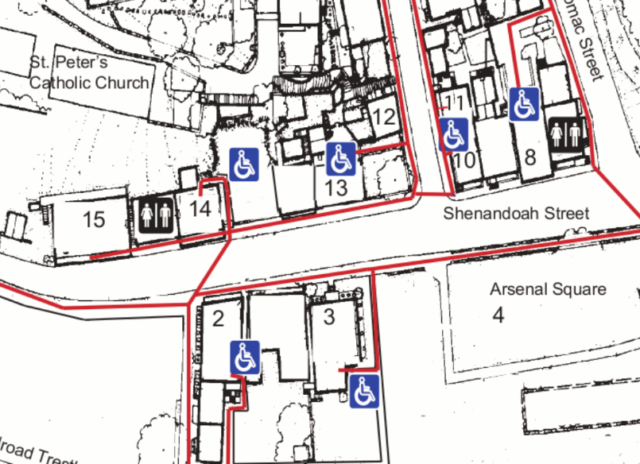
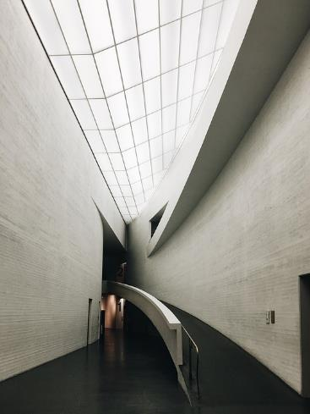
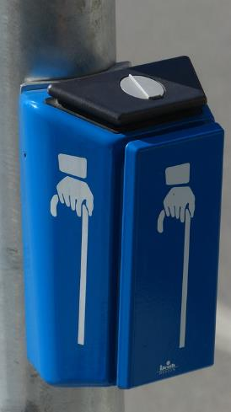
Library access
Accessibility
Access issues such as the width of doorways, angle of ramps etc will involve architects working alongside building service engineers. It is important to ensure that the designs conform to regulations for safety and security as well as meeting the needs of users.
Notes:
Images: public domain; http://maxpixel.freegreatpicture.com

Slide 15
Building services
Challenge 3: Alarm systems challenge

Slide 16
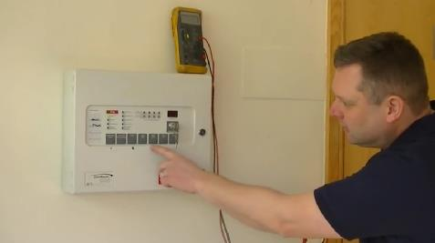
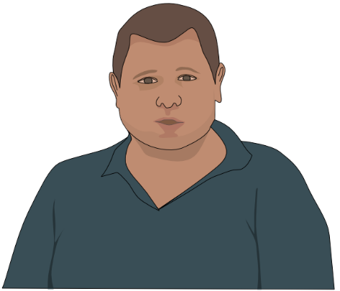
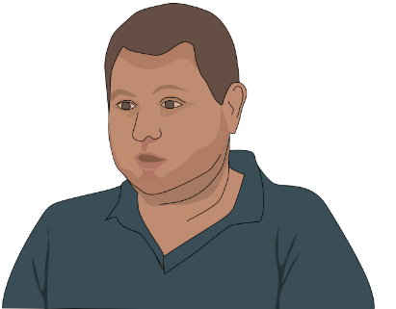
Hi, I’m Mark and I install alarm systems as part of my job. In this challenge you need to look at a range of options and choose the ones that suit the client best.
Think about…
A What are your client’s requirements?
B What are the choices you need to make when providing solutions?
C Is-cost a factor?
D Remember to check the client’s wishes to make sure you’re on track
Alarm Systems Engineer
I work mostly from home, getting details of the jobs I need to do electronically. Although I install alarms, CCTV cameras and systems and access control in a wide range of premises, I specialise in electronic article surveillance which is anti theft devices in shops.
There have been a great many changes in technology since I started work, with miniaturisation and wireless technology being the main ones.
In this project you have the opportunity to design at least two different solutions to make a business secure.
It is important to ensure the client’s needs are met and that they are happy with the solutions proposed.
Alarm systems challenge
A small business is worried about the risk of break-ins and having their documents stolen?
Their building has been secured with locks and bars, but they are looking at two alarm systems to make them feel safer. One will detect intruders and one will be triggered when the safe is moved or there’s an attempt to break into it.
Get a clear brief from the client so you know exactly what problems are to be addressed.
What are the options available to you?
Develop some ideas for solutions that you can present to the client and get their feedback.
Will you need to change the proposed solutions following feedback?
Tip:
Which switches will be best for the two needs of the business? Look at the different types of switch that are available and choose the best solution.

Slide 17
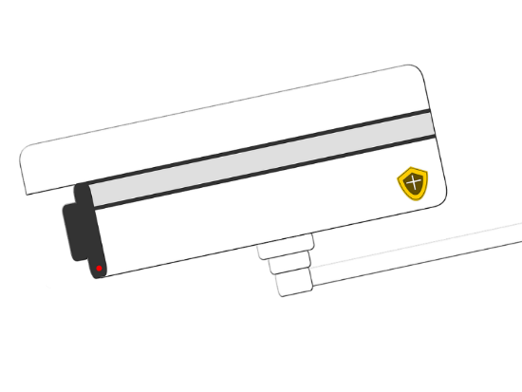
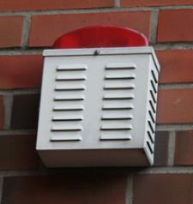
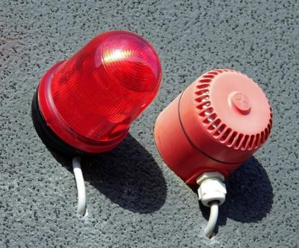
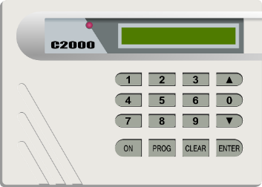
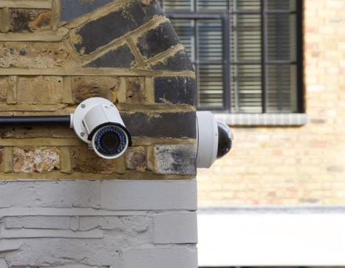
Alarm systems
Inspirations
Tip:
Can you use two different alarms to make sure any intruders are caught?
What about suggesting adding alarm systems for detecting fire or water ingress?
Notes:
Images: Public domain

Slide 18
Alarm systems – inputs
Which switch or sensor?
A Tilt Switch has a tube with electrical contacts at one end and a metal ball which slides down to the contacts when the switch is tilted to complete the circuit.
Proximity Switch
Has two parts: one part has wires connected to two strips of metal which are positioned close together but just apart. The second part is a magnet which, when brought close to the other part causes the two metal strips to come into contact and complete a circuit.
Micro switches can be set Open or Closed.
Normally Open (NO) means that the internal contacts inside the switch are held apart so the switch only completes the circuit when the lever is pressed.
The Light Sensor is made from material affected by light. When it is in the dark, it performs like a switch turned off. The sensor conducts electricity when lit up and behaves as a switch turned on.
Normally Closed (NC) means the contacts are held together, so the switch will connect the circuit when the lever or button is not pressed, and only breaks the circuit when the lever is pressed.
Notes:
Images:

Slide 19
Alarm systems – outputs
Take a pic, show off, make a noise…
Bulbs, LEDs and Sparkles
Can be programmed to flash on and off or remain on for a fixed period.
Cameras
Security cameras are commonplace and a good way of identifying an intruder.
Buzzers
Produce a loud sound when an electronic
signal passes through it.
Tip:
Your solution might also capture the intruder in a photo or video.
Smart technologies such as fingerprint and iris recognition will help keep people out in the first place!
Crumble controller
Simple to use microcontroller used to program circuits.
Notes:
Images: LEDs: Creative Commons: Afrank99

Slide 20
Alarm systems
Meeting standards
Alarm systems, whether they be for fire, water or security, must comply with regulations so the relevant consultants need to be consulted.
Schematics are drawn and can be tested using appropriate software to ensure everything is working before installation.
Notes:
Images: Bryden Wood Ltd

Slide 21
Building services
Challenge 4: A home for the elderly

Slide 22
Hi, I’m Alaa and I’m a design engineer. In this project you have to think about the needs of different people who might use the home. How might the services meet their needs?
Think about…
A The needs of residents and staff
B The internal and external facilities and environments
C Any access or special needs issues.
D How can you help the residents to feel safe and secure?
Design engineer
As a design engineer working in civil engineering I mainly work on design concepts. I also oversee the development of projects and their management.
I need to know about all the services that might be installed in a building to make it habitable and efficient.
To do my job well I need to have good problem-solving and communication skills and be able to make clear decisions when managing projects. I also need good technical knowledge to know how things work in different locations.
I work in an office mainly but do get to visit sites where the work is taking place. I work with the architects, contractors and building services engineers to make sure the ideas are possible and practical for users.
A home for the elderly
The local authority has asked for an assessment of plans for a home for the elderly.
They need to be sure that all stakeholders are catered for and that it provides a safe and secure environment for the residents.
Research the stakeholders and their requirements. These will include: staff, residents, visitors, medical professionals.
What particular needs might these stakeholders have?
What limitations are there: for example costs, building regulations and planning consent?
Summarise the needs of stakeholders and how you might meet these.
Draw up a plan showing how the facilities and spaces can be provided and used.
Tip:
This will be the residents’ home, so consider shared areas as well as private spaces.
What will the residents want in their home? What might the shared areas be used for?

Slide 23
Retirement home
Users’ needs
Complete the chart with each stakeholder’s needs
Stakeholder | Primary need | Other needs | Space(s) | Facilities | Security issues
Residents |  |  | Private room Shared space
Staff |  |  | Office Drugs storage | Kitchen equipment
Visitors |  |  | Car parking
Medical professionals
Emergency services
Tip:
Draw plans or make models of examples of the layout of the building to help you decide how each part works alongside others.
Remember to annotate with your ideas.
Notes:
Images:

Slide 24
Retirement home
Inspirations
Tip:
Think about the lighting, air quality, temperature and humidity and how these might be installed and controlled.
Notes:
Images: Public Domain

Slide 25
Retirement home
Inspirations
Hint:
What about including room for a pet for the residents?
Notes:
Images: Public Domain

Slide 26
Retirement home
Building information modelling
Building information modelling (BIM) allows designers and engineers working at all levels to assess how the overall scheme will appear and how their part will be installed and interact with other elements. It can tell the project engineers how much ducting or electrical wiring etc is required and how it will be installed in relation to other components.
Notes:
Images: Bryden Wood Ltd

Slide 27
Building services
Challenge 5: Conversion challenge

Slide 28
Hello, I’m Harry and I’m a building services consultant. Working on large sites involves many different people with different skills coming together, often in difficult circumstances.
Think about…
A Access to the site for services and contractors
B Meeting the client’s needs
C Keeping some of the features of the old church
D The costs of different options
Building services consultant
My main areas of work are with mechanical, electrical, plumbing and drainage systems and installations.
I work with clients to develop designs that meet their needs and with contractors and site engineers to make sure they are installed to the right standard to keep the client happy.
In this task there are many things to consider: the client’s requirements, access for contractors and services, security and safety, and meeting the needs of the community centre’s users. A detailed plan will be required to ensure it all fits together smoothly.
Conversion challenge
An old church is being converted into a community centre and needs a scheme for heating and lighting the building. It is down a rough track and currently has no services except an outside tap and some very old electrical lighting. The client wishes the services to be concealed as far as possible.
Assess the requirements of the community centre: what heating and lighting is likely to be required and for what purpose?
How are these services going to be installed? What will the contractors need to consider?
Draw and label some ideas of designs for concealing the services whilst allowing access for maintenance
What about security and ensuring the services are safe?
Tip:
As well as heat and light, think about air conditioning and controlling the humidity, and extraction systems for smoke.

Slide 29
Conversion challenge
Inspirations
Tip:
Remember the client’s brief is to keep the services concealed. Can you make these part of the structure or as decorative features?
Take a look around your school for examples of heating and ventilation systems and how they are concealed.
Notes:
Images: Bryden Wood Ltd; public domain

Slide 30
Conversion challenge
Inspirations – installing services
Notes:
Images: Elementa; Bridges Pound; Public Domain; Creative Commons© Copyright M J Richardson CC

Slide 31
Conversion challenge
Inspirations – heating and lighting
Notes:
Images: Elementa; Bridges Pound

Slide 32
Conversion challenge
Heating and lighting
Assessing which method of heating and lighting a building offers the best solution can depend upon a number of factors. These will include the performance for the building concerned, the ease of use and installation and the costs.
Options for concealed heating can include
Underfloor
Electric or water fed radiators
Air conditioning ducting
The control systems can be housed in a separate area.
Notes:
Images: Dmahalko; Bryden Wood Ltd

Slide 33
Conversion challenge
Planning drawings
Professionally drawn CAD drawings and building information modelling (BIM) systems contain all the information engineers and contractors need to complete a job to the appropriate standard. The drawings can be layered to show heating, air ducting, etc and can contain a great deal of detail.
In these drawings of a proposed shop fitting the air supply and extraction ducting is shown in different colours. Details of the sizes and specification of installed features is all included on the plans.
Notes:
Images:

