Slide 1
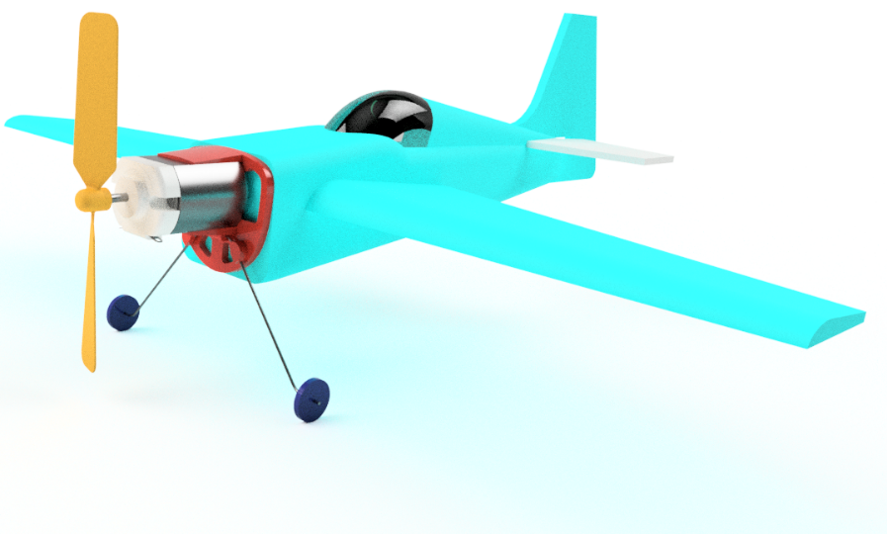
Pylon Flight
A STEM into Action resource from The Design and Technology Association.
Pupils will learn how aircraft fly and have the opportunity use digital design and manufacture tools to design, make and fly their own powered aircraft.
Notes:
Flight can be a challenging, technically rich and fun D&T activity. The principles of flight are well documented but need to be interpreted for students at an appropriate level when designing, making and testing designs for aircraft.
Paper, card and foam lend themselves to rapid design development and their low costs allow iterative testing and incremental improvement.
Success criteria can include time, distance, accuracy and load carrying capacity with no single ‘correct’ solution, allowing success on many different levels.
Risk assessment
As with any practical activity, it is important to perform risk assessments to ensure pupils are kept safe. In addition to hands-on modelling processes, flying even small paper dart aircraft presents additional dangers. During testing, model aircraft travel at high speeds and risk assessments should require eye protection and demand good behaviour at all times. Sample risk assessments are provided as an appendix in the project guide.

Slide 2
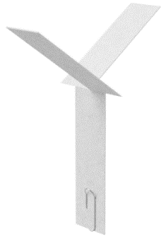
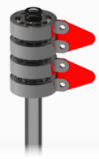
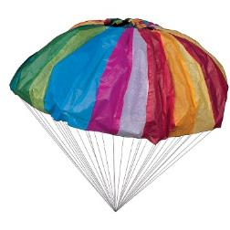
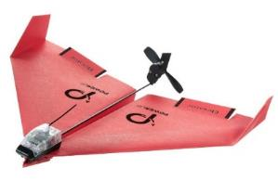
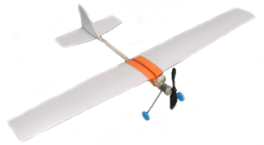
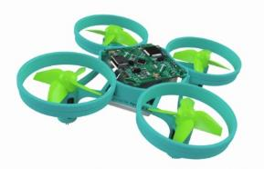
Flight – Overview
STEM
Falling seeds
Parachutes
Gliders
Free flight
Round the pole (RTP)
Control line
Remote control
Drones
Notes:
For many years flight has been used as a context for activities in schools with children of all ages.
Children regularly make paper helicopters in science based on the way sycamore seeds fly. Nature is an excellent reference for design activity and the results use the term biomimicry.
Parachutes control the descent of objects and younger pupils might create a parachute for teddy whilst older students could be tasked with modelling the delivery of aid supplies from low-flying aircraft.
The British Model Flying Association (BMFA) developed activities using tissue paper and balsa to make gliders and elastic band powered, free-flight designs. A number of low cost kits are available on the BMFA web site http://education.bmfa.org/products
Control line flying was very popular in the 1970s but getting glow-plug engines running was more art than science and all too often models were badly damaged or destroyed on their first flight!
Radio control flight provides a huge range of design opportunities but the high cost and complexity of the radio gear, servos and control systems prevent it being used with entire year groups. Cannibalising low cost toys is a useful source of control gear.
The delta paper aircraft at the bottom right is available on the web from a company called Powerup. A Bluetooth connection allows the model to be controlled from an ap on a mobile phone. These models operate at high speeds and are challenging to fly. https://www.poweruptoys.com/products/powerup-v3

Slide 3
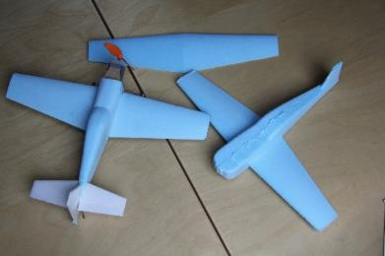
Pylon flight – Round the pole (RTP)
STEM
Edgecliff High School
Teachers Chris Jarman and David Eyre
Notes:
Flight projects have been used in schools for a very long time and pylon racing for many decades.
Most of the detailed planning and design for this challenge was developed by Chris Jarman and David Eyre whilst teaching at Edgecliff High School in Staffordshire, UK.
The video shows Chris on the left and David on the right.

Slide 4
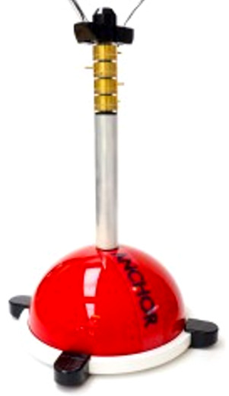
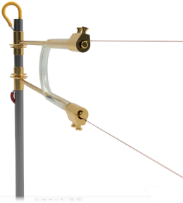
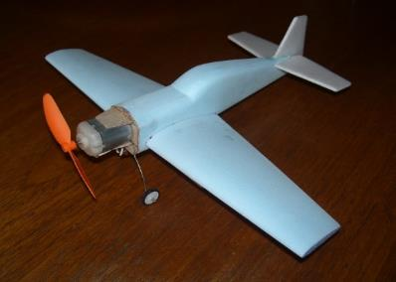
Pylon racing – Round the pole (RTP)
STEM
Pylon provides:
Power
Speed control
Trajectory
Aircraft
Low-cost
Fixed wing
Notes:
There are two key elements to this activity:
The central pylon which controls the circular flight path of the aircraft and provides power to the model.
The aircraft themselves which are tethered to the pylon by two very thin wires.

Slide 5
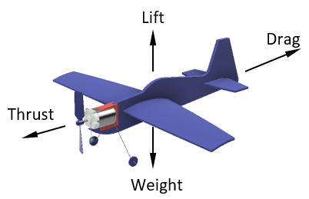
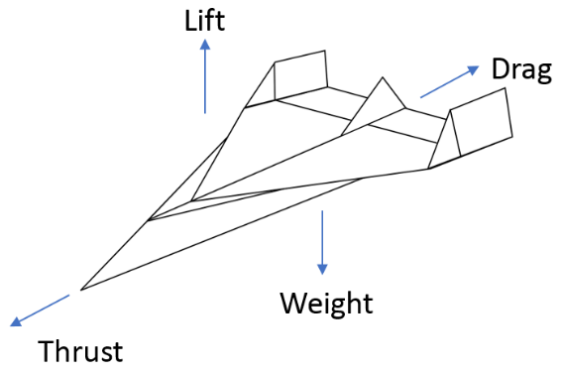
How planes fly – Four forces of flight
STEM
Forces acting on an aircraft
Shown with opposing force arrows
Notes:
The forces on an aircraft in flight are usually shown as here with lift opposing the weight of the aircraft and thrust opposing drag.
Lift/weight
Lift in a paper glider comes from air trapped air under the wings as the aircraft tries to descend.
The aerofoil section of more complex wings provides lift which opposes the weight of the aircraft.
Thrust/drag
For a paper glider, thrust is provided by a downward trajectory causing air to spill from the rear of the wings.
The motor/propeller combination in a powered aircraft provide the thrust to overcome drag.

Slide 6
Lift – Bernoulli effect
STEM
Air flowing over a sheet of paper
Air flowing over an aerofoil
LIFT
Blow over paper
Fast flow = lower pressure
Slow flow = higher pressure
Notes:
Daniel Bernoulli was the first scientist to explain how an increase in airflow will result in a decrease in air pressure.
This can easily be shown by holding a sheet of paper with the edge horizontal in front of your mouth. Blow over the top of the paper and the paper will rise in front of you.
Applied to an aerofoil shape wing, air flowing over the top surface of the wing has further to go so speeds up reducing the pressure over the top of the wing and causing a lifting force.

Slide 7
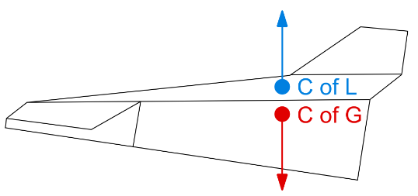
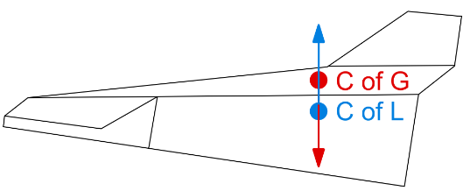
Longitudinal stability
STEM
Stable
Centre of lift above centre of gravity
Unstable
Centre of lift below centre of gravity
Notes:
Looking from the side, an aircraft will be naturally stable in pitch if the centre of lift is located above the centre of gravity.
If the centre of lift is located below the centre of gravity the aircraft will be naturally unstable in pitch.

Slide 8
Angle of attack
STEM
Controls the flight path and distance travelled
Large A of A
Stall and crash
Medium A of A
Long shallow flight
Small A of A
Rapid, short flight
Notes:
Angle of attack refers to the angle the wind hits the wings as the aircraft moves through the air.
The initial angle of attack for a thrown paper airplane is determined by the angle the dart is held as it is released.
In flight the angle of attack is controlled by the elevators at the rear of the aircraft.
Too large an angle of attack will cause the aircraft to climb steeply and stall before crashing.
Too small an angle of attack and the aircraft will dive steeply, and not travel very far.
At a shallow angle of attack and the aircraft will glide a long way.
The optimum angle of attack for any aircraft is just below the angle it stalls at.

Slide 9
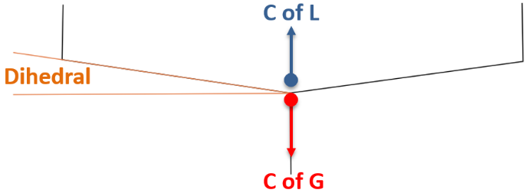
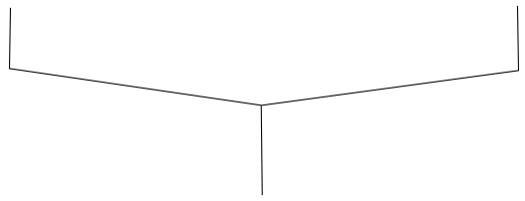
Lateral stability
STEM
Stable
C of G below the C of L
When the model rolls…
Dihedral provides more lift on lower wing returning the model to level flight.
Less lift
More lift
Turning force
rolling wings level
Notes:
Looking from the front of the aircraft the wings are higher at the tips – this is called dihedral.
With the C of G below the C of L the aircraft is naturally stable in roll.
As the aircraft rolls the lower wing provides more lift than the higher wing.
The difference in lift causes a turning force which rolls the wings level.

Slide 10
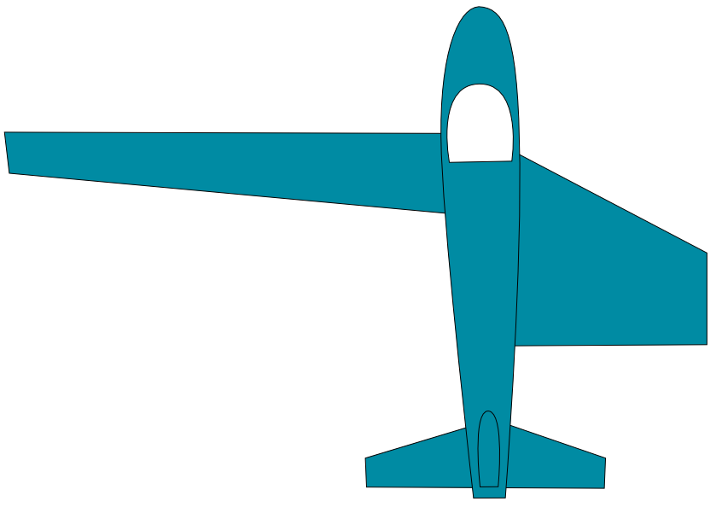
Aspect ratio
STEM
Ratio of wing length to width
Low aspect ratio
Low drag – High speed flight
High aspect ratio
High drag – Low speed flight
2:1
Low aspect ratio
20:1
High aspect ratio
Notes:
Aspect ratio describes the relationship between the wing length and wing width.
Short, stubby wings like those seen on fighter aircraft have a low aspect ratio with low lift and low drag and are suitable for high speed flight.
Long thin wings like those seen on gliders have a high aspect ratio with high lift and drag and are ideal for low speed flight.

Slide 11
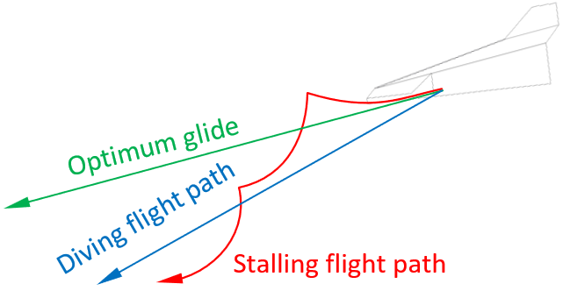
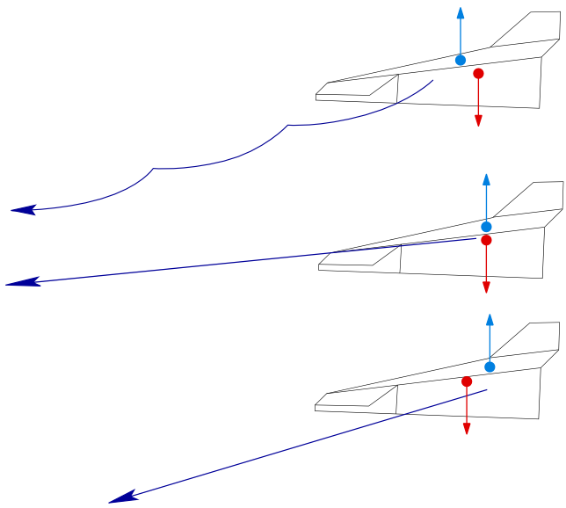
Control
Glidepath
Stall
Dive
Glide
Stalling flight path
Optimum glide
Diving flight path
Notes:
We have already described typical flight paths for gliders depending on the location of C of L and C of G and the angle of attack.
For pylon flight, aircraft should be trimmed for level flight at around half power with a small amount of up elevator. The up elevator allows the trajectory to be altered using different power settings.

Slide 12
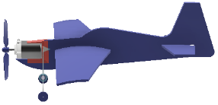
Control
Power settings
Low power – descending
High power – climbing
High power = climbing
low power = descending
Notes:
A higher power setting will increase airflow over the tail and elevators causing the aircraft to climb.
A lower power setting will decrease airflow over the tail and elevators causing the aircraft to descend.

Slide 13
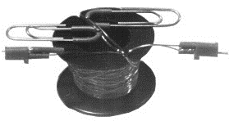
Flying wires
Insulated
Thin
Light
RTP Hut – Reel of flying wire
Notes:
Reducing the affect flying wires have on the aircraft model is important and so they need to be as thin and light as possible. For these reasons, single strand 0.36 mm (28 SWG) copper wire with a PVA coating is suitable for the flying wires.
RTP Hut web site specialises in supplies for pylon flight. www.thertphut.co.uk

Slide 14
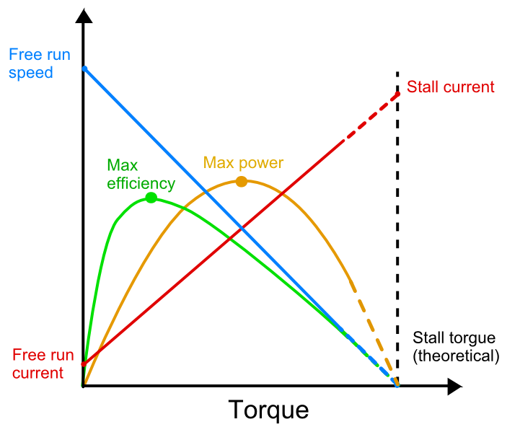
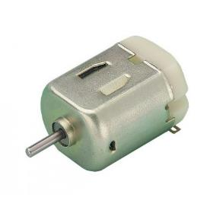
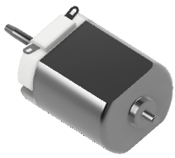
Motors
STEM
Small DC motors
Inexpensive
Efficient at high RPM
Low torque
Notes:
The diagram is adapted from the supplier of the motors listed in the spreadsheet – STEM into Action – Pylon flight – Parts list.xlsx
Low-cost DC motors like the ones used here are built with large tolerances and individual motors will perform differently.
For optimum performance aim to have the motor running in the region between maximum efficiency and maximum power.
A more detailed study of motor/propeller matching can be found here: http://rcadvisor.com/simplified-motor-propeller-selection-method

Slide 15
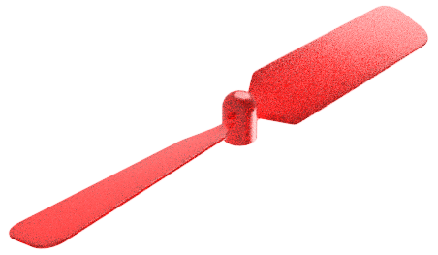
Propellers
STEM
Matching prop to motor
Aim for motor RPM between max efficiency and max power.
WARNING!
Avoid 3D printed props – If the layers don’t bond properly, blades can separate at very high speed.
Notes:
The propellers sourced for this activity were supplied by Hobby King, one of the largest suppliers of parts and kits for aeromodelling. They are deliberately too long for the standard design to cater for a variety of designs.
Propellers are specified according to the diameter and distance travelled through the air for one rotation.
Matching propellers to motors involves complex geometry and mathematics beyond most school students but an alternative approach is to measure the power being used by the motor and swapping propellers until the motor is operating in the region between maximum efficiency and maximum power.
For the aircraft design in this guide the propeller tips should be shortened by the same amount (10mm) at both ends. Cuts must be equal to ensure the propeller is balanced and does not vibrate.

Slide 16
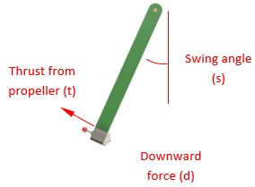
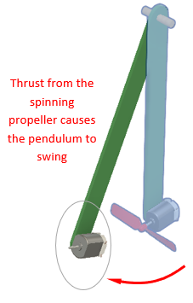
Testing – Propeller thrust
Motor/propeller mounted on a pendulum
Power up the motor
Allow the pendulum to settle
Measure the angle
Calculate thrust

Slide 17
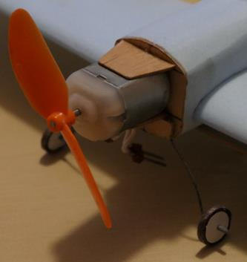
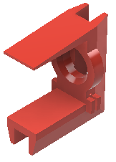
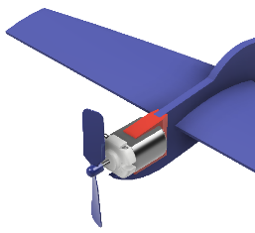
Motor/undercarriage mount
STEM
Fabricated motor mount
3D printed motor mount
Notes:
On the left is a motor mount for a 3D foam model fabricated from 1mm plywood.
On the right is a motor mount for a 2D foam model designed for 3D printing.

Slide 18
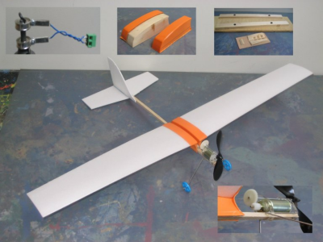
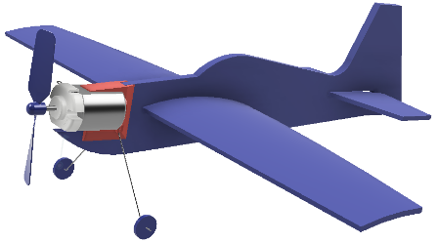
2D profiles
STEM
Slot together construction
Depron
Curved profiles
Notes:
Depron sheet is used extensively in model aircraft due to its high strength to weight ratio and smooth surfaces.
Depron sheet is easily cut with a sharp modelling knife and can be sanded.
Slots allow sheet to be assembled at right angles
Curved slots create curved profiles that are ideal for wings
The model in the photograph is a free-flight aircraft with vacuum formed wing roots that curve the wings.
The motor drive is unusual with a pair of gears and an axle. Under power, thrust from the propeller keeps the gears engaged. When the batteries run down, the propeller stops turning and drag on the propeller pushes the gears out of mesh allowing the propeller to windmill. This reduces drag during the glide back to a landing.

Slide 19
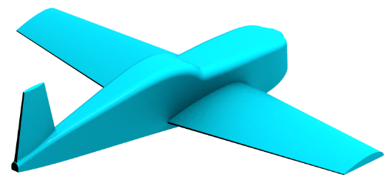
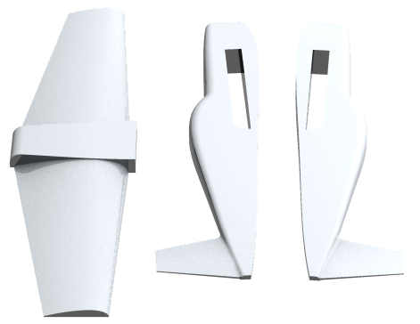
Digital design
STEM
Precise geometry
Mirrored parts
Editable
Wind tunnel analysis (CFD)
Repeatable parts using CNC
Assembly simulation
Manufacture
Notes:
Advantages of digital design, many of which are described and/or demonstrated in this session.

Slide 20
Sharing F360 files for this project
STEM
 Share a public link – data protection
 Invite another into a Fusion 360 project – data protection
 Share an archive file - http://myhub.autodesk360.com
Copy folder from the USB memory cards
or
Download from: https://1drv.ms/f/s!Av9FFm7Ll5GbgYt_Ed9Wruo1sDqDCw
Archiving F360 designs
Notes:
Methods for sharing F360 models – There are three methods of sharing F360 models.
The first two require email addresses of the people you wish to share files with. Data protection rules prevented delegates email addresses from being shared with presenters so we have used the third method using archive files.
Creating an archive file – F360 models are stored in the cloud.
In-product export
With the model open in F360, open the File menu and select Export
In the Type drop-down menu select *.f3z and then click Save.
If the Export option is not be available in the File drop-down menu try the Dashboard method
Dashboard export
Open your dashboard using the link: http://myhub.autodesk360.com
From within the Dashboard, hover over the design you would like to export and select Export.
Select the Archive File format. Note an F3Z or F3D file extension will be selected based upon whether or not this is a distributed design containing X-Ref's.
A notification will be sent to your e-mail with a link to download the archive file once it has been translated in the cloud services.
Share the archive file with others.
A copy of this presentation, the Excel parts lists and Fusion 360 CAD archive models for this activity can be copied from the USB memory cards circulating in the room or by downloading using the link on this page.

Slide 21
Fuselage – Introduction
STEM
Geometric shapes
Extrude
Rounds
Loft
Sweep
Notes:
The final shape will determine which modelling tools and strategies will be needed.
There are no short cuts in developing these skills. Experience is the key!

Slide 22
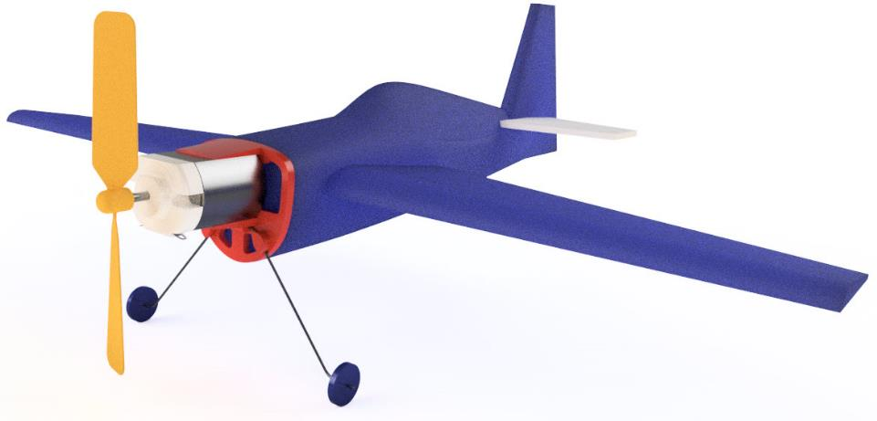
Fuselage – Sculpt
STEM
Complex curves
Sculpt T-spline
Notes:
The final shape will determine which modelling tools and strategies will be needed.
There are no short cuts in developing these skills. Experience is the key!

Slide 23
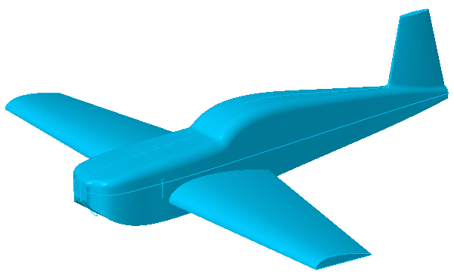
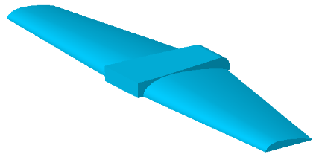
Wing sections
STEM
3D modelling aerofoils
Published profiles (NACA)
Sketching profiles
Importing profiles
Extrude
Loft
Sweep
Notes:
This will be a hands-on session exploring CAD models that use some of the modelling techniques listed here.

Slide 24
Wing sections – Published profiles
STEM
Clark Y
NACA
2412
12 % ratio thickness and chord
4 Maximum camber = 0.4 of the chord length from the leading edge.
2 Maximum % for camber = 2%
http://airfoiltools.com/
Notes:
A great deal of research on aerofoil sections exists and much of the information is freely available on the internet.
Invented in 1922 by Virginius E Clark, the Clark Y aerofoil is one of the most commonly used wing sections for low to medium speed flight.
Early in the 20th Century the US government sponsored aerodynamic research including aerofoils and the results were published by the National Advisory Committee on Aeronautics (NACA). NACA profiles have been used extensively in civilian, military and model aircraft. NACA developed a mathematical method of plotting wing shapes based on key parameters. The illustration is the NACA 2412 shape in their four digit series where the digits stand for:
2412
12 Percent ratio between thickness and chord.
4 Location of maximum camber – 0.4 of the chord length from the leading edge.
2 Maximum value for camber = 2%
Profile created using Airfoil Tools – http://airfoiltools.com/
The tables produced by third party software may need to be formatted to work with F360. This is explained in the next slide.

Slide 25
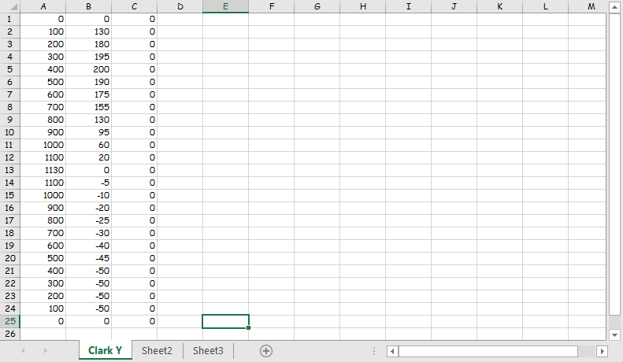
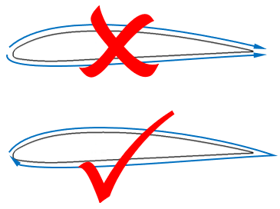
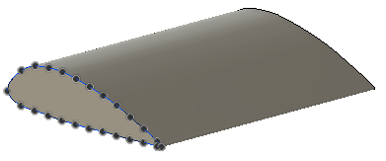
Wing profiles – F360
STEM
Single series of coordinates
Online tools create two sets of coordinates
New F360 model
Add-ins > Scripts and Add-ins
ImportSplineCSV > select file Clark Y.csv
A sketch is created with spline through points.
Create a solid (extrude) from the spline.
Notes:
Data from the web
It is important to check the coordinates you get from the web. You should glance down the numbers to check they ‘make sense’. F360 expects to start in one location and increment around to finish adjacent to the starting point.
Some online aerofoil generators draw the top surface outline first and then the bottom outline both starting at the front and finishing at the trailing edge, effectively drawing two separate splines. If this is the case with your coordinates you will need to reverse one set of numbers.

Slide 26
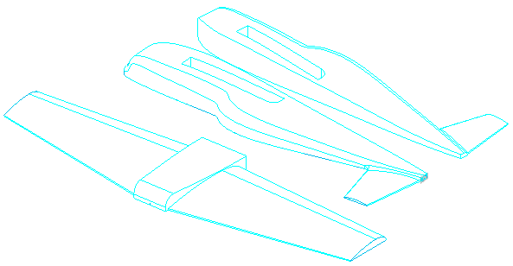
Digital manufacture
STEM
Create ‘flat’ assembly
Export
Import STL file
Post process
Foam block
Define tooling
Choose machining cycles
Simulate machining
Machine foam
Assemble
Test
Notes:
Your post processing software may let you nest multiple components in the workspace.
If not, you can assemble the parts on to a base plane in your CAD software and export the nested parts as an STL.

Slide 27
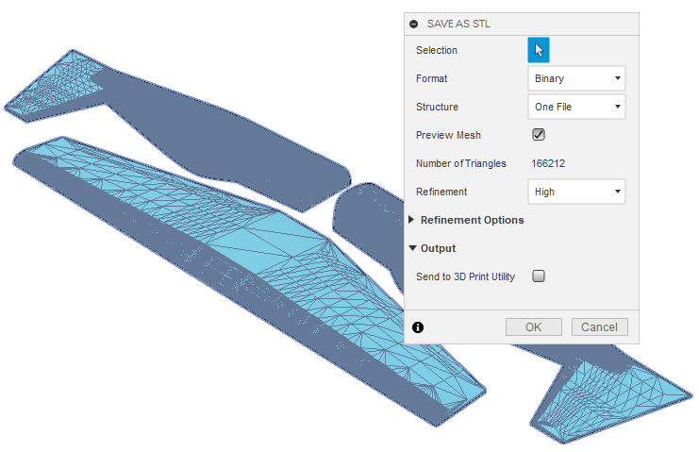
Exporting STL
STEM
STL export varies across CAD software
Specify the quality of the STL file
Smaller facets result in a smoother machined part
Notes:
F360
In the model tree, RMB over the assembly name and click Save As STL.
In the dialog select the options shown here on the right.
Notice the mesh of triangles is previewed on the model.
Click OK.
Navigate to the folder where you want the file and click Save.

Slide 28
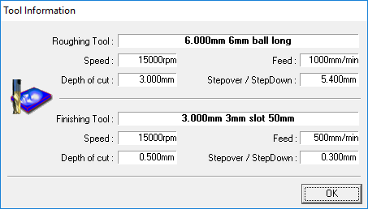
Tooling and offsets
STEM
Tool type
Diameter
Length/flute length
Feed
Depth of cut
Stepover/down
Notes:
Tooling is normally defined in the software that comes with the machine tool. In this case a 3-axis mill or router.
Tooling information should be linked to material so that feed rates, depth of cut, etc. will vary according to the properties of the material being cut.
Common types of tool include: end mill, slot drill and ball nose cutters. Schools may be using cutters made from High Speed Steel or ones with carbide cutting edges. Larger cutters may be fitted with inserts which a supplied in a range of materials.
Each tool should have a cutter and flute length defined which dictate the maximum depth of cut.

Slide 29
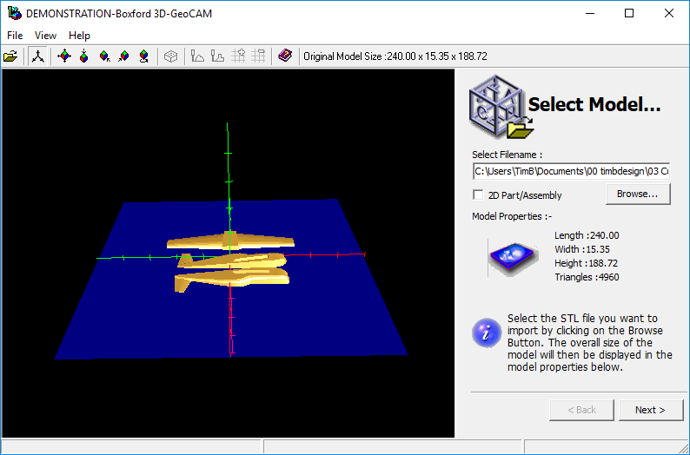
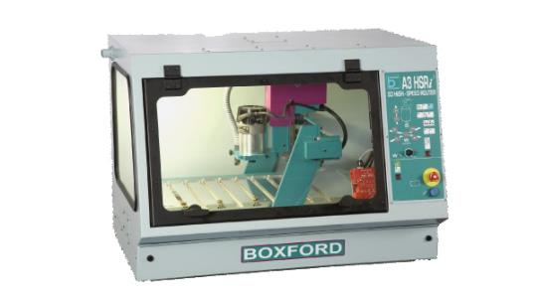
Post processing – Import STL
STEM
Boxford 3D GeoCAM
Notes:
Postprocessing software ‘3D GeoCAM’ from UK based company Boxford is used in the next sequence of slides to illustrate the process of taking a 3D model through to a machined component.
The stereolithography (STL) file exported from the CAD program is opened in the post processing (PP) software.
The modelled shapes will be visible in the PP software.
The side panel lists overall dimensions for the part to be machined. This will be used later to define the size of block or ‘billet’ of material to be cut.
Boxford manufacture their own machine tools and supply all over the world. 3D GeoCAM was designed specifically for schools and uses a ‘wizard’ approach presenting students with a series of screens which structure the process with prompts and descriptions at every step to help students make informed choices.

Slide 30
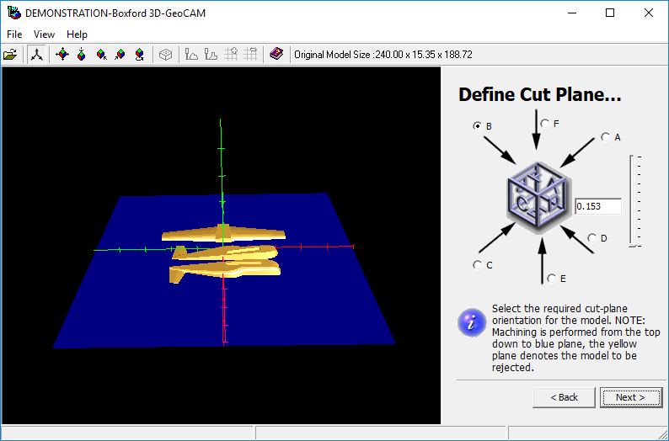
Post processing – Cut direction
STEM
Cutting direction
Cut plane
Notes:
On this screen you select the direction in which cutting will occur.
In this example option ‘B’ was selected. Machining occurs down to the blue side of the plane. Anything on the yellow side of the plane will not be machined.
By default the plane cuts through the centre of the parts to be machined. The slider must be dragged fully down to ensure all surfaces are machined.

Slide 31
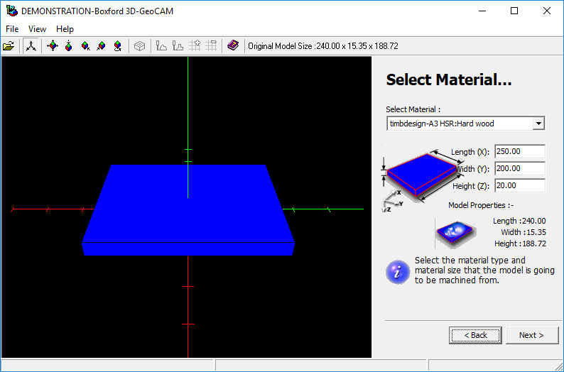
Post processing – Material/billet
STEM
Material
Cutting parameters
Billet size
Larger than shape to cut
Notes:
This screen allows the material to be selected. In the background this sets the cutter speeds and feed rates.
The billet size in this example is typed in and must be larger than the model by at least the largest cutter diameter.

Slide 32
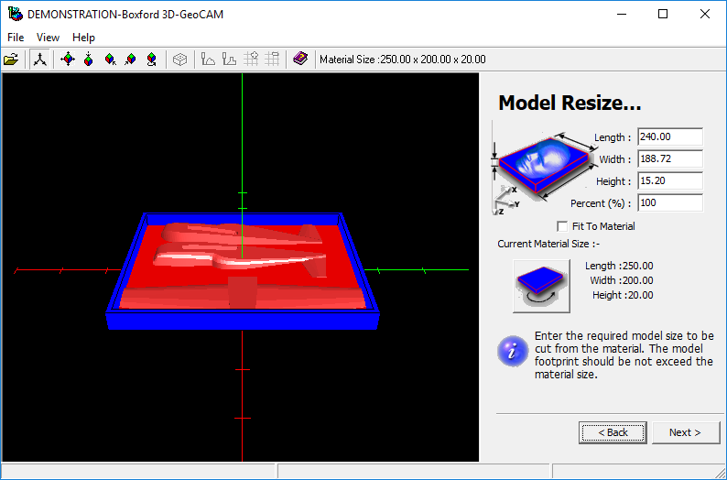
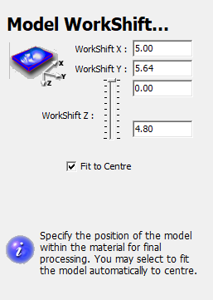
Post processing – Model resize
STEM
Full size - 100%
Model Work shift
Notes:
The model was designed full size so:
Make sure the Percent (%) value is set to 100.
The next screen shows work shift which moves the model up and down in the block of material. For our model drag the slider to the top. For parts with flat surfaces on top, dragging the slider down ensures the top of the model is machined.

Slide 33
Post processing – Tooling – Allowances
STEM
Select tooling
Roughing
Finishing
Allowances
Material depth for finishing
Notes:
In the ‘Select tooling’ screen, the top two fields display the tools that were defined in the tool library.
Choose a roughing tool. In this example a 6mm diameter ball nosed long shank cutter is selected.
Choose a smoothing tool. In this example a 3mm dimeter slot drill with shank length of 50mm is selected.
Roughing (%) defines how far the tool moves between cuts. In this example 90% of the tool diameter.
Finishing (%) defines how far the tool moves between cuts when finishing. In this example 10% of the tool diameter.
The Allowances screen specifies how much material is left between successive cutter paths. In this case 1mm after roughing before finishing. Only one finishing cut is planned so no finishing allowance is needed hence the zero value.

Slide 34
Post processing – Footprint control
STEM
Border allowance
Adjust (dist)
Zero
Rough entire material
Notes:
Footprint control specifies the amount of material around the outside of the model.
Allowance was made for this in the billet size so the adjust size can be left at zero.
Select ‘Rough Entire Material’ to remove any un-machined edges.

Slide 35
Post processing – Roughing/finishing
STEM
Roughing
Large diameter cutter
Fast material removal
Finishing
Small diameter cutter
Fine detail
Notes:
The PP software contains a number of pre-programmed cutting sequences and in this screen you can select which one will be followed.
Roughing
Select ‘Compute Roughing Cycle’. This is important as not selecting a roughing cycle will allow the fragile finishing cutter to plunge through a large amount of material, most likely breaking the tool!
Choose ‘Offset Waterline Milling’. The Boxford Help text includes which setting is suitable for different shapes.
‘Compute Rest Roughing Cycle’ will create a smoother finish but take longer to compute and machine.
Finishing
Select ‘Compute Finishing Cycle’.
Select ‘Compute Base Finishing Cycle’. This machines the lowest Z axis of the model.
Select one of the finishing strategies. For beginners the combination milling option will produce good results. Some of the other strategies will complete in a shorter time but at the expense of surface finish which may not be a problem if the surface is going to be sanded.
‘Compute Rest Finishing Cycle’ will create a smoother finish but take longer to compute and machine.

Slide 36
Post processing – Generate tool paths
STEM
Compute
Simulate
Notes:
This is where a lot of complex mathematics is done converting all of the settings into a series of tool movements that follow the shape of the CAD model.
Click on ‘Compute’. Depending on the speed of your computer, this could take some time…

Slide 37
Post processing – Simulate
STEM
Simulation controls
Started, stopped and stepped through
Displays
Estimated time
Collisions!
Notes:
Once the toolpaths have finishing calculating, click on ‘Simulate’ and the ‘Play’ buttons to see a simulation of the cutting process.
When the simulation is stopped or finishes the current cycle time up to this point of the program is displayed and the model window will display an accurate representation of the resulting shapes and surface finish. Also displayed will be the total number of any Tool Collisions up to this point of the program (see 'Very Important Warning' note below).
VERY IMPORTANT WARNING – A Tool Collision occurs when the shank of a cutter (the section of cutter above the cutting flute) collides with the material. This can usually be seen on the verification animation as an area marked in purple. If tool collisions have occurred during the full verification of a program, YOU MUST either; a) select tooling with a flute length sufficient to avoid collisions or b) modify your original CAD model so it can be manufactured with the available tooling. Failure to follow this advice could result in tool breakage and/or machine tool damage.

Slide 38
Post processing – Export machine file
STEM
Computer Numerical Control (CNC)
File format
G&M code
Notes:
The machine instructions should now be saved in the correct format for importing into your mill/router.

Slide 39
CNC machining
STEM
3 axis router/mill
Sharp high speed steel cutter
Fast feeds
Notes:
CNC machine tools usually come with their own control software.
Import the G&M code from the post process into the machine tool control software.
If the control software allows, run a simulation to check for errors and most importantly tool collisions.
Confirm tooling, any tool changes and install the first tool to be used.
Fix the material to the bid with any sacrificial material if needed.
Set/check the x,y,z datums to the material.
Run the machine cycles. On manual tool change machines, change the tools when prompted.
The video shows a set of aircraft parts being machined.

Slide 40
Assembly and finishing
STEM
Adhesives
Solvent free – foam friendly
Finishing
Light sanding
Sealer
Paint
Notes:
Assembly and finishing uses the same procedures, techniques and safety considerations as those used for foam modelling in product design.

Slide 41
Gliding flight
Ailerons
STEM
Rudder
Trim for the glide when hand launched
Slight up elevator
Large space – no wind!
Indoors
No obstructions
Small adjustments then re-test
Aim for long, straight, shallow glide
Elevators
Notes:
Ideally the model will perform a long, gentle glide with control surfaces in the neutral positions. This is the most aerodynamic state with least drag.
The following list describes the flight path and changes needed to achieve a long, straight, shallow flight. Adjustments should be very small and retested between each change.
Model dives – bend elevators upwards.
Model stalls – bend elevators downwards.
Model turns to the left – bend right aileron up and left aileron down.
Model turns to the right – bend the right aileron down and left aileron up.
Once a long, straight, shallow flight is achieved move on to powered flights can begin.
If there is an opportunity to redesign the aircraft, the centre of gravity or centre of lift can be moved to remove the need for offset control surfaces.

Slide 42
Safety rules
STEM
Power supply unplugged when changing aircraft
Only one person inside the flying circle changing aircraft
Safety goggles
Spectators behind taped off area away from flying circle
Pilots with clear view of entire flying circle
Pilots next to PSU and back from flying circle
Notes:
Powered flight is the culmination of this exciting design – make – fly challenge but needs to be carefully managed to keep students safe and avoid damage to the tower, wire tethers and aircraft.
Flight rules
Power supply turned off and unplugged when changing aircraft.
Walk the model around the circuit to check clearance.
Only one person inside the flying circle when changing aircraft.
All participants should wear safety goggles or safety glasses.
Spectators in a taped off area set back from the flying circle.
Pilots will need to stand or sit next to the power supplies, which should be set back from the flying circle.

Slide 43
Powered flight
STEM
Power supply > pylon
Flying line length
Plug-in Molex
Thread flying wires through tether
Ground handling
Power settings
http://www.thertphut.co.uk
Notes:
Flying lines should be shortish (2-3m) with beginners to make wire management easier.
Aerobatic flight should only be attempted when experienced with flight characteristics of a range of models, stable flight and height changing on demand.
For aerobatic flying, lines will need to be five metres or longer.
Flying lines are connected to the aircraft through notches for tension and with small Molex electrical connectors.
Guide to trimming aircraft for flight
High/full power may be required to get the model rolling for take off.
Reduce power to prevent steep climb.
Models turn into circle – move attachment backwards.
Turns away from circle – move attachment forwards.
Trim with some up elevator may be needed for stable take-off and flight.

Slide 44
Simulation – CFD
Airflow over the wing
Angle of attack
Pressure difference above/below
Centre of pressure
Lift force
Must exceed aircraft mass/weight
Flight on another planet?
Notes:
Computer simulation is a very wide field covering; structural, thermal, flow, electrical, etc. In the context of flight, airflow simulation will help evaluate designs and inform improvements prior to expensive manufacture and time-consuming physical testing.
Flow Design
Computational fluid dynamics or CFD is the accepted engineering term for Fluid flow simulation.
Autodesk CFD software Flow Design is shown on the right. A video introduction to Flow Design can be seen here.

Slide 45
Simulation – CFD
Airflow over the fuselage
Areas of turbulence
Drag coefficient
Thrust from the motor must exceed the drag force resisting movement.
Notes:
The fuselage is another opportunity for optimising a design and can benefit from CFD analysis. The following feedback would be helpful in optimising the shape of the fuselage.
Areas of turbulence
Drag coefficient
Thrust from the motor must exceed the drag force resisting movement.

Slide 46
Suppliers, parts list and costings
STEM
Pylon flight – parts list.xlsx
Parts
Suppliers
Part numbers
Costings
Notes:
An Excel spreadsheet is supplied listing suppliers, part numbers and costings.
Pylon flight – Parts list.xlsx
Prices were correct on 13th December 2018.

Slide 47
Aircraft examples
STEM
Notes:
Chris Jarman and David Eyre first developed this project while teaching at Edgecliff High School in Staffordshire, UK. The models shown here were designed and built by them and their students.

Slide 48
Pylon – light weight
STEM
Notes:
The pylon shown here is a lightweight design suitable for small aircraft.
A detailed description of this lightweight pylon design can be found in the guide for this challenge.

Slide 49
Pylon – medium weight
STEM
Notes:
The pylon shown here is a heavy weight version of the previous design. The solid steel upright requires some machining to accommodate the power wires.

Slide 50
Motor – Propeller
STEM
Single
Twin
Direct
Geared
Disengage
Multi-engine
Notes:
The simplest arrangement has the propeller pressed onto the motor spindle.
Scale modelling often requires a larger, slower rotating propeller. Moving the propeller to a geared axle achieves this. This arrangement has the added benefit of lowering the motor.
The arrangement on the right in the picture allows the propeller spindle to float along it’s axis. This disengages the gear and allows the propeller to ‘windmill’ after the batteries are depleted when gliding back to earth.
Where more power is required, two low-cost motors can be linked with gears.

Slide 51
Pylon racing – design challenges
STEM
High/Low speed
Speed differential
Weight lifting
Power/distance
Chase – tissue tails
Aerobatics
Image: MER-C/Wikimedia Commons
Notes:
The home of unlimited air racing is Reno, Nevada, USA. The photo shows an aircraft turning at one of the Reno pylons.
A range of challenges is possible with pylon models.

Slide 52
Pylon flight web links
STEM
RTP Hut – Models, aircraft kits, towers and consumables
http://www.thertphut.co.uk/
Australian site with plans (SAE) for pylon flight aircraft models
http://www.southcom.com.au/~rtpelectrix/
Australian site with simple instructions for getting started
http://www.ctie.monash.edu.au/hargrave/mccarthy_rtp.html
YouTube video of pylon flight in a classroom
https://www.youtube.com/watch?v=LaAhHLFerRc
Notes:
Links to further information suppliers and videos of pylon flying.

Slide 53
Other flying challenges for schools
STEM
Airgineers – STEM drone challenge for students age 11-18
https://www.airgineers.co.uk/
BMFA – Payload Challenge
http://payloadchallenge.bmfa.org/
Flying Start Challenge
http://www.flyingstartchallenge.co.uk
Notes:
Airgineers is a STEM challenge where students design, build and fly drones. Launched in 2018 in the UK, the challenge is expanding into new regions around the world.
British Model Flying Association (BMFA) – Provide support for schools undertaking flying challenges in schools and run an annual competition called the ‘Payload Challenge’.
Flying Start Challenge – Aerospace companies set an annual, glider based challenge for local UK schools.

Slide 54
Pylon Flight
A STEM into Action resource from the Design and Technology Association

