Slide 1


Slide 2

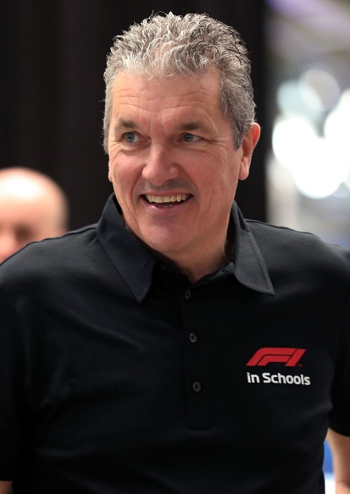

BACKGROUND
Launched in the UK in 1999 in 8 schools and now operates in over 26,000 schools across 51 countries worldwide.
Acclaimed as the world’s biggest and most exciting STEM-based educational Project.
Deliver the Challenge across a vast network of education establishments, ranging from township schools in South Africa, favela schools in Brazil, to inner city schools and independent schools, including international schools, right across the globe.
Andrew Denford
Founder & Chairman, F1 in Schools

Slide 3
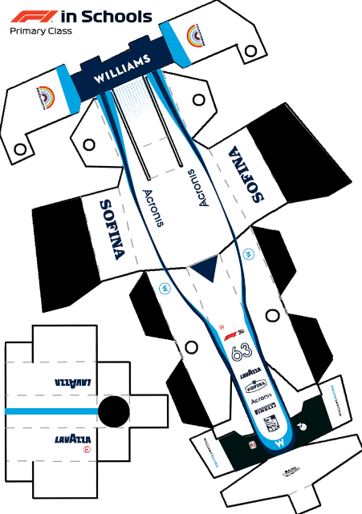
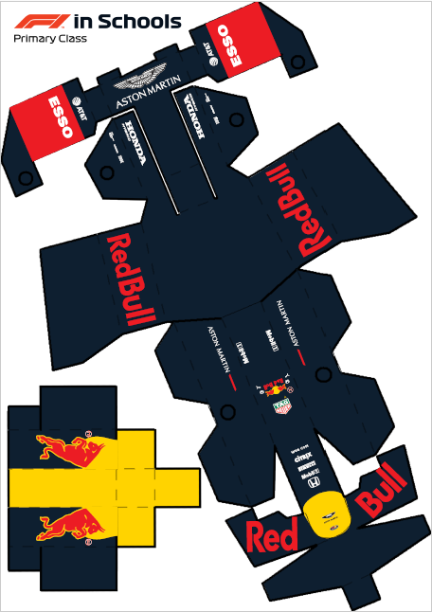
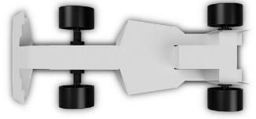
NEW F1 PRIMARY CLASS
2020 launch of “in-classroom” PRIMARY CLASS for 9-11 year olds
The cross-curricular project includes resources, lessons plans and
project materials
Students Design – Make – Test and Race a paper model car, powered by a 4 gm compressed gas cylinder over 20 metres

Slide 4

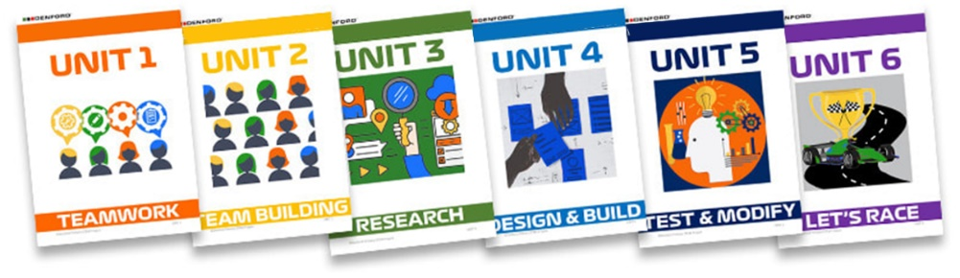
It all starts in the classroom with
The Denford Primary STEM Project provides the ideal starting point for your entry into F1 in Schools. To find out more, click here.
From Design to Creative Writing, this cross-curricular project is delivered using six purpose-written units of work, broken into individual lessons with teaching notes and lesson plans. Research, design, make, assemble and test your car before entering your teams into the F1 in Schools Primary Class competition.
Deliver the project as part of your curriculum, create a teamwork activity for transition days, or inspire pupils with an extra-curricular STEM project.

Slide 5
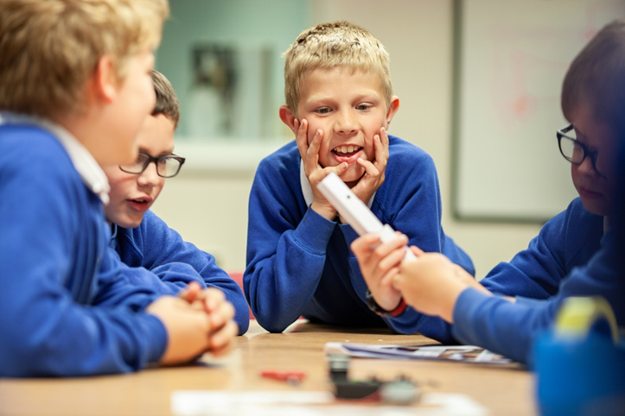
What is it about?
Apply real life skills in the classroom.
Design, make, test a model car and then race their finished models on
a 10 metre track.

Slide 6
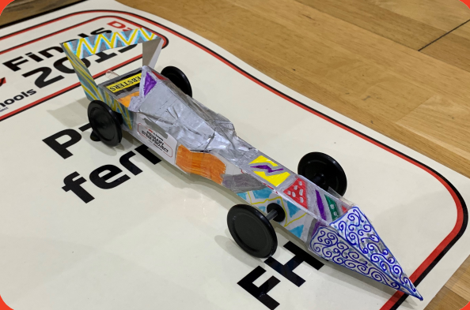
DESIGN
During the design process students must consider:
How forces will impact the car’s performance
How they want to style the car
What design features will help their car go faster
What might cause the car to go slower
Relevant sciences such as air resistance, gravity and air pressure
How to develop ideas through sketching

Slide 7
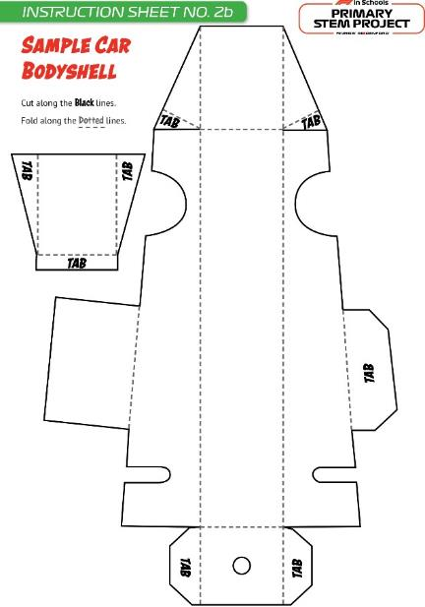
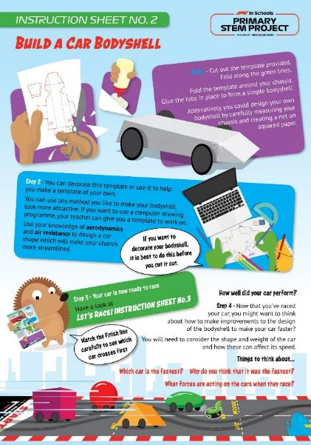

BUILD
Body
Following research, students will design, make and decorate a body to create their own miniature racing car.

Slide 8
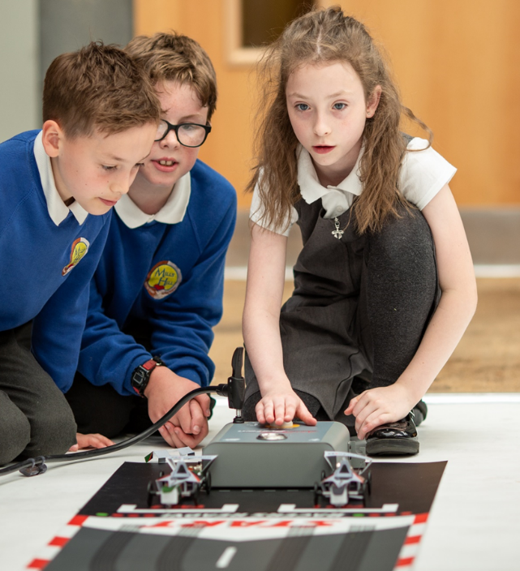
RACE
The EXCITING final stage of the project, where students get to see how their ideas shape up against others.
It’s not just about winning, but about:
Seeing ideas & designs come to life
Developing sportsmanship
How they can improve next time

Slide 9
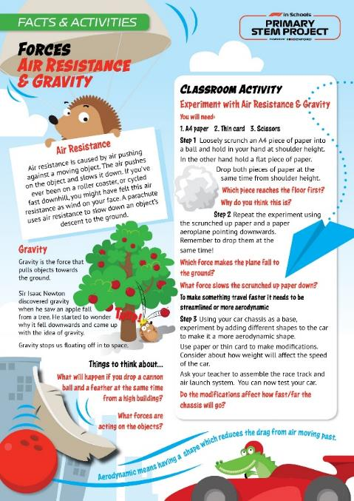
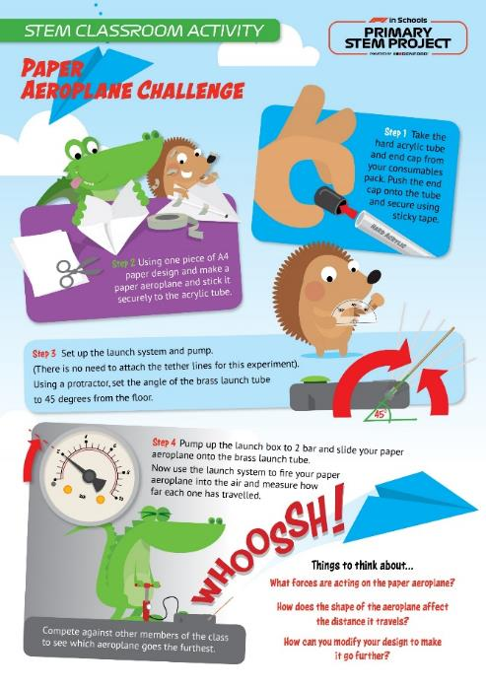
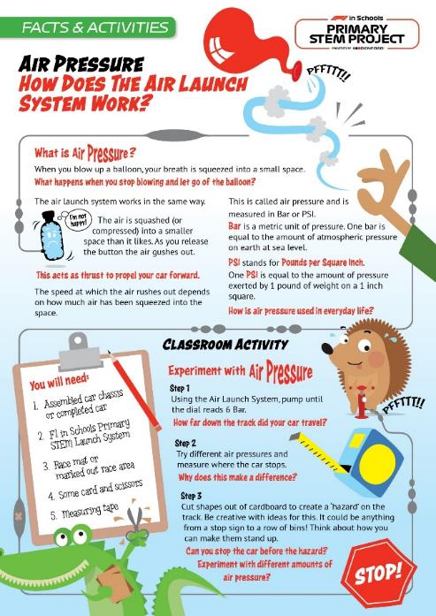
Activity Sheets
Fun classroom activities
Covering STEM subjects
Explaining scientific principles
Mapped to the UK National Curriculum
Other activities coming soon…

Slide 10

AND NOW …….
11 years and under - Compete in a global STEM competition!

Slide 11


Mark Wemyss-Holden
UK National Project Manager

Slide 12
First things first…
WHAT?

Slide 13




LIFE
SKILLS
STEM
PLUS
REAL
RACING
AGES
9-19
TEAMS
3-6…
FREE
ENTRY

Slide 14
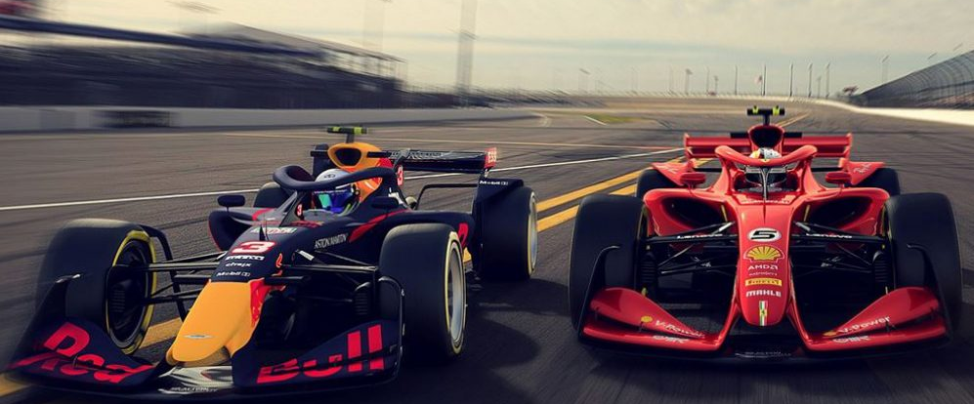
Twilight video link at the end!
What’s in it for pupils?
Designing and manufacturing a working product – it HAS to work!
Trying out real jobs like Project Management, Engineering, Design, Marketing, Sponsorship and Finance
Working together as a team against proper deadlines
Solving problems through innovation
Using Science and Maths to work out how to go faster
Gain CREST Awards for your project work
Business manners and understanding the world outside school…
…and realising money doesn’t grow on trees!

Slide 15
Sounds great, but…
WHY?

Slide 16
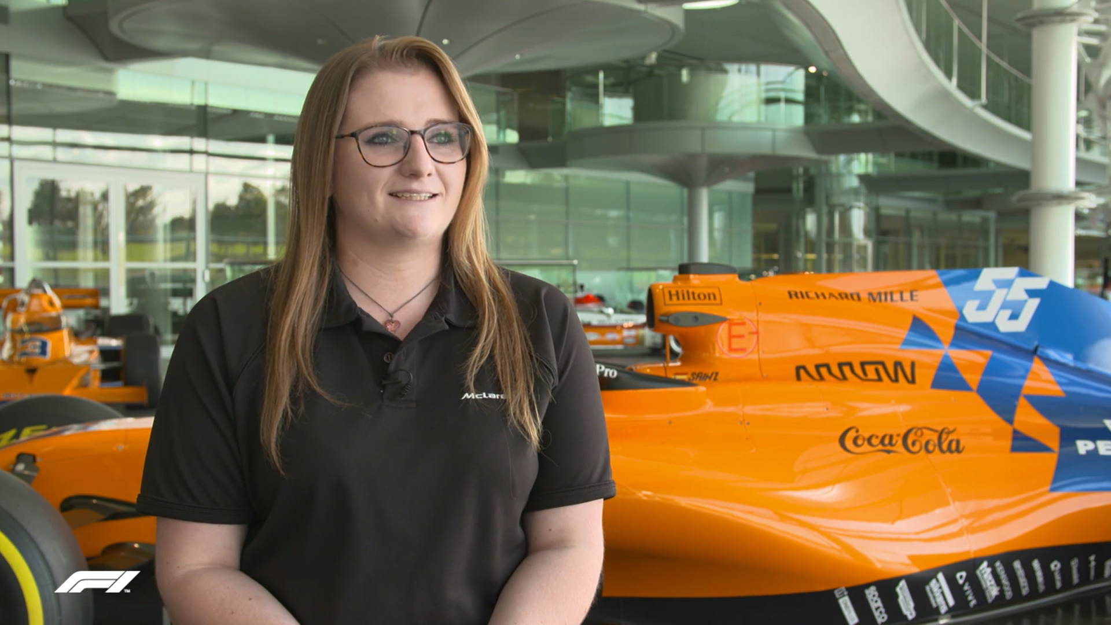
Case study video link at the end!
Raise aspirations…
Mary Aldersley
Operations Graduate, McLaren

Slide 17
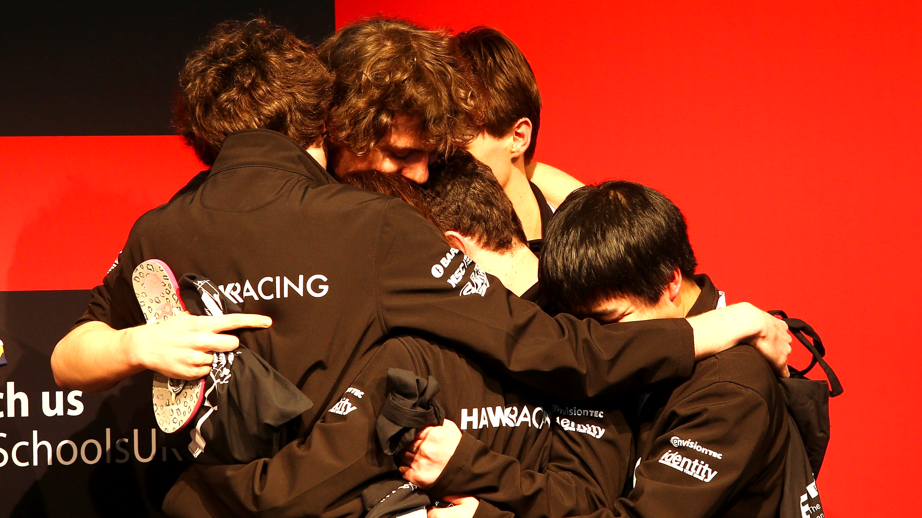
Give pupils a purpose…
Hawk Racing
Colyton Grammar School, Devon

Slide 18
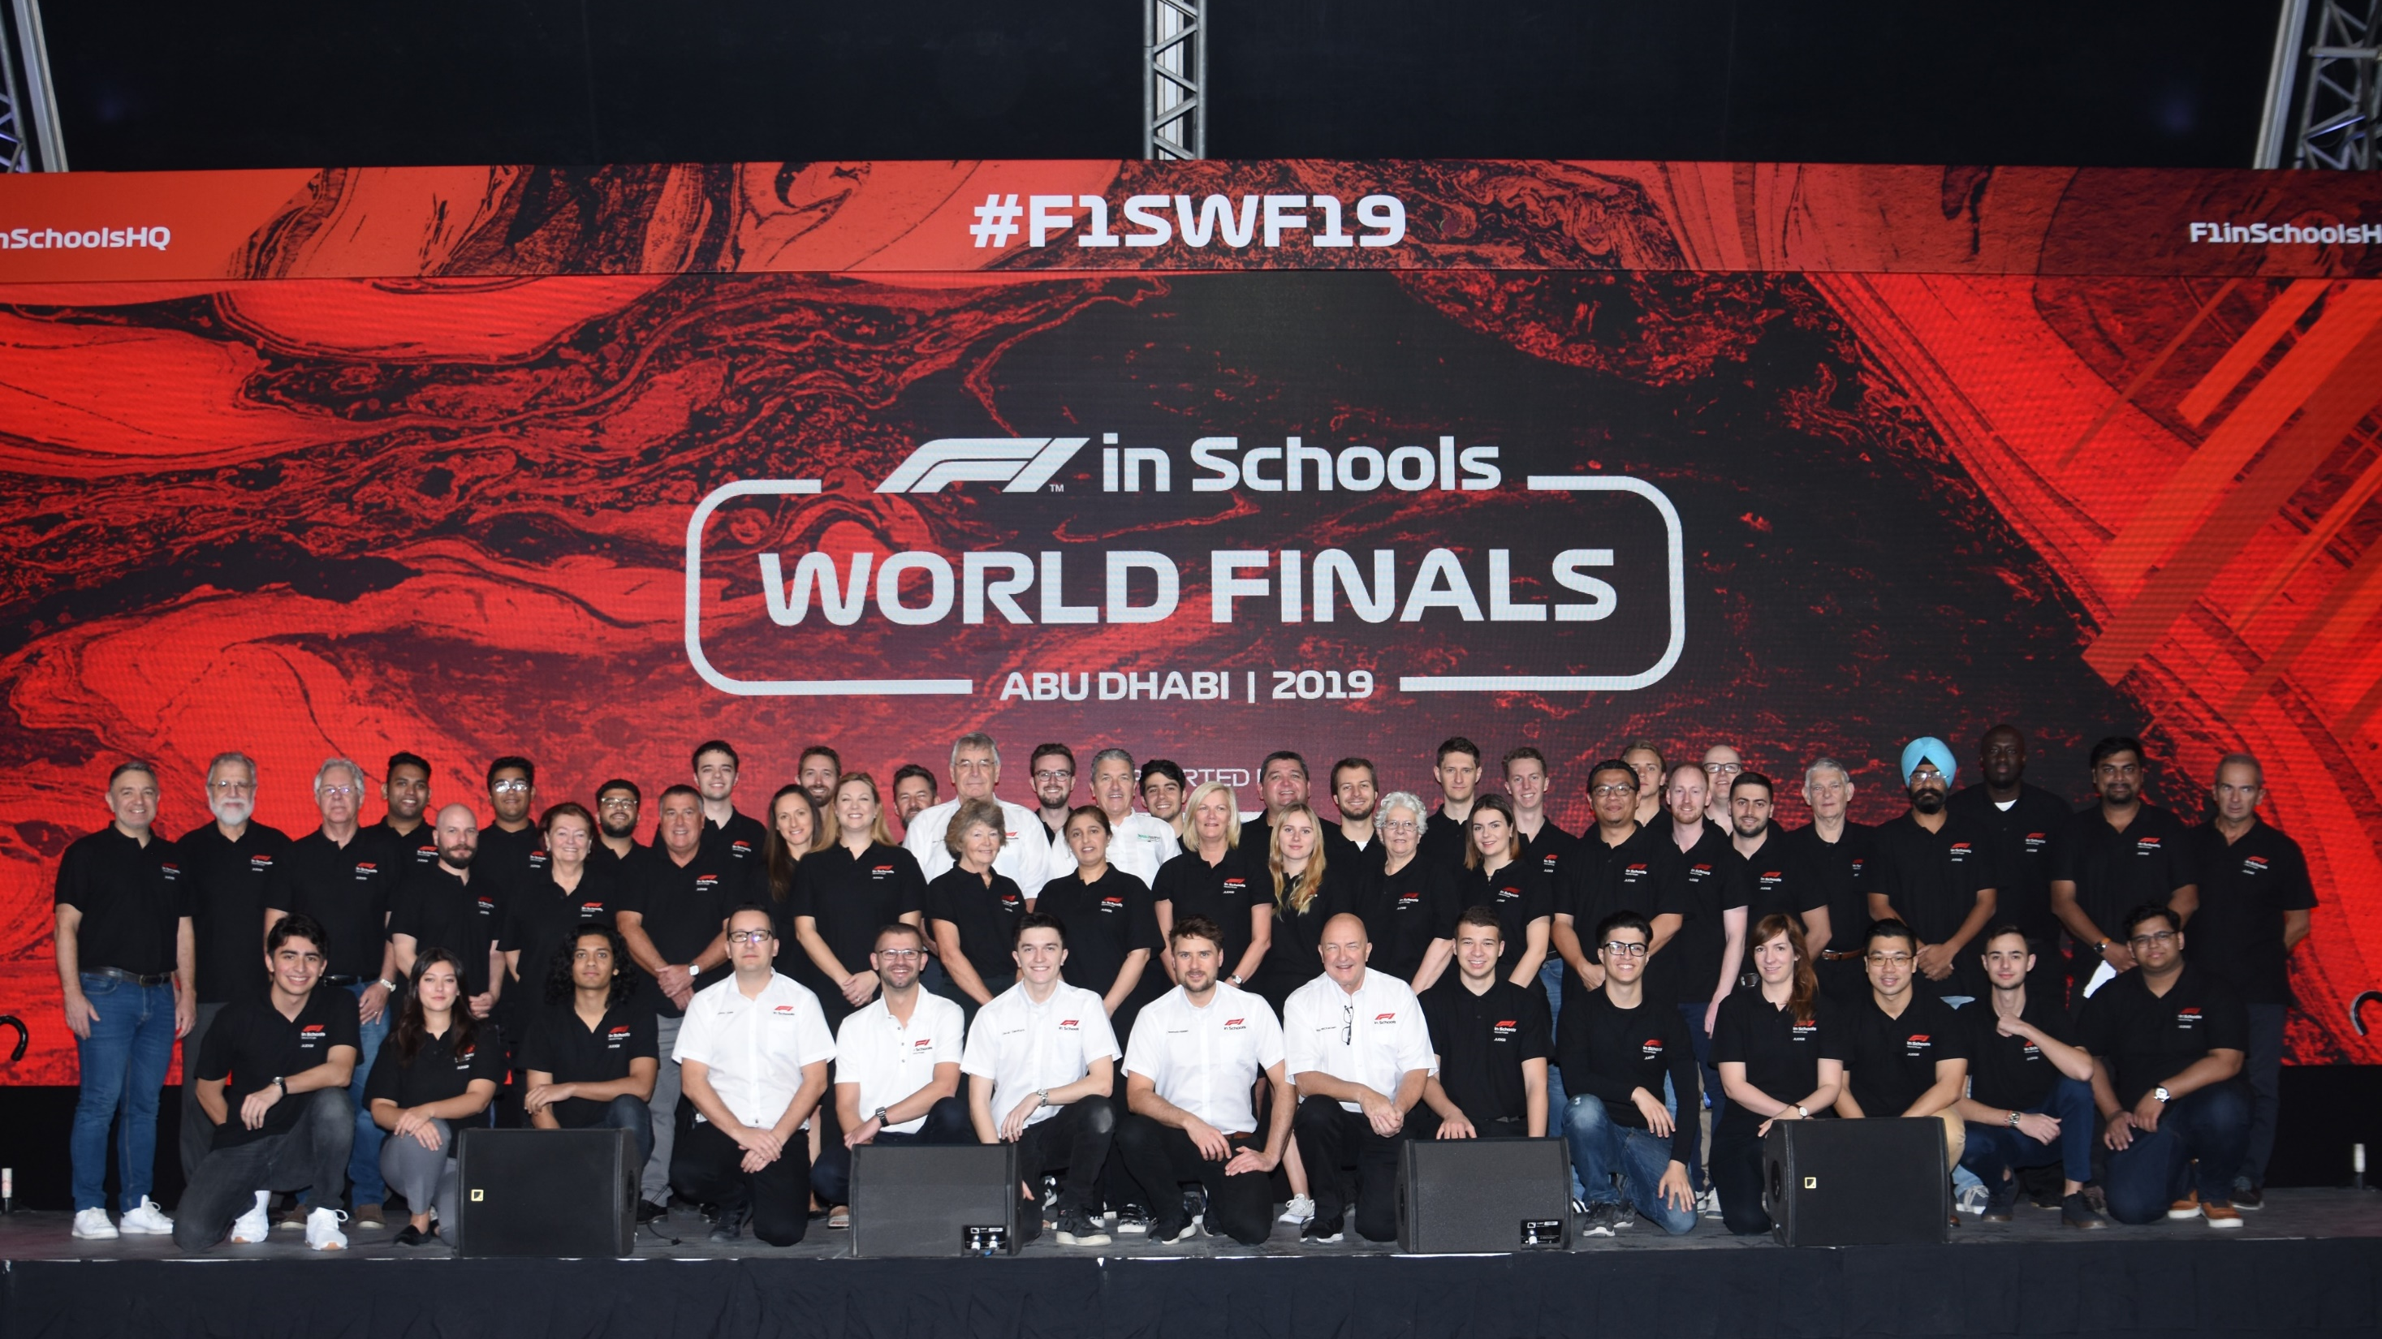
World Finals video link at the end!
Build career confidence…
The Judges!
Industry Professionals Worldwide

Slide 19
Sounds awesome…
HOW?

Slide 20
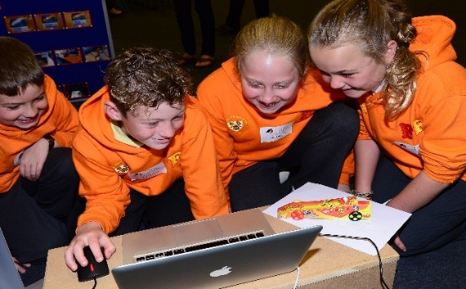
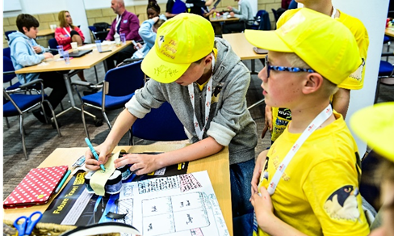
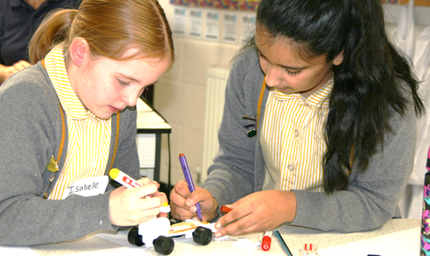
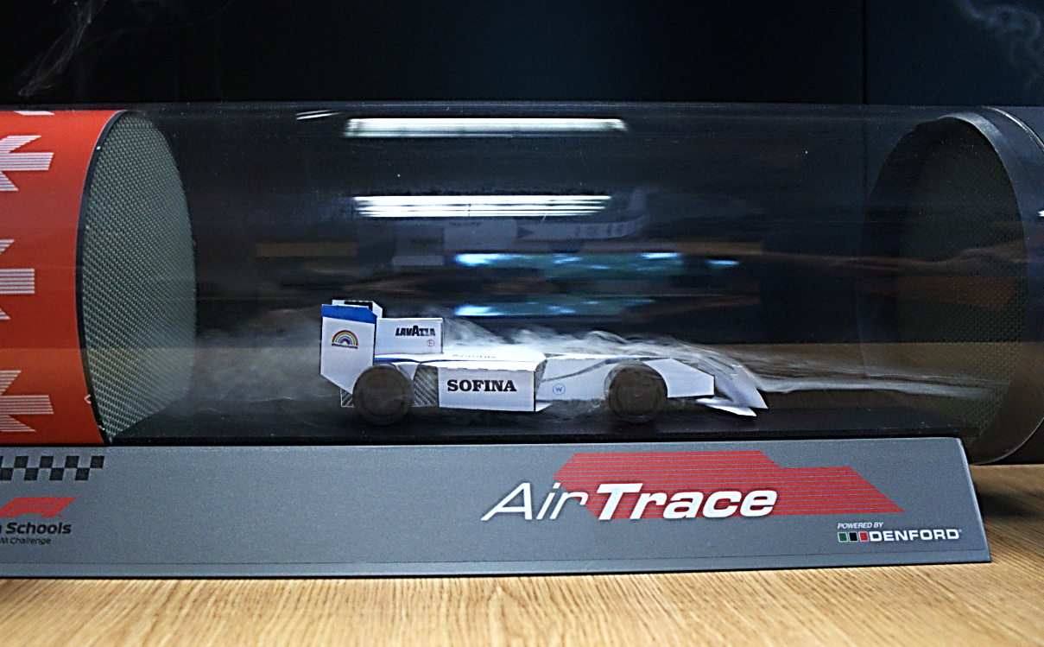
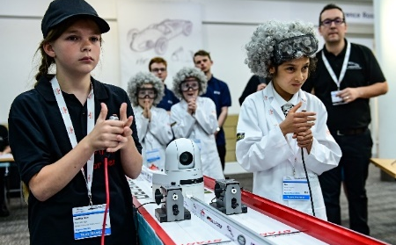
THE PROCESS
Rules & Regulations link at the end!
Read the Rules & Regulations
Form a team of 3-6
Decide on your roles
Register your team
Then follow the steps…
1. DESIGN
2. MAKE
3. ASSEMBLE
4. TEST
5. RACE

Slide 21
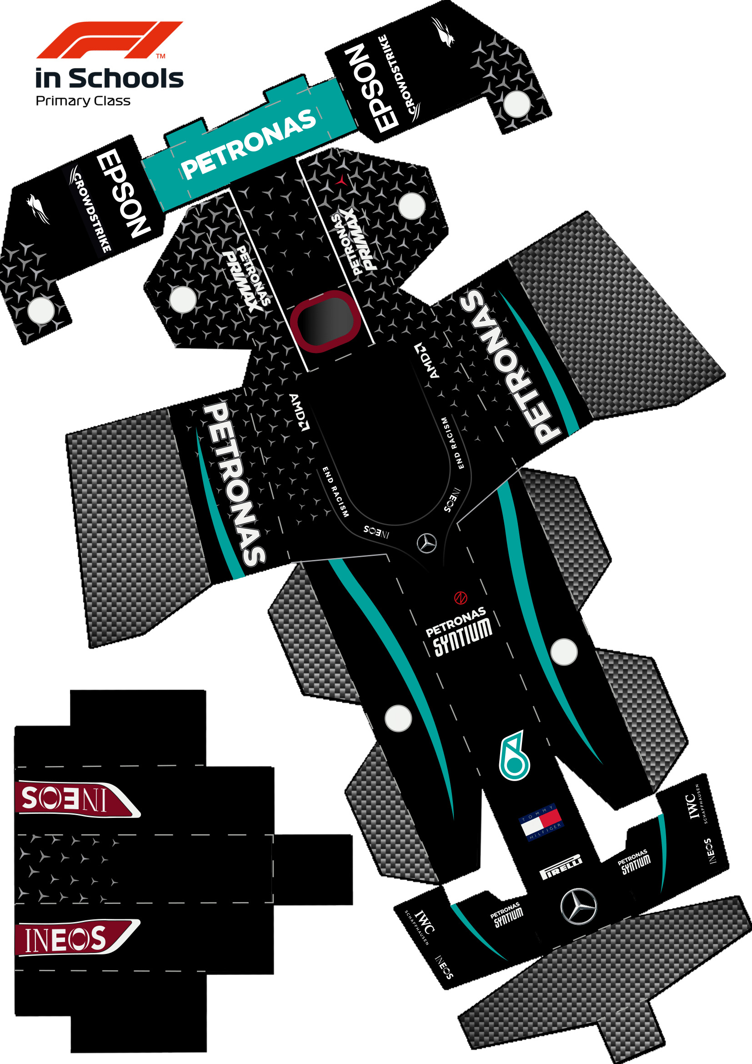
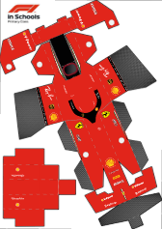

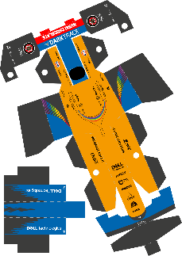
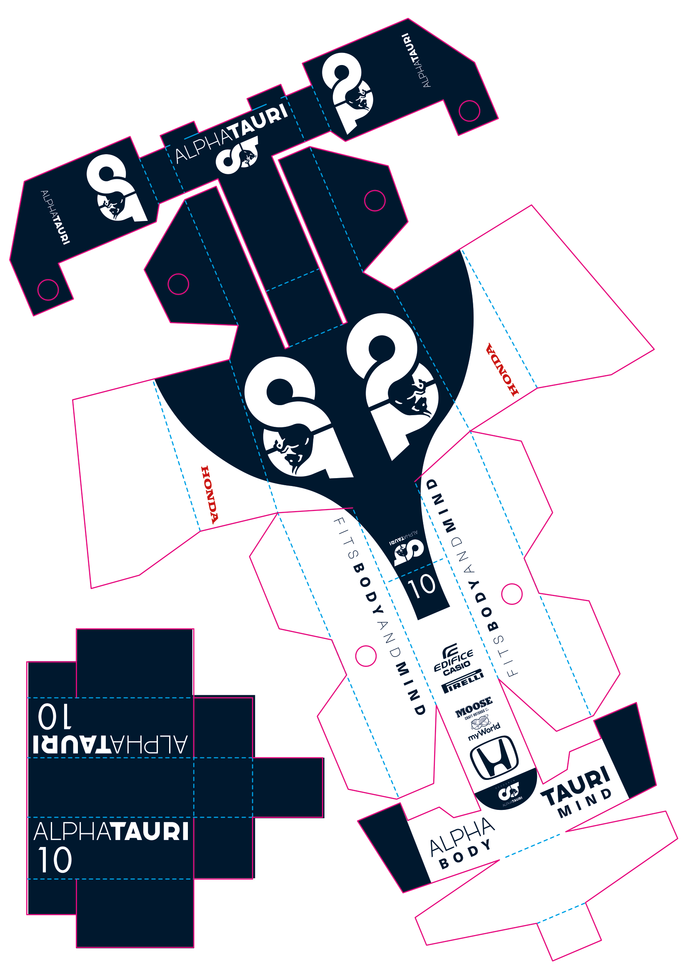





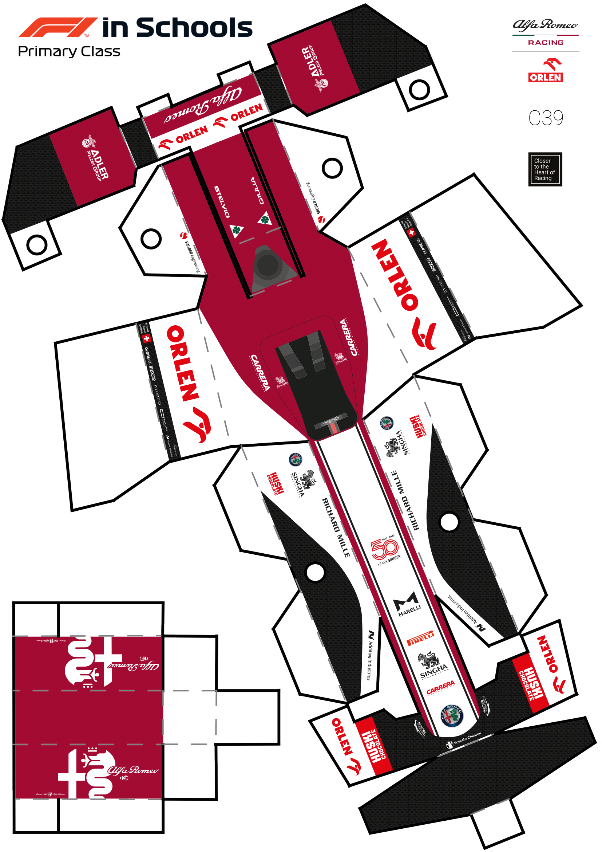
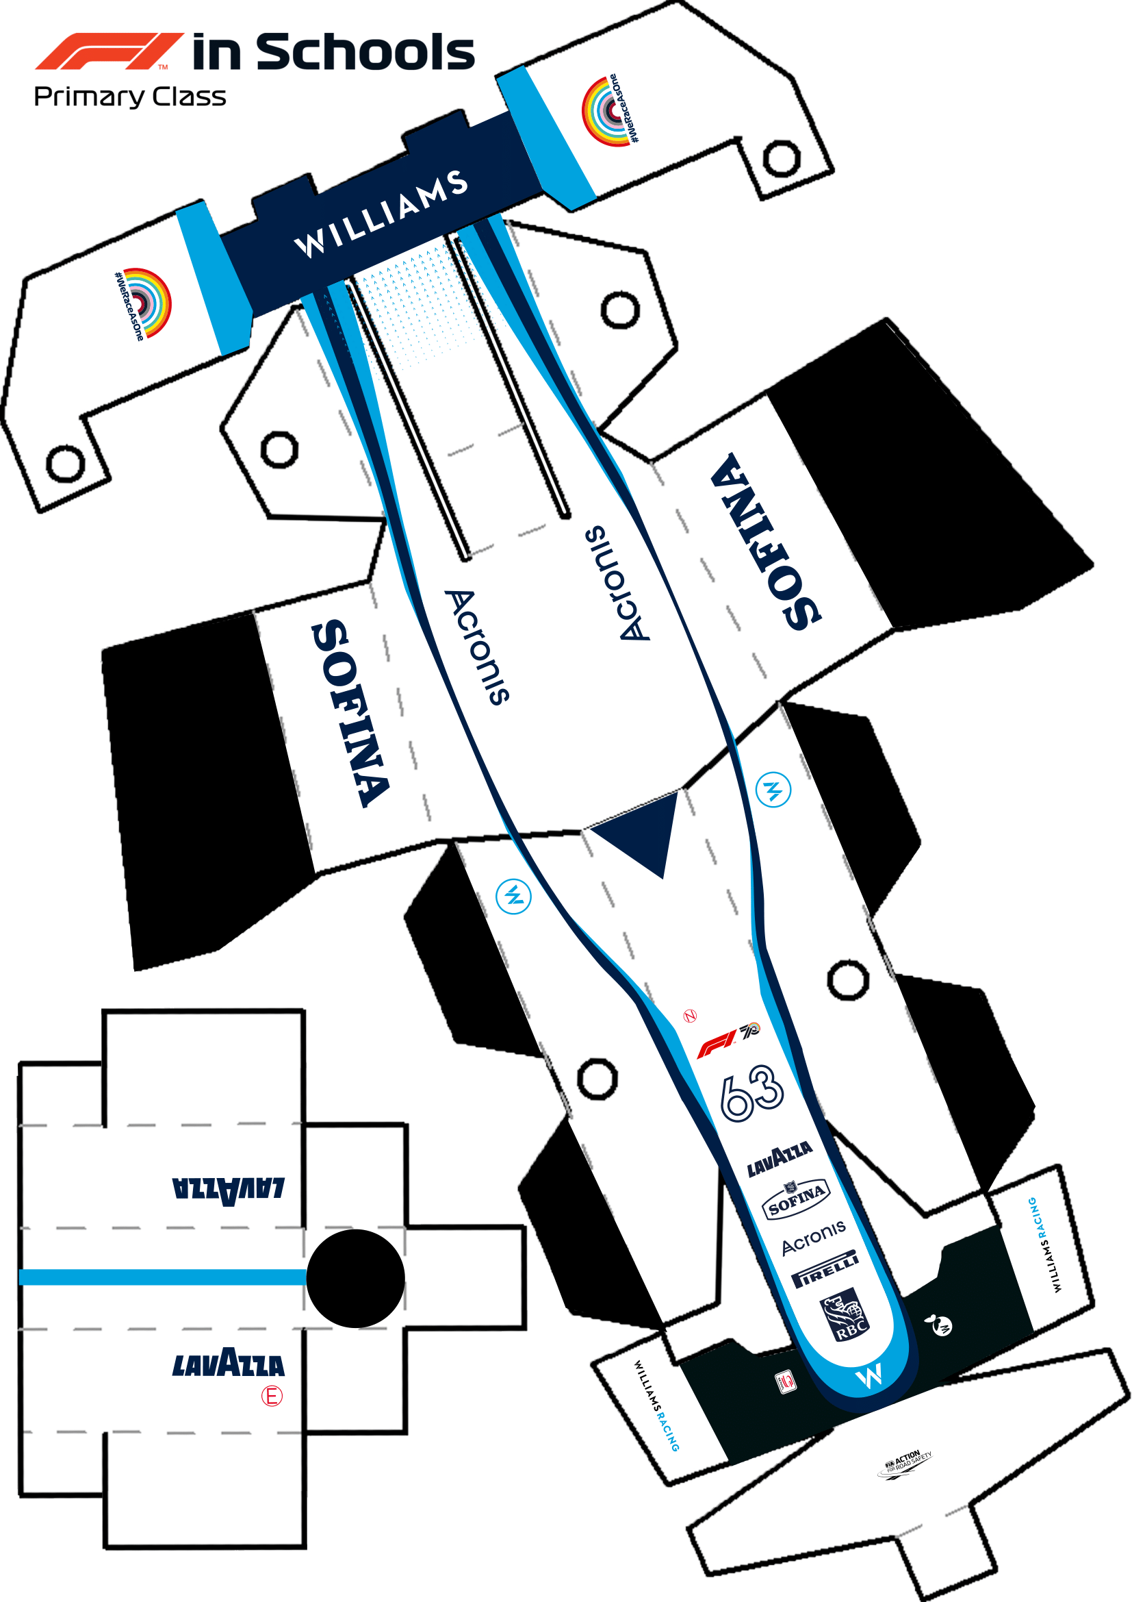
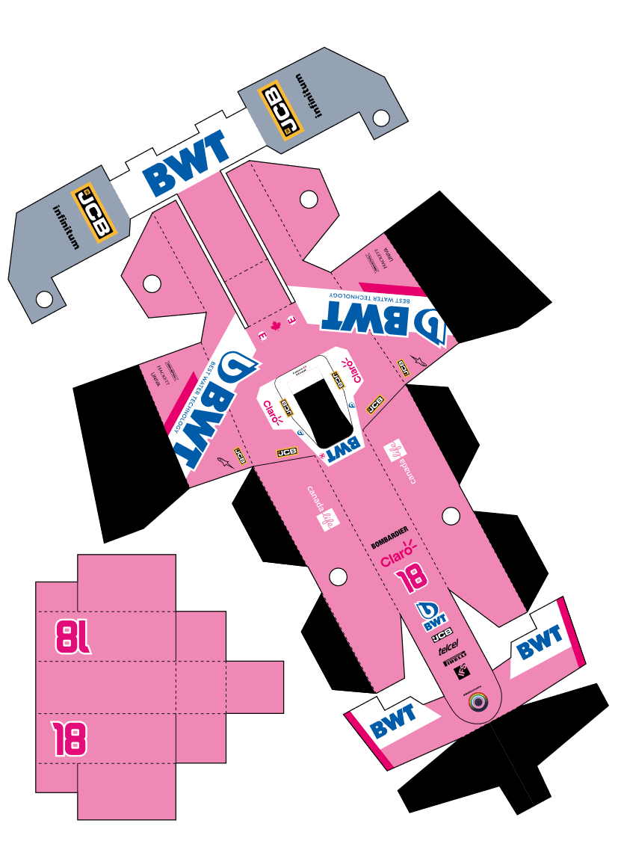
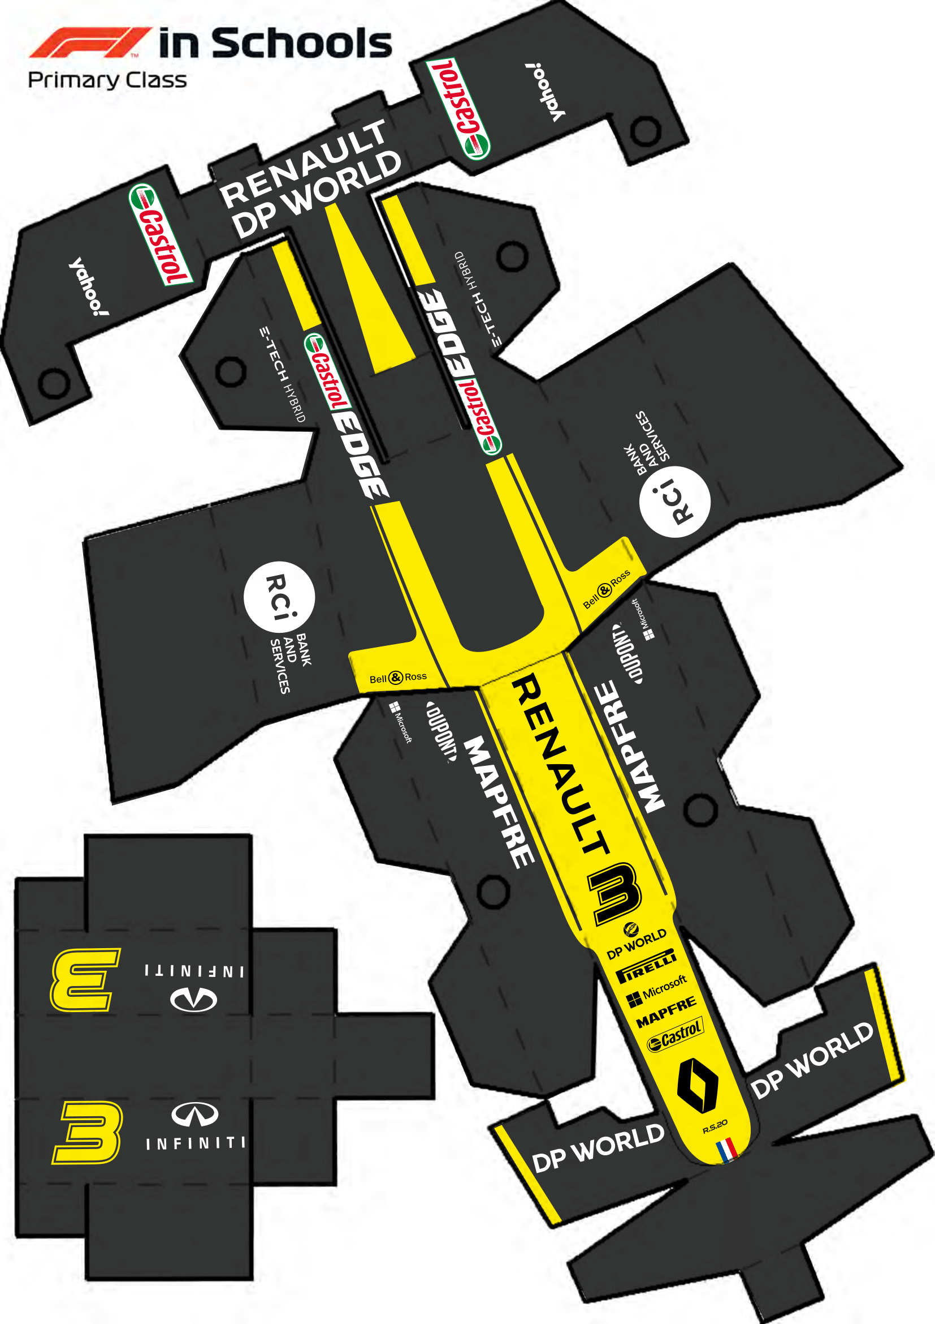





MAKE THE GRID
F1 nets download link at the end!
Download the official F1 team bodyshell nets from the F1 in Schools website, print out, then carefully cut and assemble your own Formula 1 grid! This can make an awesome intro activity…

Slide 22

OUT WITH THE OLD
WINGLESS
No mandatory wings
SKINNY WHEELS
Narrow, efficient but not very F1…
WEIGHTLESS
No minimum weight
BOX-SECTION
Easy to make, but not very F1…
4g CO2
Certainly fast enough

Slide 23
IN WITH THE NEW
F1 WINGS
Mandatory front / rear wings
WIDE WHEELS
Standardised, wide, very F1
40g
Minimum weight
F1 CHASSIS
Standardised, easy to assemble
4g CO2
Still fast enough!

Slide 24
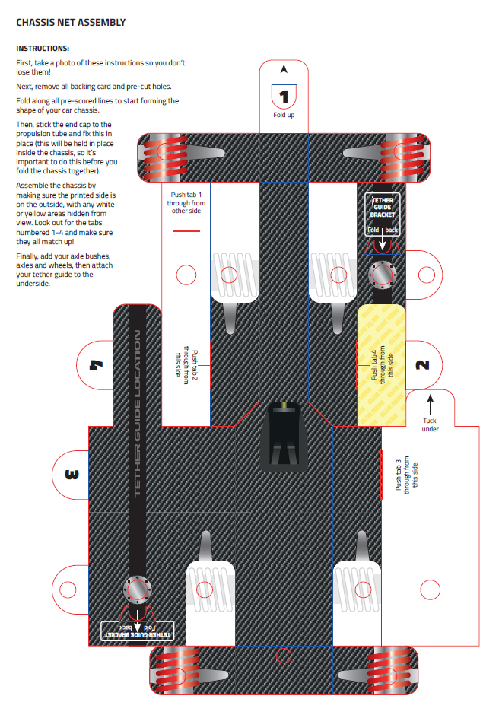
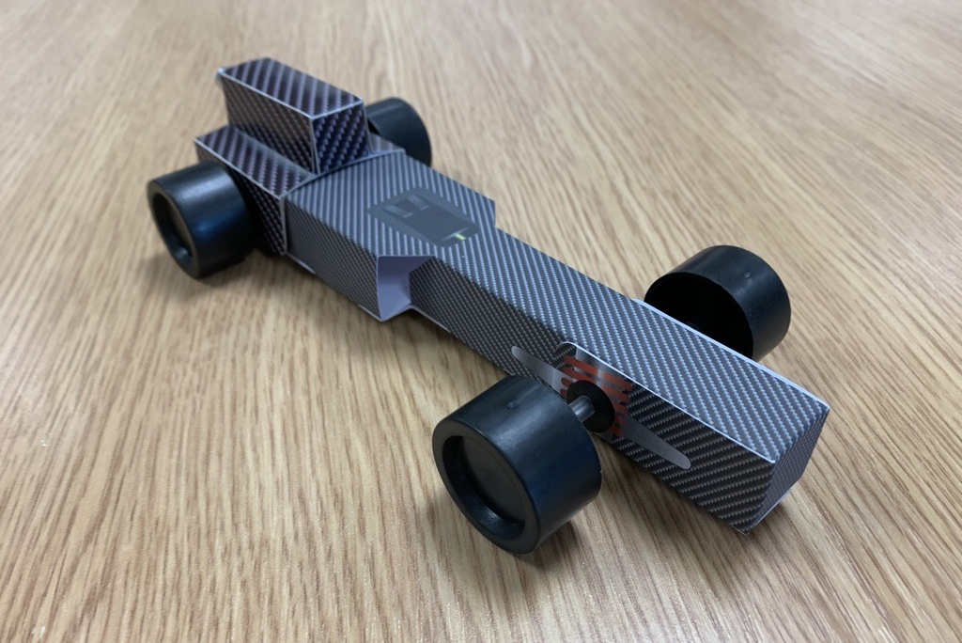
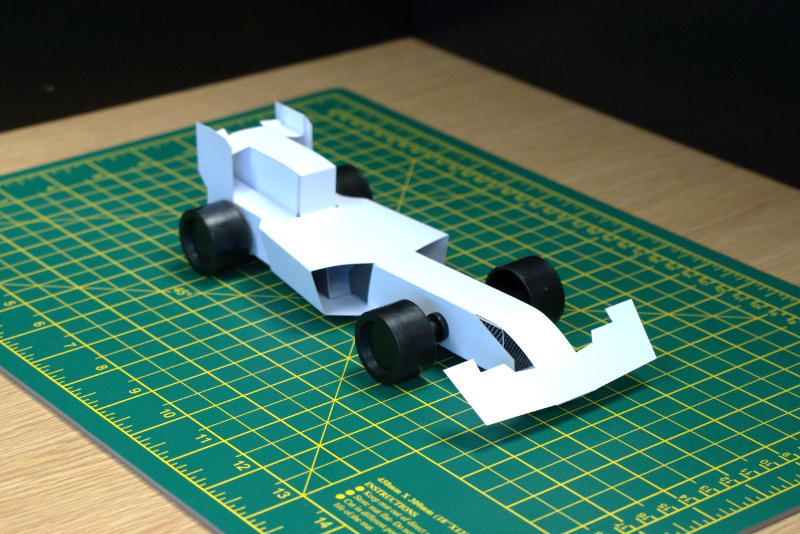
STARTING POINT

Slide 25
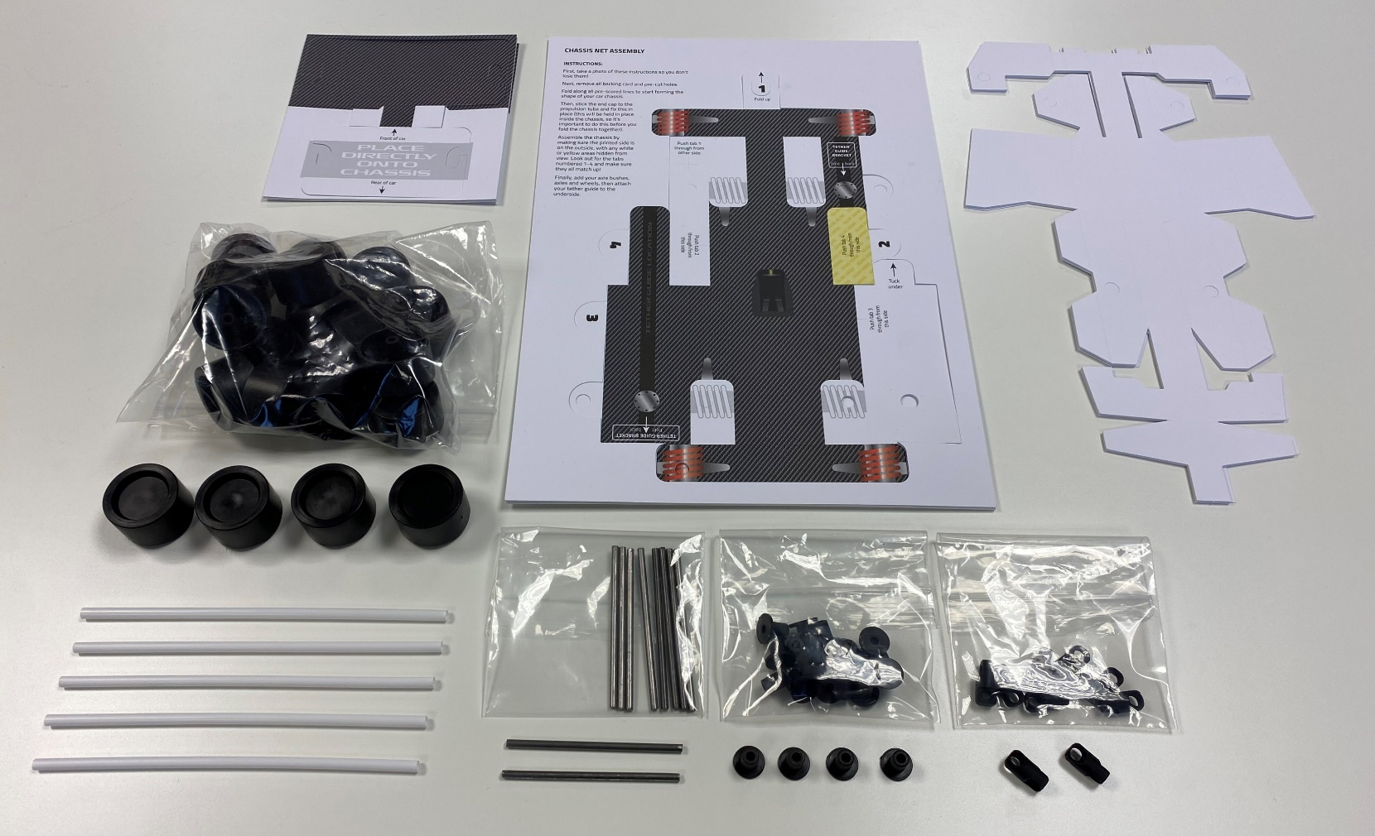
STARTER KIT (£25)
5 cars

Slide 26
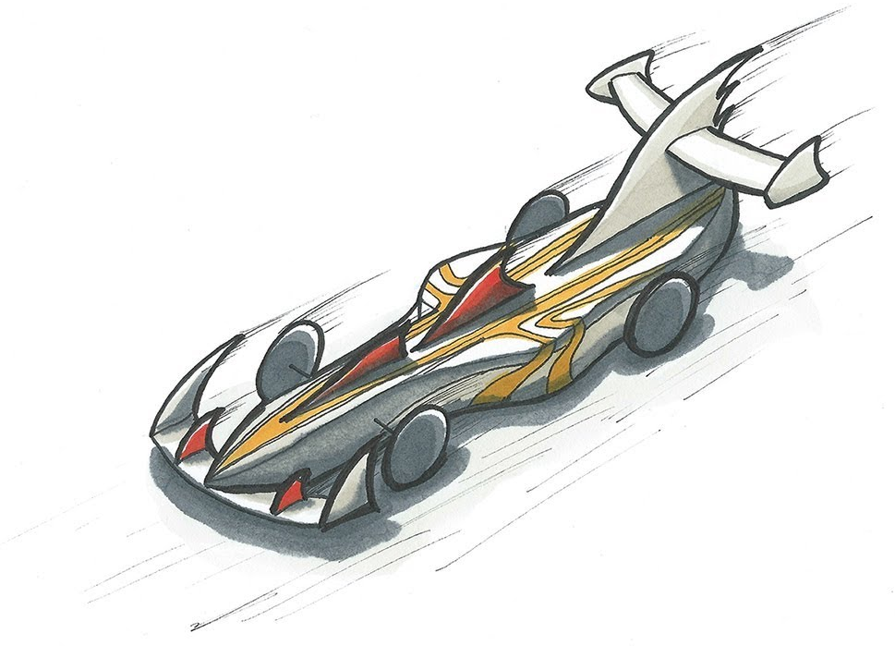
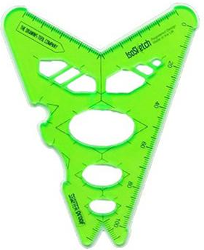

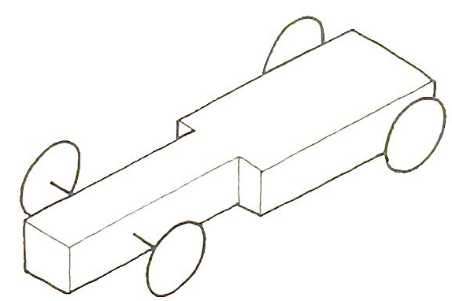
GET CREATIVE!
Design tutorials link at the end!
LEARN
SKETCH
APPLY
CREATE

Slide 27



VIRTUAL SEASON

Slide 28
It’s 2021 though…
HOW?

Slide 29
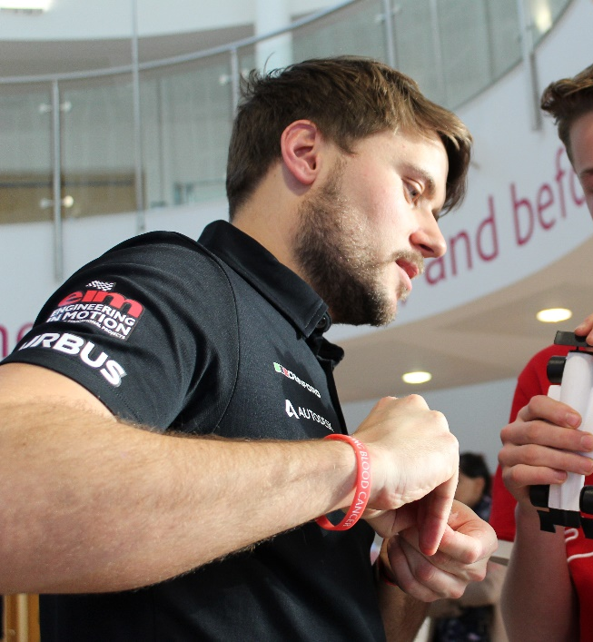
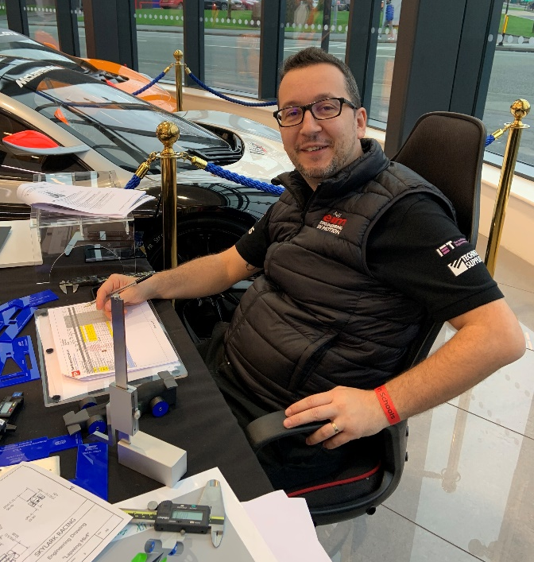
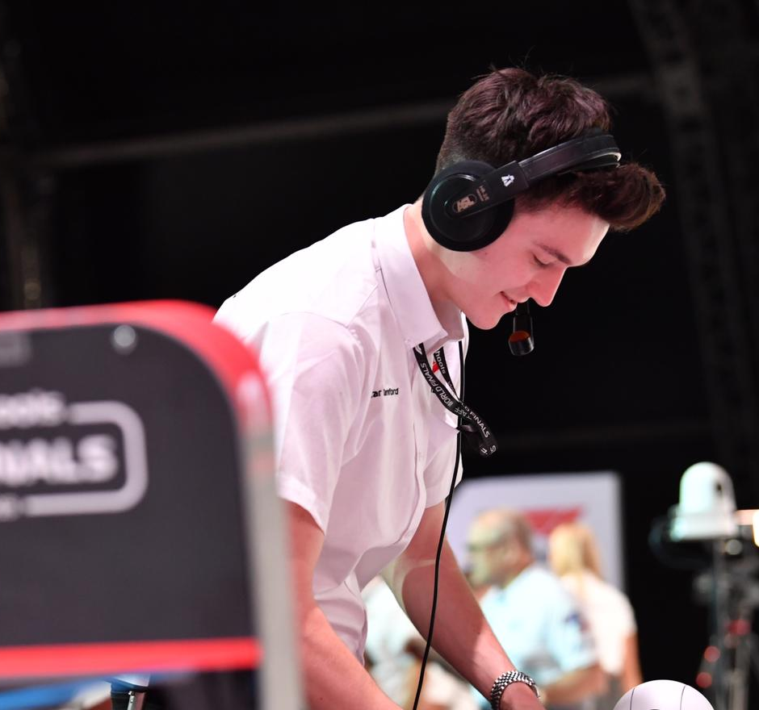



A ‘NORMAL’ SEASON

Slide 30
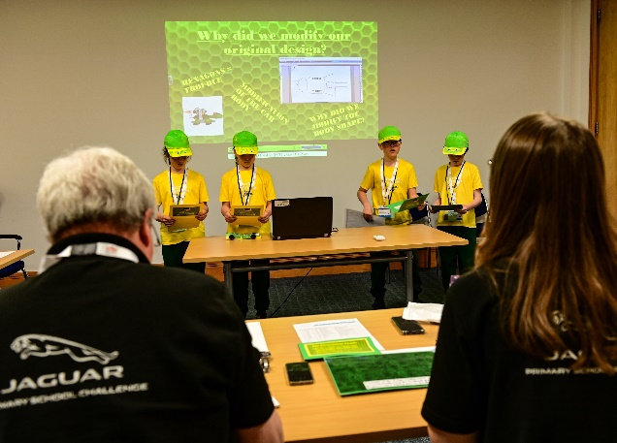
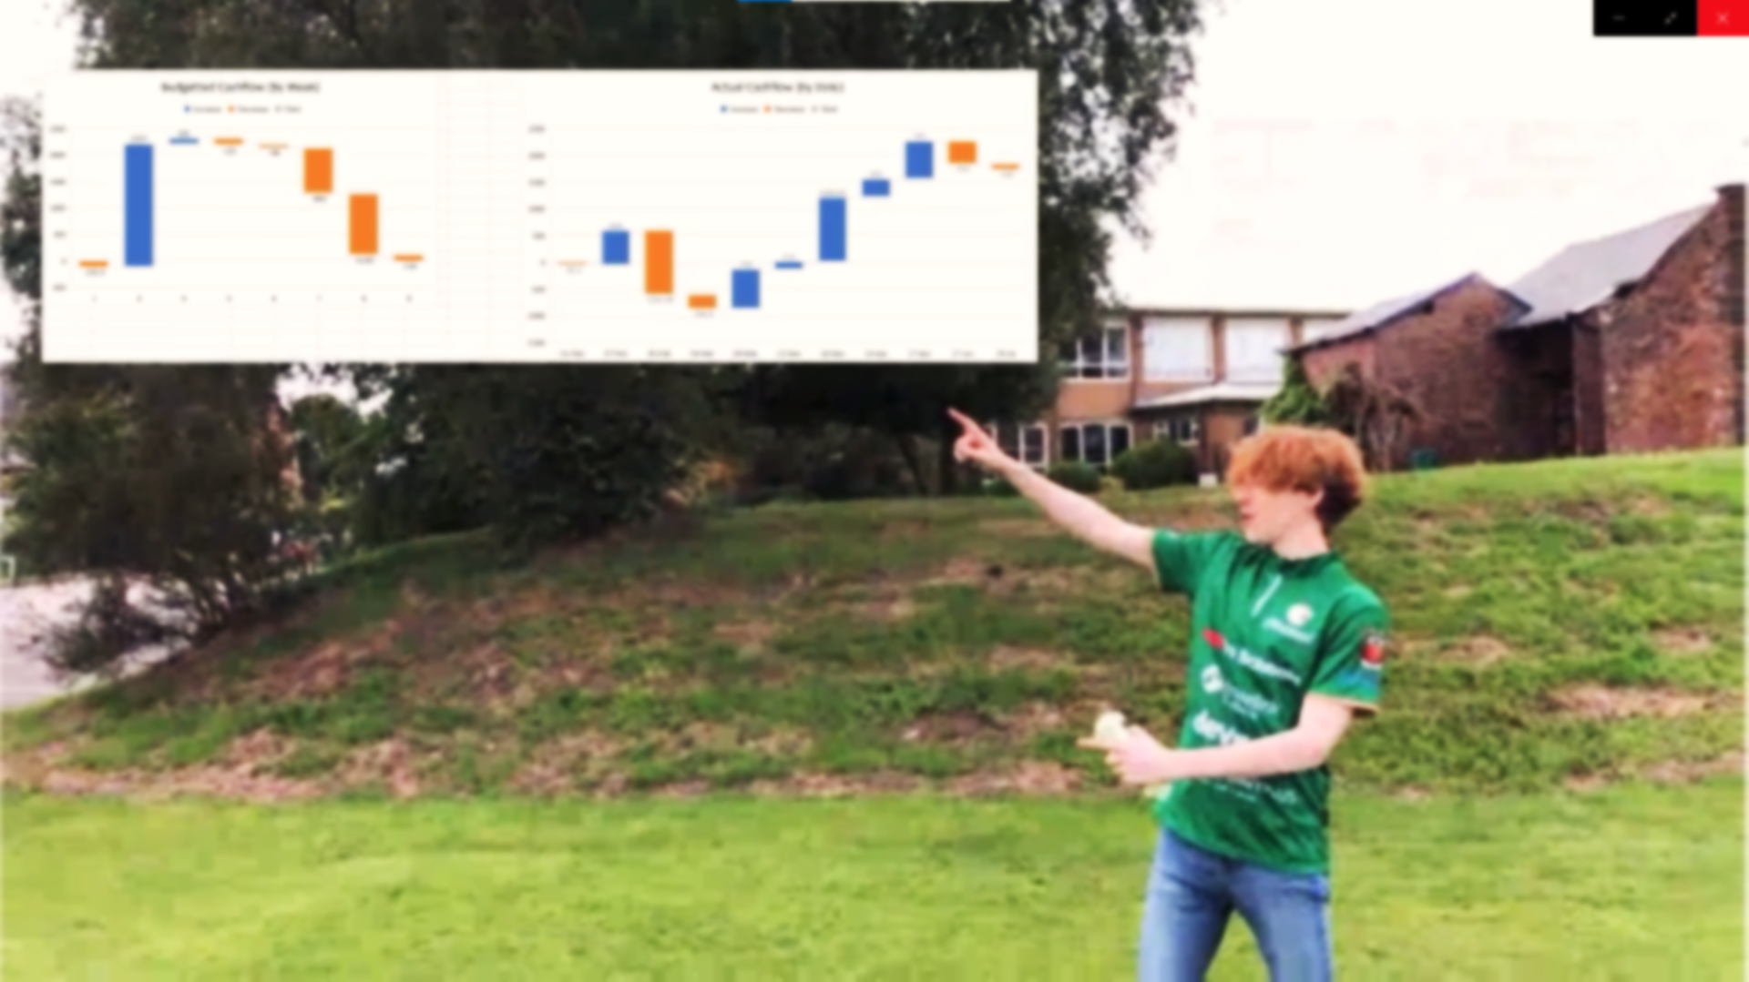
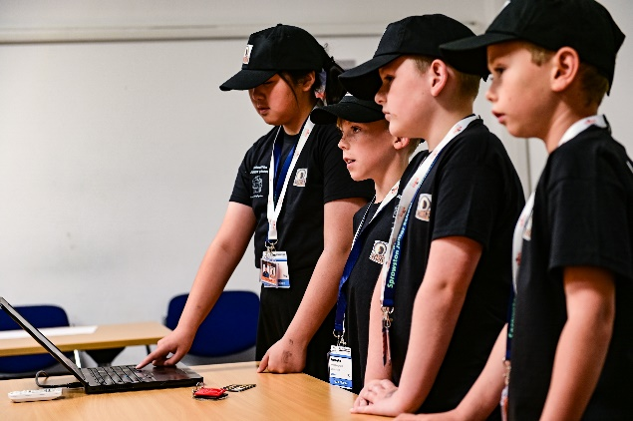
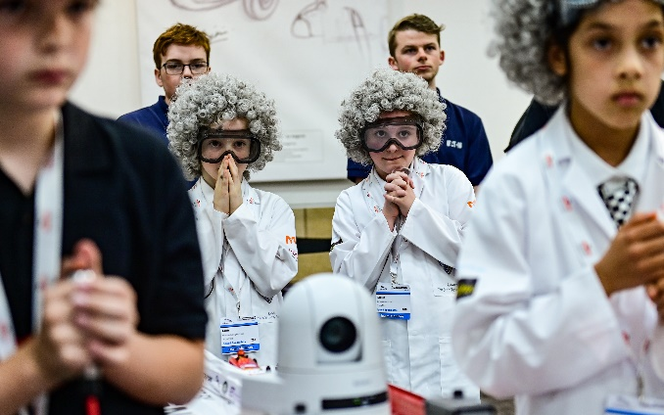
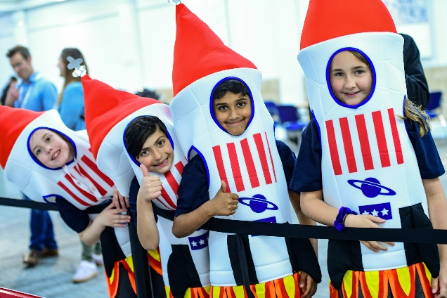
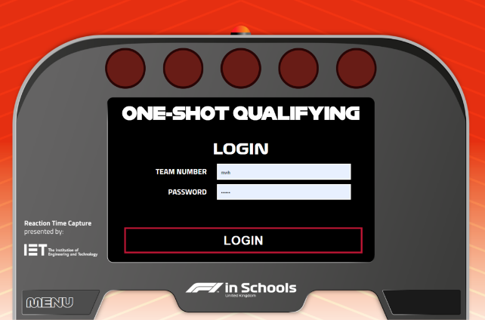

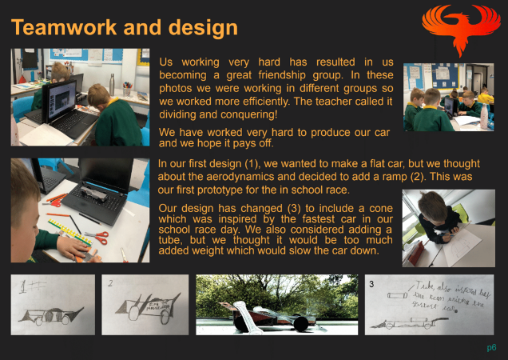
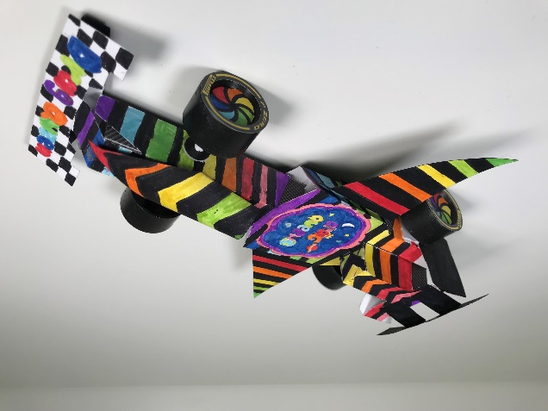
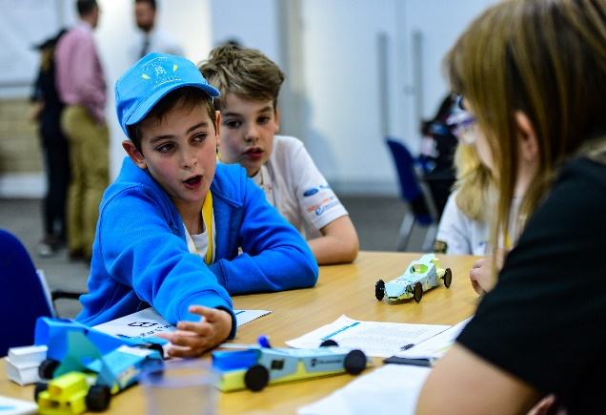
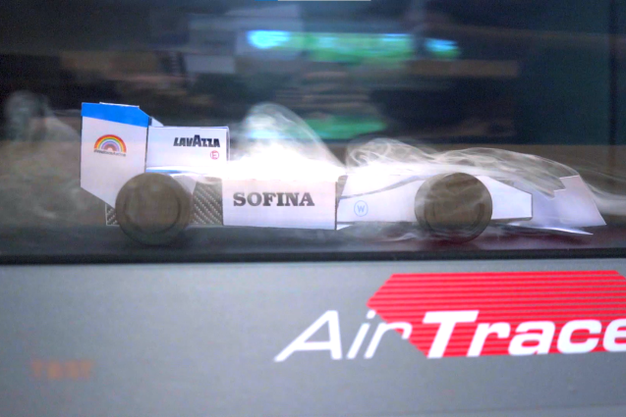


Digital Project Elements
VIDEO Verbal Presentation
VIDEO
VIDEO Verbal Presentation
VIDEO
RACE
RACE
Design & Engineering
PDF
1 x F1 in Schools Race Car
PHYSICAL CAR
Design & Engineering
PDF
1 x F1 in Schools Race Car
PHYSICAL CAR

Slide 31

VIRTUAL EVENTS
Regional Finals link at the end!

Slide 32

F1 in Schools Playlist link at the end!
In (very brief) summary…
Enter whatever your budget, resources or ambition
It’s free to enter… it could actually MAKE you money
It works when you don’t!
Empower your students to look beyond you and school
Flexibility: run it in lessons or as extra-curricular
Use our resources to get started in class
Be a shining light at a challenging time for everyone

Slide 33
Thanks for your time!
For more information visit: www.F1inSchools.co.uk
Any questions, just ask…
mwh@f1inschools.co.uk | 07799 873116

Slide 35
VIDEO LINKS
Here are all the video links we referred to in the show, in the order they appeared. Please view the videos at your leisure; feel free to share and show your pupils!
F1 in Schools Primary Class – Twilight Activity Session
Mary Aldersley – Case Studio video
F1 in Schools World Finals – Highlights
Rules & Regulations DOWNLOAD
F1 Bodyshell Nets DOWNLOAD
F1 in Schools Primary Class – Design Tutorials
F1 in Schools Primary Class – Regional Finals 2021
F1 in Schools Primary Class – Full Resource Playlist

