Slide 1


Slide 2

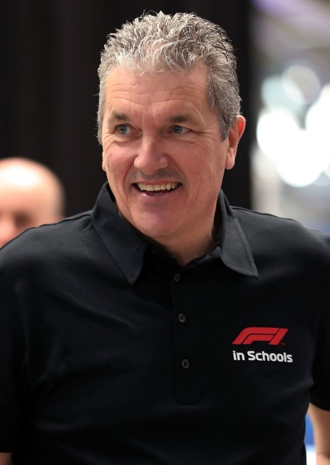

BACKGROUND
Launched in the UK in 1999 in 8 schools and now operates in over 26,000 schools across 51 countries worldwide.
Acclaimed as the world’s biggest and most exciting STEM-based educational Project.
Deliver the Challenge across a vast network of education establishments, ranging from township schools in South Africa, favela schools in Brazil, to inner city schools and independent schools, including international schools, right across the globe.
Andrew Denford
Founder & Chairman, F1 in Schools

Slide 3

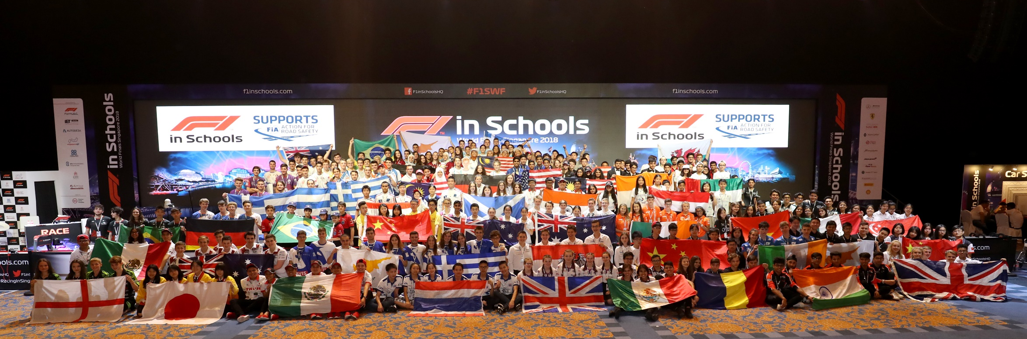
“A Project Approach to delivery of a STEM based curriculum”
“Working with Business, Industry & Government to address the Skills Gap!”
The Challenge …..
Design and manufacture the F1® car of the future simulating the design and
engineering processes employed by a real Formula 1® team.
ACTION LEARNING !!

Slide 4
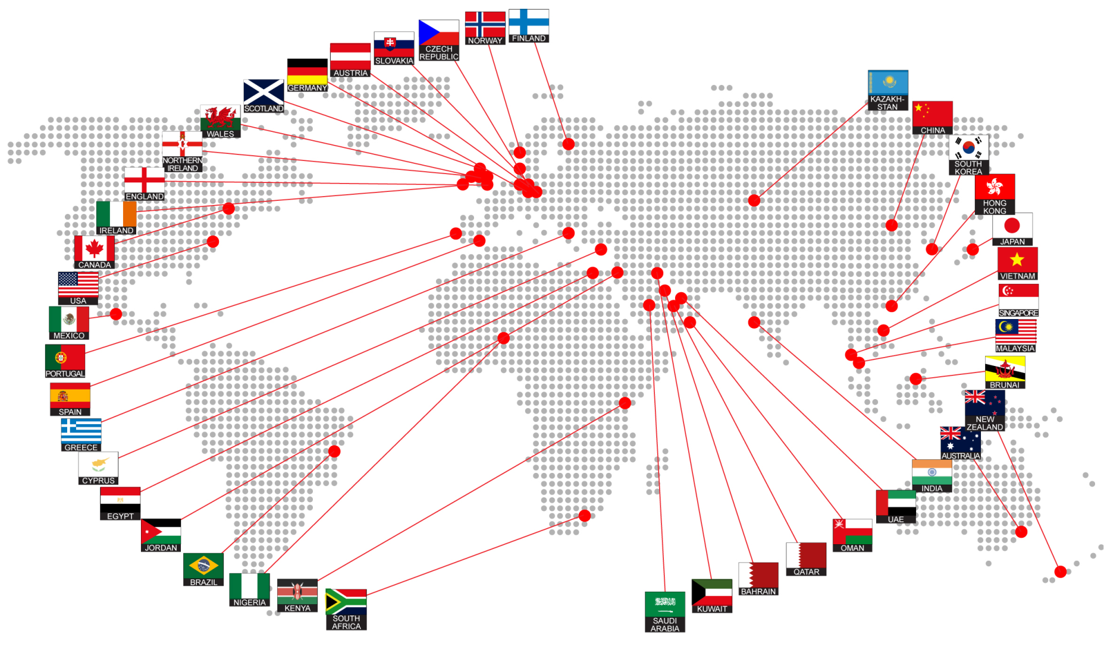
OPERATING IN 51 COUNTRIES!

Slide 5
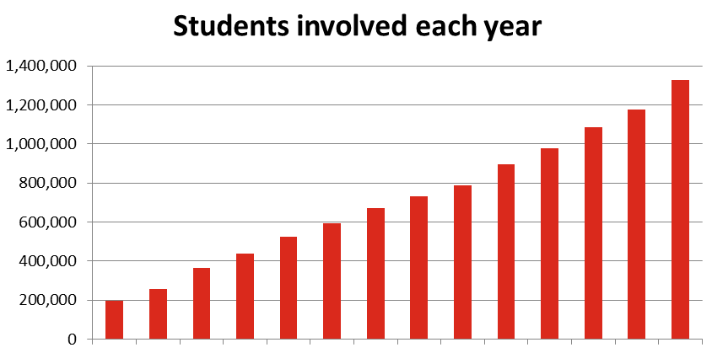
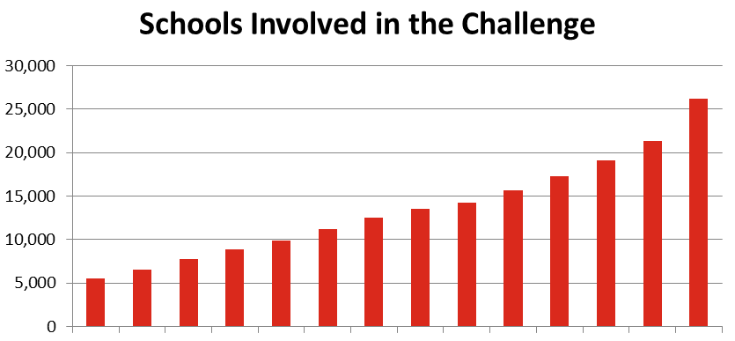
STUDENTS INVOLVED EACH YEAR
1,300,000
SCHOOLS INVOLVED
26,000
2007 2008 2009 2010 2011 2012 2013 2014 2015 2016 2017 2018 2019 2020
2007 2008 2009 2010 2011 2012 2013 2014 2015 2016 2017 2018 2019 2020

Slide 6
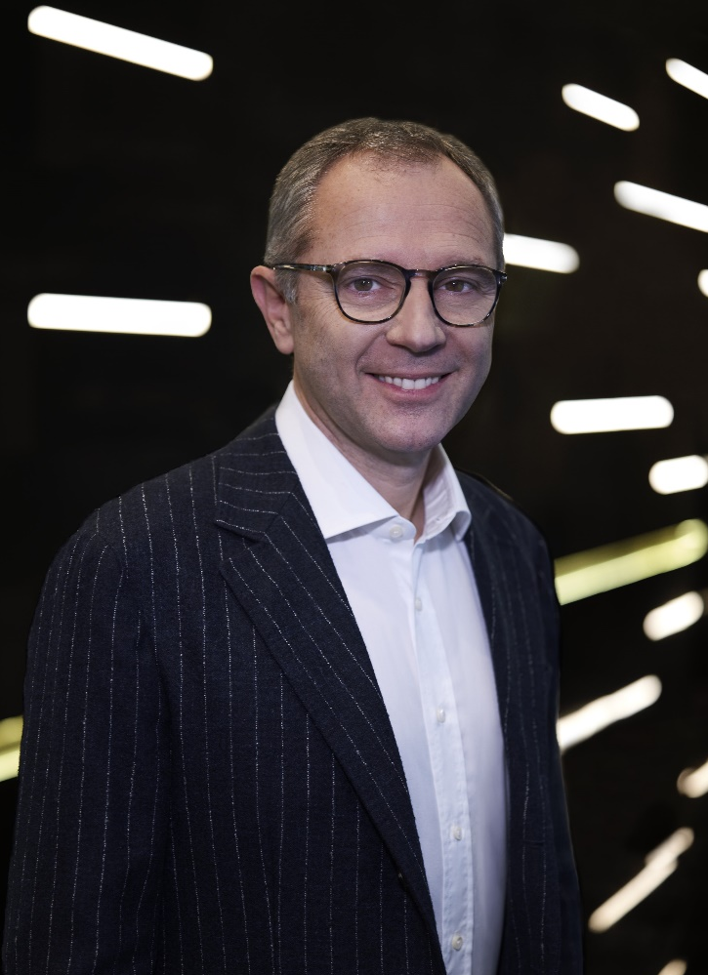
Formula One Support
“We are delighted to support the F1 in Schools programme as it continues to inspire and educate young people in STEM subjects, which are critical not only to our sport, but can have a huge impact on the wider society.”
Stefano Domenicali
Chairman and CEO Formula 1

Slide 7
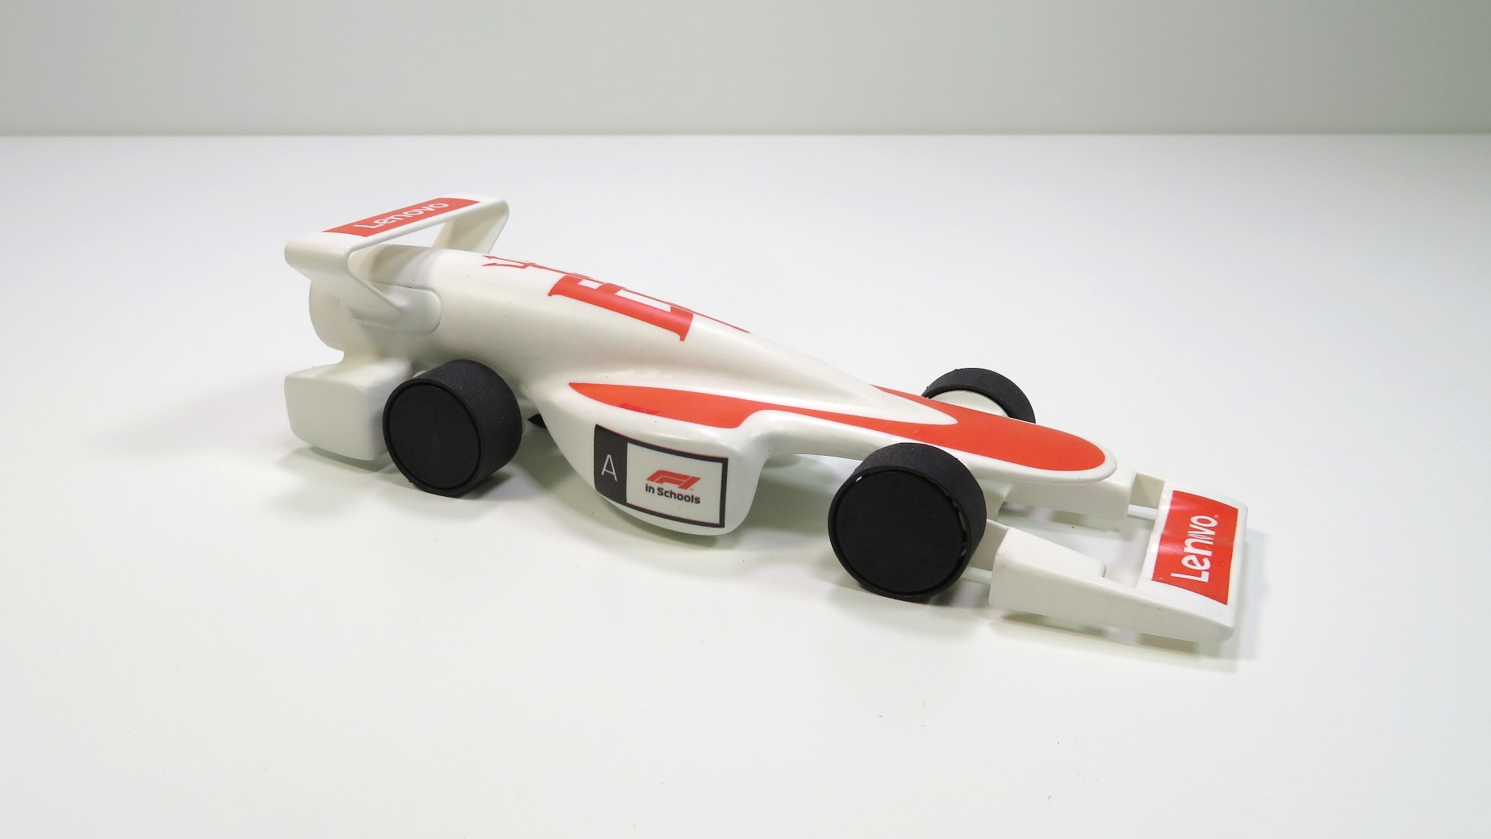
WORLD CHAMPIONS CAR
Brittania Red

Slide 8

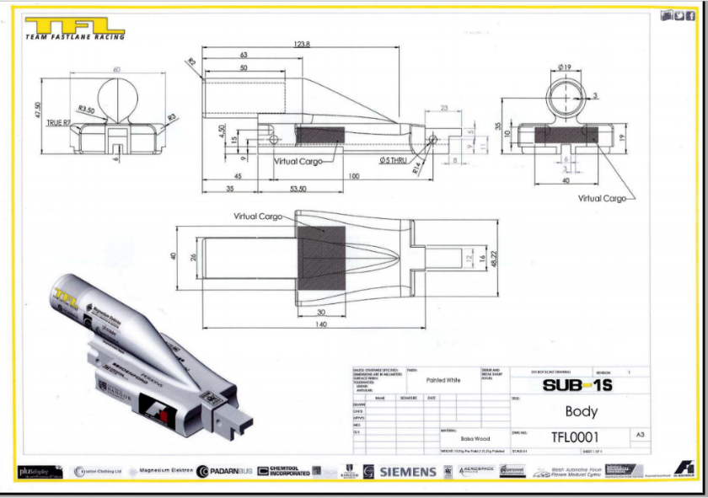
DESIGN
USING: MATHS, ENGINEERING, TECHNOLOGY

Slide 9

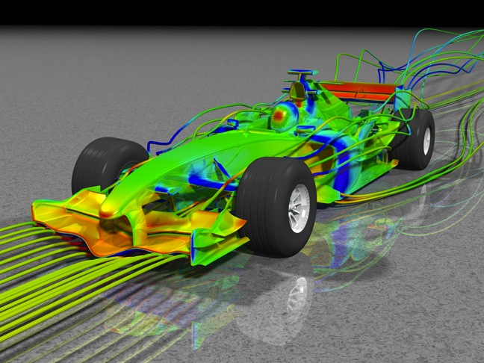
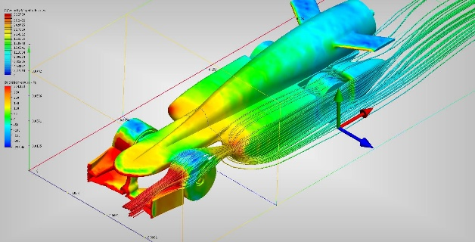
ANALYSE
F1® in Schools
F1®
USING: SCIENCE, TECHNOLOGY, MATHS

Slide 10
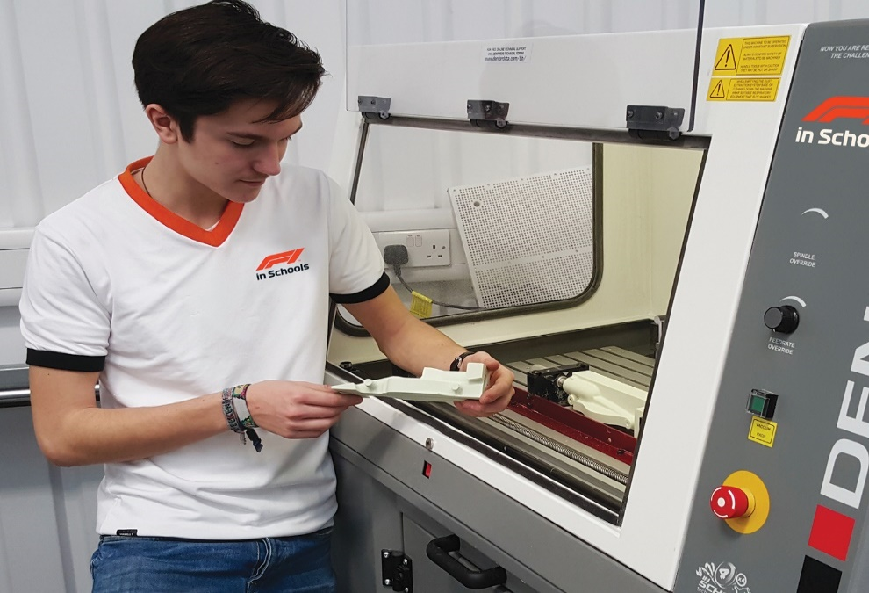
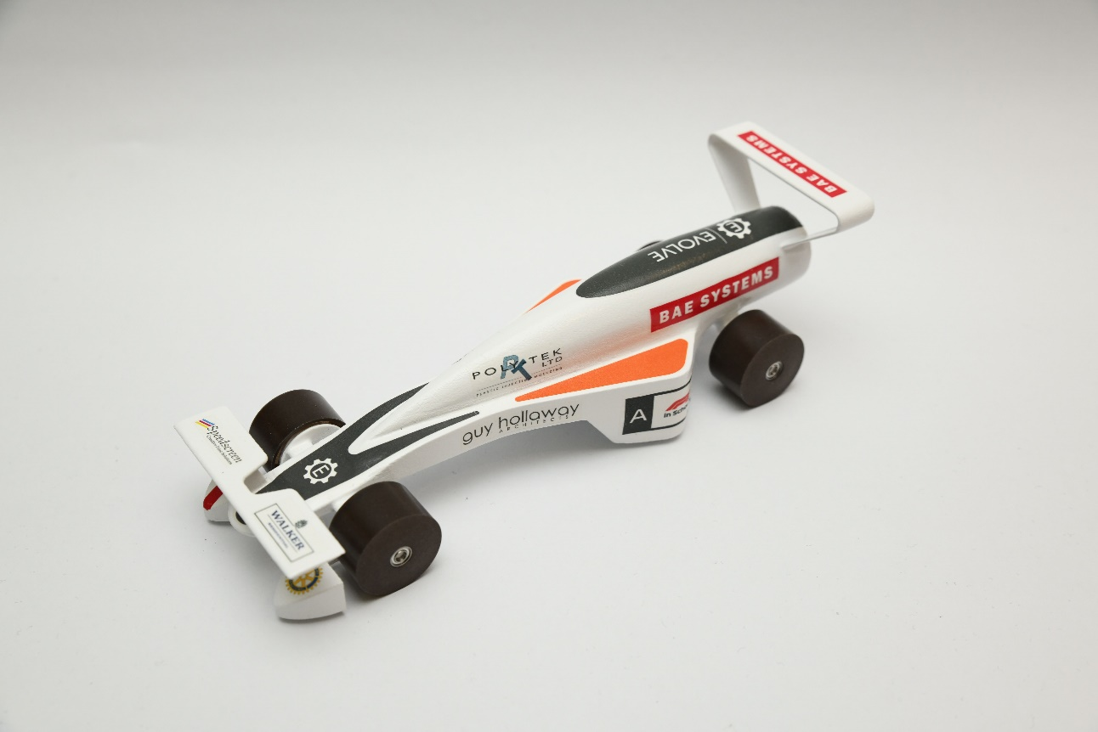
MAKE
USING: ENGINEERING, MATHS, TECHNOLOGY
UNDERSTANDING: CNC CODE, PROGRAMMING, EDITING

Slide 11
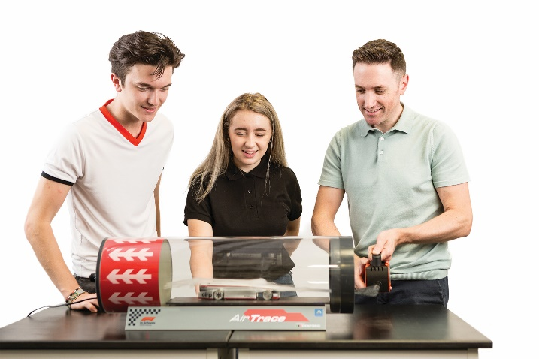
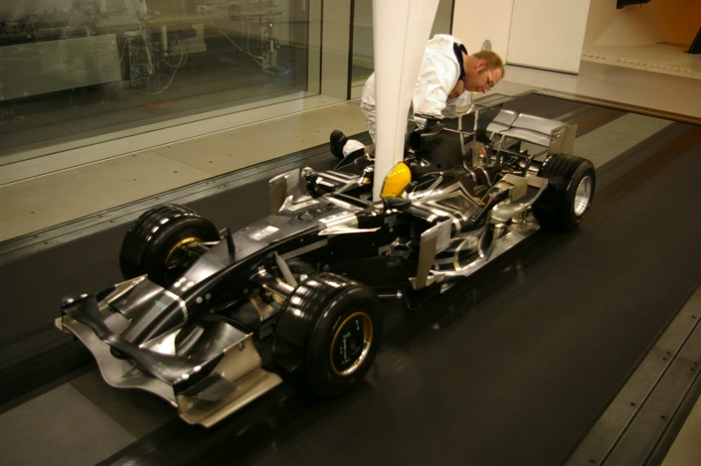
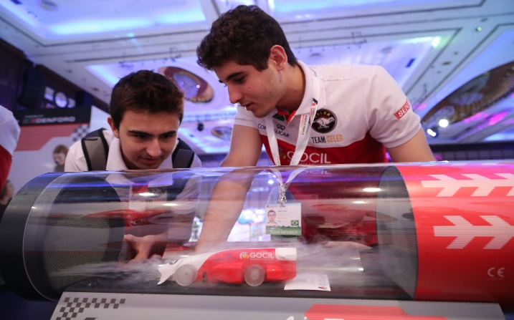
TEST
Smoke and Wind Tunnels
USING: ENGINEERING, TECHNOLOGY

Slide 12
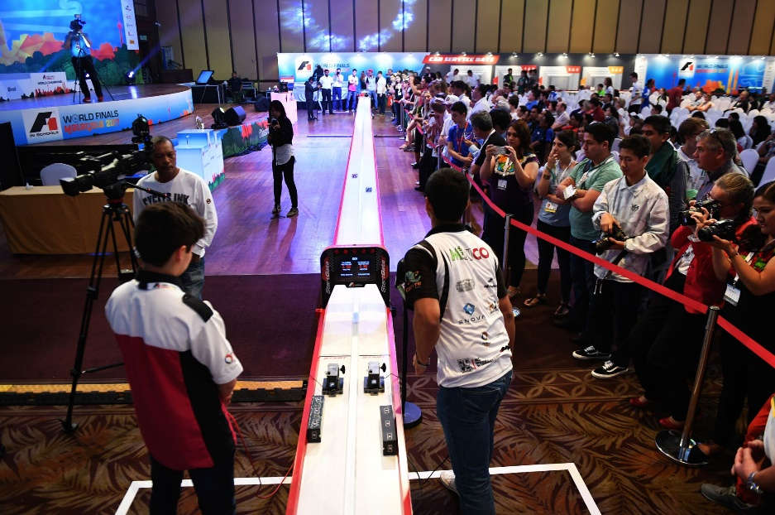
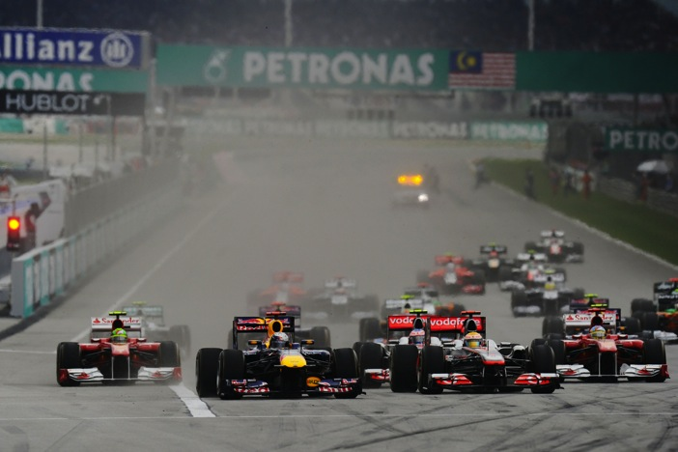
RACE
USING: MATHS, ENGINEERING, TECHNOLOGY

Slide 13
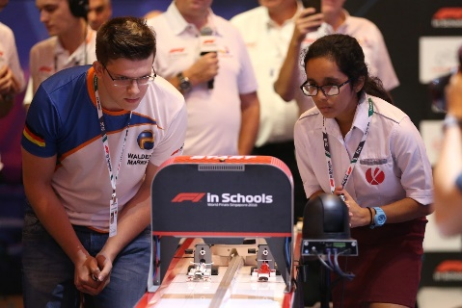
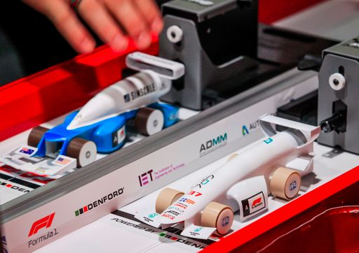
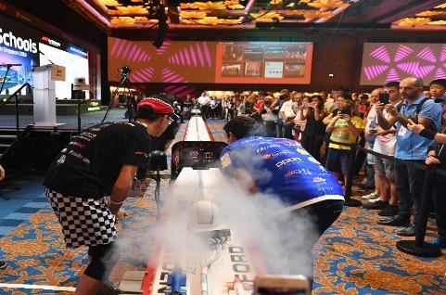
WHAT IS THE CHALLENGE?
RACE – The pinnacle of the competition
Teams are judged on the speed of their car, the ultimate test over 20m of straight track. Just like in the exciting world of Formula 1, this Demonstrates the aerodynamics, in particular the downforce and drag of the car. The race is on!
WORLD RECORD
0.916 seconds

Slide 14
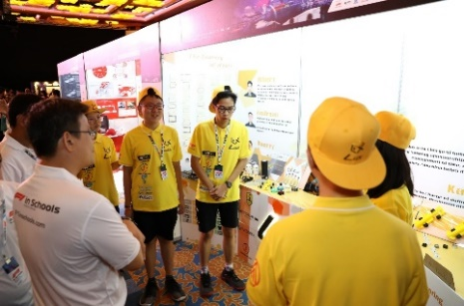
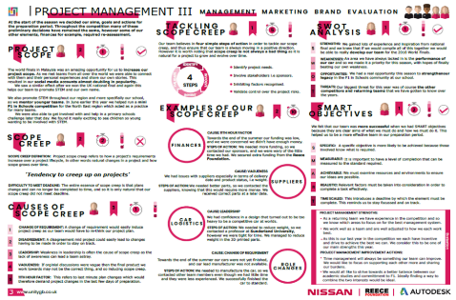
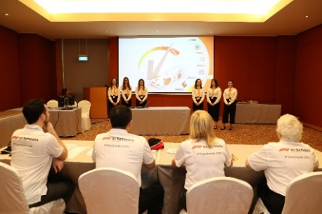
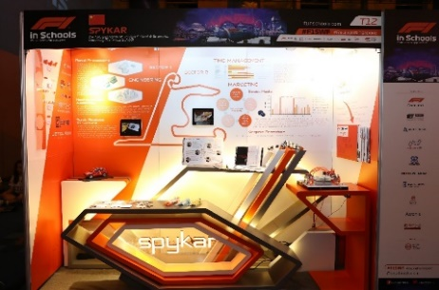
SO MUCH MORE!
Life skills developed through different elements of the Challenge
MARKETING
Students use marketing, PR, and coding skills to design and build their team website and communication strategy to help develop their business plan.
BUSINESS & SPONSORSHIP
Teams prepare a business plan, develop a budget and raise sponsorship using proven project management methodologies. Teams are encouraged to collaborate with industry and create business links.
JUDGING PANELS
Teams enhance their communication skills by presenting to a panel of judges covering all aspects of the challenge, including how their car has been manufactured and why they chose particular designs.
DISPLAY BOOTHS
The Regional, National & World Finals also require students to put together an informative display where a team’s brand really comes to the forefront here

Slide 15
AND IT’S NOT JUST STEM…
Life & Employability Skills:
Project management
Business planning
Financial strategy
Budgeting
Leadership
Teamwork
Sponsorship and Marketing
Communication skills
Branding
Graphic identity
Media skills
International collaboration

Slide 16

COMPETITION FORMAT
Schools, Colleges, Academies, Young Student Groups, Home Schooled
Regional Final
Regional Final
Regional Final
Regional Final
Regional Final
National Final

Slide 17

F1 IN SCHOOLS ACADEMIES
Working with key institutions around the world, we are establishing a global network of F1 in Schools Academies.
These facilities provide access to RESEARCH, MANUFACTURING, TEST and RACE resources for visiting schools.
For colleges and universities, the relationship is symbiotic, as it enables these institutions to recruit students onto courses.
Academies can also host Regional or National Finals.

Slide 18
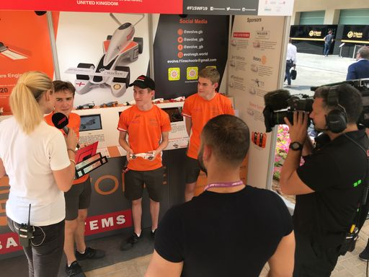
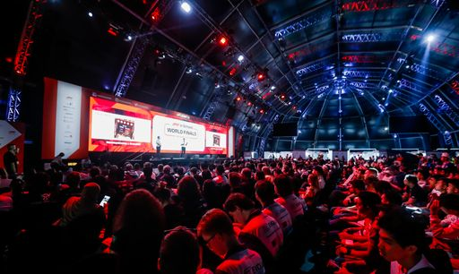
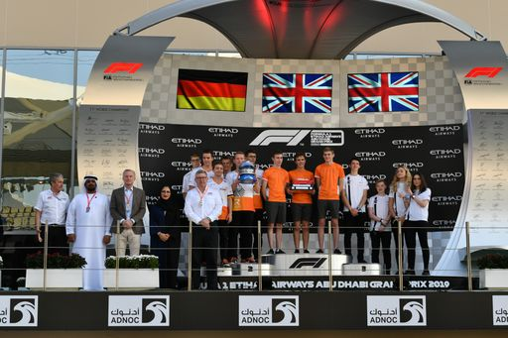
WHERE IT CAN LEAD
Arrive on the global stage with Formula 1
Competing with the best AND aiming for a dream career

Slide 19
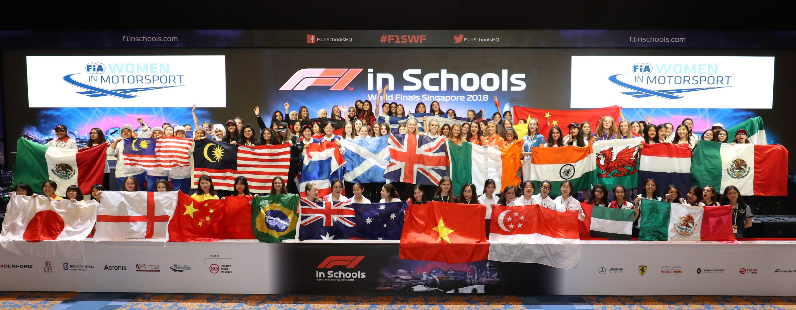
OVER 40% FEMALE PARTICIPATION
57% from BAME background

Slide 20


Mark Wemyss-Holden
UK National Project Manager

Slide 21
First things first…
WHAT?

Slide 22




LIFE
SKILLS
STEM
PLUS
REAL
RACING
AGES
9-19
TEAMS
3-6…
FREE
ENTRY

Slide 23
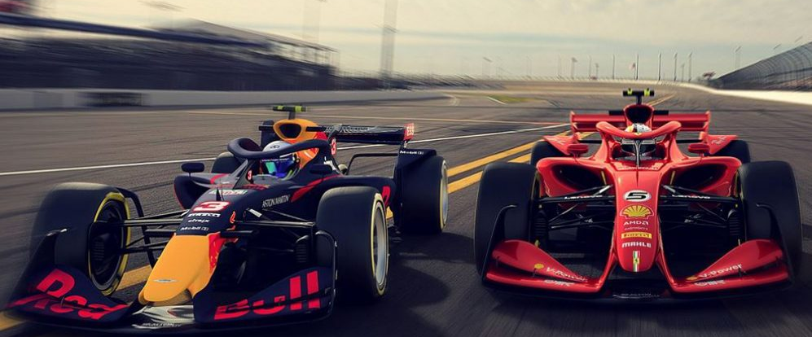
Twilight video link at the end!
What’s in it for pupils?
Designing and manufacturing a working product – it HAS to work!
Trying out real jobs like Project Management, Engineering, Design, Marketing, Sponsorship and Finance
Working together as a team against proper deadlines
Solving problems through innovation
Using Science and Maths to work out how to go faster
Gain CREST Awards for your project work
Business manners and understanding the world outside school…
…and realising money doesn’t grow on trees!

Slide 24
Sounds great, but…
WHY?

Slide 25
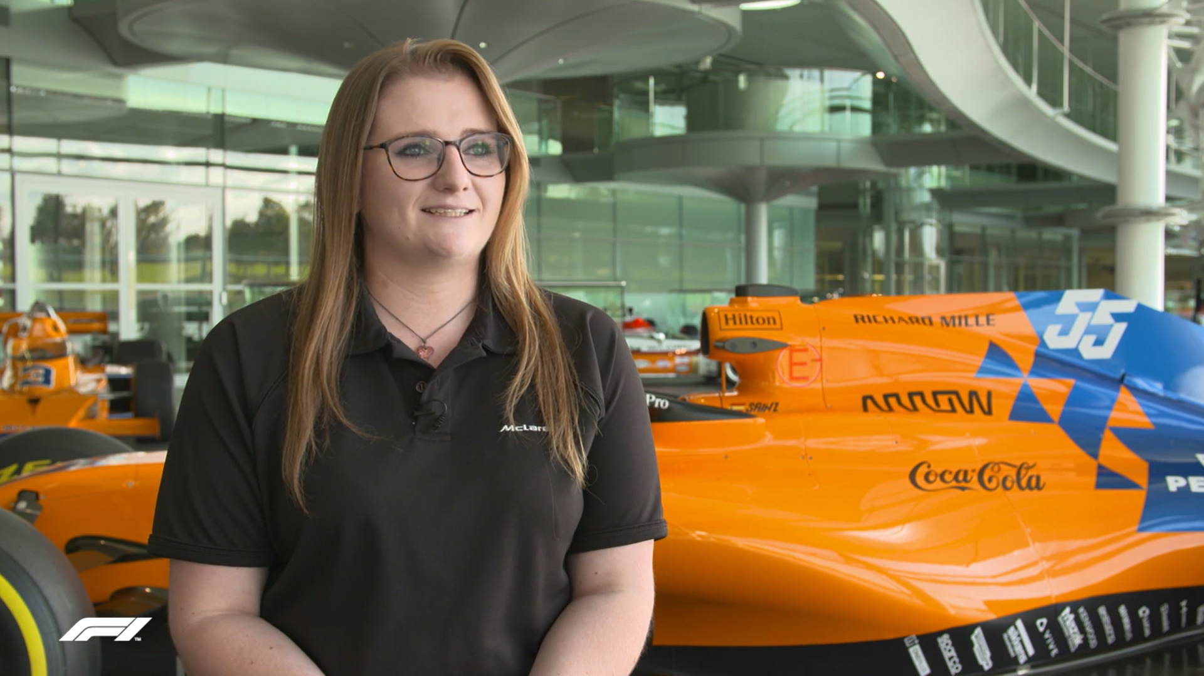
Case study video link at the end!
Raise aspirations…
Mary Aldersley
Operations Graduate, McLaren

Slide 26
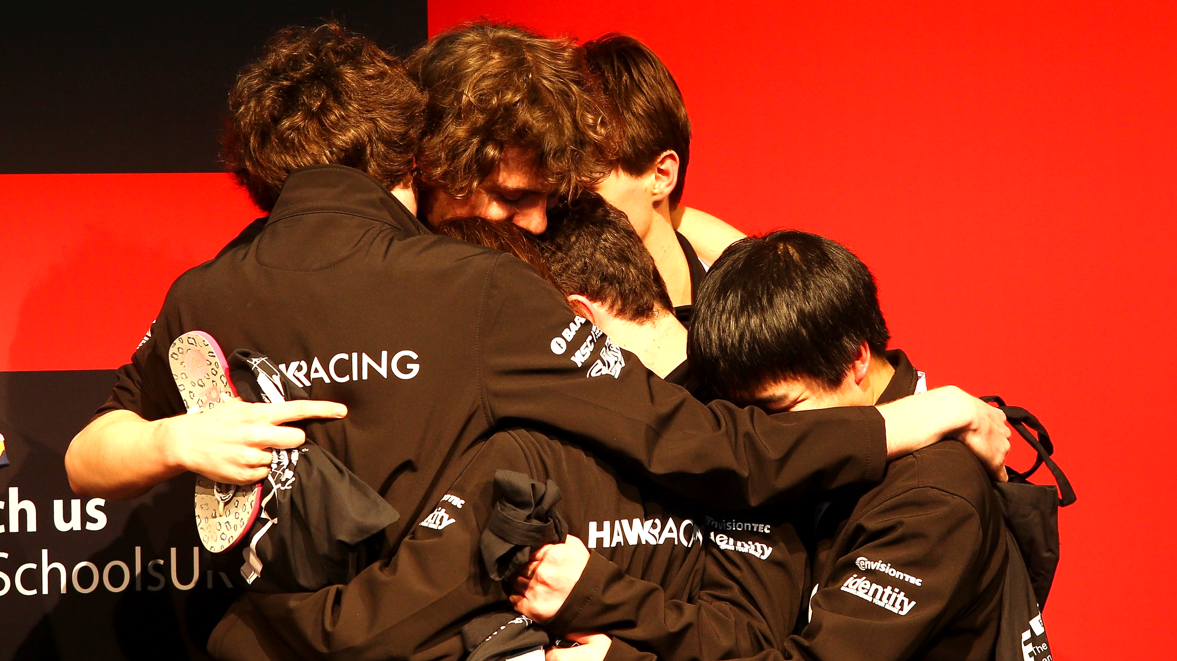
Give pupils a purpose…
Hawk Racing
Colyton Grammar School, Devon

Slide 27
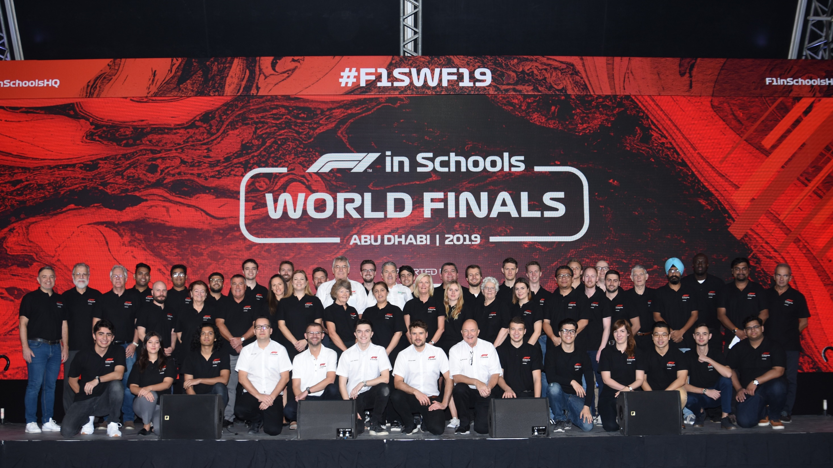
World Finals video link at the end!
Build career confidence…
The Judges!
Industry Professionals Worldwide

Slide 28
Sounds awesome…
HOW?

Slide 29
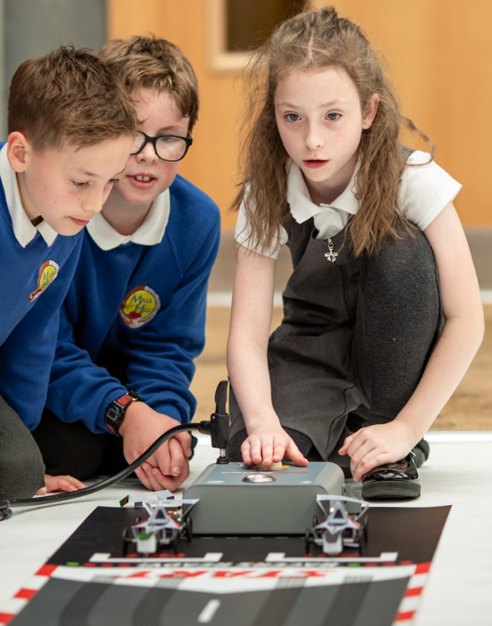
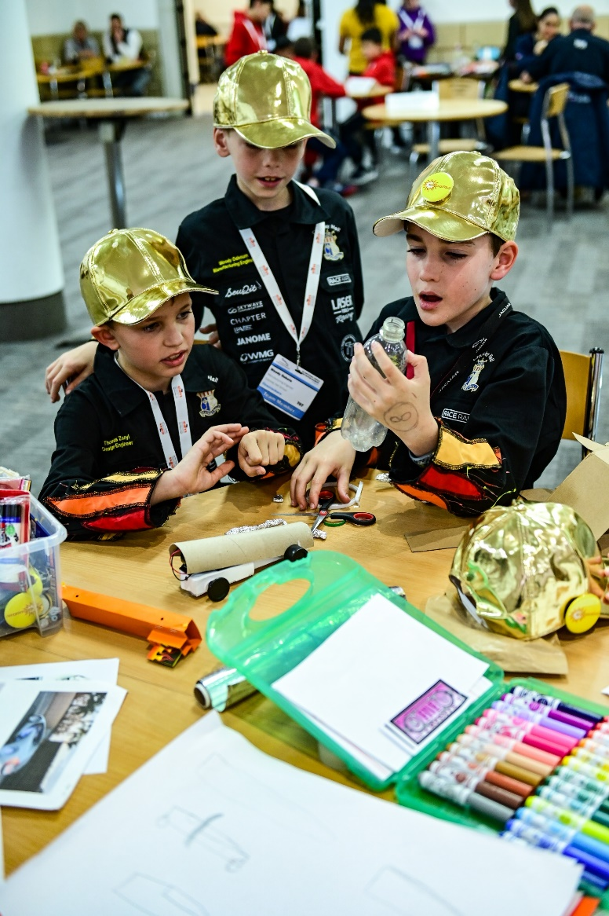
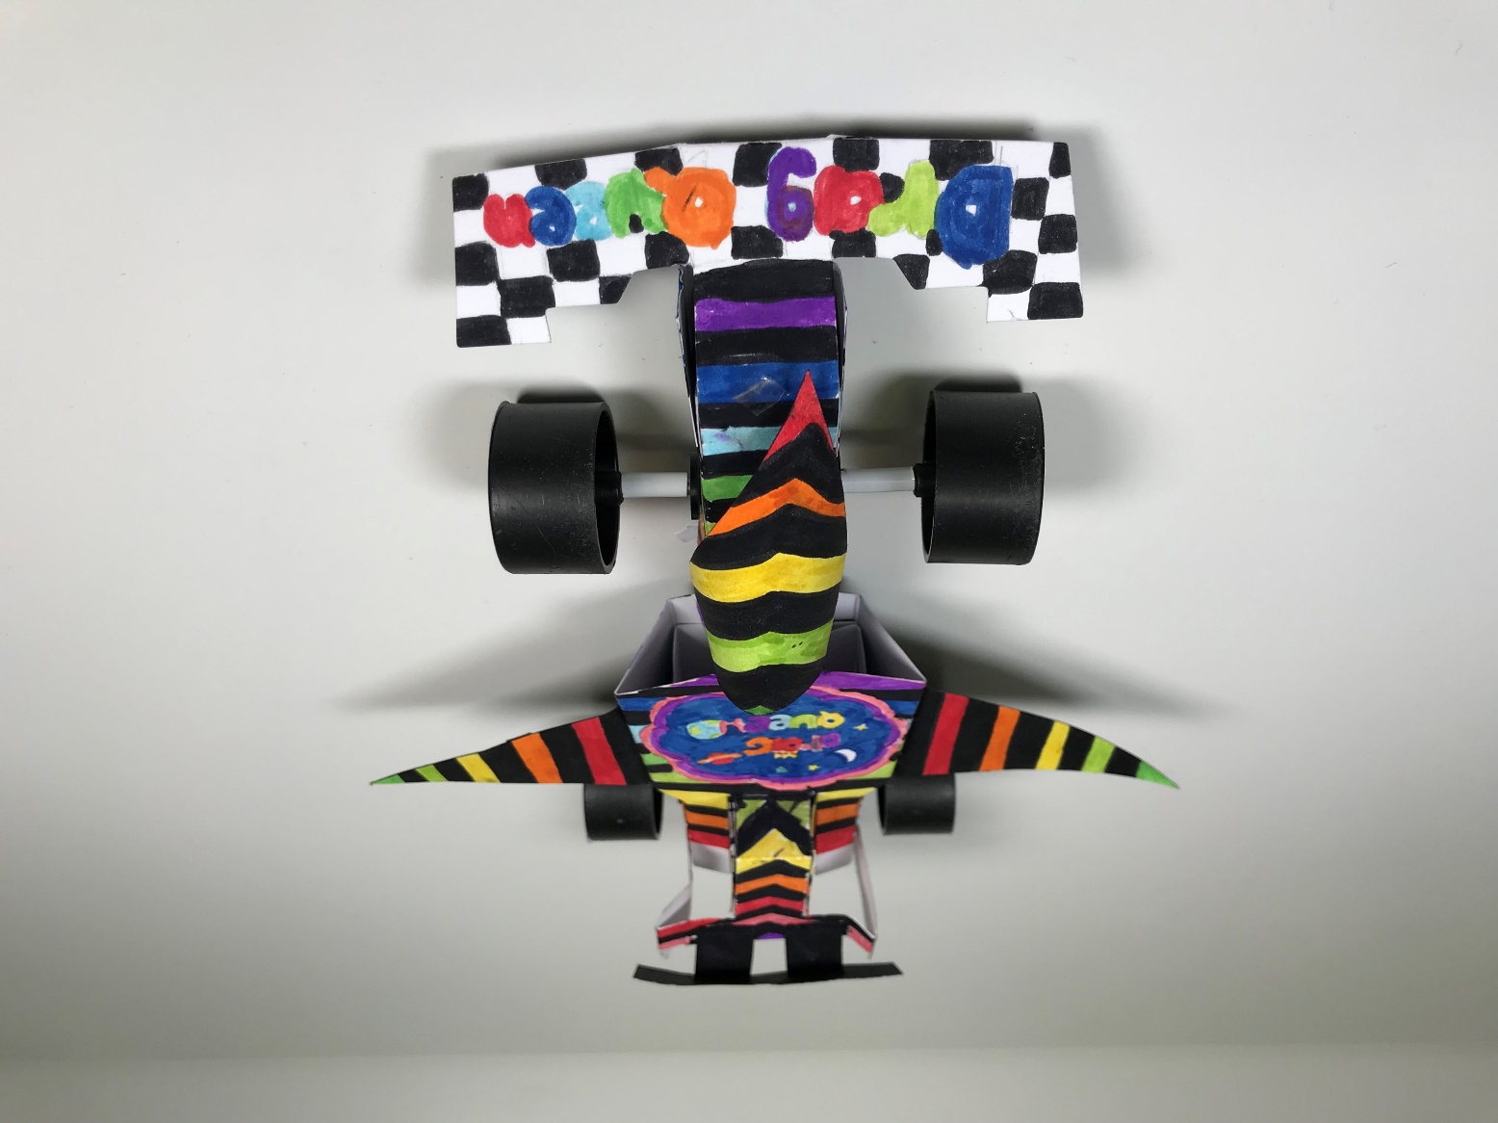
SUMMER / TRANSITION
Primary STEM link at the end!

Slide 30
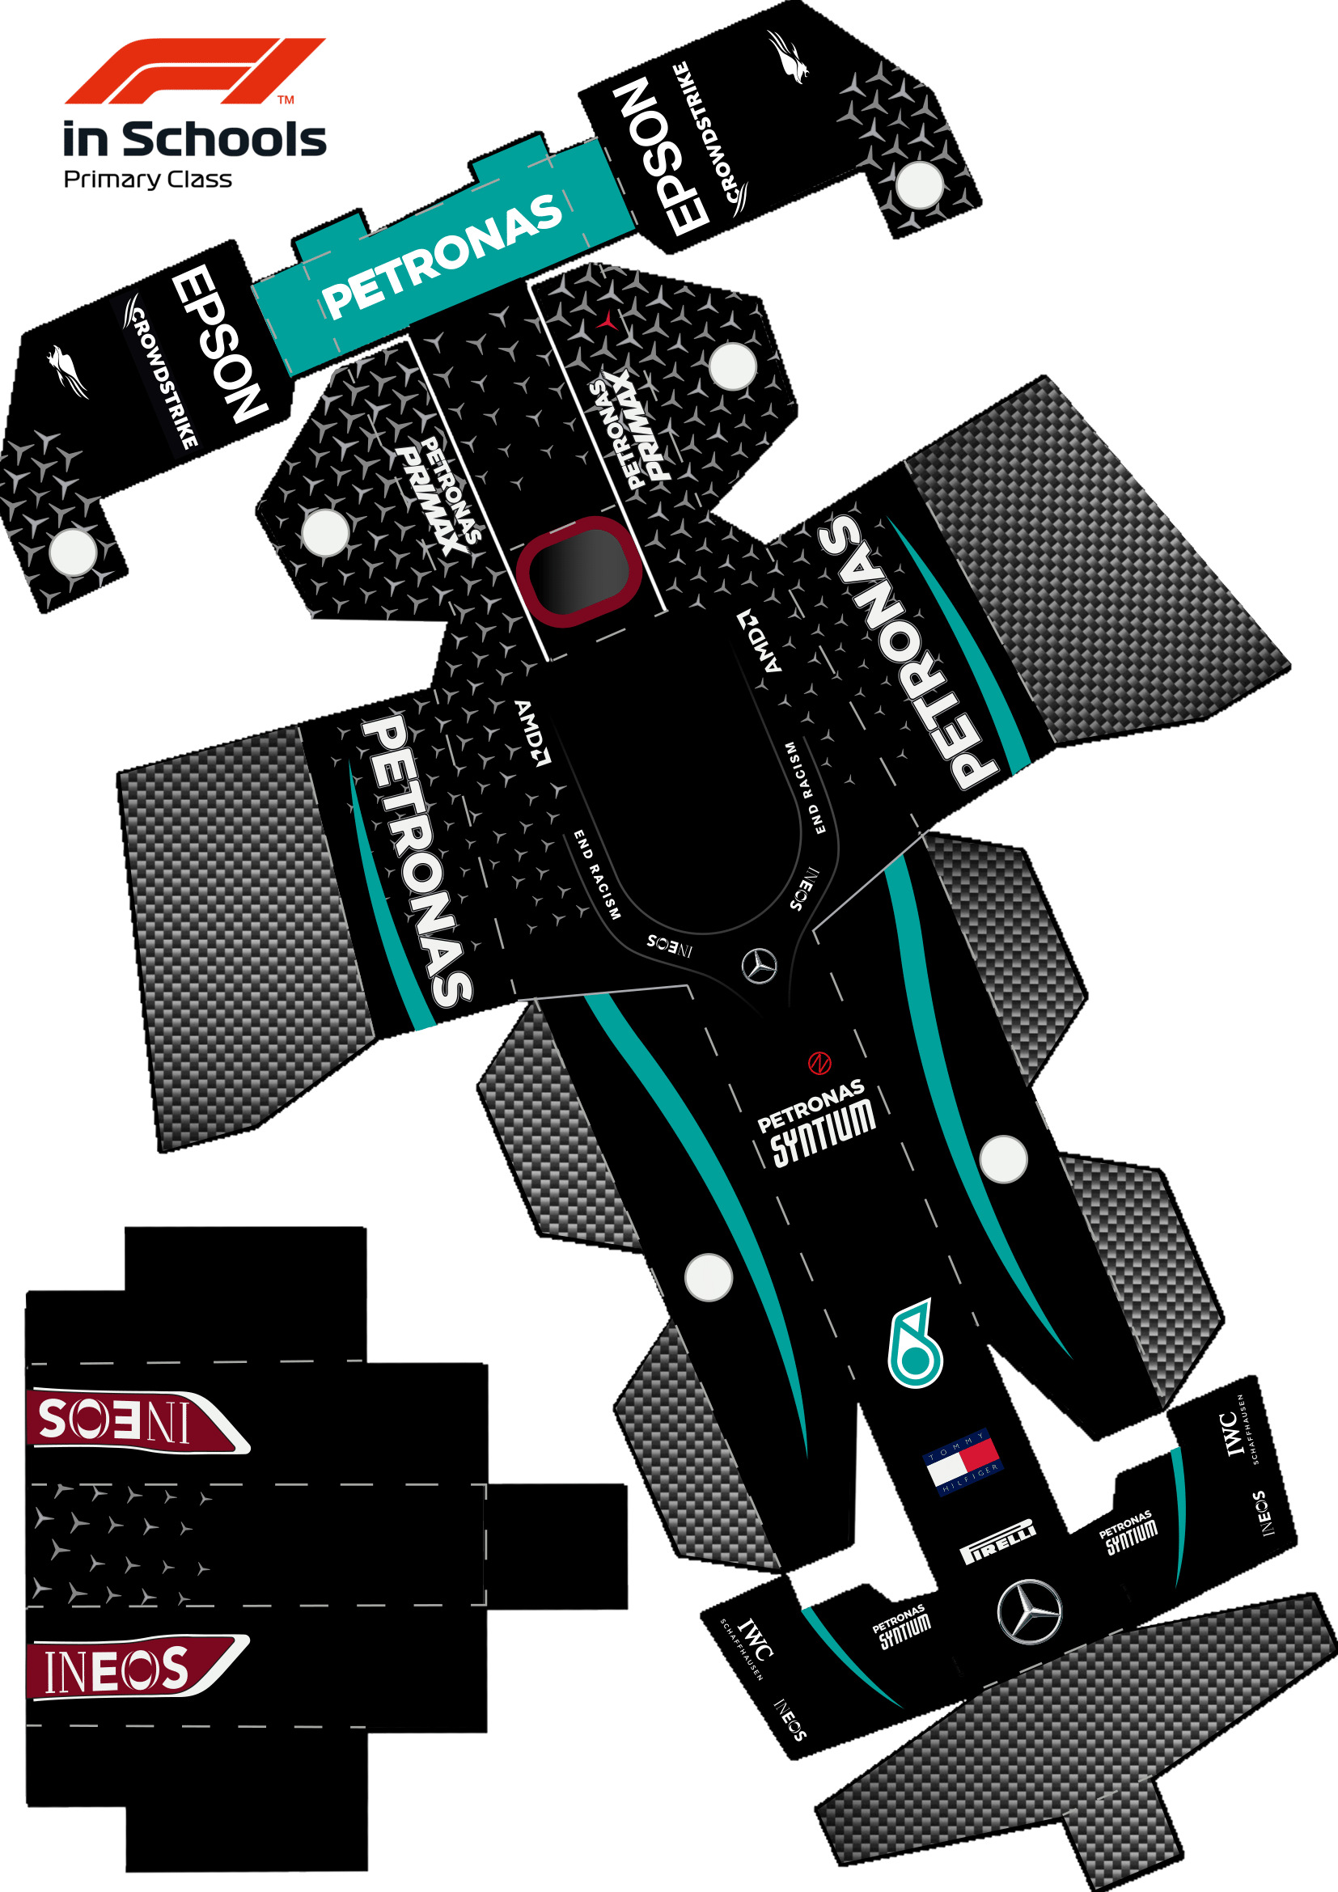
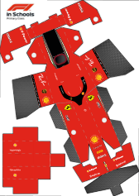
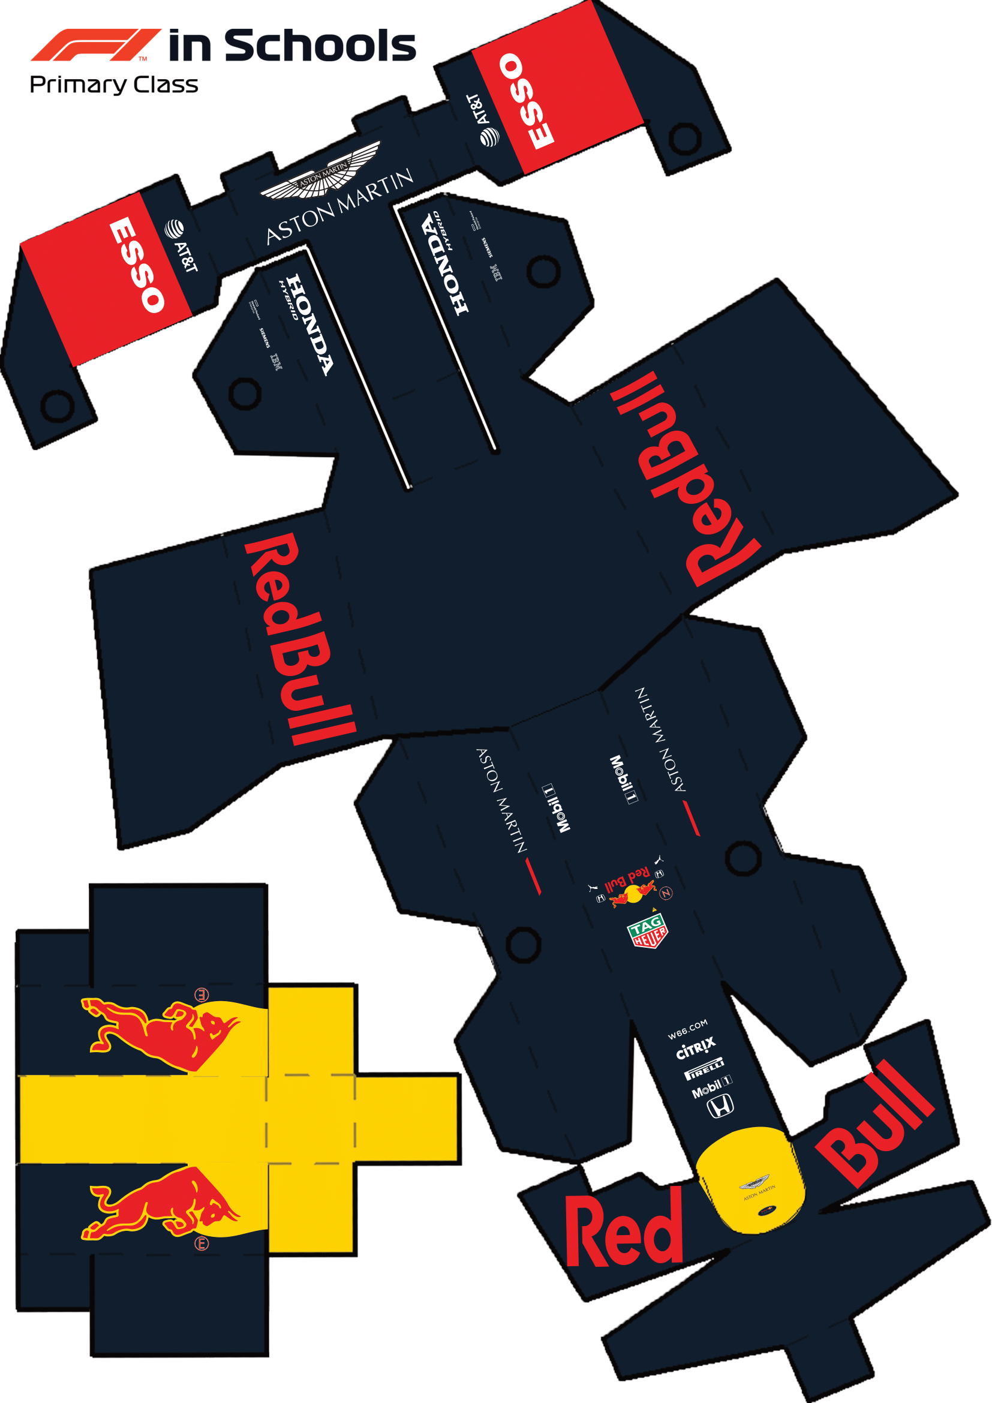
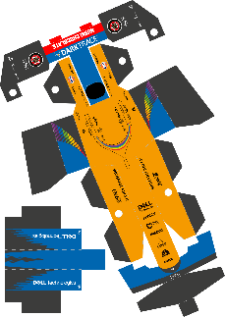






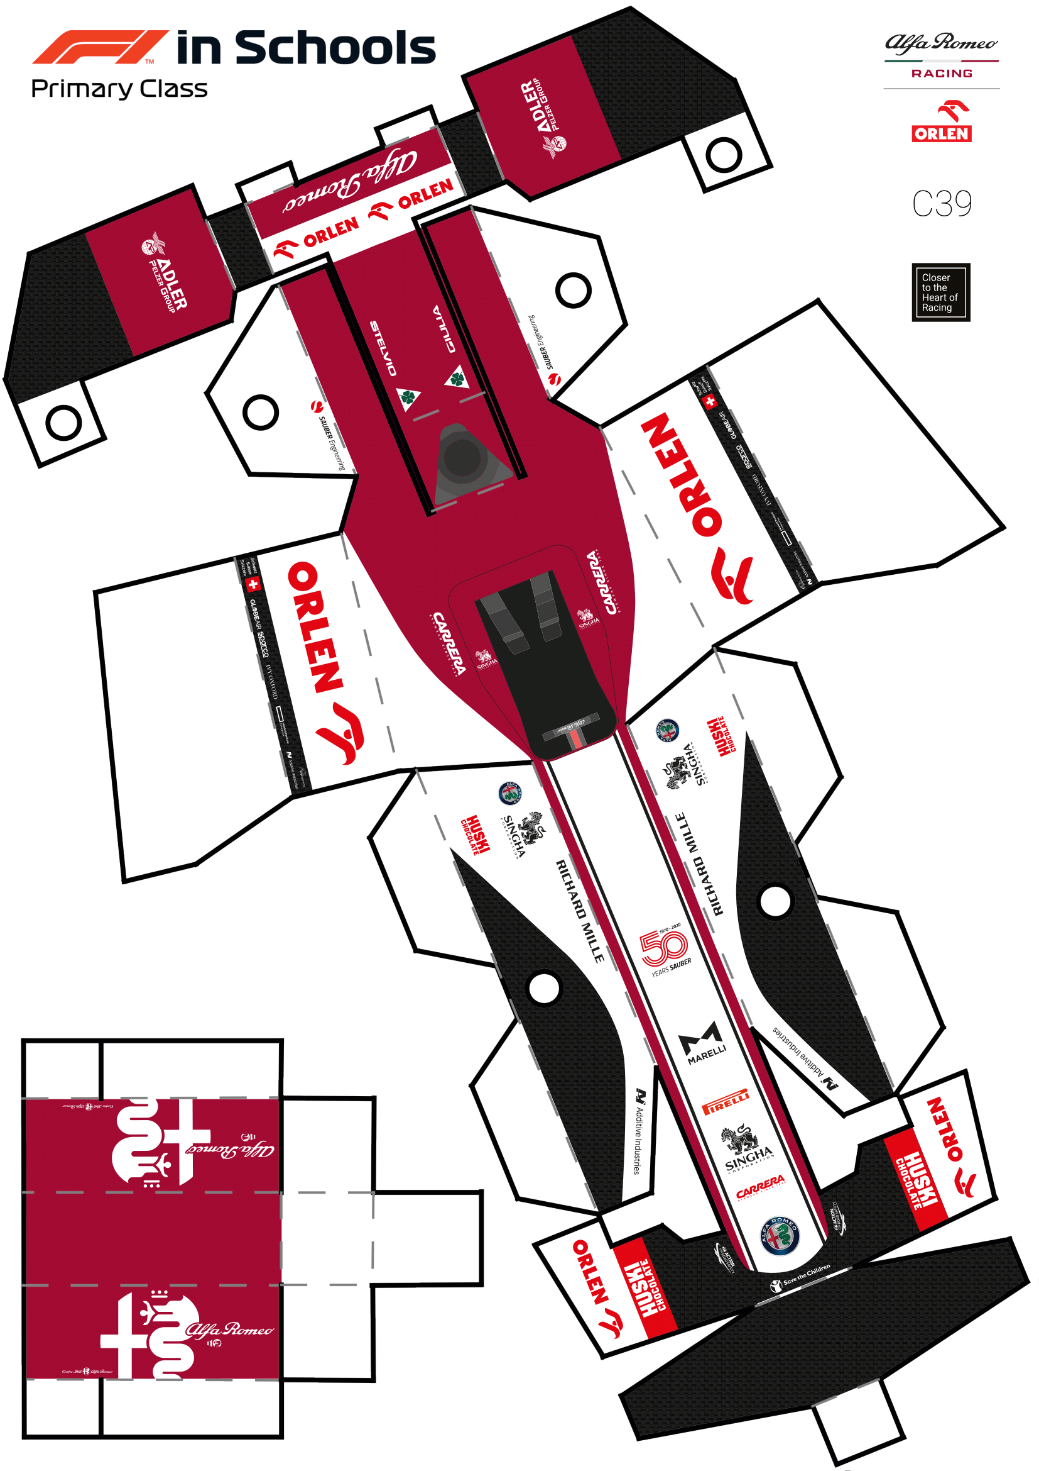
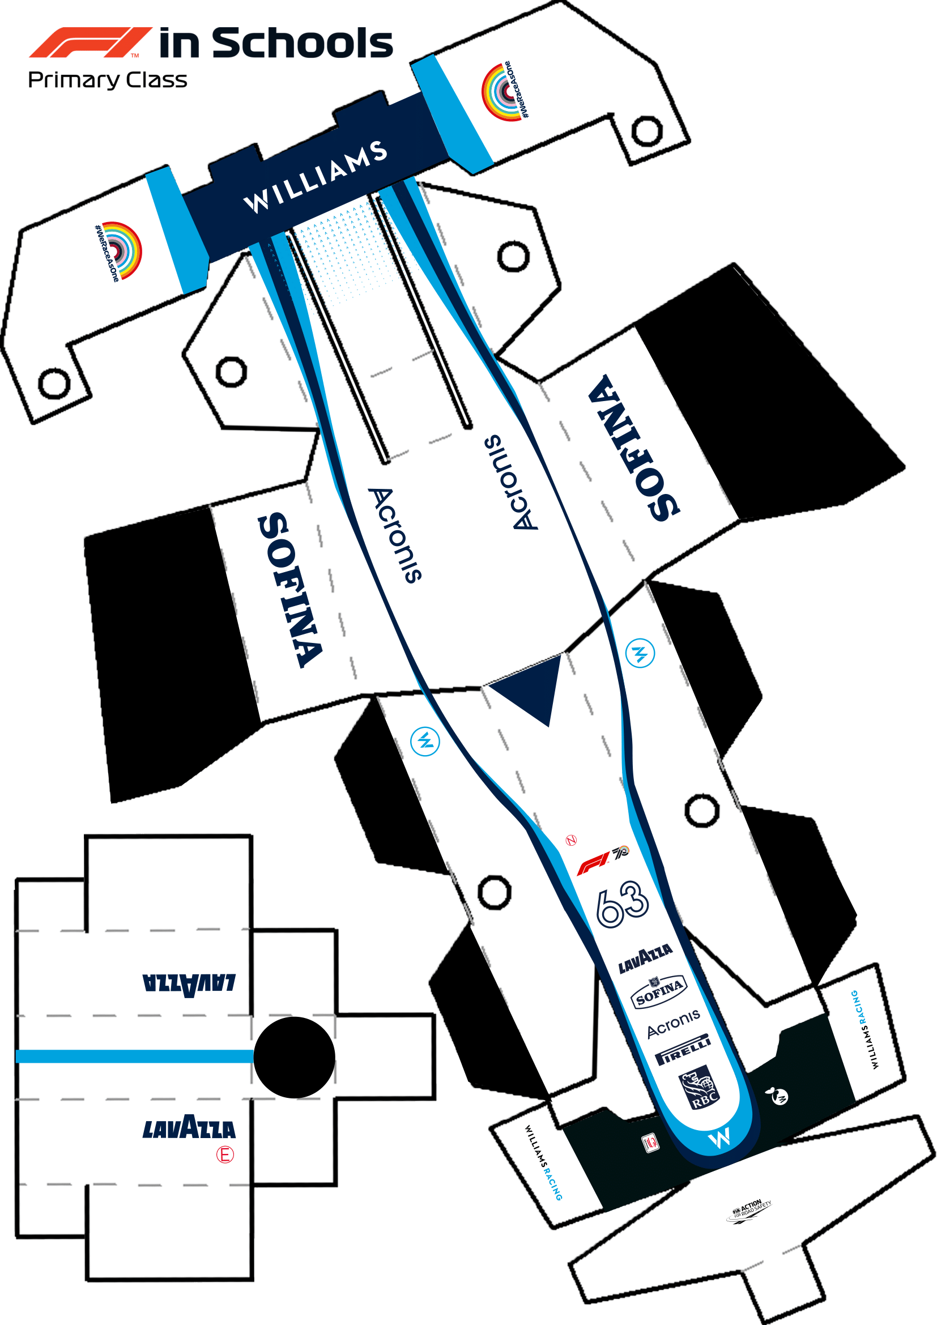
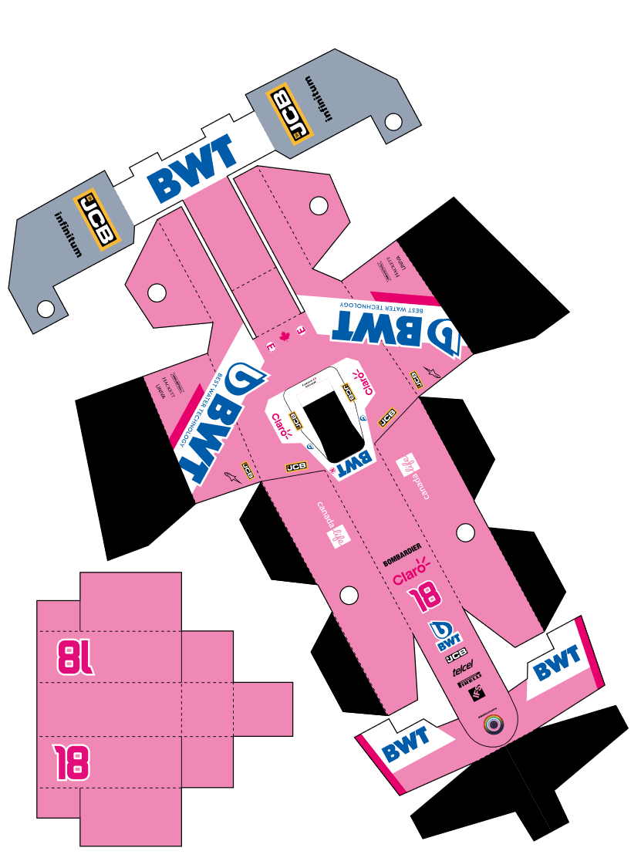
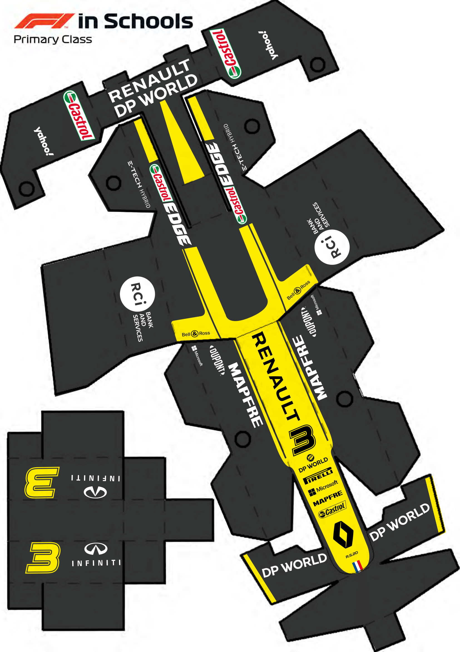





MAKE THE GRID
F1 nets download link at the end!
Download the official F1 team bodyshell nets from the F1 in Schools website, print out, then carefully cut and assemble your own Formula 1 grid! This can make an awesome intro activity…

Slide 31
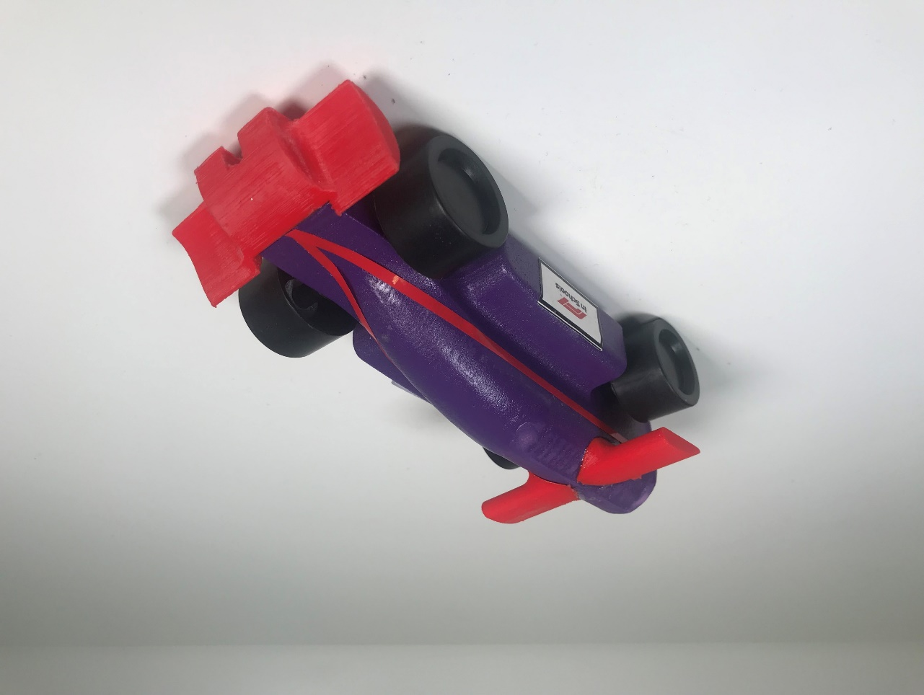
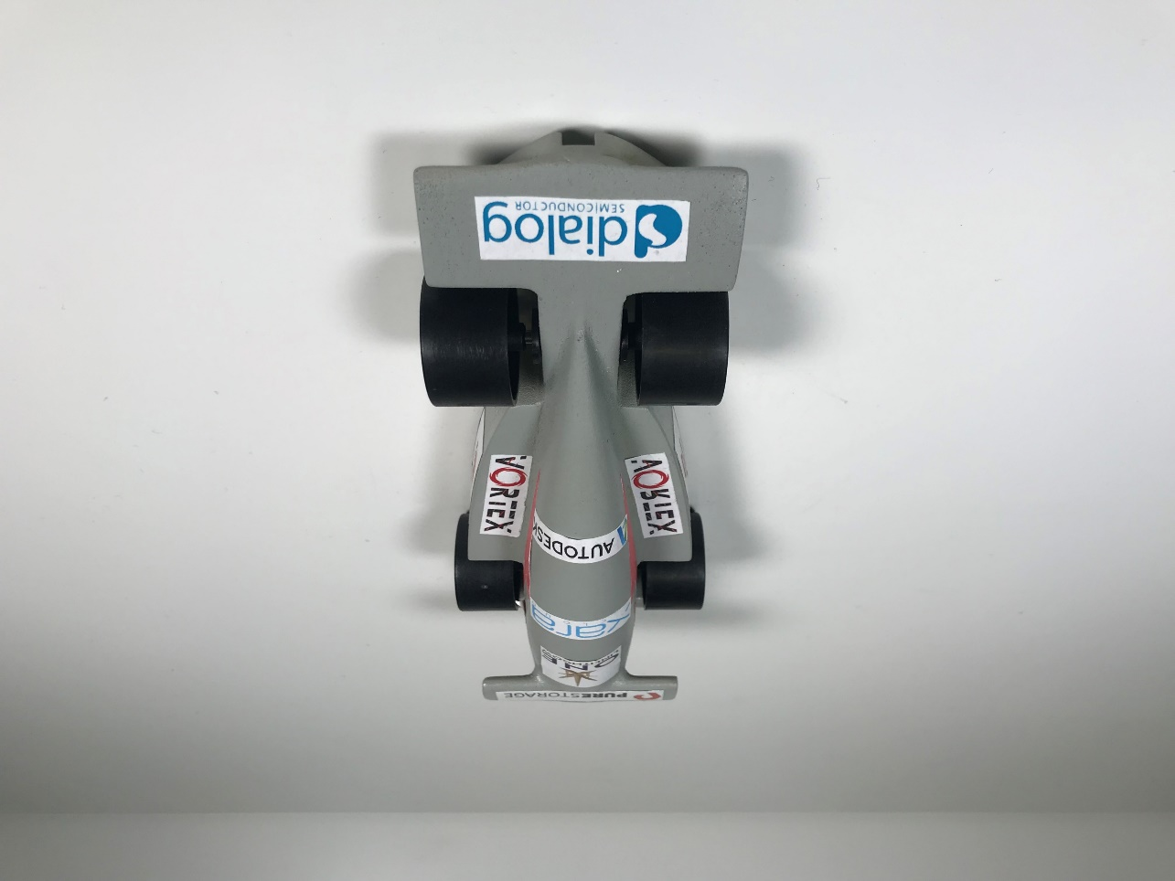
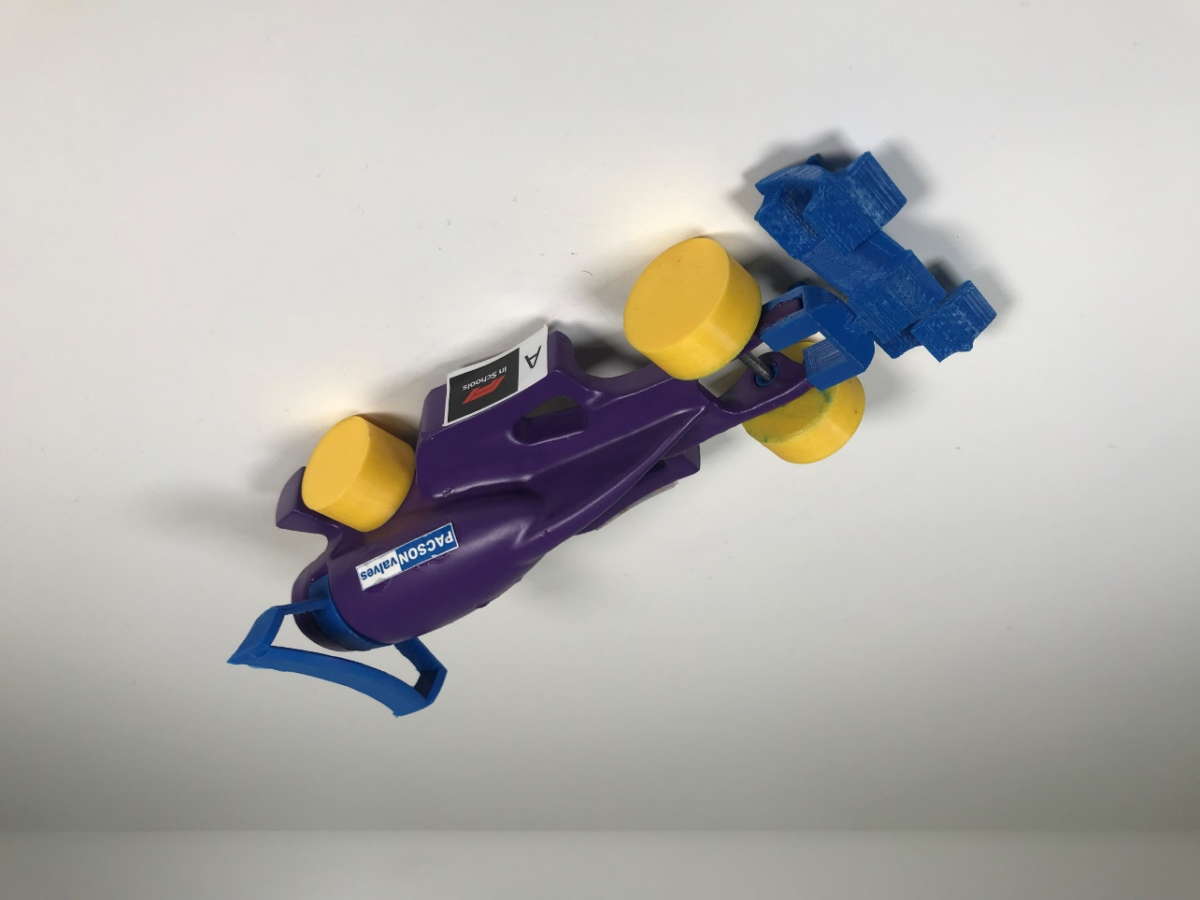



PICK A CLASS
Classes Explainer & Rules and Regulations link at the end!
65g minimum
‘No-Go-Zone’
Standard wheels
Standard axles
8g Power Pack
Average 40km/h
60g minimum
‘No-Go-Zone’
Standard wheels
Standard axles
8g Power Pack
Average 50km/h
50g minimum
‘Virtual Cargo’
Custom wheels
Custom axles
8g Power Pack
Average 75km/h
ENTRY
DEVELOPMENT
PROFESSIONAL

Slide 32
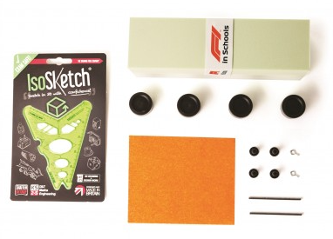
STARTER KIT (£30+)
1-30 cars

Slide 33
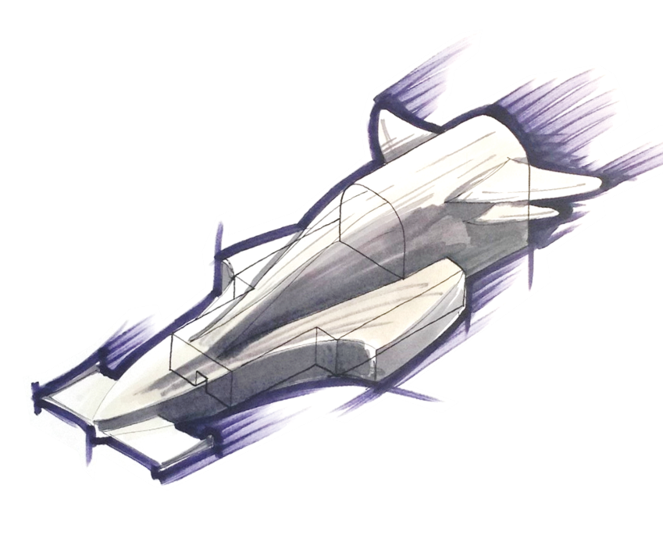
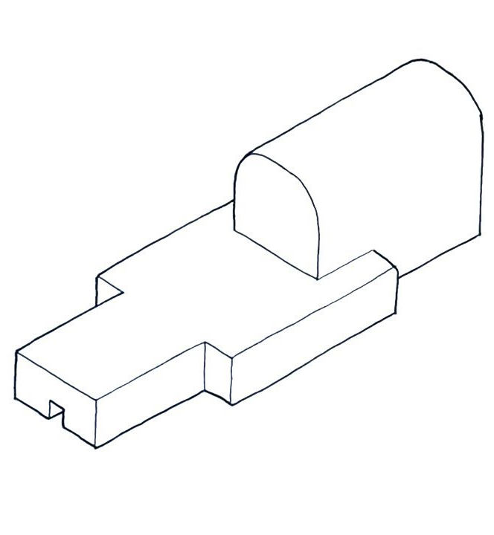
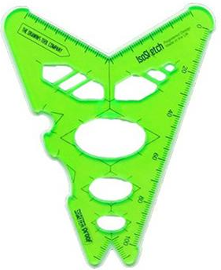

GET CREATIVE!
Design tutorials link at the end!
LEARN
SKETCH
APPLY
CREATE

Slide 34






USE OUR RESOURCES
Kick it off with some rapid sketching and modelling…
Don’t accept “can’t draw” as a reason to skip this vital step, because help is at hand…
Check out our YouTube sketching tutorials using the IsoSketch 3D drawing tool on F1inSchoolsUK
Start with the basics, get them creating loads of different ideas before moving to physical modelling
Download / make a no-go-zone to design around
Card, foam, plasticine, then move onto CAD when the time is right

Slide 35



A ‘NORMAL’ SEASON

Slide 36
It’s 2021 though…
HOW?

Slide 37






VIRTUAL SEASON

Slide 38






















Digital Project Elements
VIRTUAL Pit Display
3D CAD MODEL
VIRTUAL Pit Display
3D CAD MODEL
RACE
Enterprise Portfolio
PDF
RACE
Enterprise Portfolio
PDF
1 x F1 in Schools Race Car
PHYSICAL CAR
Design & Engineering
PDF
1 x F1 in Schools Race Car
PHYSICAL CAR
VIDEO Verbal Presentation
VIDEO
Design & Engineering
PDF
VIDEO Verbal Presentation
VIDEO

Slide 39



Slide 40

VIRTUAL EVENTS
Regional Finals link at the end!

Slide 41

F1 in Schools Playlist link at the end!
In (very brief) summary…
Entry points whatever your budget, resources or ambition
It’s free to enter… it could actually MAKE you money
CREST Awards when you make it to Regional Finals
It works when you don’t!
Empower your students to look beyond you and school
Run it as extra-curricular, no forced planning or monitoring
Smash cross-curricular collaboration and Gatsby Benchmarks
Be a shining light at a challenging time for everyone

Slide 42
Thanks for your time!
For more information visit: www.F1inSchools.co.uk
Any questions, just ask…
mwh@f1inschools.co.uk | 07799 873116

Slide 44
VIDEO LINKS
Here are all the video links we referred to in the show, in the order they appeared. Please view the videos at your leisure; feel free to share and show your pupils!
F1 in Schools – Twilight Activity Session
Mary Aldersley – Case Studio video
F1 in Schools World Finals – Highlights
Primary STEM Project website
F1 Bodyshell Nets DOWNLOAD
F1 in Schools – Classes Explainer
Rules & Regulations DOWNLOAD
F1 in Schools – Design Tutorials
F1 in Schools – Regional Finals 2021
F1 in Schools – Full Resource Playlist

