Slide 1
Business day
Notes:
Some images in this presentation are used under creative Commons licenses: https://creativecommons.org/licenses/by/2.0/

Slide 2
Inspiring innovation
Learning objectives:
To consider the commercial viability of your product as a group
To explore and develop your brand
To think about the impact of
Product placement
Celebrity endorsement
Catch phrases
To be able to identify the different forms of intellectual property
To apply this knowledge to your own product
Notes:
2
Give groups of 3-4 students large sheets of paper onto which they should give a title and summary of their design. Groups can add answer sheets, logo and slogan designs and use the sheets as the basis of presentations at the end of the session.

Slide 3
Name the entrepreneur & their product/brand
Notes:
Answer sheets

Slide 4
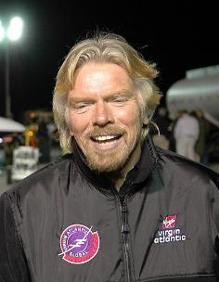
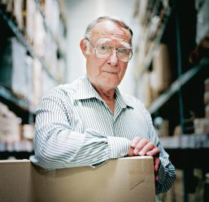
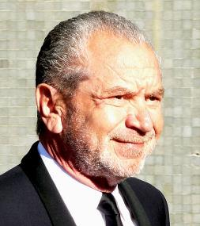
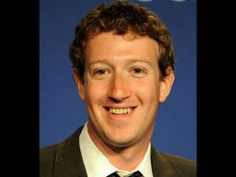
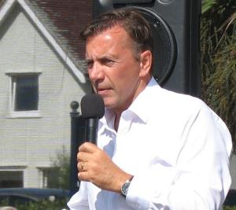
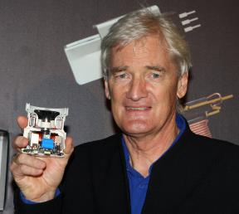
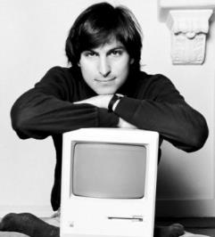
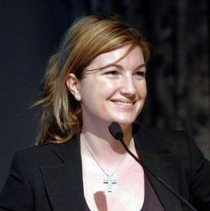
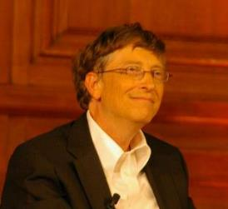
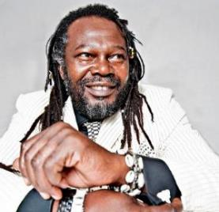
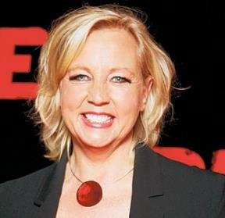
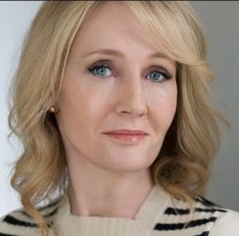
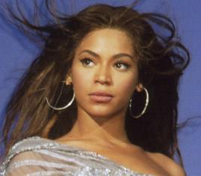
1
2
3
4
5
6
7
8
9
10
11
12
13
Notes:
Students work in pairs and complete sheet. Name and their product/brand
Prize awarded to winning pair
Richard Branson – Virgin
Ingvar Kamprad – Ikea
Lord Alan Sugar – Amstrad (Dragons Den)
Mark Zuckerberg – Facebook
Bill Gates – Microsoft
Duncan Bannatyne – Bannatyne’s (Health Clubs)
James Dyson – Dyson (Vacuum)
Steve Jobs – Apple Company
Baroness Karren Brady – Vice Chair West Ham United, Journalist and star of Apprentice
Beyonce – Popstar and brand (perfume, clothing, makeup)
Levi Roots – Reggae Reggae Sauce
Deborah Meaden – Hotel industry and Dragons Den
JK Rowling – Author (Harry Potter)
Images: Public Domain; Creative Commons: Guillaume Paumier, CC-BY; The Rambling Man; James Dyson; John Morris; John Ferguson;
IKEA.com; apple-talk.com; jkrowling.com

Slide 5
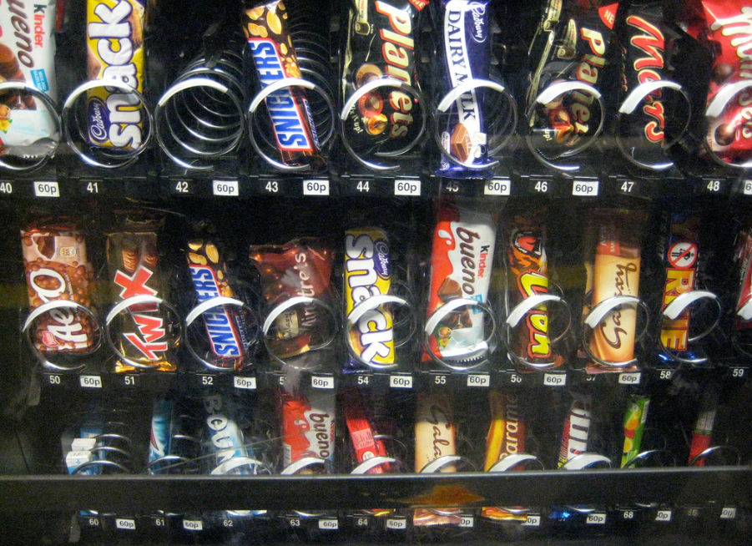
From the picture, which brands can you identify? Write these on your sticky note…
How did you identify them?
Colours
Type font
Shape
Notes:
Image: Creative Commons: Phil Whitehouse

Slide 6
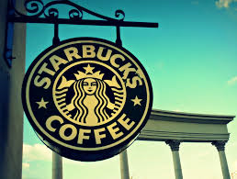
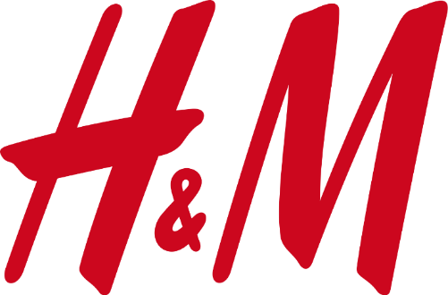
What brand am I?
3
2.
1.
5.
4.
6.
7.
Notes:
Images:
Coca Cola - https://upload.wikimedia.org/wikipedia/commons/thumb/c/ce/Coca-Cola_logo.svg/2000px-Coca-Cola_logo.svg.png
Sony - https://upload.wikimedia.org/wikipedia/commons/thumb/c/ca/Sony_logo.svg/2000px-Sony_logo.svg.png
Starbucks - https://pixabay.com/p-1069758/?no_redirect
Google - https://upload.wikimedia.org/wikipedia/commons/5/51/Google.png
Mcdonalds - https://upload.wikimedia.org/wikipedia/commons/thumb/a/a9/Mcdonalds-90s-logo.svg/1014px-Mcdonalds-90s-logo.svg.png
Ebay - https://upload.wikimedia.org/wikipedia/commons/thumb/1/11/EBay_former_logo.svg/1543px-EBay_former_logo.svg.png
H&M - https://upload.wikimedia.org/wikipedia/commons/thumb/5/53/H%26M-Logo.svg/1280px-H%26M-Logo.svg.png

Slide 7
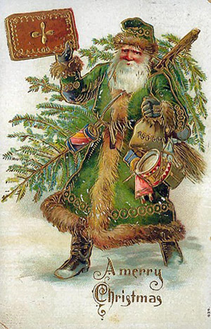
Father Christmas was originally GREEN!
Why do we think of him now as RED?
Notes:
Due to the branding of Coca Cola portraying Father Christmas in the Coca Cola Red – the perception of Father Christmas is now that he is RED.
Images:
Coca cola - https://upload.wikimedia.org/wikipedia/commons/thumb/c/ce/Coca-Cola_logo.svg/2000px-Coca-Cola_logo.svg.png
Father Christmas - http://3.bp.blogspot.com/_s5iNjHF-jmk/SUG1y7yYWJI/AAAAAAAAAX0/VS0ndd0Z9c8/s200/Father+Christmas.jpg

Slide 8
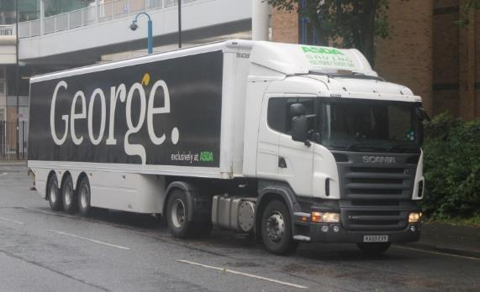
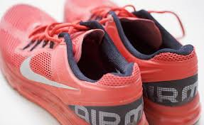
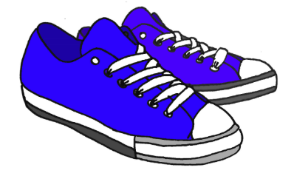
What words do you associate with the following brands?
How much would you pay for trainers from Nike in comparison to trainers from Asda?
1.
2.
3.
4.
5.
1.
2.
3.
4.
5.
Why are people prepared to pay more for certain brands?
Notes:
Discussion on brand reputation, perceived quality etc.
Images:
Nike - https://upload.wikimedia.org/wikipedia/commons/thumb/a/a6/Logo_NIKE.svg/640px-Logo_NIKE.svg.png
Asda - https://c1.staticflickr.com/8/7114/7487482204_d3e7a5354f_b.jpg
Trainers – plain - http://www.publicdomainpictures.net/pictures/40000/velka/blue-trainers.jpg

Slide 9
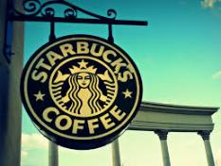
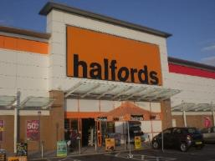
Your product…
Imagine that the product you created last lesson was to be mass produced and sold in high street stores
Who is your product aimed at?
What are the unique selling features of your product (USP)?
What brand would you choose to sell your product from? (You can choose any brand)
Is there a suitable brand or would you need to recreate your own?
Think about what colours would be suitable?
What would you not like to associate with your product?
Notes:
Images, as previously, and:
Mothercare - http://maternidadcomopuedas.com/wp-content/uploads/2016/07/mothercare-logo.jpg
Halfords - http://upload.wikimedia.org/wikipedia/commons/e/e6/Halfords_Ocean_Park.JPG

Slide 10
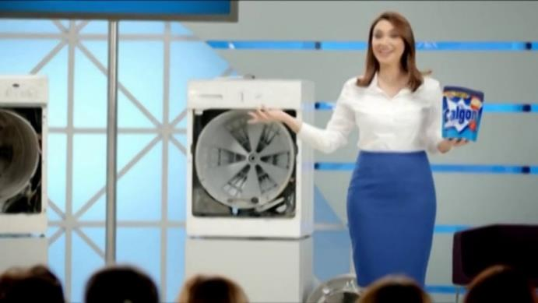
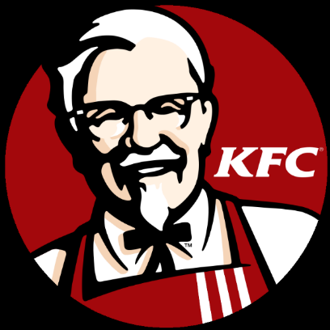
Guess the catch phrase…
Because you’re worth it
Finger lickin’ good!
Washing machines live longer with Calgon
What could be the logo and catch phrase for your product?
Just do it
Notes:
Students to design a logo and catch phrase for their product
Images:
Maybelline - https://upload.wikimedia.org/wikipedia/commons/7/7c/Maybelline_logo_png.png
Calgon - http://i.vimeocdn.com/video/433299795_1280x720.jpg
KFC - http://upload.wikimedia.org/wikipedia/en/thumb/b/bf/KFC_logo.svg/768px-KFC_logo.svg.png

Slide 11
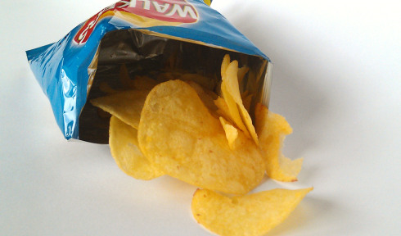
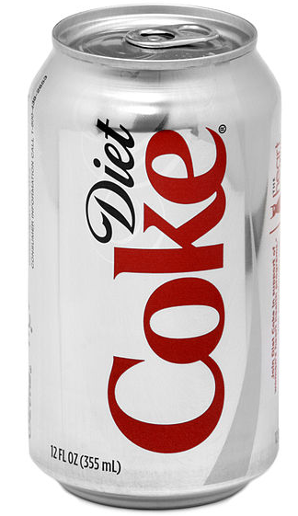
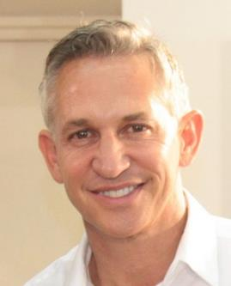
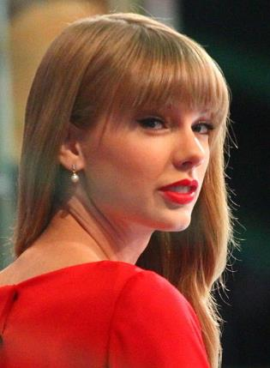
What celebrity would you associate with these products/brands?
Reveal the celebrities…
Which celebrity could endorse your product?
Notes:
Images:
Crisps - https://upload.wikimedia.org/wikipedia/en/7/74/Packet_of_Walkers_Salt_%26_Vinegar_crisps.jpg
Gary Lineker - https://c1.staticflickr.com/4/3770/10343539824_594ff574f7_b.jpg
Taylor Swift – https://commons.wikimedia.org/wiki/File:Taylor_Swift_GMA_2012.jpg
Diet Coke can – Public Domain
Pencil - https://pixabay.com/static/uploads/photo/2015/08/29/14/49/pencil-913101_960_720.png

Slide 12
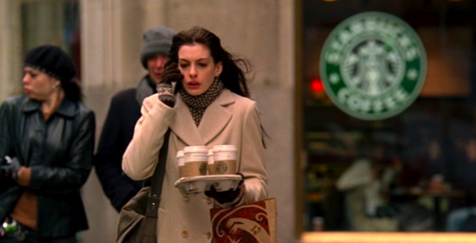
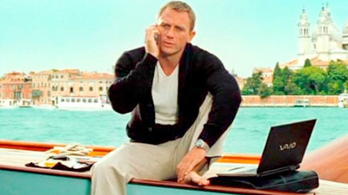
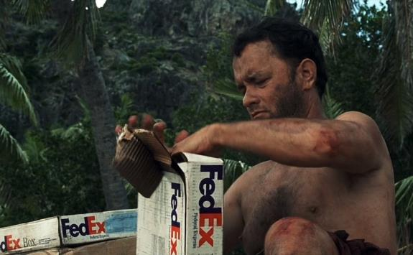
Guess what film each picture is from…
Devil Wears Prada
James Bond - Skyfall
Castaway
Notes:
Images:
James bond - http://www.joescaramanga.co.uk/blog/wp-content/uploads/2012/10/casino-royale-laptop.jpg
Lotus James bond - https://nomequieroquedar.files.wordpress.com/2012/07/james_bond_lotus-600x391.jpg?w=300
Castaway - http://static5.businessinsider.com
Devil wears Prada - http://2.bp.blogspot.com/-mmbg-s8fYdI/US4XR4FxEOI/AAAAAAAAAEs/DUJ38-7MaUc/s1600/Starbucks.png

Slide 13
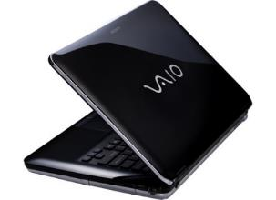
Product Placement
This is called Product Placement – where a product is purposely placed in a film/program/series so that its target audience sees the product being used by people or in environments that they may look up to.
James Bond - Skyfall
Which film would you place your product in to reach the right audience?
Notes:
Image:
Vaio laptop - http://woikr.com/wp/wp-content/uploads/2009/05/vaio-cs-24-black.jpg

Slide 14
So I had an idea…
Notes:
Steal an idea from the students’ designs.
Explain the concept to the students… see if anyone realises that it’s their idea.
Ask for their thoughts on MY idea… do they like it?... will it work?

Slide 15
How did you feel?
How could you stop other people from stealing your ideas and claiming them as their own?
Notes:
This question could lead to discussions depending on what pupils know about patents, copyright, trademarks and designs.
Images:
Red face - https://cdn.pixabay.com/photo/2013/07/13/09/38/smiley-155846_960_720.png

Slide 16
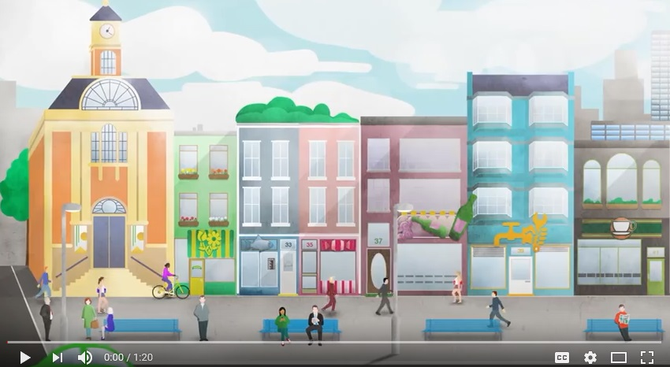
What is Intellectual Property?
Notes:
Photo is hyperlinked to https://www.youtube.com/watch?v=AYiXTKbdNr4
An alternative video from Durham University is available at: https://www.youtube.com/watch?v=EQsZf2G4Sdc

Slide 17
Patents

Slide 18
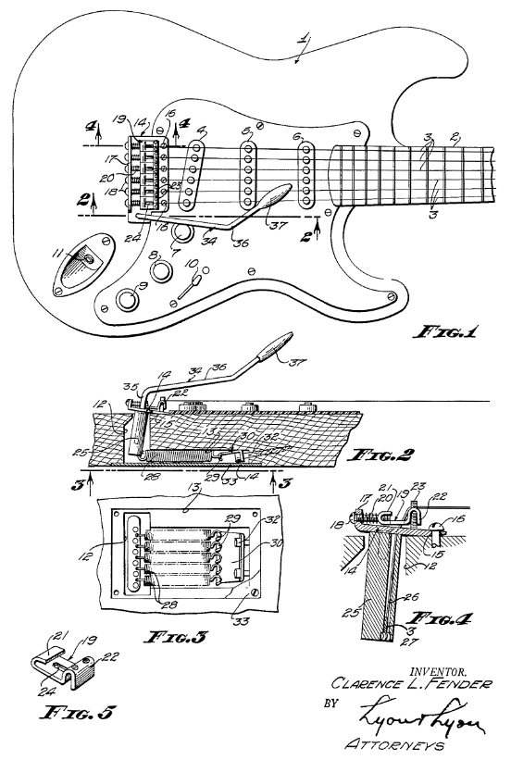
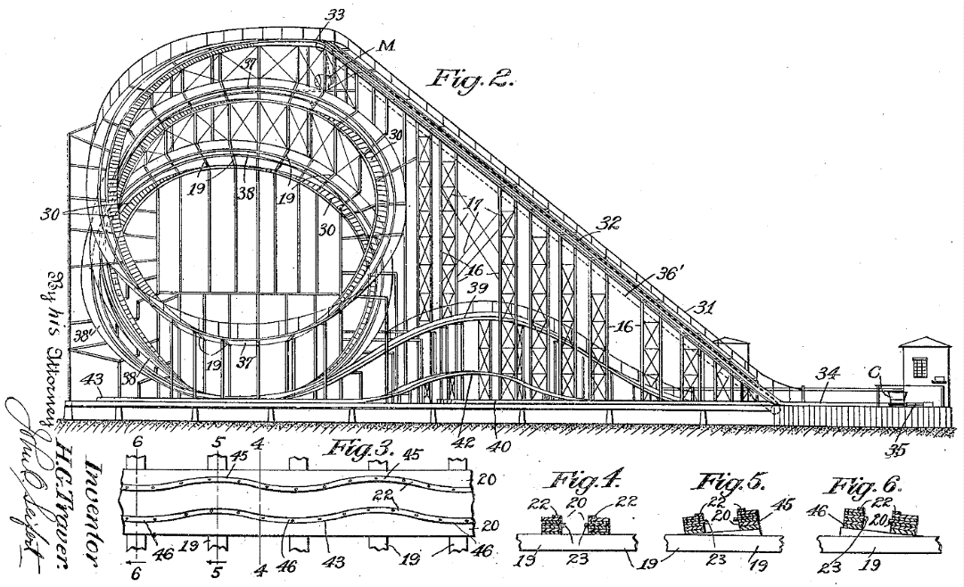
What are these?
Patents
Notes:
Images: Public Domain
Harry G. Traver: Cyclone roller coaster patent
Fender: Tremolo Patent Diagram for Fender guitar

Slide 19
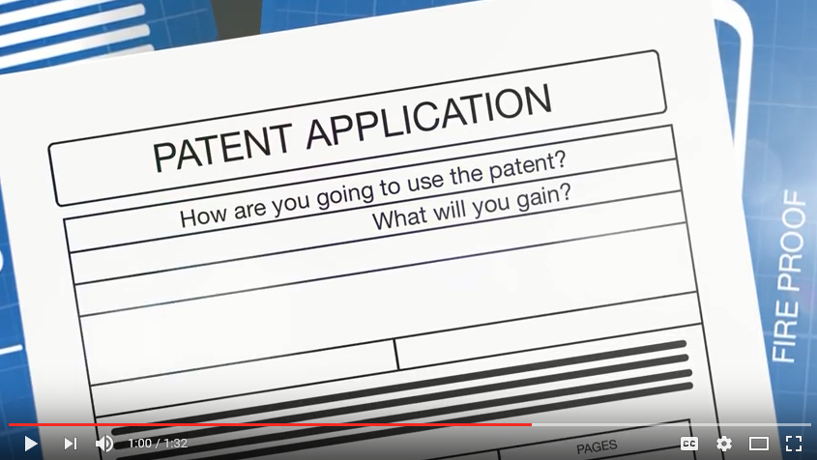
Do I need a patent?
Patents
Notes:
Link to video:
https://www.youtube.com/watch?v=4sCMwbNuWqA

Slide 20
Patents
Patents
Protects something that can be made or used; it must be new and inventive (not just a simple modification to something that already exists).
Lasts for up to 20 years.
Lets inventors profit from their inventions.
Inventions must be kept confidential for them to be patentable.

Slide 21
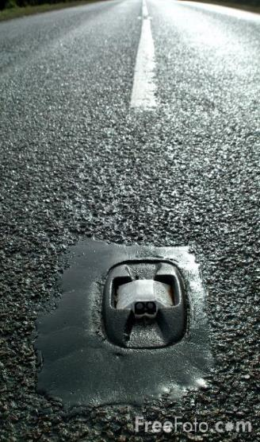
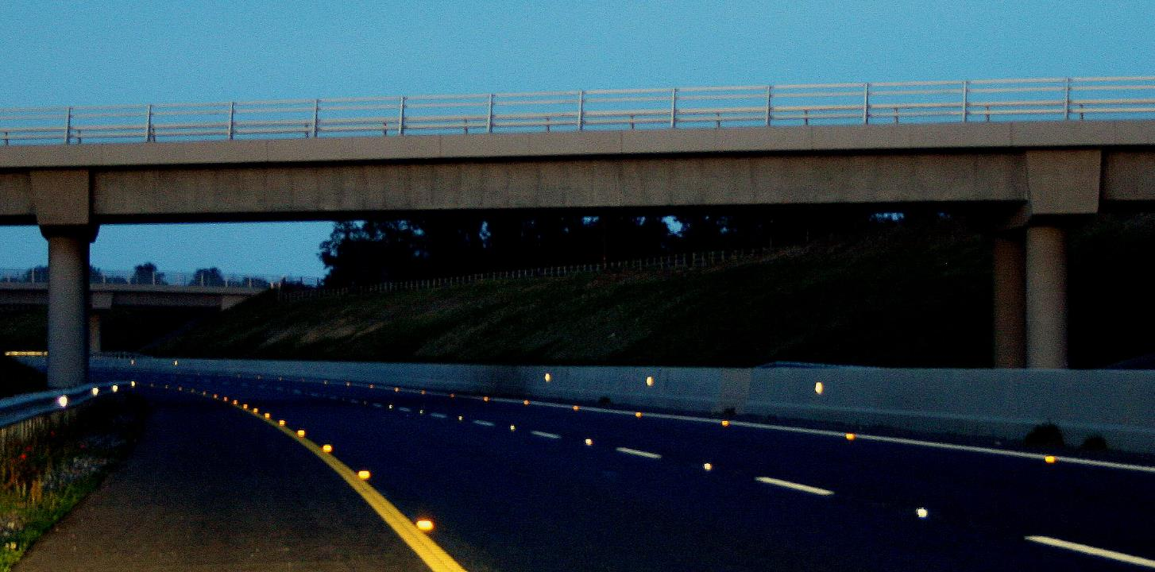
There is product on the road that has a patent – what do you think it is?
Patents
Notes:
Images:
Road- https://upload.wikimedia.org/wikipedia/commons/4/43/M9_motorway_Carlow_Ireland_catseyes.jpg
Cats eye - freefoto.com

Slide 22
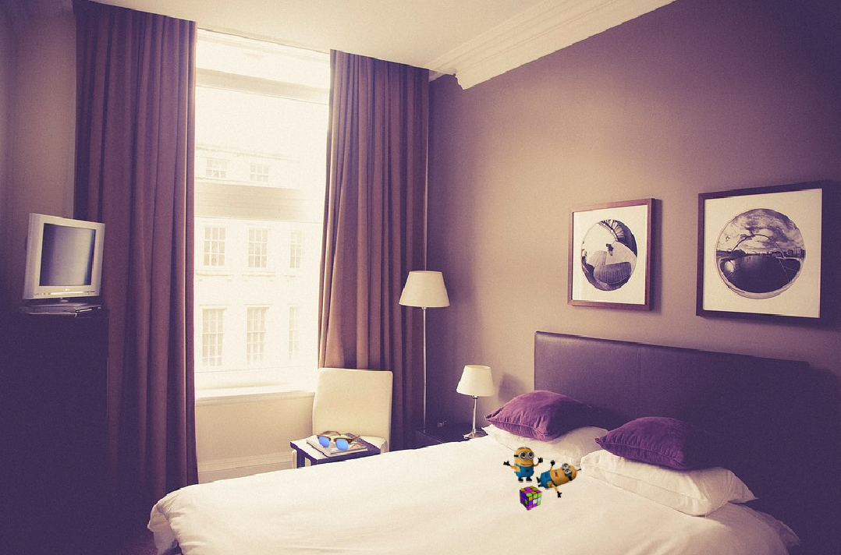
What in this room might have patents?
Patents

Slide 23
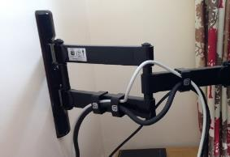
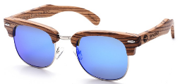
Some patents may not be easy to see
Patents
Curtain tracking
TV brackets
Toys
Sunglasses

Slide 24
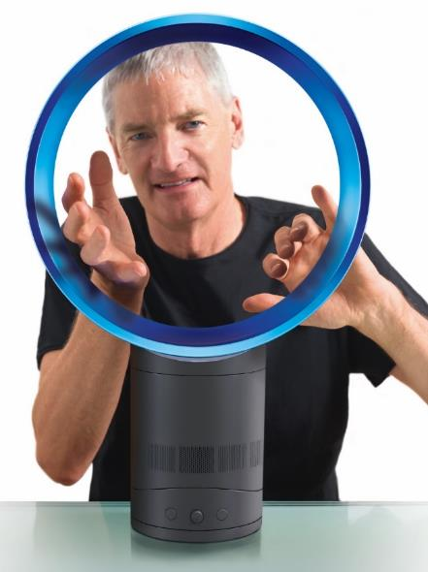
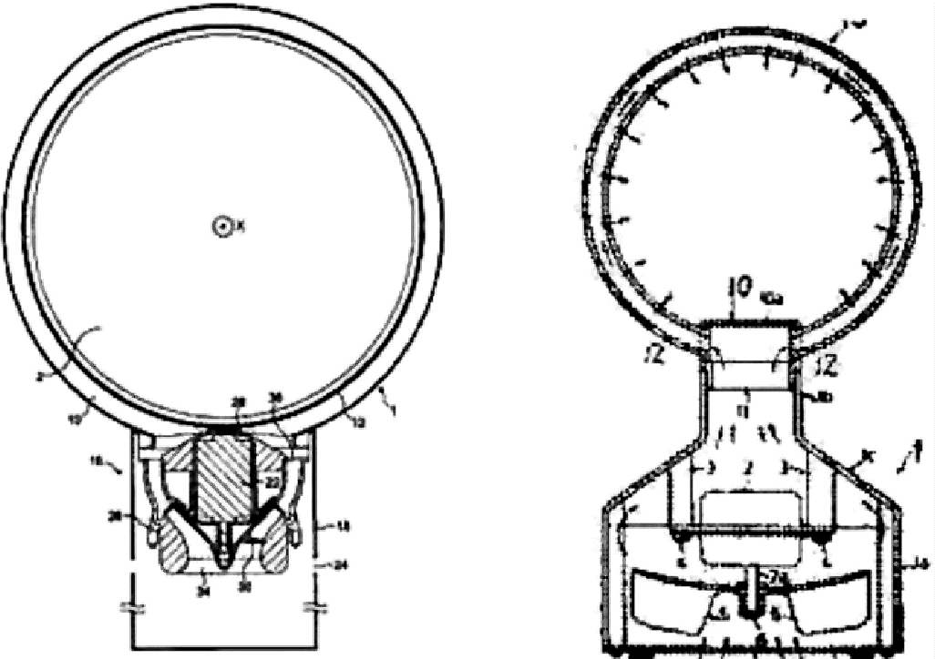
What if your invention is similar to something which has been done before?
Patents
Dyson patent 2009
Tokyo Shibaura patent 1981
According to publicly available documents, a product similar in appearance to the Dyson desktop fan from 2009 was apparently disclosed in a Japanese patent document in 1981.
The UKIPO took the view that it was similar to Dyson’s invention, noting that although patents expire after 20 years, they cannot be re-submitted by someone else unless there has been an improvement which is patentable.
Dyson secured their patent by highlighting to the IPO key technical features included in their product, such as the Coanda surface that creates a smooth and powerful blast of air to the user.
Notes:
Images
Public Domain; www.Dyson.com
http://www.telegraph.co.uk/technology/news/6377644/Dyson-fan-was-it-invented-30-years-ago.html

Slide 25
Trade Marks

Slide 26
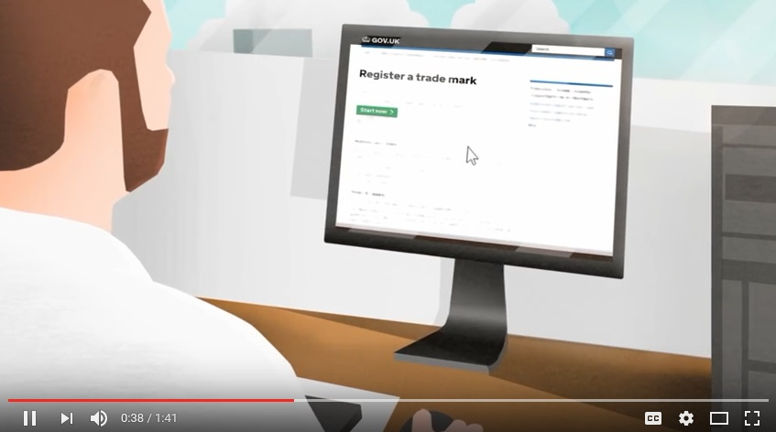
Trade marks
What is a trade mark?
Notes:
Photo is hyperlinked to https://www.youtube.com/watch?v=_CM9-4Qrj3I

Slide 27
Trade Marks
Trade marks
Protects a logo/word/shape/colour/sound
Lasts for ever providing it is renewed every 10 years (first trade mark in the UK was registered in 1876 and is still alive today)
Identifiable with a
What would not count as a trade mark?
Words that describe directly what you sell e.g. Really Fab Haircuts.
Words that are customary in your trade e.g. Four by Four.
Words that are not distinctive to one business e.g. Putting Customers First
Use of specifically protected emblems e.g. the Olympic logo.
Pornographic/taboo words.
Notes:
Images:
Registered trademark symbol - https://upload.wikimedia.org/wikipedia/commons/thumb/2/2b/RegisteredTM.svg/1024px-RegisteredTM.svg.png
Red cross - https://cdn.pixabay.com/photo/2013/07/13/10/33/cross-157492_960_720.png

Slide 28
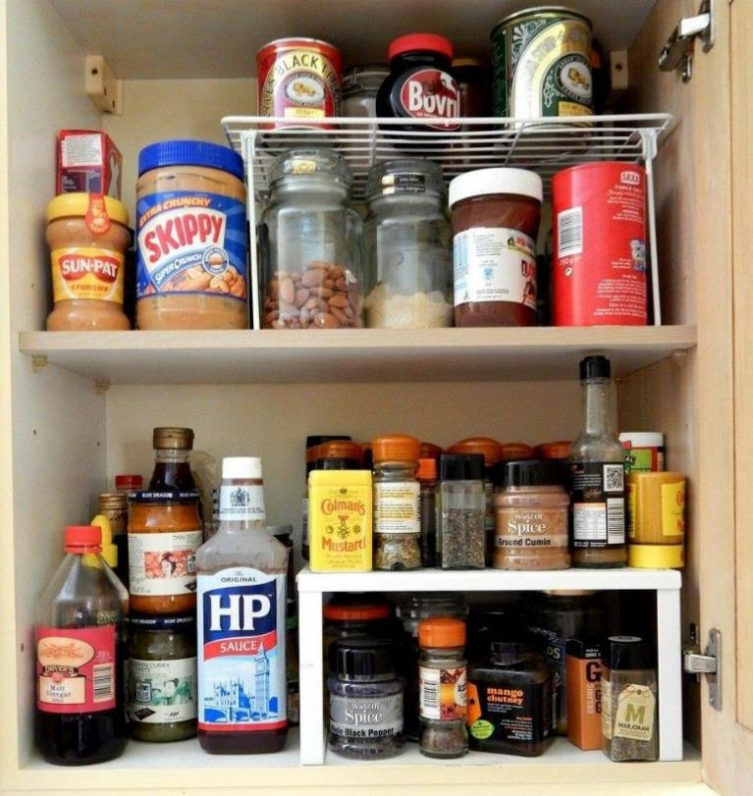
Trade marks
What trade marks can you see inside this cupboard?

Slide 29
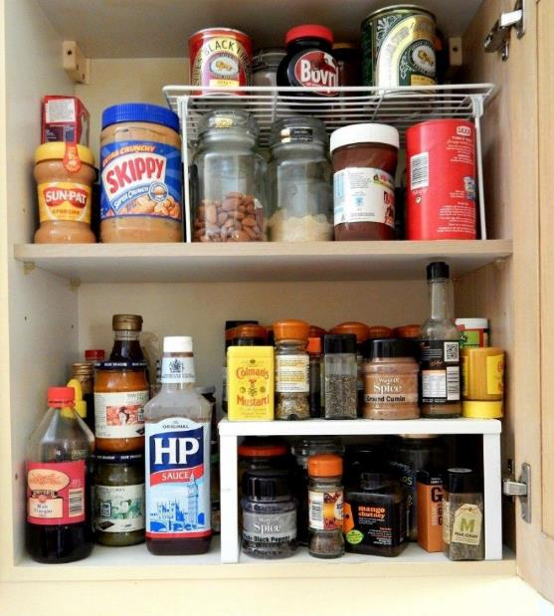
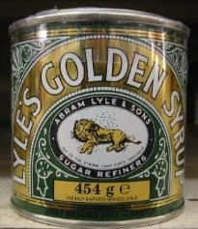
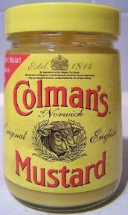
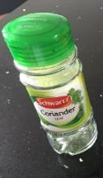
Trade marks
Did you spot these?
The majority of branded products will be trade marked.
Which other ones are there?
Notes:
Images:
HP sauce - https://c1.staticflickr.com/4/3323/4578993380_cb0caa774b_b.jpg
Golden syrup - https://upload.wikimedia.org/wikipedia/commons/thumb/2/20/Lyle%27sGoldenSyrup.jpg/518px-Lyle%27sGoldenSyrup.jpg
Nutella - https://upload.wikimedia.org/wikipedia/commons/thumb/8/8a/Logo_Nutella.svg/2000px-Logo_Nutella.svg.png
Oxo - https://upload.wikimedia.org/wikipedia/commons/thumb/2/23/OXO_logo.svg/2000px-OXO_logo.svg.png

Slide 30
Copyright

Slide 31
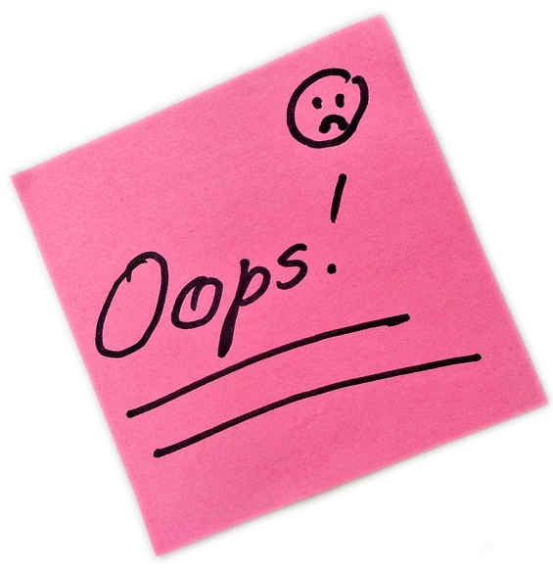
Have you ever…
Copyright
Printed a picture off the internet
Downloaded music illegally
Videoed/filmed something off TV screen
Taken a picture of a chapter from a book
Taken a picture of the screen in a cinema
Copied a CD
Notes:
FOCUS ON THIS SLIDE
Image:
https://upload.wikimedia.org/wikipedia/commons/4/4a/Prison_Bars_%285997920696%29.jpg

Slide 32
What would happen if you were caught?
Copyright
Notes:
Video link - https://www.youtube.com/watch?v=de5R71fXq4Q

Slide 33
Copyright
What is Copyright?
Notes:
Photo is hyperlinked to https://www.youtube.com/watch?v=dXfdhKqK258
There is a Copyright Quiz archived at: http://webarchive.nationalarchives.gov.uk/20140512142416/http://www.copyrightsandwrongs.nen.gov.uk/ipr-and-copyright/ipr-and-copyright-quiz?controller=question&task=show&quiz_id=29&qid=17

Slide 34
Copyright protects celebrities’ and cartoon characters’ images on products
Copyright
Justin Bieber branded toothbrushes
Peanuts branded lunch box
Notes:
Images:
Lunchbox - https://c1.staticflickr.com/4/3752/9191252515_5e9964416f_z.jpg
Justin Bieber - https://commons.wikimedia.org/wiki/File:Justin_Bieber_NRJ_Music_Awards_2012.jpg

Slide 35
Copyright
Copyright
Protects the following:
Literature
Art
Films
Photographs
Databases
Music
Dramatic works
Sound recordings
Software
Radio and television broadcasting
Lasts for the life of the creator plus 70 years
No formal registration required
To protect your work, place the copyright symbol and the year you made it
Notes:
Copyright symbol - https://cdn.pixabay.com/photo/2012/04/12/19/42/copyright-30343_960_720.png

Slide 36
Creating money from copyright…
Copyright
In 1929, J.M. Barrie gifted all of the rights to Peter Pan to Great Ormond Street Hospital. This enables GOSH to charge a royalty fee every time a performance of Peter Pan is staged, a film made or a book published, which creates a fantastic source of income for the hospital.
Notes:
Images:
https://cdn.pixabay.com/photo/2012/04/13/01/19/peter-pan-31644_960_720.png
https://upload.wikimedia.org/wikipedia/commons/thumb/c/c2/Peter_Pan_Logo_Black.svg/1280px-Peter_Pan_Logo_Black.svg.png

Slide 37
Registered designs

Slide 38
Registered designs
Registered designs
Notes:
Video link - https://www.youtube.com/watch?v=orFnFEzV5ic

Slide 39
Registered designs
Registered designs
Protects the look and appearance of a product e.g. a surface pattern
Lasts for up to 25 years but needs to be renewed every five years

Slide 40
So what would have happened if you had sorted out your IP and I had stolen your ideas?!
Registered designs
Notes:
Video links:
Left - https://www.youtube.com/watch?v=zrFGUSELtxc
Right - https://www.youtube.com/watch?v=9hS2kTGKXRM

Slide 41
Are your ideas protected outside of the UK?
Notes:
Video link: https://www.youtube.com/watch?v=87M8l27ECRE

Slide 42
Which IP rights might an electric toothbrush need?
The look/ appearance protected by design rights
The technology protected by the patents
TV adverts by copyright
The brand name protected by trade mark rights
Notes:
Images:
https://upload.wikimedia.org/wikipedia/commons/c/c5/Electrical_toothbrush_20050717_001.jpg
https://upload.wikimedia.org/wikipedia/commons/d/d5/Electric_Toothbrush_Head_%2811694299396%29.jpg

Slide 43
How could you protect your design?
Patents Copyright
Trade marks Registered designs
Notes:
Pattern picture - https://cdn.pixabay.com/photo/2015/10/24/19/42/pattern-1004855_960_720.jpg
All others are from previous slides.

Slide 44
Patent, copyright, registered design or trade mark?
Notes:
Students to decide which image matches which IP…
Coke –
http://www.clker.com/clipart-302623.html
Dyson
http://multiwebdirectory.info/new/dyson-dc37.htm
Tesco
https://www.flickr.com/photos/raver_mikey/377794962
Trainer
http://nikeshoes.razul.net/champs-nike-shoes/
Heat magazine
http://www.standard.co.uk/showbiz/celebrity-news/x-factor-s-caroline-flack-reveals-she-fancied-olly-murs-who-says-she-is-the-perfect-girlfriend-a2947316.html
Harry Potter
http://www.independent.co.uk/arts-entertainment/books/news/how-to-tell-if-your-old-copies-of-harry-potter-are-worth-up-to-40000-a6897756.html
Food mixer –
https://cdn.pixabay.com/photo/2014/12/21/23/29/mixer-575443_960_720.png
Crayola - http://farm6.staticflickr.com/5517/9235155456_b50aecd7f9_z.jpg
Beach photo – https://cdn.pixabay.com/photo/2016/02/24/22/27/sunset-1220925_960_720.jpg
Car - https://cdn.pixabay.com/photo/2013/07/12/13/21/sports-car-146873_960_720.png
Printer - https://cdn.pixabay.com/photo/2013/07/13/13/32/printer-161063_960_720.png
Fidget spinner - https://static.pexels.com/photos/422292/pexels-photo-422292.jpeg
Art - https://upload.wikimedia.org/wikipedia/commons/4/40/The_Kiss_-_Gustav_Klimt_-_Google_Cultural_Institute.jpg
Radio broadcast - https://cdn.pixabay.com/photo/2015/05/18/17/20/microphone-772577_960_720.jpg
Beyonce - https://c1.staticflickr.com/3/2059/5765878735_7ddc33396c_z.jpg

Slide 45
Group evaluation & feedback

Slide 46
Extra activities to consolidate learning
Notes:
Use if time allows?

Slide 47
Question A
Explain why the choice of colour is important to the design of a children’s lunchbox. (2) __________________________________________________________________________________________________________________________________________________________________________________________________________________________________________________________
Explain how laws affect the use of well known TV or film characters when designing products. (4) ______________________________________________________________________________________________________________________________________________________________________________________________________________________________________________________________________________________________________________________________________________________________________________________________________________________________________________________________________________
Fig 1
Fig 1 shows a child’s lunchbox.
Many lunchboxes are made in different shapes, using different colours and decorated using well known TV or film characters.
Give two reasons why manufacturers use well known TV or film characters to decorate products aimed at children. (2)
a.__________________________________________________________________________________
b.__________________________________________________________________________________
Notes:
Image:
Lunchbox - https://cdn.pixabay.com/photo/2012/04/26/10/36/lunchbox-41973_960_720.png

Slide 48
Question A: Example answers
Q1.
Appeal to children.
Easily recognisable.
Makes the child put pressure on the parent/guardian to buy it for them – a good marketing strategy.
Makes children want a new product e.g. a lunchbox with the latest character on even if the old lunchbox still functions – increases sales.
Q2.
Primary colours tend to appeal to children as they are bright and bold.
Colours can sometimes be stereotyped e.g. blue for boys, pink for girls. A boy may not want a product in pink.
Certain colours are recognisable with certain children’s characters such as Dennis the Menace with black and red – this will appeal to certain children and the latest fad.
Q3.
Copyright protects the use of well known TV or film characters when designing products. If for example, a company wanted to use an image of Winnie the Pooh on the front of their lunchbox then they would have to get permission from the designers/company (Walt Disney) that own the copyright protection to those characters/photos. This would nearly always include a payment to the company. If they did not get permission, then Walt Disney would have every right to sue them through the misuse of copyright.

Slide 49
Question B
Name two other products that use smart materials. (2) a.___________________________________________________________________________________b.___________________________________________________________________________________
Explain, using an example, how smart materials have evolved the design of household products. (4) ______________________________________________________________________________________________________________________________________________________________________________________________________________________________________________________________________________________________________________________________________________________________________________________________________________________________________________________________________________
Fig 1
Fig 2
Fig 1 shows a traditional metal spoon.
Fig 2 shows a modern thermochromic spoon.
Describe the changes that will happen to the thermochromic spoon if the food is too hot. (2)
_____________________________________________________________________________________________________________________________________________________________________________________________________________
Notes:
Images:
Spoon - https://cdn.pixabay.com/photo/2014/12/02/14/49/teaspoon-554065_960_720.jpg

Slide 50
Question B: Example answers
Q1.
The spoon would change from its original colour (e.g. green) at room temperature, to a different colour (e.g. blue) when the temperature is too hot. When the spoon returns to room temperature, then the spoon would return to its colour (e.g. green).
Q2.
Colour changing kettles, sunglasses that change colour in sunlight, colour changing nail varnish, shape memory glasses, polymorph orthopaedic aids, self healing concrete walls etc.
Q3.
Shape memory polymers are an example of a smart polymer that have been used to make glasses. This means that if you sit on these type of glasses you will not break them as they will return to their original shape. This is really useful for long sighted people who do not wear their glasses all of the time as they are prone to putting them down wherever they are such as on the sofa. Children and adults could easily sit on them and accidently bend them out of shape – but this would not happen with shape memory glasses. This means that the product life is longer and less repairs are needed; this would appeal to customers and they maybe more willing to spend extra money on this technology.

Slide 51
Question C
Explain how companies could stop other businesses copying their logo. (2) __________________________________________________________________________________________________________________________________________________________________________________________________________________________________________________________
Discuss, using an example, the importance of labels and symbols in the safety of products. (4) ______________________________________________________________________________________________________________________________________________________________________________________________________________________________________________________________________________________________________________________________________________________________________________________________________________________________________________________________________________
Fig 1
Fig 1 shows examples of company logos.
Name two features of a logo that make them easily recognisable. (2)
a._________________________________________________________________________________
b._________________________________________________________________________________

Slide 52
Question C: Example answers
Q1.
Colours, shape, type font, positioning of letters, size of letters, shading.
Q2.
Could apply for a trade mark for the logo – this would protect the logo for up to 10 years and the trade mark would be recognisable with a letter ‘R’ in a circle. They could then sue a company who tried to copy their logo.
Q3.
Labels could include health and safety instructions on how to use a product safely. For example on a child’s toy, it would be useful to have instructions on how to use so that the parent/guardian knows how to use/not use the product – for example certain parts may be a choking hazard. This could be shown through the symbol with a cross through a baby and the numbers 0-3. The company would be wise to also have the product tested against BSI and CE standards as this quality assures the product for the safety of the customer. This is important not only for the family using the product but to also protect the company in case of an accident happened through the misuse of a product – the company could claim that they had taken preventative measures through instructions to prevent such accidents.

Slide 53
Question D
Explain a reason why an ice scraper may be needed other than to scrape ice off a vehicle. (2) __________________________________________________________________________________________________________________________________________________________________________________________________________________________________________________________
Discuss the intellectual property that an innovative design for an ice scraper might need. (4) ______________________________________________________________________________________________________________________________________________________________________________________________________________________________________________________________________________________________________________________________________________________________________________________________________________________________________________________________________________
Fig 1
Fig 1 shows a vehicle ice scraper.
There’s a variety of different ice scraper designs available to purchase in high street stores.
Name two different stakeholders that may have an interest in the ice scraper. (2)
a.________________________________________________________________________________
b.________________________________________________________________________________

Slide 54
Question D: Example answers
Q1.
Car owners, taxi firm owners, high street stores, children who scrape the vehicles for their parents/ guardians etc.
Q2.
Visibility with ice on the car is reduced making it dangerous to drive.
Speed – people need to get to work on time so ice scrapers help to decrease the time to get driving in very cold conditions.
Q3.
Trade mark for the name of the product, registered design for the way that the ice scraper looks, patent for an innovative design method which is different to others sold in the high street stores. These methods of IP are extremely important to stop other people from stealing your fantastic idea and means that you will be rewarded for your hard work in creating a fantastic new design. It also means that customers will have less choice of similar products so are more likely to spend their money on your winning design.

