Slide 1
Lamb industries Supporting unit focused task: adapted PRODUCTS
Notes:
Please note; This resource, accompanying resources and associated images, videos and graphics are to be used for educational purposes only and in line with our terms and conditions as stated here. https://www.designtechnology.org.uk/terms-and-conditions-and-policies/

Slide 2
Adapted PRODUCTS
Because design and innovation matter

Slide 3
ADAPTED PRODUCTS
To make gardening more accessible and inclusive, products may be designed from scratch to meet the needs of the user. In some circumstances, these types of products may be impractical to design due to cost, market demand or that they would exclude other users.
There will often be situations where a product works well for most people but needs some adaptation to extend the range of users and to make it more inclusive.
In this unit we will look at how you can take this approach to adapting existing products rather than designing them from scratch.

Slide 4
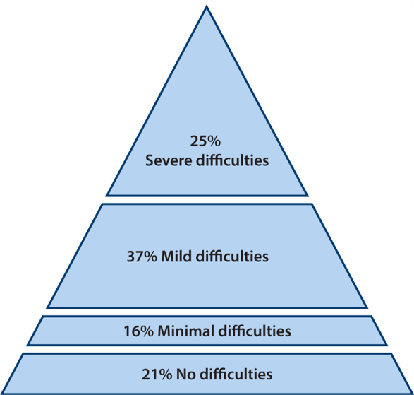
Inclusive design
Inclusive design (also called universal design) makes places and products usable by everyone, regardless of age, ability and circumstance. It is based on the principle that designing for the widest range of people creates better designs and benefits everyone.
Inclusive design aims to remove barriers that make it difficult for everyone to participate equally, confidently and without assistance.
Basic data about user needs and difficulties they have can help to support a drive for more inclusive design
Notes:
For a great case study of Inclusive Design, visit https://www.fastcompany.com/90239156/the-untold-story-of-the-vegetable-peeler-that-changed-the-world where we take a look into the design of a vegetable peeler and the story behind it.

Slide 5
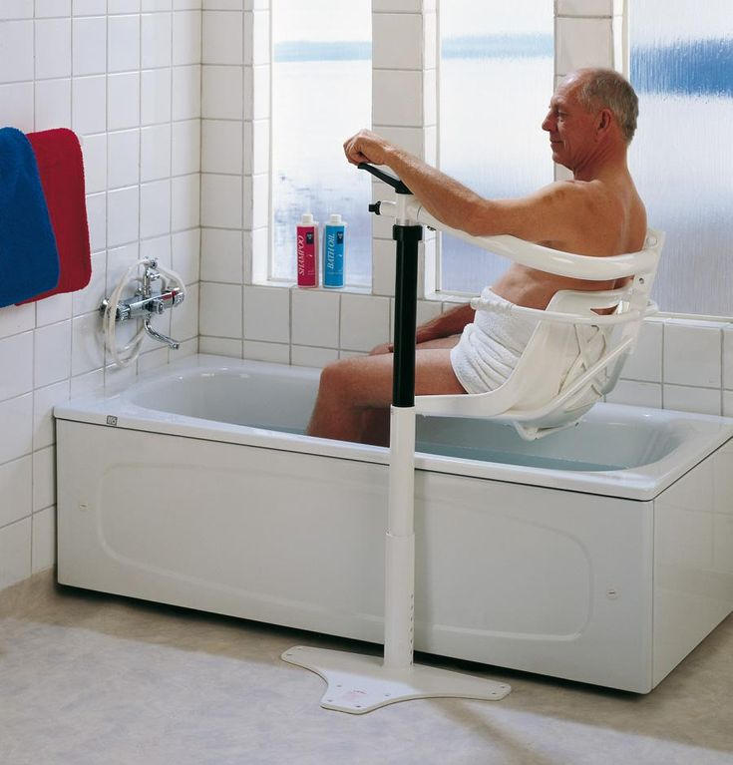
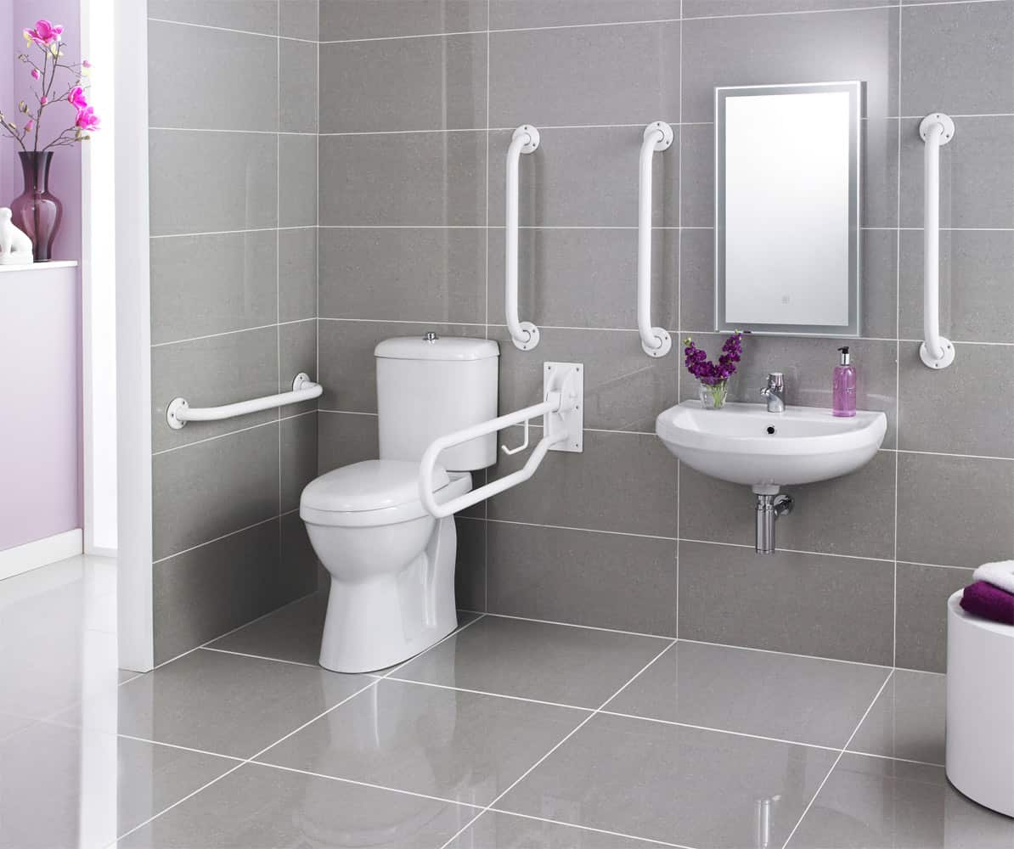
Adapted environments
Sometimes whole environments need to be adapted to be as inclusive as possible. A commonly adapted environment would be a bathroom which may be used by a wide range of public users.
Notes:
There is the opportunity for a discussion around any adaptations that may be made that students are aware of in their family. This may be for a baby (think of something as simple as a step or stairgate) or an elderly relative.

Slide 6
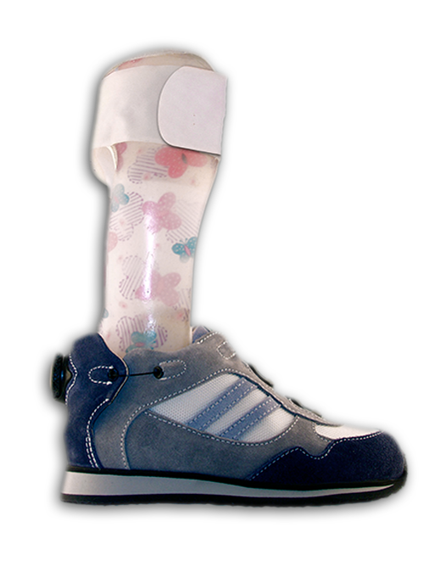
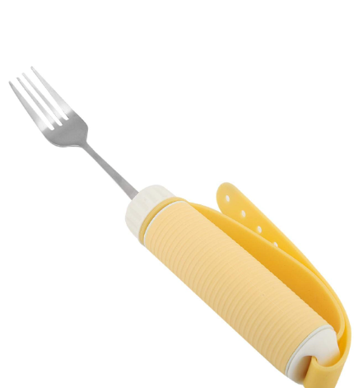
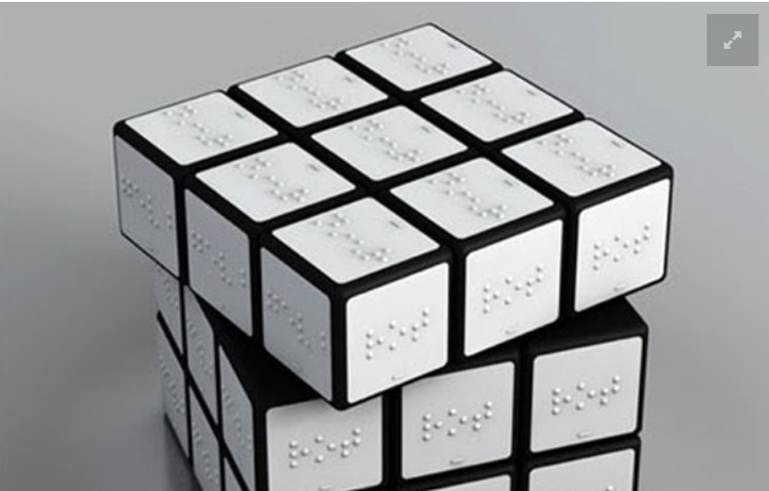
Adapted products
It would be helpful to investigate a range of existing products that are designed to be as exclusive as possible.
If you can, see if you can try these for yourself to see if they can be used by a range of users.
Notes:
Adaptations are fairly common, even if someone does not consider themselves to have a physical disability – consider PS / Xbox thumb grips for the controller. Can students think of any other adapted products they have used or are aware of?

Slide 7
Adapted products
Why do products need to be adapted? What is the barrier to being usable by a wide range of users?
What issues or impairments might make a product more difficult to use?
These could be due to limited strength, grip, eyesight, space perception, stability, cognitive ability and more.
See the unit on user experience for more details of how you can try and experience some of these limitations for yourself.

Slide 8
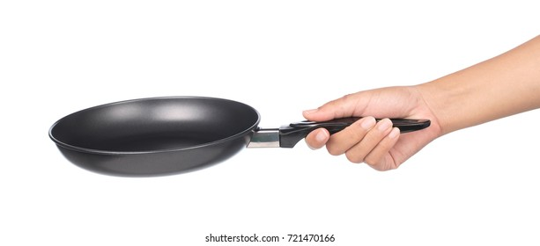
Adapted products
Let’s take strength and/or grip as a problem with an existing product. The way a frying pan is designed means holding it in a certain way. This can be very difficult for someone with an injury or if they have limited strength especially with larger pans full of water, oil or food that considerably add to the weight.
Excessive strain on this part of the wrist when carrying a pan in the traditional way.

Slide 9
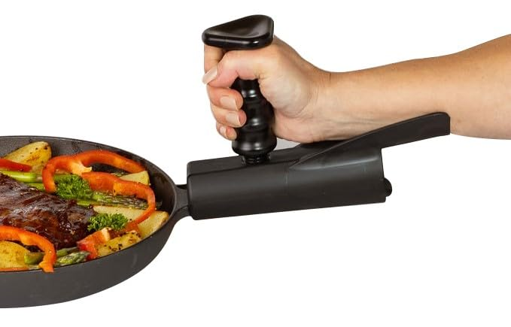
Adapted products
Think about a more natural position for the hand such as holding a mug of tea. This provides greater grip
With the fist clenched like this, there is no strain across the top of the wrist.
We could design an additional part to replicate this type of grip when using a pan.

Slide 10
Adapted products
One of the supporting units for the accessible gardening context looks at how products can be adapted through the use of simple braille labels and another unit looks at user experience.
Consider trying to replicate the problems users may have and identify where the problems are using existing products.
You can use print the cards off on the next page and randomly choose a product and a limitation then set the students the task of adapting that product to make it more inclusive.

Slide 11
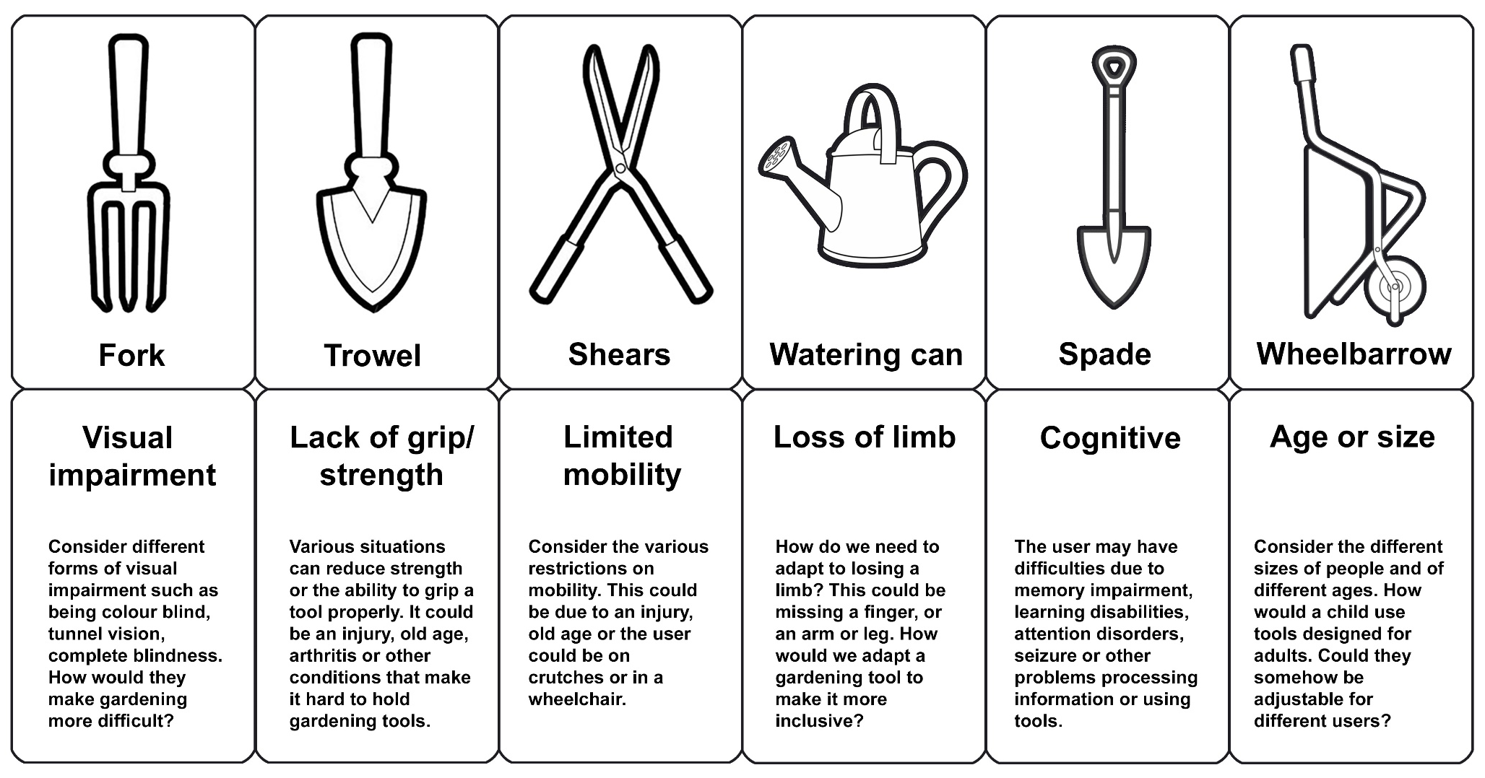
Empathy Activities
Notes:
Print and cut these cards for an empathy-design activity. Students can choose a tool and impairment at random to help generate new ideas for a range of users. This can be particularly useful if they are stuck for ideas / focus. Feel free to add more of your own.

