Slide 1
Lamb industries Supporting unit focused task: thick and thin line sketching
#InspiredbyLambIndustries
Notes:
Please note; This resource, accompanying resources and associated images, videos and graphics are to be used for educational purposes only and in line with our terms and conditions as stated here. https://www.designtechnology.org.uk/terms-and-conditions-and-policies/

Slide 2
Pencil sketching
Because design and innovation matter

Slide 3
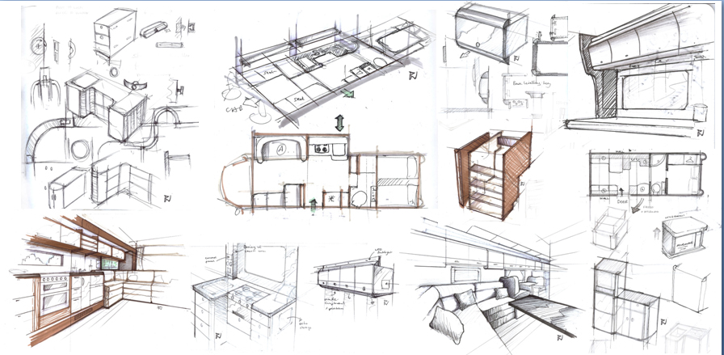
sketching
The most traditional and still most effective means of communicating designs ideas is through drawing with a pen or pencil. Despite advances in 3D CAD packages and vector drawing software, traditional drawing skills are still considered an important tool in a designer’s arsenal.
They can help to get messages across quickly and at any time. There are several techniques that can be used to add impact to sketches to highlight parts and allow people to understand it more clearly.

Slide 4
Sketching
Let’s start by sketching out a simple gardening tool such as this trowel. We want to use a hard pencil to be able to create feint lines that we can emphasize using a pen or thicker pencil lines later.
Reduce the pressure when drawing so the lines are feint. Alternatively, try drawing with a blue pencil. This is an approach animators and designers used to use (some still do) as when they are photocopied they disappear. You can nowadays also scan them and remove digitally.
Even if you don’t do those things, it produces a line that isn’t very obvious later on when you go over it with a pencil or pen.

Slide 5
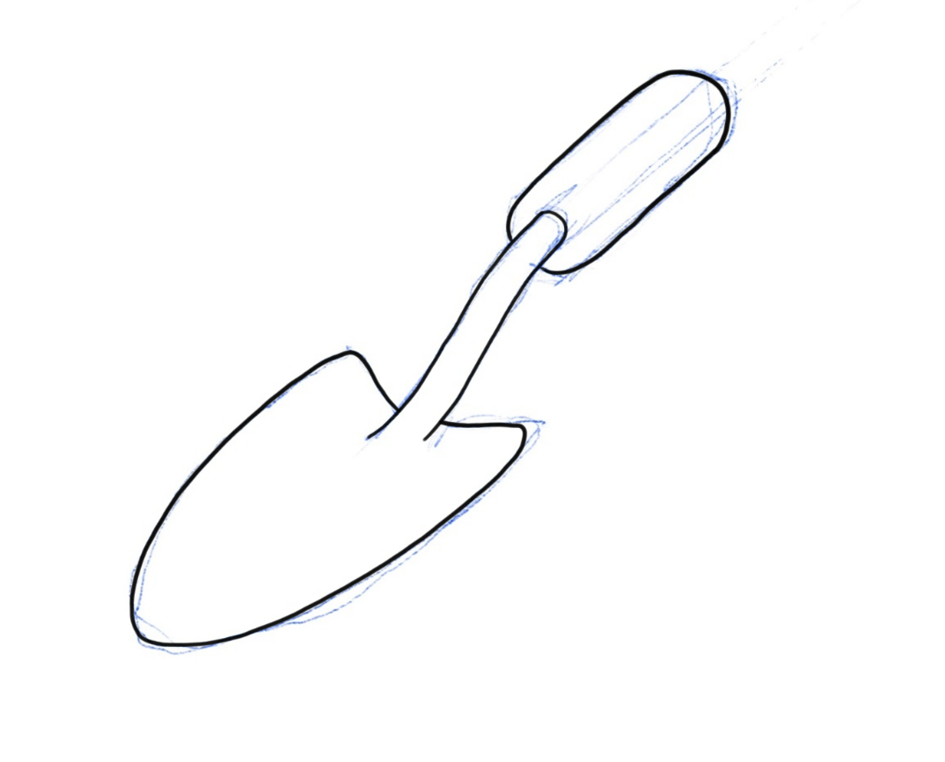
Adding impact
We can use a fine-liner or a pencil to go over the shape we want and ‘hide’ the blue lines. If your drawing is good (and fairly simple) it should be fairly easy to understand. However, there are times we want it to pop off the page, or show that it is 3D, or to make bits clearer. One was of doing this (without colour) is using a technique called thick & thin lines. To do this you will need (ideally) two different thicknesses of pen, and to understand the ‘rules’…

Slide 6
Example
To explain the rules of using thick and thin lines we are going to use a simpler example to start with. Have a go yourself. Here we have sketched a cube, then gone over it with a pen. You could remove the blue lines if you wanted it to be even neater, but there is no need really.

Slide 7
Thick and thin line sketching

Slide 8
Spiders
To help explain the rule, we need to imagine a spider is on our shape. The rule is, we use a thick line every time the spider goes over an edge and we then can’t see it.
So, the spider starts on the top and it walks left, over the edge marked with an arrow. Would we still see it?
No! It would be hidden, so this line is thick.

Slide 9
Spiders
Now the spider walks over this edge and onto the face marked with an arrow. Would we still be able to see it?
Have a go on your shape and try to work out where all the thick lines are and where the thin ones are!
What about if it goes around here?
It would vanish, so it’s a thick line.
Yes! So the edge stays thin.

Slide 10
Outcome
Your shape should look something like this.
The thick lines create an illusion of depth and make it easier to understand the 3D aspects of it.
This is a common technique designers often use, and once you have practiced it, is very quick to do.
It is worth practicing a few simple shapes such as this, before we move on.

Slide 11
Curves in thick & thin
Things can get a little more tricky when you are using curves and organic shapes.
Have a go at this shape, or similar, to see where the thick and thin lines would go.
Notes:
Explaining this shape/technique is useful. For example, the hole in the top could have a flat bottom (blind hole), or the entire shape could be hollow and this ellipse in the top could allow us to see inside the whole thing. The thick and thin lines will alter depending on what they see/feel. There is a hidden slide following this that you may want to use to show this point.
You may also want to run through small techniques they may (or may not) like, such as broken lines on corners so the whole shape doesn’t appear as heavy, then finally, small details to further emphasise shapes, holes etc as shown in the final image.

Slide 12
Curves in thick & thin
Do the differences in the top help to explain what is going on in this area? You may find that you still need to add extra detail / lines to fully explain what is happening.

Slide 13
Using products
Because design and innovation matter

Slide 14
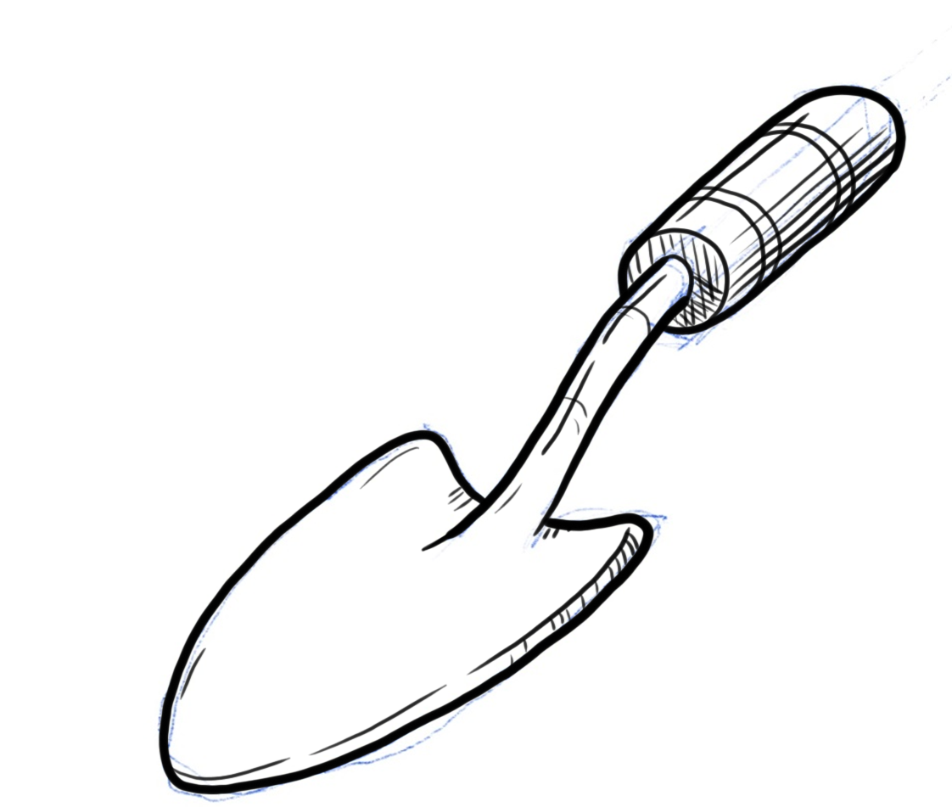
Back to the trowel
Have a go at a product, rather than a simple shape. You will find curves, straight lines and complex parts where you need to apply what we have just been through.
You can use a smaller tip (0.1-0.3) to add the internal details and simple hatched lines for shading.

Slide 15
Sketching
Here is an example of a simple development of an existing product using the same technique. Here we have added an arm support to make it easier to hold.

Slide 16
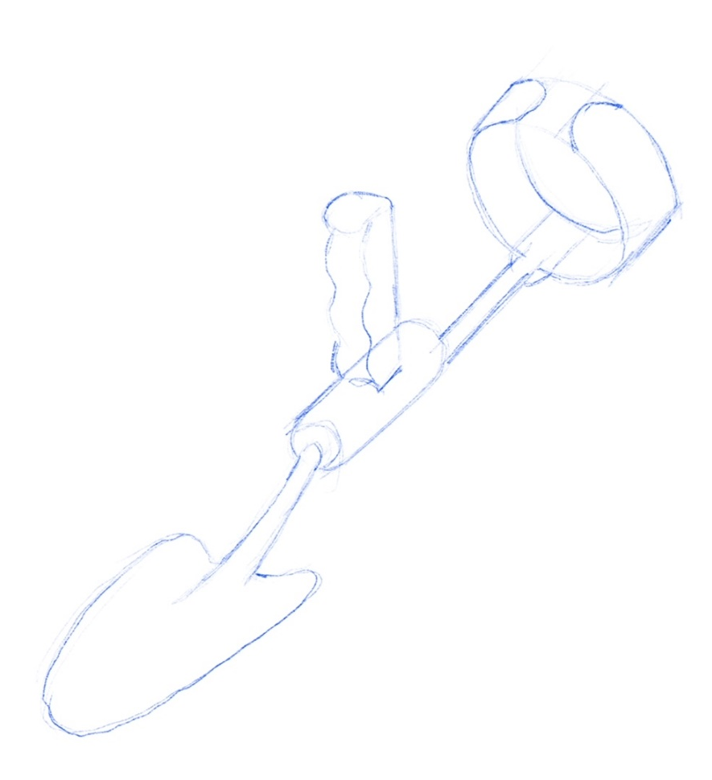
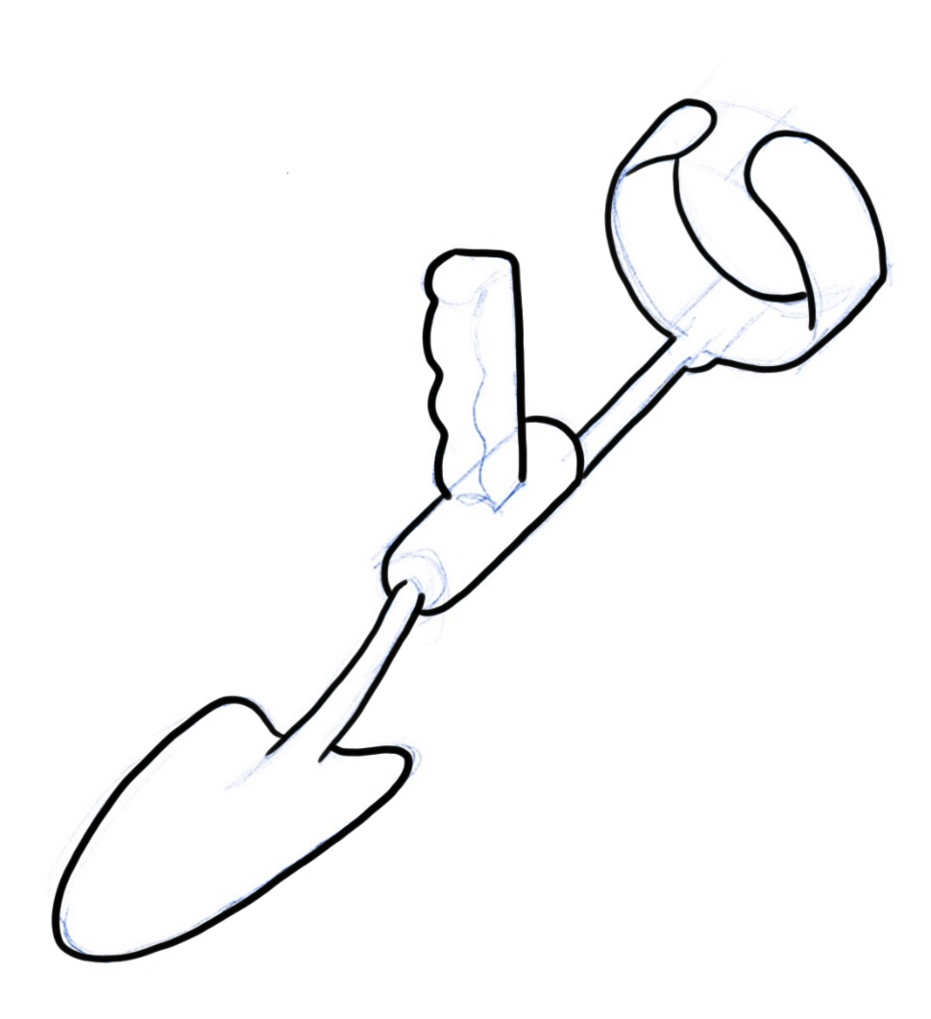
Sketching
We can now add in a hand grip. The more complex and detailed the pencil drawing becomes, the more effective the use of thick and think lines will be. Note how the pencil lines just seem to disappear without needing to be rubbed out.

Slide 17
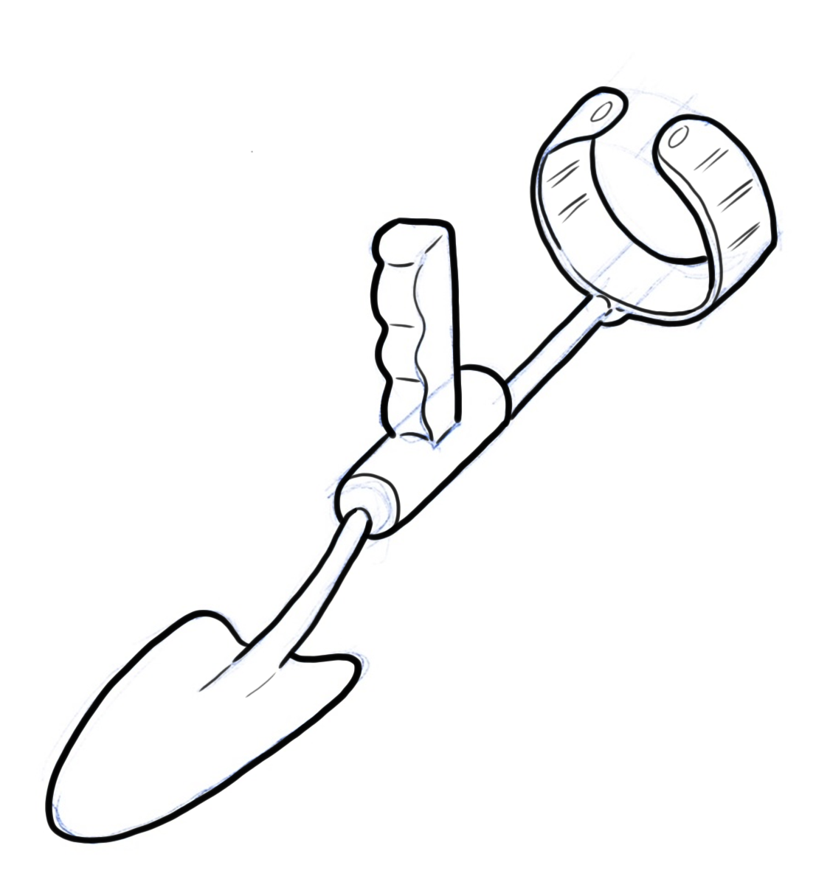
Sketching
Finally add in the internal details with a finer pen and add simple shading to make the design look more realistic. Those pencils lines we started with are now completely invisible!

Slide 18
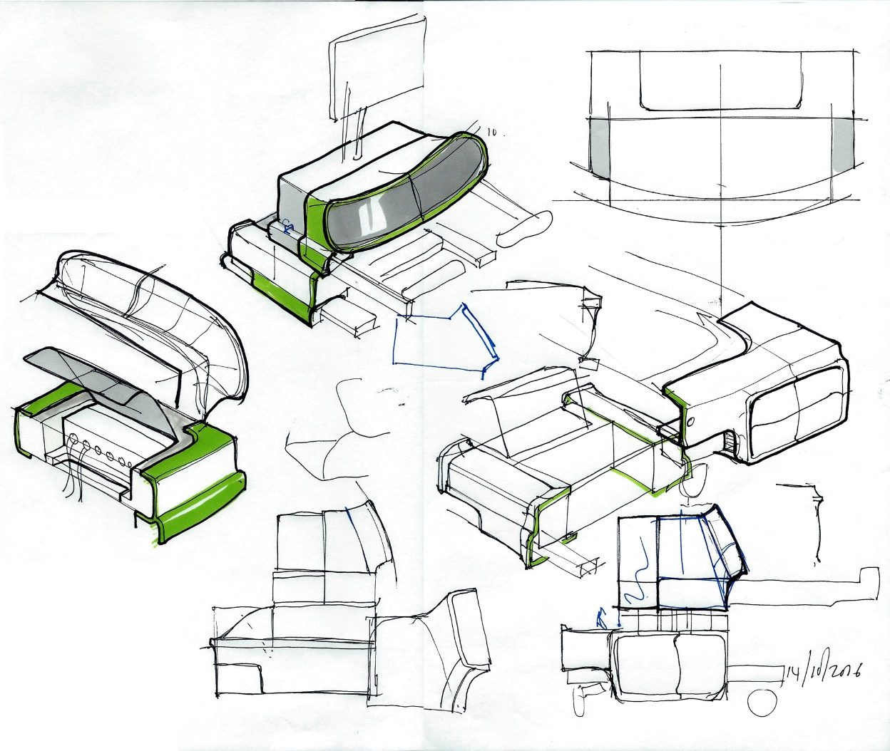
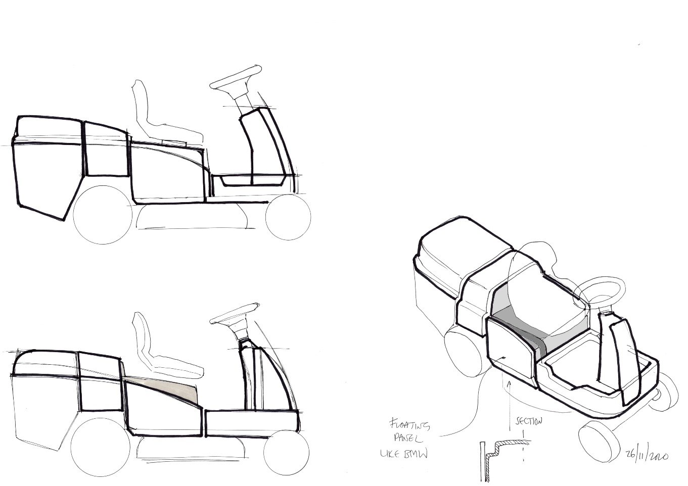
Sketching Examples
Some examples of James’ own sketching using this technique.
Try adding thick lines and shading to these line drawings of garden tools
Notes:
Examples of James Lamb’s own sketching help to link to the context and show how an industrial designer would use this technique. At times it may not be entirely accurate to the technique, but also used to draw attention to certain parts. Note there is minimal splashes of colour also.

Slide 19
Practice
Because design and innovation matter

Slide 20
Practice
Try adding thick lines and shading to this line drawing

Slide 21
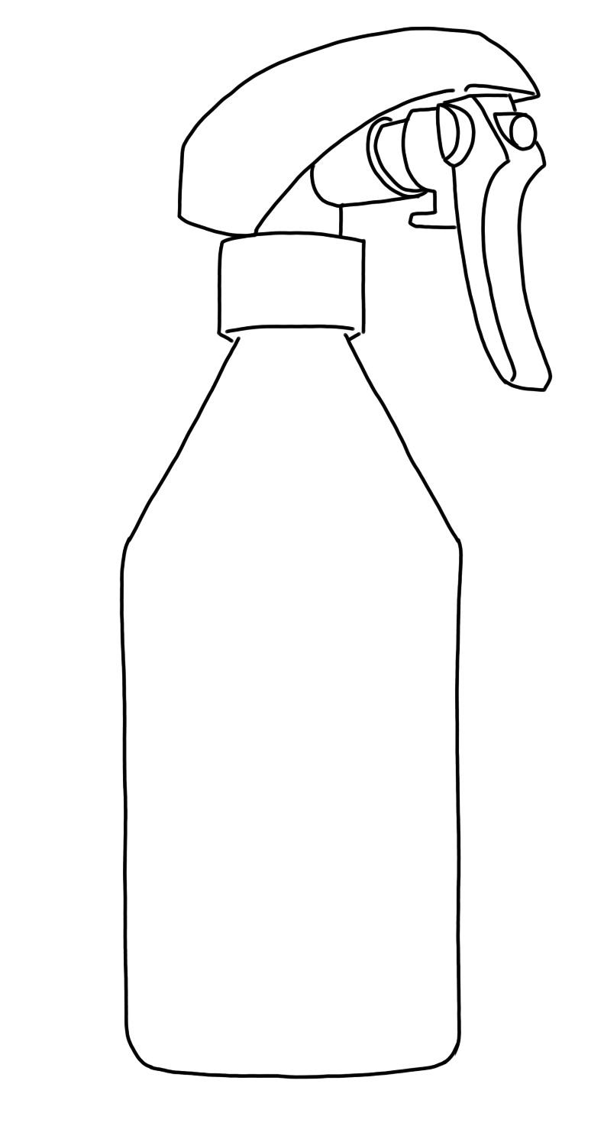
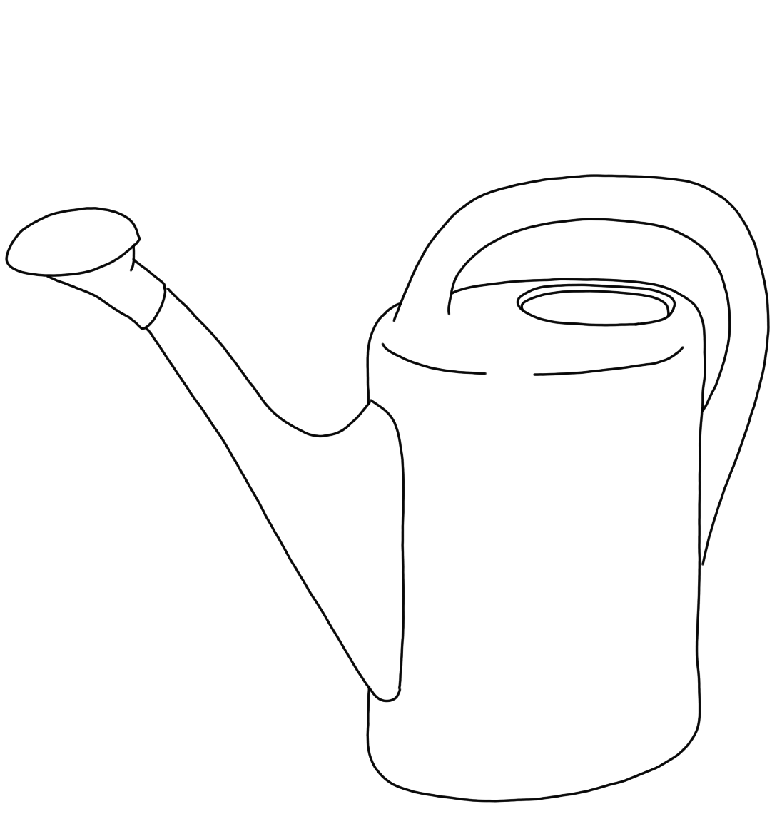
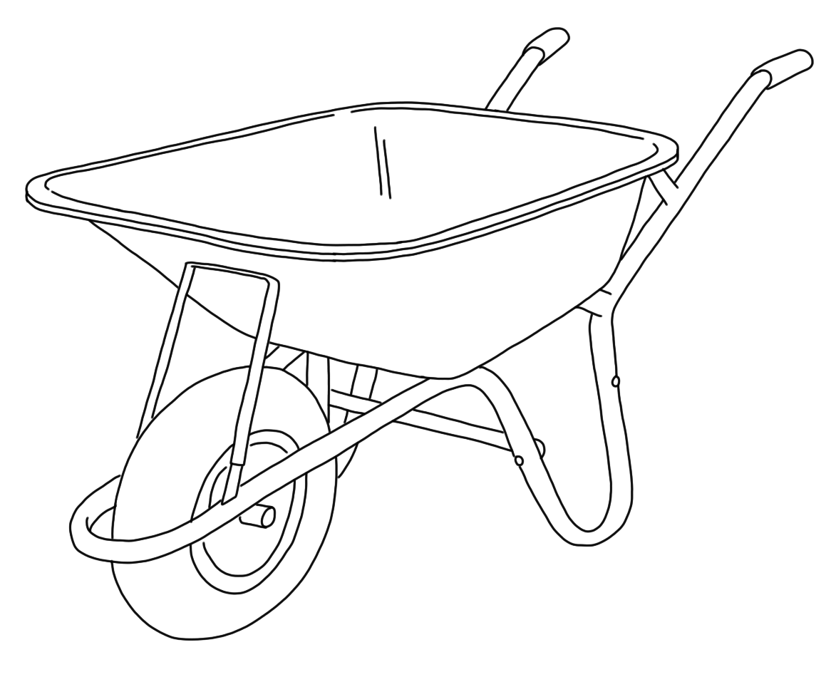
Practice
Try adding thick lines and shading to these line drawings of garden tools
Notes:
Feel free to photocopy these shapes and/or enlarge/reduce as required. Students may also want to add details (e.g. to the watering can) such as water levels, some surface detail or to make it appear more rounded.

