Slide 1
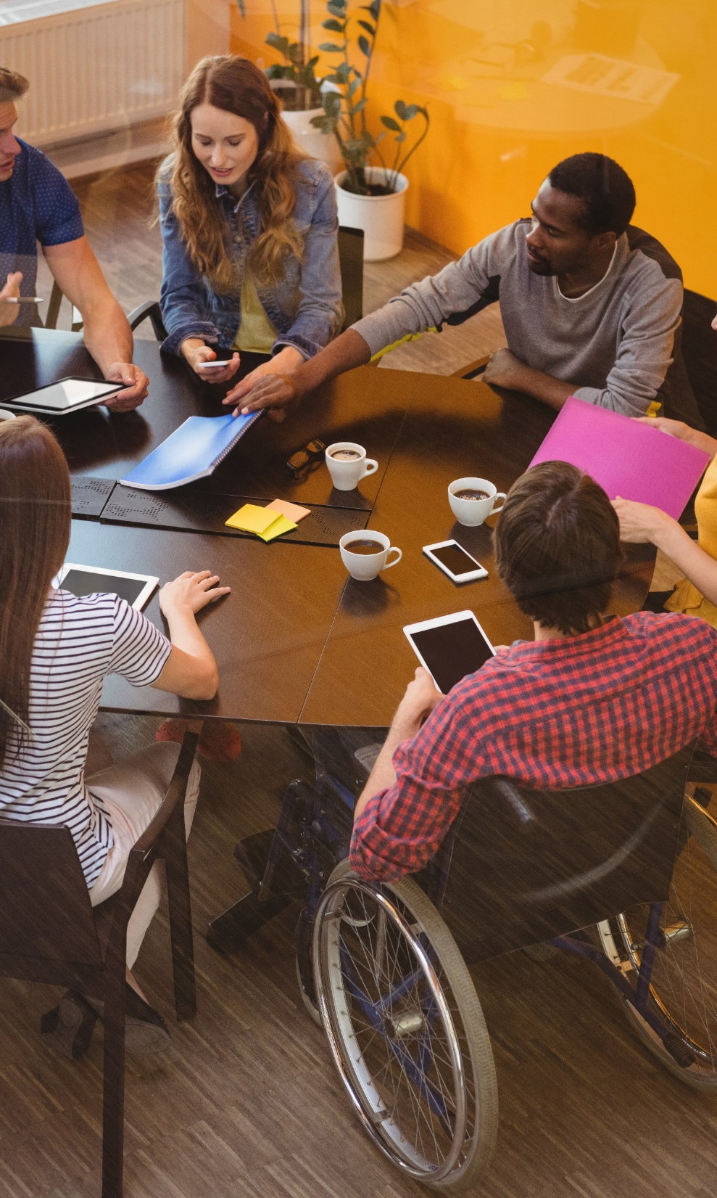
lamb industries Supporting unit investigative & evaluative activity: inclusive design
#InspiredbyLambIndustries

Slide 2
Inclusive design
Because design and innovation matter

Slide 3
Inclusive design
Inclusive Design concerns developing products that can be used by as many different groups as possible, such as disabled and able bodied, young and old consumers.
Very often, changes in products to accommodate disabled users can also be of benefit to the able bodied e.g. more user-friendly appliances.
Designers working on inclusive designs will often use techniques to give them the experience of what it is like to be disabled in order to better understand the needs of that particular group. This is a form of empathetic design.
They will also use data and observation as well as working with specific users (see UCD) to ensure that they meet their specific needs.
Notes:
Please note; This resource, accompanying resources and associated images, videos and graphics are to be used for educational purposes only and in line with our terms and conditions as stated here. https://www.designtechnology.org.uk/terms-and-conditions-and-policies/

Slide 4
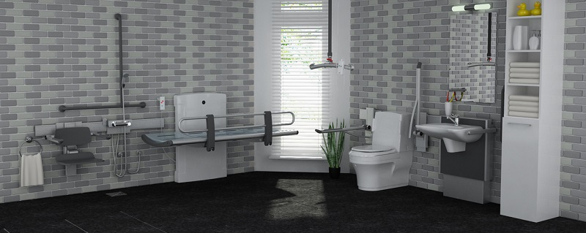
Adapted design
Many products have been changed to meet the needs of disabled users and designers are now more aware of trying to make these products as ambiguous as possible so they don’t stand out as being simply for ‘disabled use’. An example would include shower areas where the necessary aids fold away to be almost ‘invisible’ when not needed or other features added to make bathing more practical.

Slide 5
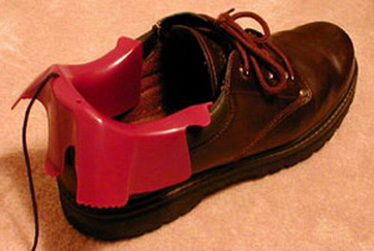
Adapted design
People in the 95th percentile will have very large body sizes either because of their height or their weight and build. This has already resulted in the need for XXXL clothing, fully adjustable car seats, steering wheels and seat belts and is likely to be more important as the weight of the population in general increases.
This is an example of how an existing product, a shoe can be adapted to support additional weight and strain.

Slide 6
universal design
This is a method of designing that tries to make environments, service and products useable by as many different people as possible without the need for any adaptation.
Inclusive design is very similar but considers a wide range of diverse needs and how products, environment and services can be adapted to accommodate different needs.
Can you find practical examples of each approach to show the difference?
https://sayyeah.com/digital-insights/universal-design-accessibility-inclusive-design/ is quite good to give some examples / clarification

Slide 7
exclusive design
Not all products can be designed for everyone to use. For example, motorcycle helmets are designed for adults as babies should not really be carried on a motorcycle and therefore there is no market for such a product. Likewise, furniture, clothing and utensils for babies do not have to be made in a larger version for adults.
Can you think of other examples of products designed exclusively for a user group or target market?
Make a list of these and consider what features makes them exclusive to their particular market.

Slide 8
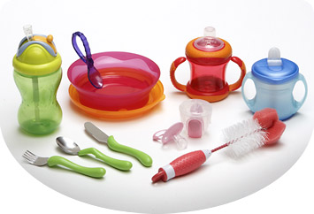
exclusive design
As mentioned previously there are some groups that fall into the 5th and 95th percentiles.
Children are generally in the 5th percentile compared to adults and designers need to be aware of their smaller sizes and physical abilities. Many products already take this into account such as baby spoons and bottles, but a designer can also use this to make it difficult for a child to access a medicine bottle for example.

Slide 9
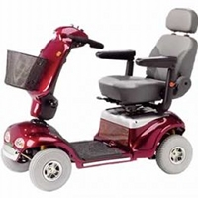
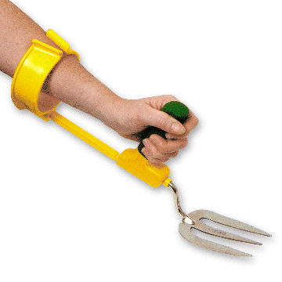
exclusive design
Adults are a different percentile to children and often fit into the 50th percentile in terms of their physical size. They may not have a disability but, like children, they can have limited physical ability in later life meaning that products need to be adapted to make them easier to use. Examples included lever taps, easy opening jars and bottles, elasticated clothing and easy pour kettles to name just a few.
Ironically, many elderly people need to access medication but struggle to open ‘child proof’ medicine bottles.

Slide 10
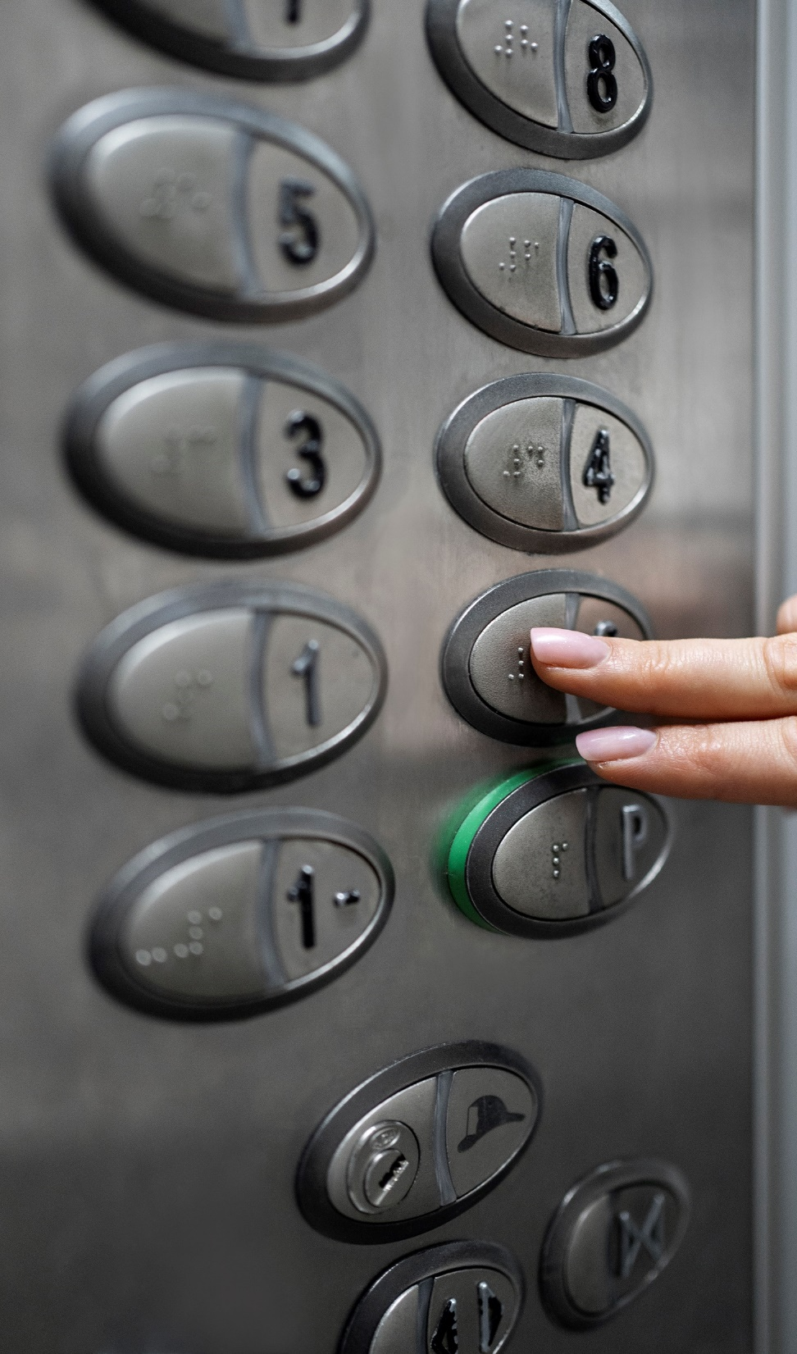
inclusive designs
This is a modern elevator panel.
What inclusive features can you identify in this elevator panel?
Are there other features that might make it more inclusive?
How would you improve the design?

Slide 11
inclusive designs
Try using a chart like this to investigate and evaluate a range of inclusive products like the example on the previous page. Try rating them for how accessible they are.
Product | Inclusive features | Things to improve | Problems | Accessibility rating

Slide 12
inclusive designs
Try using a radar chart to show your ratings of how inclusive products are

