Slide 1
Investing in The Design & Technology Association Primary School Membership
Enhancing Learning and Preparing for the Future
Presented by: [Enter your school's name here]

Slide 2
Purpose This presentation will demonstrate why our school should invest in membership of The Design & Technology Association
We will cover
Importance of design & technology in Primary Education
Current Challenges in design & technology
What does the membership offer?
Return on Investment
Success stories from other schools
Alignment with our school goals
Next Steps
Payoff As a result of this presentation, my aim would be that the leadership team will feel confident that our school will understand how membership can support our school's vision and goals cost-effectively and I will grant permission to proceed

Slide 3
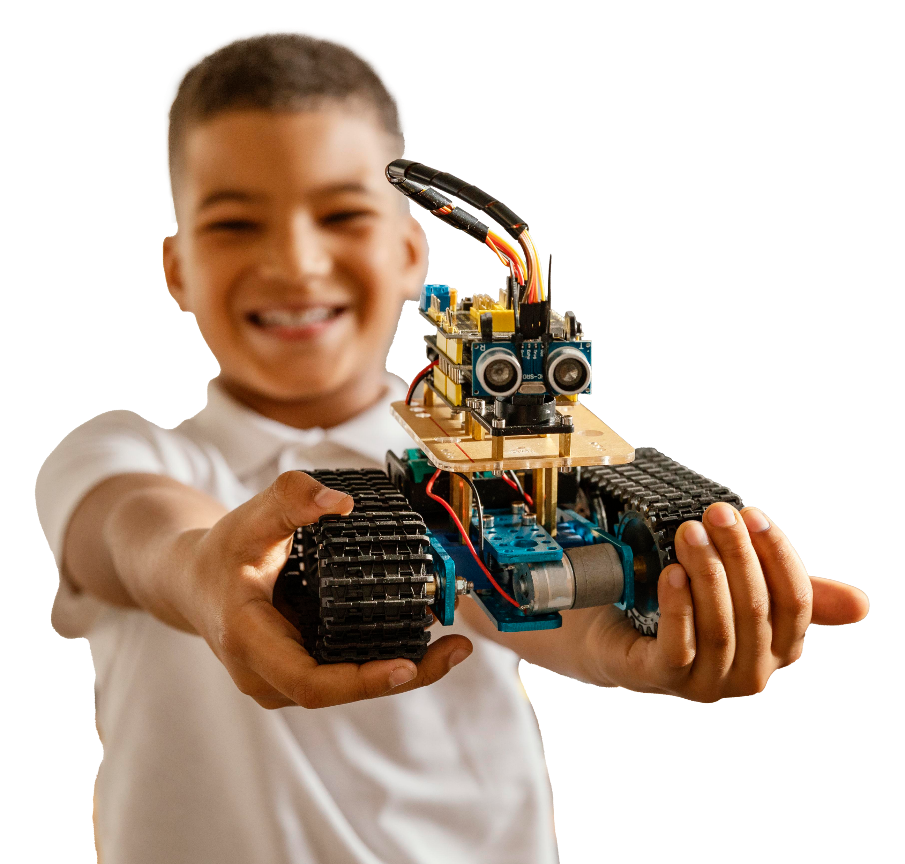
Importance of Design & Technology in Primary Education
Encourages creativity, problem-solving, and critical thinking.
Supports cross-curricular links (maths, science, art).
Develops practical skills and real-world understanding.
Prepares students for future technological advancements
Informs and excites pupils about possible jobs and careers

Slide 4
Current Challenges in Design & Technology
D&T is constantly evolving as it is at the forefront of innovation (AI, Robotics, CAD etc)
Limited resources and exemplary up-to-date classroom materials.
Lack of staff confidence and training in D&T delivery.
Need for structured and engaging curriculum plans.
Pressure to meet curriculum standards with limited guidance.

Slide 5
What does the membership offer?
Projects on a Page: Access to 23 well-structured, curriculum-compliant planners
Primary Subject Leadership File: Comprehensive guidance, resources, and support to ensure high-quality D&T provision
Primary Self Review Framework: Support continuous improvement in D&T education with our comprehensive framework that helps schools assess and enhance their D&T delivery.
Termly Glossy Magazines: featuring articles, hints, and tips that exemplify excellent D&T teaching and learning
Up to date information on D&T trends and innovations
Discounts on Training and CPD (Approx 26%)
Networking Opportunities with other schools and experts
Access to 100’s of resources at no additional cost

Slide 6
Return on Investment
Annual membership fee £156
Two training course attendances would provide £142 member saving
Typical price for a non-member to attend a course £270
Member price for the same course £199
Member saving £71 per teacher per course
Subject leader time saved through support and resources, of 7 hours per year to break even
Assuming Subject Leader salary of approx. £23 per hour (156/23)
Improved student success & engagement
Improved teaching quality and curriculum enhancement

Slide 7
Success Stories from other schools
"The D&T association has become an invaluable resource for supporting and advancing Design & Technology (D&T) across the trust I work for. Whether in primary or secondary education, the skills, knowledge, resources, and guidance they provide are truly exceptional. The team at the Association is incredibly friendly and approachable, always going above and beyond to offer the support you need. Personally, I believe that two standout resources have made a significant impact: Projects on a Page for primary and Inspired by Industry for secondary. These resources offer exactly what’s needed at each educational level, ensuring high-quality teaching that meets and exceeds the national curriculum requirements." - Drew Wicken,, Director of Design &Technology and Vocational Education at Co op Academies.
“It is excellent! Skills are progressive and the way it's been written allows for teacher creativity and pupil voice.”
“I started working with the Year 6 children to introduce the 'Tinkercad' program. They were very enthusiastic, and I was very impressed with how they embraced their new learning.... The Design and Technology Associations' resources have certainly made the delivery of the CAD lessons manageable and less frightening” - Marie Myers, St Dominic Catholic Primary School
“It has been wonderful to see the awe and wonder on the pupils' faces and to see them get so excited and be so enthusiastic about their learning.” - Sophie Porteous, Christopher Pickering Primary School
“We cannot thank the team enough for enabling us to learn more about the use of 3D printers in our Curriculum offer.” - Alison Moxham, Bretherton Endowed Church of England Primary School

Slide 8
Alignment with our school goals
Add some of your own school goals]
Enhancing student engagement and achievement in D&T.
Supporting teacher development and confidence.
Promoting a culture of innovation and creativity.
Meeting OFSTED requirements for a broad and balanced curriculum

Slide 9
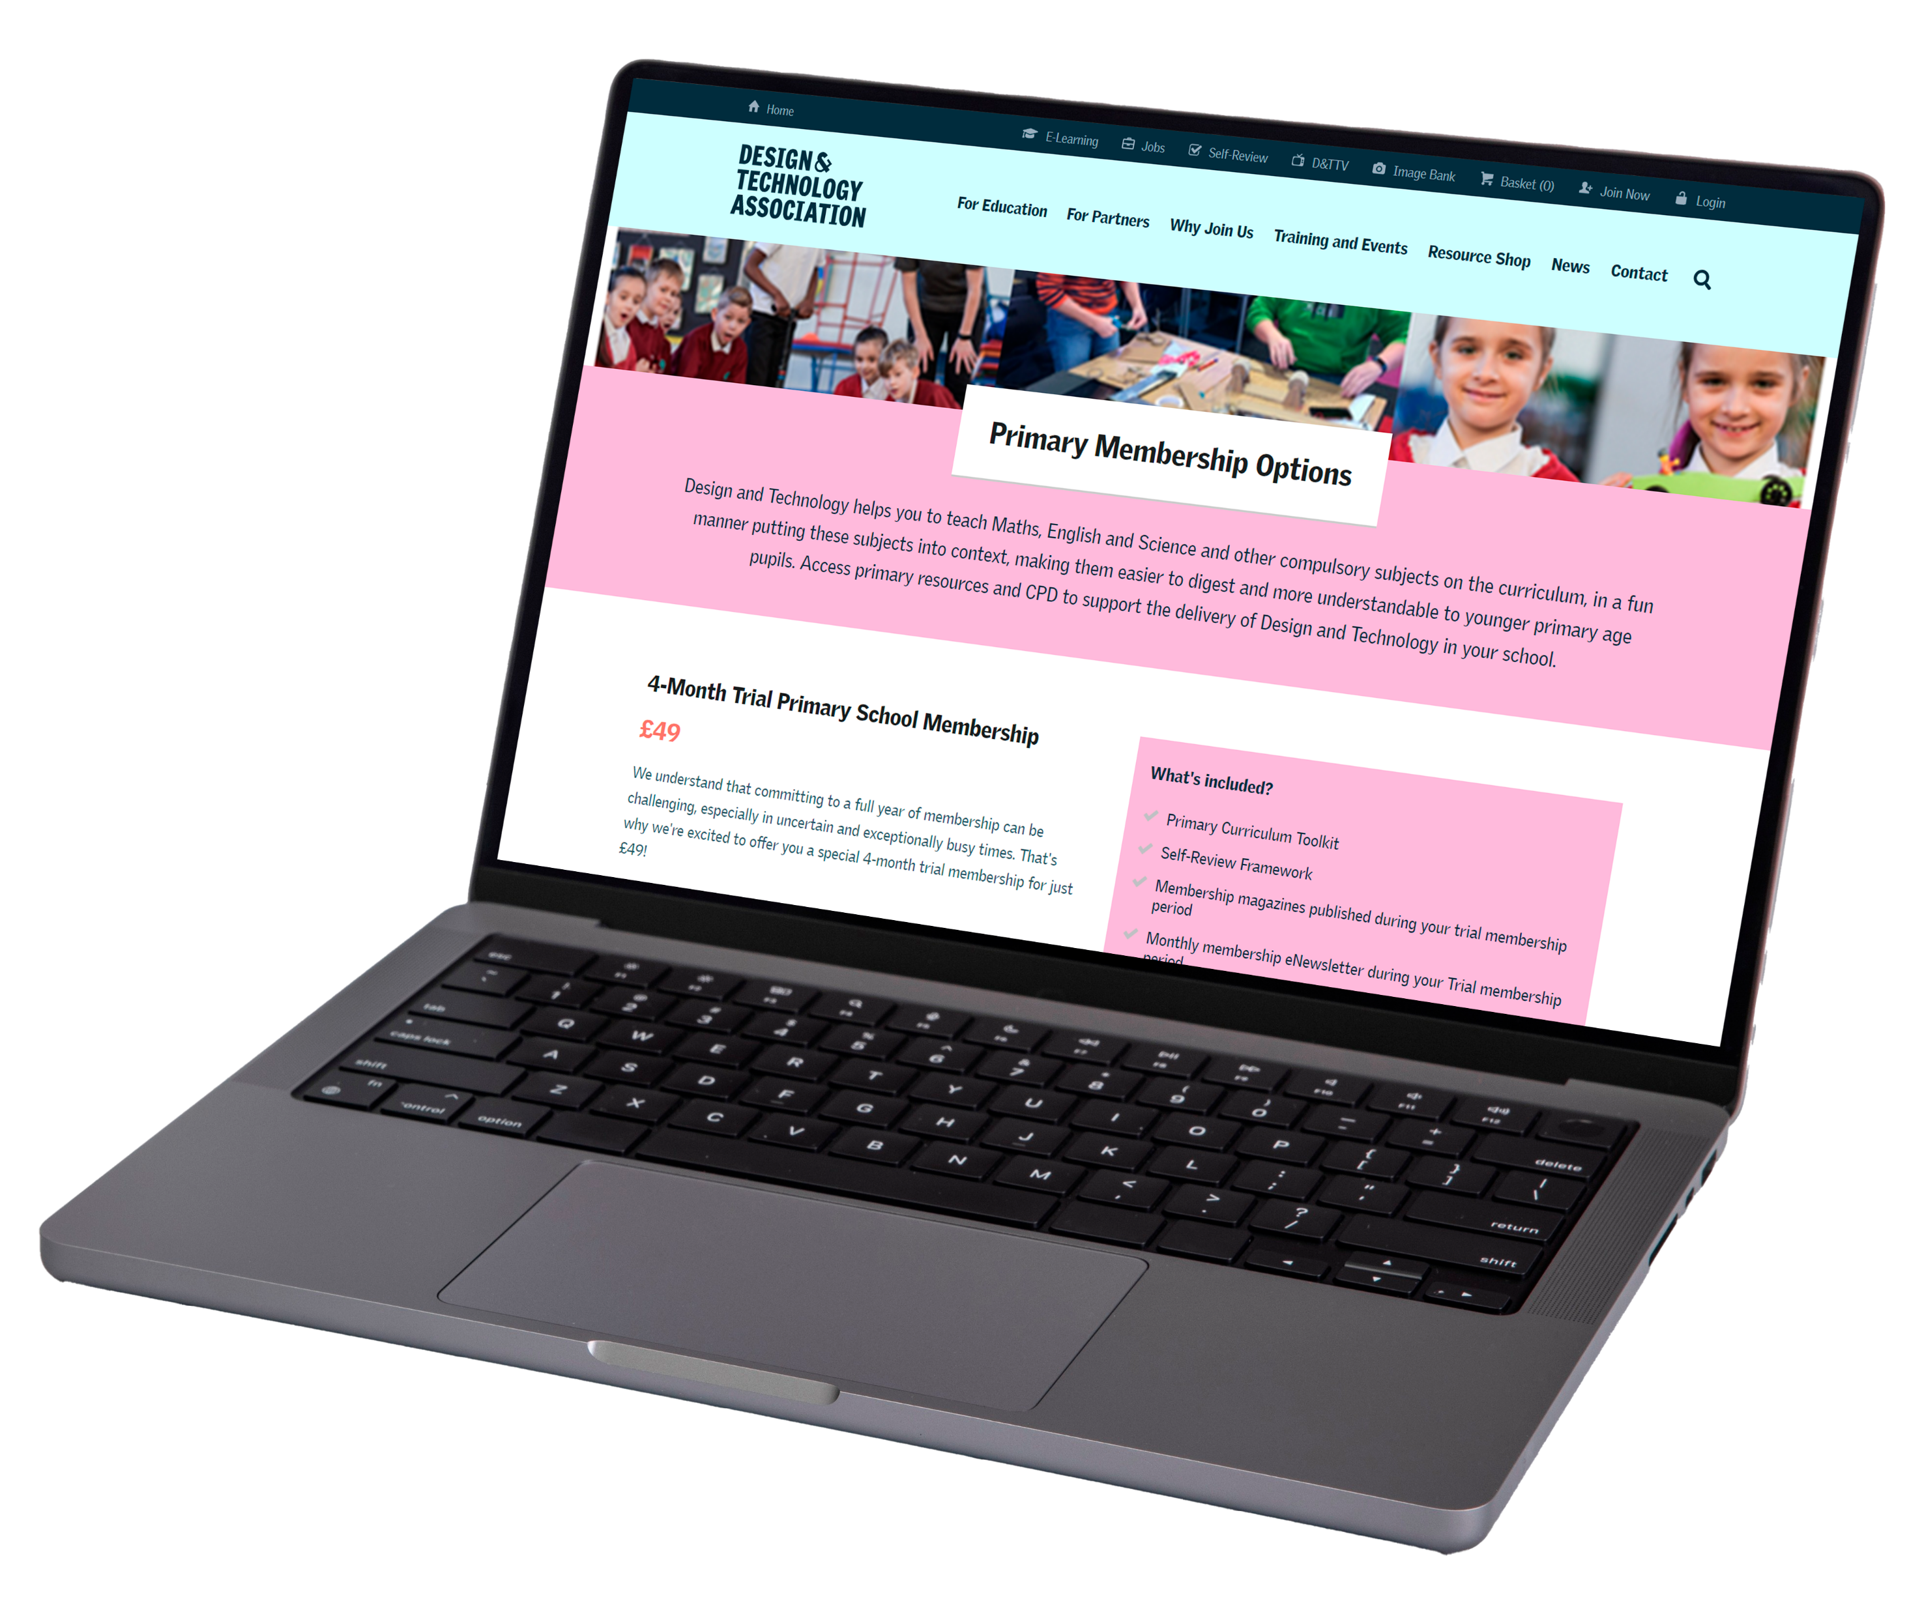
Summary & Next Steps
Summary
Investing in the D&T primary school membership supports our commitment to high-quality education.
It offers valuable resources, training, and community connections.
Let's empower our students to become innovators and problem-solvers of the future.
Next Steps
Review the membership options and choose the best fit.
Plan for staff CPD sessions to maximize the benefits.
Schedule regular evaluations to measure impact on teaching and learning.

Slide 10
Any questions or concerns?

