Slide 1
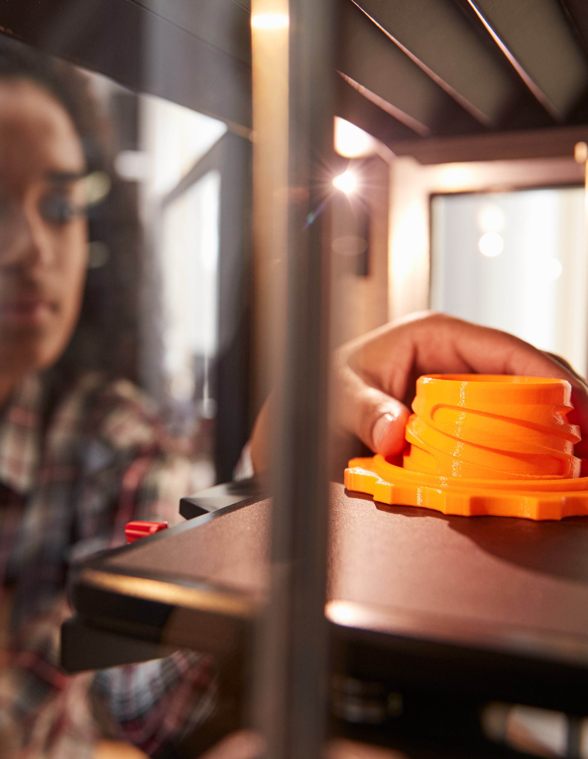
Investing in secondary School Membership with The Design & Technology Association
Enhancing Student Progress and Learning and Preparing our Young People for a Technological Future
Presented by: [Enter your name here]

Slide 2
WE WILL COVER
Importance of design and technology in secondary education
Current challenges in design and technology
What does membership offer?
Return on Investment
Success stories from other schools
Alignment with our school goals
Next steps
PAYOFF
As a result of this presentation, my objective is to inform and assist the leadership team to feel confident in investing in the Design & Technology Association's school/department membership offer.
PURPOSE This presentation will demonstrate why our school should invest in membership of the Design & Technology Association.

Slide 3
Importance of Design and Technology in secondary Education
Encourages: Analytical thinking, creative thinking, resilience (grit), flexibility and agility, curiosity, technological literacy and empathy.*
Supports multi-disciplinary learning (maths, science, art)
Develops practical skills and real-world understanding
Prepares students for future technological advancements
Informs and excites pupils about possible jobs and careers
* World Economic Forum https://www.weforum.org/agenda/2023/05/future-of-jobs-2023-skills/

Slide 4
Current Challenges in Design and Technology
Lack of specialist D&T teachers in schools across the country*, due to:
Teachers leaving the profession and
Not enough new teachers entering the system
D&T is a subject at the forefront of change and is constantly evolving.
Subject training must allow teachers to keep up with the rapid pace of change (AI, Robotics, CAD, coding, etc.).
We need to focus on re-energizing the KS3 curriculum to ensure it equips all students with the knowledge, skills, and personal attributes to thrive in a fast-changing and volatile world.
D&T teachers cannot and should not work in isolation. The D&T Association
provides a network to support subject development and growth. With
units of work and support structures designed by teachers, for teachers.
*Over 15,000 trained D&T teachers in 2009, just over 6,000 in 2024

Slide 5
What does membership offer?
Inspired by industry.org.uk: a suite of free contextual learning materials
Secondary Subject Leadership Support: Comprehensive guidance, resources, and support to ensure high-quality D&T provision
Secondary Self Review Framework: Support continuous improvement in D&T education with our comprehensive framework that helps schools assess and enhance their D&T delivery.
Termly Glossy Magazines: featuring articles, hints, and tips that exemplify excellent D&T teaching and learning
Up to date information on D&T trends and innovations
Discounts on Training and CPD (Approx 26%)
Networking Opportunities with other schools and experts
Access to 100’s of resources at no additional cost
Recommended annual membership option
Secondary Departmental partnership - £199 pa
Membership for 4 teachers covering your whole departments
Access to Inspired By Industry, designed to re-energise your KS3 and over 70 member only resources to support the delivery of this real world inspired suite of contextual resources. (Curriculum units, Focus tasks and Investigative and evaluative activities)

Slide 6
Return on investment
Annual membership fee £199
Two training course attendances would provide £142 member saving
Typical price for a non-member to attend a course £270
Member price for the same course £199
Member saving £71 per teacher per course
Head of Department and Teacher time saved through support and resources, of nearly 8 hours per year to break even
Assuming D&T teacher salary of approx. £25 per hour (199/25)
Improved student success & engagement
Improved teaching quality and curriculum enhancement

Slide 7
Success Stories from other schools
“The D&T Association has become an invaluable resource for supporting and advancing design and technology across the trust I work for. Whether in primary or secondary education, the skills, knowledge, resources, and guidance they provide are truly exceptional. The team at the Association are incredibly friendly and approachable, always going above and beyond to offer the support you need.
Personally, I believe that two standout resources have made a
significant impact:
‘Projects on a Page’ for primary and ‘Inspired by Industry’ for secondary.
These resources offer exactly what’s needed at each educational level,
ensuring high-quality teaching that meets and exceeds the national
curriculum requirements.”
Drew Wicken, Director of Design and Technology and
Vocational Education at Co-op Academies

Slide 8
Alignment with our school goals
Enhancing student engagement and achievement in D&T.
Supporting teacher development and confidence.
Promoting a culture of innovation and creativity.
Meeting OFSTED requirements for a broad and balanced curriculum
[Please add in your own schools' goas and show how this aligns and supports your objectives.]

Slide 9
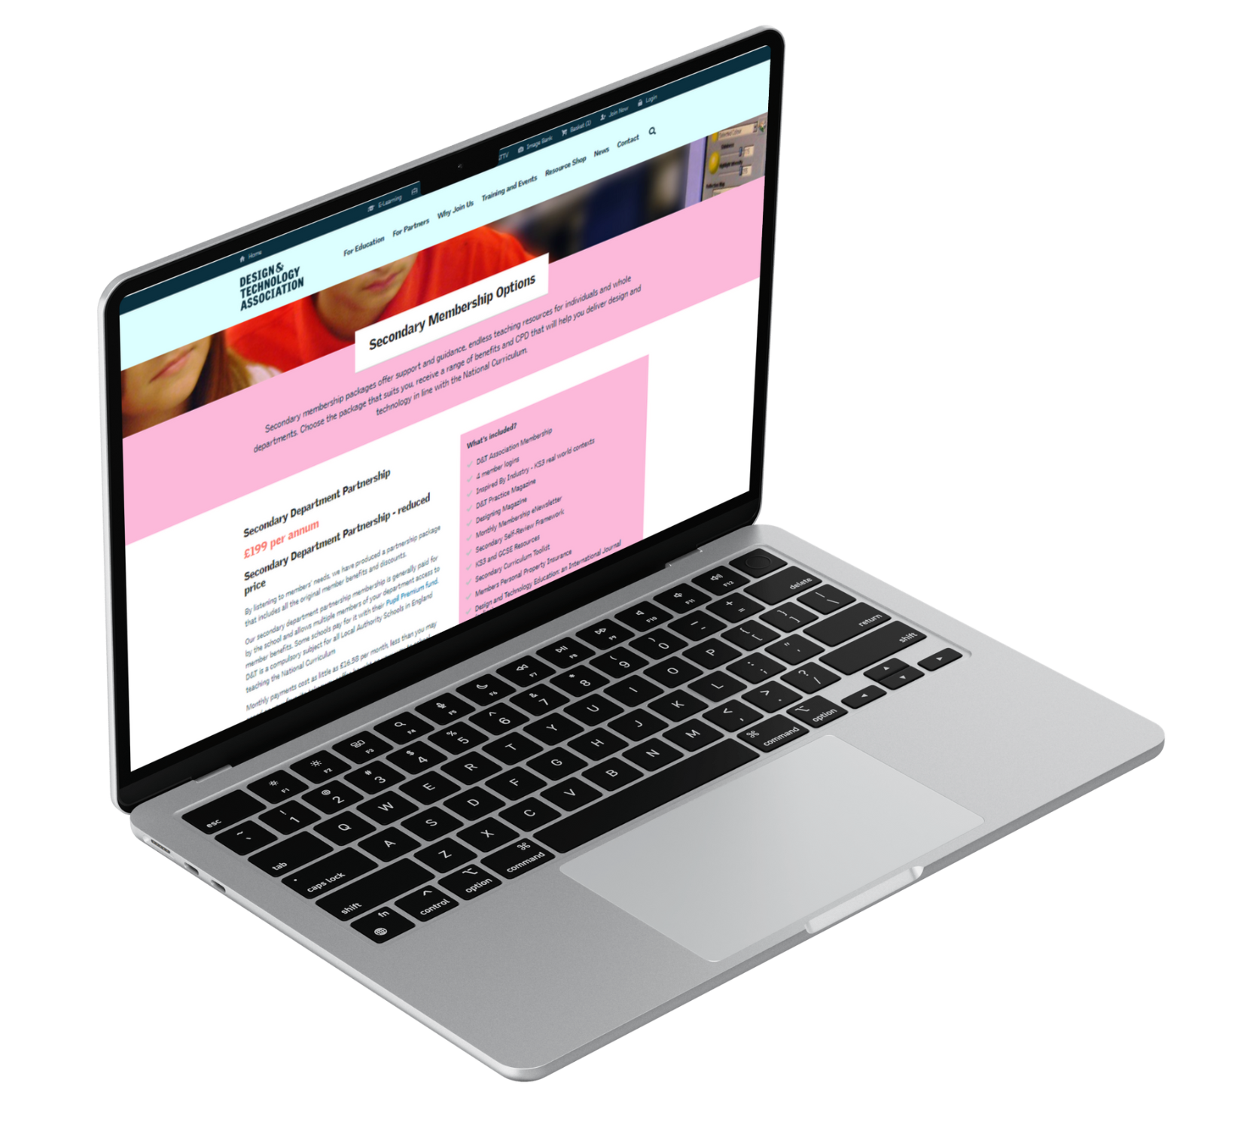
Summary & Next Steps
SUMMARY
Investing in the D&T secondary school membership supports [Insert school's name] commitment to high-quality education.
Membership offers valuable resources, training, and community connection.
Let's empower our students to become the innovators and problem-solvers of the future.
NEXT STEPS
Review the membership options and choose the best fit.
Plan for staff CPD sessions to maximize the benefits.
Schedule regular evaluations to measure impact on teaching and learning.

Slide 10
Any questions or concerns?

